Slide 1
Capstone Review
ML & NN Analyst Internship · InGen Dynamics
Hongyu Liu · August 2026
Eight weeks · six model families · three evaluation panels · all six PIC 2.0 classes

Slide 2
PIC 2.0 ML context
The six model classes, the platform task that exercises each, and the week that delivered the evidence
All six classes now carry a runnable experiment rather than a literature mapping.
PIC 2.0 class | Platform anchor | Exercised by | Week
GRPO | Aido Rover | policy-gradient patrol policies and a group-relative baseline | W5–6
STUM | Rover · Senpai | calibration of the score-producing classifiers | W3 · W7
SEOM | Aido Rover | training-time low-battery penalty and its ablation | W6
AMDC | Aido Rover | cross-channel feature evidence and SHAP attribution | W2 · W7
HTD-IRL | Rover · Humanoid | maximum-entropy IRL and a node-level hierarchy | W6
CRL-MRS | Aido Rover ×2 | two-rover cooperative patrol | W6
One substrate under all of it
A single world core generates the 9-channel Rover stream and the RL environments, so offline and online results describe the same physics. A leakage-safe block split, 23 blocks into 7 folds with a 50-step purge, is read by every classification and sequence model.
The standard every number is held to
Design choices are tuned on one fold, then the locked configuration is rotated across all seven and only those numbers are reported. Every RL claim carries five training seeds on ten fixed worlds under a paired Wilcoxon test, and near-ties are named as near-ties.
InGen Dynamics · ML & NN Analyst Internship — Capstone Review (W1–W8)

Slide 3
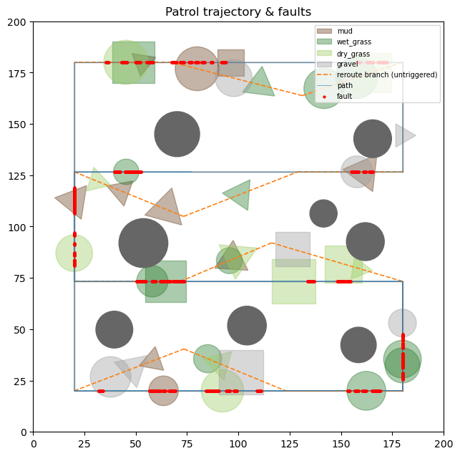
World and fault design
Week 2 · the procedural site the whole programme runs on, and how a fault is generated rather than injected
15,000 steps at 10 Hz, 15.1 % anomalous across 72 causal fault events.
Route and coverage
A boustrophedon main loop of 960 m over eight edges, inset from a 200 m site, with a rejoining detour on each sweep. Eight static obstacles are rejection-sampled clear of every route and detour edge, and four terrain types modulate wheel torque.
Faults are mechanical, not labels
A slip event spikes one wheel's torque while the other three shed load and displacement drops; a stuck event raises all four together and displacement collapses. Severity is drawn per event, so the fault-to-signal relation is statistical rather than deterministic.
Why this shapes everything downstream
Faults appear as runs along the path rather than isolated points, which is why the split is cut into blocks and purged, and why both mechanisms are cross-channel relations that a per-channel view cannot express.
InGen Dynamics · ML & NN Analyst Internship — Capstone Review (W1–W8)

Slide 4
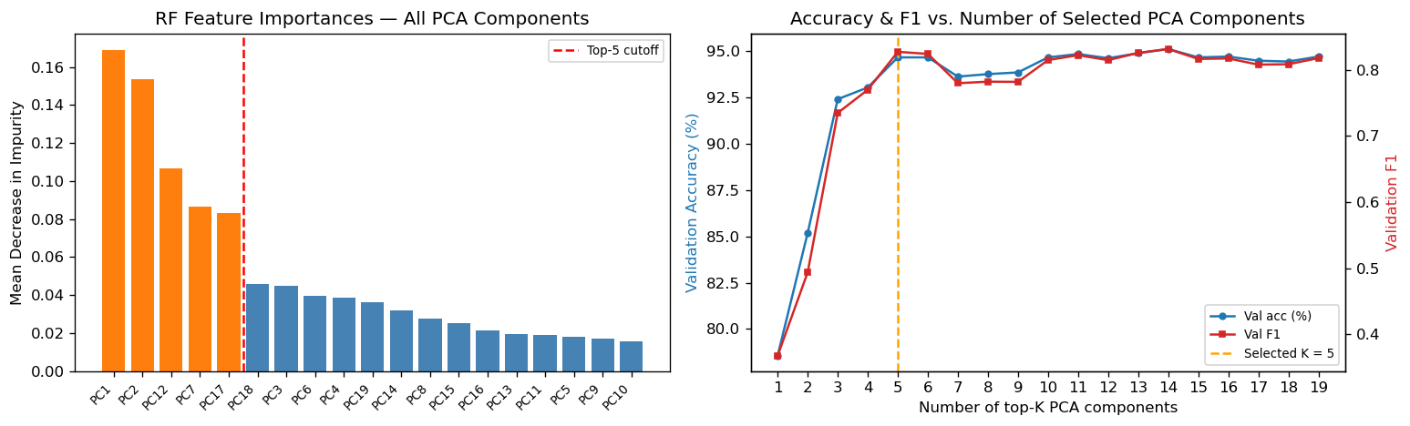
Preprocessing, features and the classical benchmark
Week 2 · FFT on the four torque channels and LiDAR · PCA 40 → 19 at 95.14 % variance · RandomForest on the canonical split
Two cross-channel features moved test F1 from 0.553 to 0.823, the largest single effect of the programme.
Feature matrix | F1 @ 0.50 | F1 tuned | AUC
34-D raw channels + FFT descriptors | 0.5528 | 0.4991 | 0.8739
40-D + inter-wheel dispersion, stall ratio | 0.8225 | 0.8471 | 0.9796
The cross-channel finding
Slip is one wheel against the other three, stuck is effort against absent motion. Neither has a signature in any single channel.
Selection is flat beyond five components
Importance ranks the 19 components (left) and validation F1 plateaus at K = 5 (right).
The classical benchmark
The deployed 200-tree forest reaches 0.749 ± 0.048 at 7.9–9.0 ms: a clear pass on the 100 ms gate, and 87 % of the 10 ms breach tier.
InGen Dynamics · ML & NN Analyst Internship — Capstone Review (W1–W8)

Slide 5
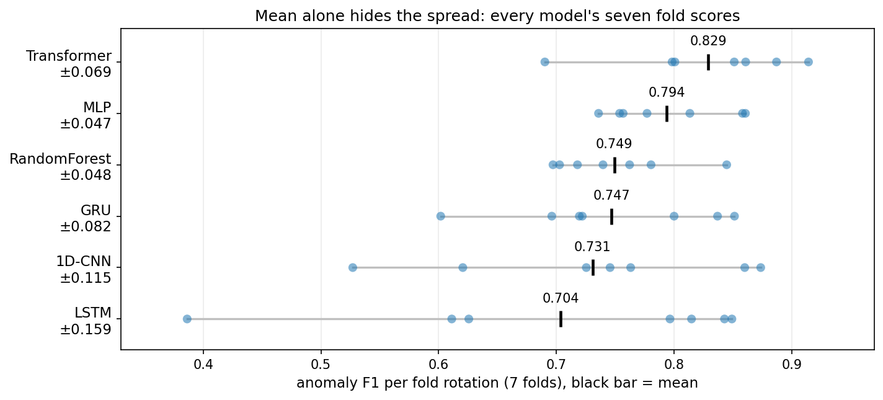
Supervised model comparison
Week 3 · six families on one split, identical folds and seeds · 7-fold block-rotation mean ± std
The MLP is the pick; the Transformer's 0.829 is not significant (p = 0.34) and collapses to 0.760 when parameter-matched.
Model | F1 (7-fold) | worst fold | latency
MLP | 0.794 ± 0.047 | 0.736 | 0.14 ms
Transformer | 0.829 ± 0.069 | 0.690 | 0.44 ms
GRU | 0.747 ± 0.082 | 0.602 | 0.62 ms
RandomForest | 0.749 ± 0.048 | 0.697 | 7.9 ms
1D-CNN | 0.731 ± 0.115 | 0.527 | 0.15 ms
LSTM | 0.704 ± 0.159 | 0.386 | 1.26 ms
Why the MLP and not the higher mean
The two are one equivalence class on a paired test, so the axes inside it decide: lowest fold variance, best worst fold, lowest latency, and the STUM calibration target met raw at 0.025 against 0.031. Matching on width had given the Transformer four times the GRU's parameters, and the matched control ties the GRU at p = 0.76.
What the spread rules out, and what transfers
The 1D-CNN and LSTM carry the widest fold spreads, and the CNN cannot be refit bit-identically, spanning 0.683 to 0.738 across identical runs. On Fari's tabular task both the forest and the MLP land within 0.04 of a computable Bayes ceiling, so the methodology transfers.
InGen Dynamics · ML & NN Analyst Internship — Capstone Review (W1–W8)

Slide 6
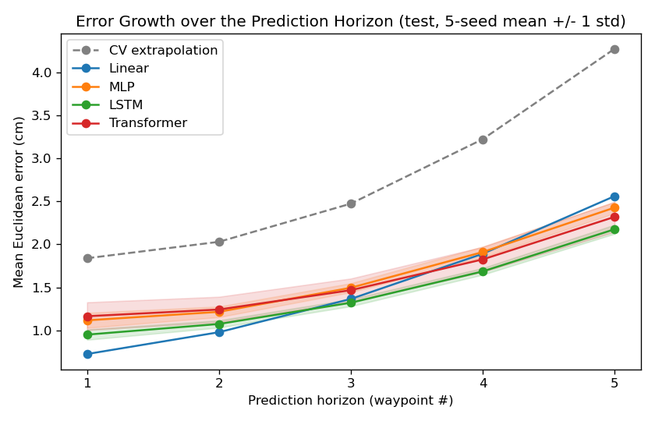
Trajectory prediction
Week 4 · Aido Humanoid · 10 steps of state to the next 5 waypoints, 0.1 s apart · 5,000 episodes · 5 seeds · 50 ms gate
The LSTM is best far and linear regression best near: the ranking changes along the horizon.
Model | h1 | h3 | h5 | mean (cm) | ms
CV extrapolation | 1.84 | 2.47 | 4.28 | 2.77 | 0.003
Linear | 0.73 | 1.37 | 2.56 | 1.50 | 0.09
MLP | 1.12 | 1.50 | 2.43 | 1.63 ± 0.06 | 0.03
LSTM | 0.95 | 1.32 | 2.18 | 1.44 ± 0.04 | 0.34
Transformer | 1.17 | 1.47 | 2.32 | 1.60 ± 0.15 | 0.51
Two error sources cross over
Near the horizon, error is dominated by gait sway and sensor noise, where closed-form least squares is the optimal linear filter. Far out it is dominated by unanticipated velocity change, which compounds in time and is the mechanism that makes long planning horizons expensive for any predictive planner.
The nonlinear gain is concentrated
On the 273 avoidance episodes of 750 the LSTM leads linear regression by 0.66 cm at the fifth waypoint; on the 477 clean episodes that gap falls to 0.15 cm. The Transformer is the panel's one dominated point, slowest and less accurate at every horizon.
InGen Dynamics · ML & NN Analyst Internship — Capstone Review (W1–W8)

Slide 7
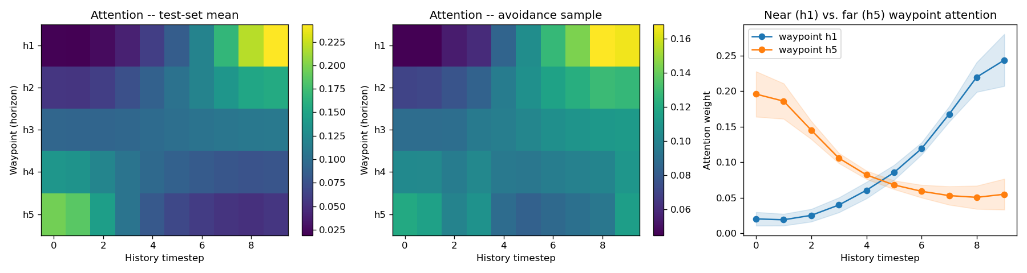
What the trajectory model reads
Week 4 · Transformer horizon-query decoder · attention over the 10-step history, resolved per output waypoint
Attention's centre of mass slides from step 6.7 to step 3.1 as the horizon extends.
The centre of mass moves monotonically
Averaged over the test set, attention mass moves steadily back through the history as the horizon grows. One decoder, five different read patterns from the same input, none of them specified in advance.
Near leans on the latest state, far on the earliest
The near waypoint concentrates about 0.24 of its weight on the final step, where current velocity is close to the answer; the far waypoint about 0.20 on the first, where the trend to be extrapolated is anchored. A tilt rather than a concentration.
The learned analogue of a receding-horizon planner
Instantaneous state for the immediate control step, trend and context for the tail of the horizon. Read as a description of the attention pattern rather than a mechanism the model was shown to use.
InGen Dynamics · ML & NN Analyst Internship — Capstone Review (W1–W8)

Slide 8
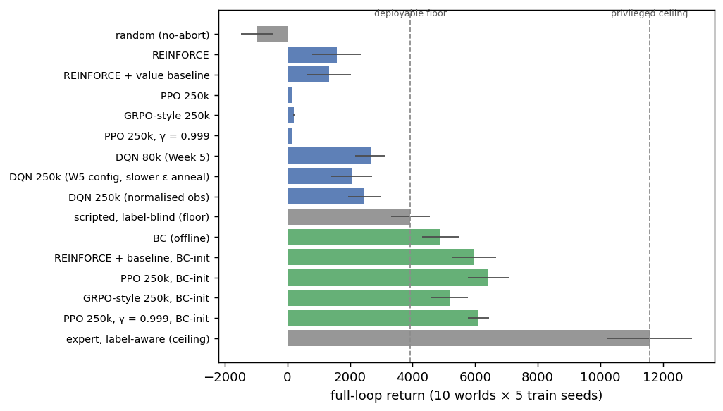
RL environment and policy
Weeks 5–6 · patrol MDP tied to the offline table by a bit-exact replay gate · 5 train seeds × 10 fixed worlds
The behaviour-cloning warm start is a precondition, not an optimisation: 156 from scratch against 6,421 warm-started.
From scratch, on-policy lands below the floor
PPO returns 156 and the group-relative variant 214, both collapsing to roughly 310-step episodes, against a scripted rule policy at 3,931 that any deployment already has. From a cloned checkpoint the same code clears that floor by 1,251 to 2,490.
Behaviour cloning is distillation
It converts a policy that needed the ground-truth fault label into one running on sensors alone, reaching 4,892 and inheriting the best navigational profile in the chapter at 0.84 rerouting. The privileged expert ceiling is 11,575.
Value-based methods never clear the floor
DQN reroutes on 1 to 9 % of blockages against the rule policy's 1.00 and does not transfer. Tripling its budget moved the paired return by −603 at p = 0.084, so the navigational failure is structural rather than a training-time shortfall.
InGen Dynamics · ML & NN Analyst Internship — Capstone Review (W1–W8)

Slide 9
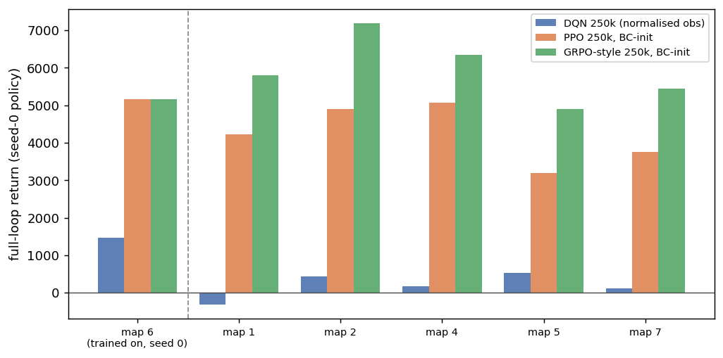
GRPO-style, hierarchy and multi-agent
Week 6 · seed-0 policy per family on five unseen layouts · node-level semi-MDP · two-rover coordination
A leaderboard on the training layout selects the policy that generalises worse.
The canonical ordering reverses
PPO and the group-relative variant are tied on the training layout (p = 0.084), but the group-relative variant wins all five held-out layouts by 1,286 to 2,300. PPO's edge is bought by alerting hard, which tunes it to where the faults sit on this terrain. One seed per family, so this is a direction rather than an effect size.
Hierarchy and inverse RL
A node-level semi-MDP lifts rerouting from 0.34 to 0.82, though its option controllers read the ground-truth label and so sit in the privileged bracket. Maximum-entropy IRL recovers a reward correlating only 0.31 with the truth, yet the policy optimal under it covers 96 % of the floor-to-ceiling range: reward recovery and policy recovery are separate objectives.
Multi-agent is a structural null
Shared and difference rewards are indistinguishable on every coordination metric. At about nine node-level decisions per episode, a million steps yields roughly thirty policy updates, so neither scheme accumulates enough attributed outcomes to differ.
InGen Dynamics · ML & NN Analyst Internship — Capstone Review (W1–W8)

Slide 10
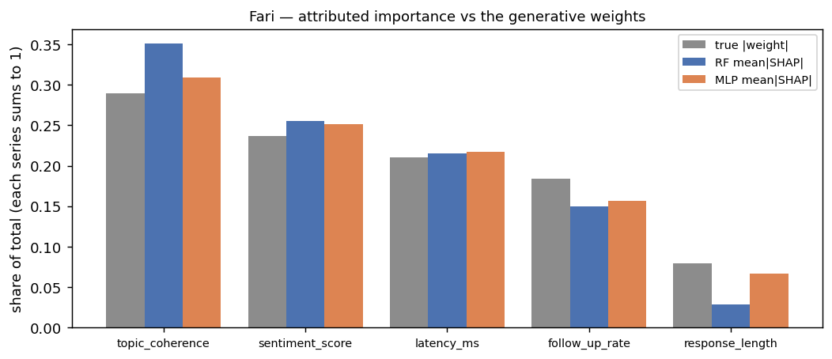
Explainability — validated against a known truth
Week 7 · Fari attribution against the generative weights that produced its labels · SHAP on the forest and the MLP
Where a ground truth exists both model families recover it exactly, at Spearman 1.0.
Why start where the answer is known
Fari's labels come from an explicit linear generator, so the true importance ordering exists. Both models reproduce it, and their attribution shares track the true weight shares to within a few points on every feature. That is what licenses reading attributions on Rover, where no such truth exists.
Variance ordering is not relevance ordering
The forest's top five Shapley components are the Week-2 selection exactly, and the MLP's ranking in its own 40-D space is led by the engineered dispersion feature. Two of the forest's five carry only 2.1 % and 1.4 % of the variance, and a 0.90 retention threshold would have discarded one outright, so where the PCA cut sits is a modelling decision.
And on the third task
On Senpai the forest reaches macro-F1 0.667 against a 0.764 oracle ceiling, about 87 % of the information the features carry, with hint requests attributing nearly twice as strongly for the beginner class as for the intermediate one.
InGen Dynamics · ML & NN Analyst Internship — Capstone Review (W1–W8)

Slide 11
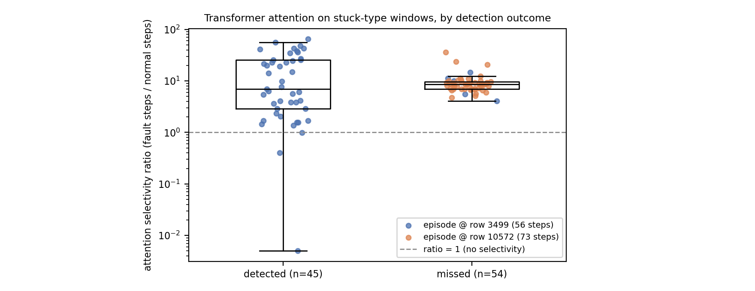
Explainability — where the residual misses come from
Week 7 · stuck-type windows by detection outcome · selectivity is mean attention on fault steps over normal steps
On the episode missed entirely, all 49 windows localise the fault while the head calls them normal.
A decision-layer failure, not a localisation failure
Stuck-type faults carry the recall ceiling, caught in 39.5 % of windows against 76.2 % for slip. If the encoder had lost the fault, the missed group would sit near a selectivity of 1. It sits at a median of 8.7 instead.
Which inverts the fix
More capacity in the attention stack addresses a component that is already working. The remaining recall lives in the pooled readout and the operating point, and an event-level decision rule is the direction that would reach it. The windows tile only two episodes, so only this one-sided claim stands, not a detected-versus-missed ranking.
The same lens on the policy
Input-gradient saliency shows the alert logit is essentially a torque-surge detector at 43 % of its gradient, while the reroute logit has no dominant feature at all. Alerting is the learnable part of the patrol task and routing is the hard part, which foreshadows the verdict two slides on.
InGen Dynamics · ML & NN Analyst Internship — Capstone Review (W1–W8)

Slide 12
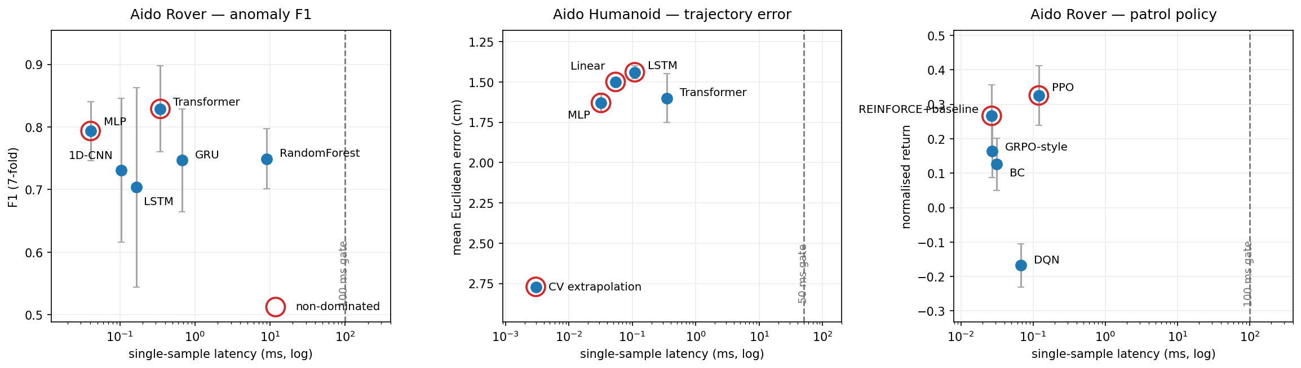
Pareto deployment recommendation
Cross-family frontier per platform task, ringed points non-dominated, dashed line the platform gate
Rover → MLP, Humanoid → LSTM, patrol → no pick, because every learned policy alarms 15 to 65× the reference rate.
Aido Rover — the MLP
Tied with the Transformer on score and ahead on latency, fold variance, worst fold and calibration. For the ≤10 ms breach tier a 50-tree depth-6 forest is the fallback, 8.73 → 2.45 ms for −0.021 F1, inside the full model's own fold spread.
Aido Humanoid — the LSTM
1.44 cm at 0.11 ms, non-dominated and ahead of the Transformer on both axes at once. Linear regression stays the minimal-footprint alternative on motion known to be obstacle-free.
Aido Rover patrol — no pick, and why
The ordering reverses on every held-out layout, and at 10 Hz the rule policy already deployed alerts once every 27 s while PPO alerts once every 0.4 s. That follows from a reward pricing a caught fault at +5.0 against a false alert at −1.5, so the blocking item is the alert pricing rather than the algorithm.
InGen Dynamics · ML & NN Analyst Internship — Capstone Review (W1–W8)

Slide 13
PIC 2.0 readiness and next steps
The same six classes as slide 2, now scored against what the evidence supports for a deployed platform
Four classes reach 3 of 5; AMDC at 2 and CRL-MRS at 1 set the order of the next three experiments.
Class | Readiness | Evidence that sets the score | Priority next experiment
GRPO | 3 / 5 | warm start is a precondition; held-out layouts reverse the ordering | layout sweep at all five seeds
SEOM | 3 / 5 | penalty takes depletion 26 % → 0 at a return cost of 5,190 → 998 | sweep the penalty weight
HTD-IRL | 3 / 5 | hierarchy lifts rerouting 0.34 → 0.82, controllers still privileged | sensor-window alerting in the options
STUM | 3 / 5 | MLP meets the ECE target raw, 0.025 against 0.031 | calibration transfer across folds
AMDC | 2 / 5 | cross-channel features carry the attribution mass, no drift injected | inject per-sensor gain and offset drift
CRL-MRS | 1 / 5 | a structural null at ~30 credit-assignment updates per 1M steps | a macro-action decision level
Synthetic-data validity
One map topology throughout, and the cross-layout result shows a winner can reverse when only the terrain changes.
Privileged components
The hierarchy's option controllers and the IRL demonstrations both read the ground-truth label, so those results sit outside the deployable bracket.
Reward pricing
The patrol reward makes alarm-spam the rational response, which blocks any policy recommendation until the alert terms are re-priced.
InGen Dynamics · ML & NN Analyst Internship — Capstone Review (W1–W8)

