Slide 1
Mid-Point Review
ML & NN Analyst Internship · InGen Dynamics
Hongyu Liu · July 2026
Phase A (foundations) and Phase B (neural & sequence models) complete · Phase C (reinforcement learning) next
1 world core
one generator, one canonical
leakage-safe split, one ledger
11 models
6 anomaly detectors + 5 trajectory
regressors, one shared protocol
All gates PASS
100 ms Aido Rover streaming ·
50 ms Aido Humanoid planning
InGen Dynamics · ML & NN Analyst Internship — Mid-Point Review (W1–W4)

Slide 2
One world core, one split, one standard
Weeks 2–4 · the shared scaffolding and feature pipeline behind every number in this deck
Shared world dynamics
One core generates the 9-channel stream — 15,000 steps at 10 Hz, calibrated 85/15 normal/anomaly, faults causal (slip + stuck) rather than injected. The W5–6 RL environments import the same core, so offline data and the online env cannot drift.
Leakage-safe canonical split
Block segmentation + StratifiedGroupKFold with a 50-step purge kills window leakage at the split level; every fault event sits fully inside one block. All six model families read the same fold file instead of re-deriving a split.
Two-phase fold protocol
Design choices are tuned on the canonical fold only; the locked config is retrained across all 7 rotations. Mandatory per model: split sizes, seed, confusion matrix, per-class P/R/F1, timeit latency, gate verdict.
40-feature matrix
9 raw + 25 FFT (50-step window on the 4 torque channels + LiDAR, built to capture a spectral fault signature) + 6 physical. GPS enters as per-step deltas — absolute position is a memorised map shortcut, the delta is the transferable signal.
The feature lesson that carried Phase B
Torque shows zero 3σ outliers — terrain already spreads it wide, so a plain outlier rule cannot work. Two cross-channel features close the gap: inter-wheel torque std (slip) and stall ratio (stuck), worth +0.27 F1 on the RF baseline before any neural model.
PCA and selection
40 scaled features → 19 components at 95.1% variance, fit on train only; PC1 is the torque spectral centroid, PC2 the stall ratio. Selection ranks on F1, not accuracy — with an 85% majority class, accuracy is blind to the minority.
InGen Dynamics · ML & NN Analyst Internship — Mid-Point Review (W1–W4)

Slide 3
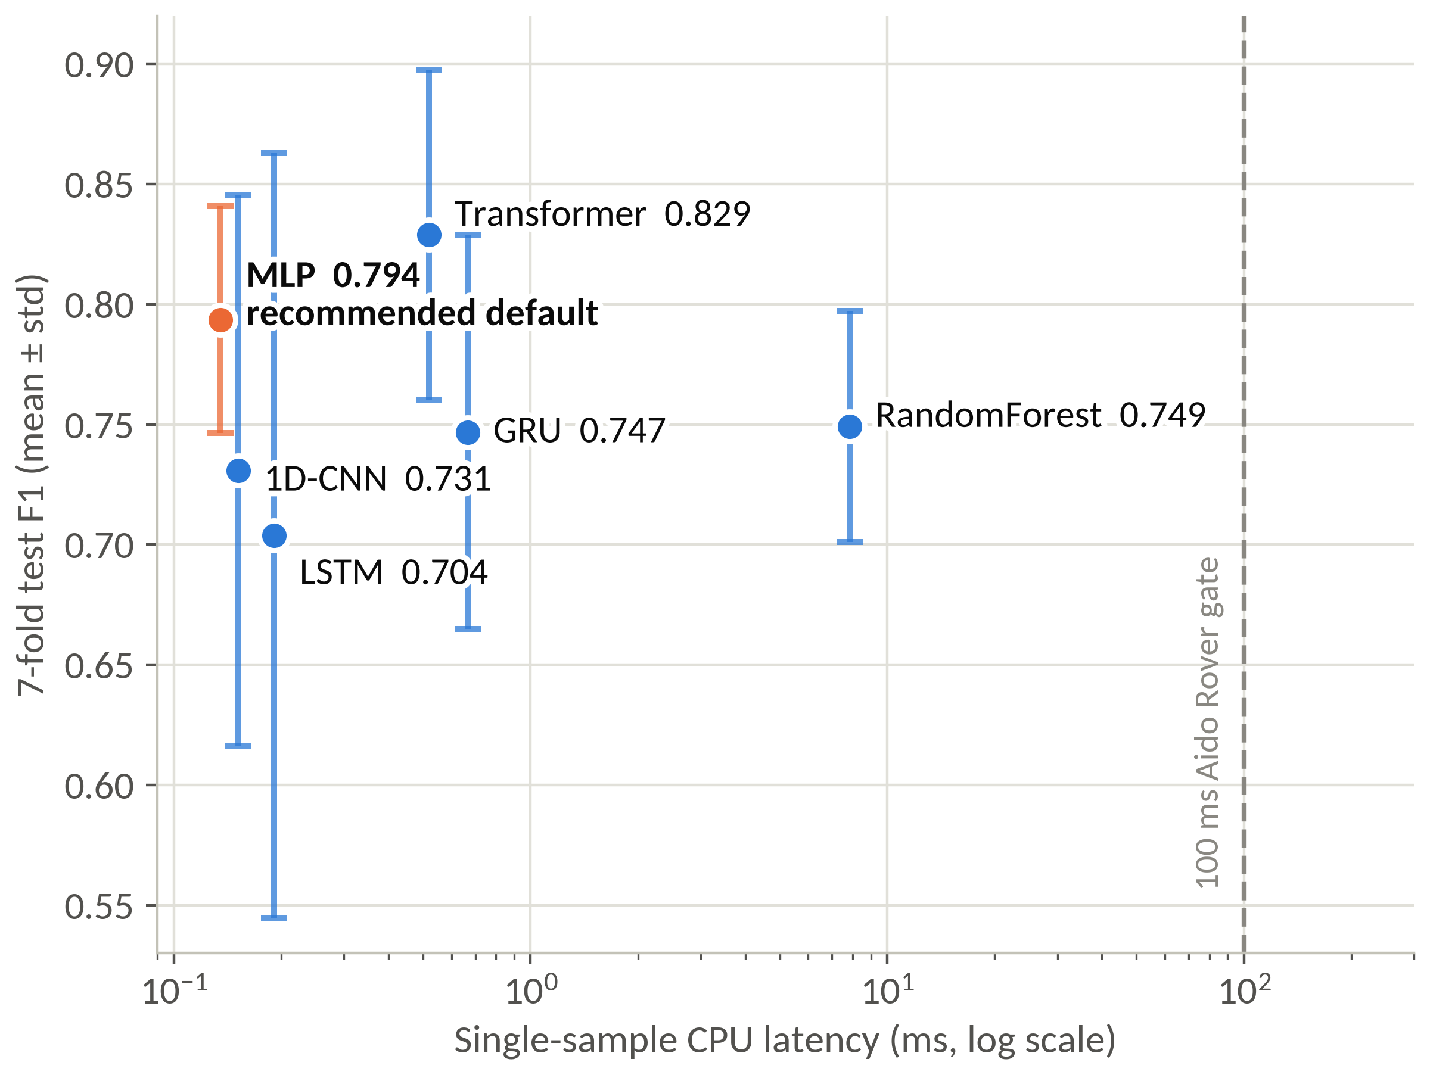
All six models clear the 100 ms gate ≥12×
Headline · Aido Rover anomaly detection · 7-fold block-rotation mean ± std on the canonical split · single-sample CPU latency
Model | F1 (7-fold) | AUC (7-fold) | ms | ≤100 ms
RandomForest | 0.749 ± 0.048 | 0.960 ± 0.009 | 7.86 | PASS
MLP | 0.794 ± 0.047 | 0.979 ± 0.011 | 0.14 | PASS
1D-CNN | 0.731 ± 0.115 | 0.965 ± 0.022 | 0.15 | PASS
LSTM | 0.704 ± 0.159 | 0.969 ± 0.014 | 0.19 | PASS
GRU | 0.747 ± 0.082 | 0.975 ± 0.006 | 0.67 | PASS
Transformer | 0.829 ± 0.069 | 0.982 ± 0.005 | 0.52 | PASS
All six deployment-feasible; highlighted row = recommended default. Sub-ms readings are single-session means — order of magnitude only.
· MLP is the recommended default: the Transformer's F1 edge is within noise by a paired t-test (p = 0.34) and vanishes at matched parameters (Transformer-S 0.760, itself inside the same near-tie). On the axes that decide selection the MLP is not beaten — equal F1, the better worst fold (0.736 vs 0.690), 4.5× fewer parameters.
· Latency never binds at 10 Hz — the slowest model sits >12× under the gate; model choice is a quality/stability decision, not a speed one.
InGen Dynamics · ML & NN Analyst Internship — Mid-Point Review (W1–W4)

Slide 4
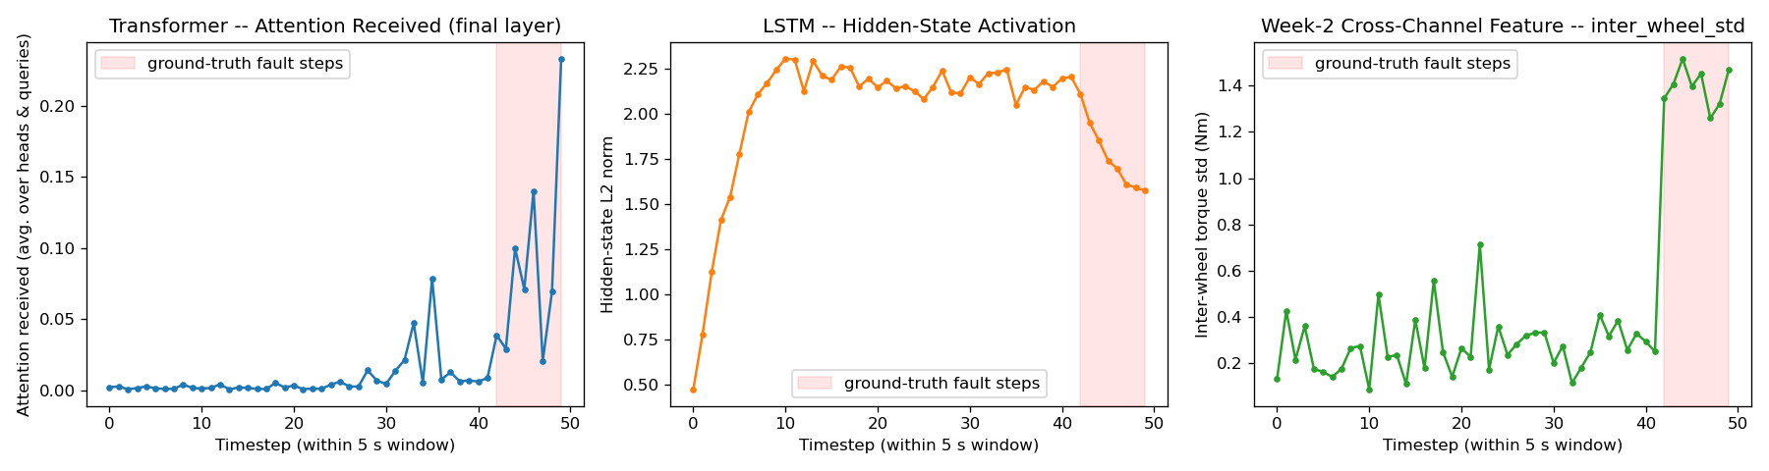
Attention localises the fault, LSTM smears froward, the feature steps at onset
Week 3 · one anomalous test window (slip fault, last 8 of 50 steps, shaded) · three views on one shared time axis
Attention — time domain localisation
Near-zero for 4.2 s, then rising an order of magnitude inside the true fault span. Across all 267 eligible anomalous test windows: median fault/normal selectivity 5.3×, above 1 in 98%. All four final-layer heads key on the same span.
LSTM hidden state — a regime shift
The norm saturates in normal operation and shifts regime once fault steps arrive, but the per-step change is barely more concentrated on fault steps (median ratio 1.15, >1 in 57%). A causal state smears evidence forward — why the final-state readout is fragile mid-window.
Feature — the reference for where
inter_wheel_std steps 0.27 → 1.40 Nm (5.1×) at exactly the onset step, and it is one of the 11 input channels. Attention mass concentrates on the same steps — temporal co-location with the discriminative feature, not proof the model reads that channel.
InGen Dynamics · ML & NN Analyst Internship — Mid-Point Review (W1–W4)

Slide 5
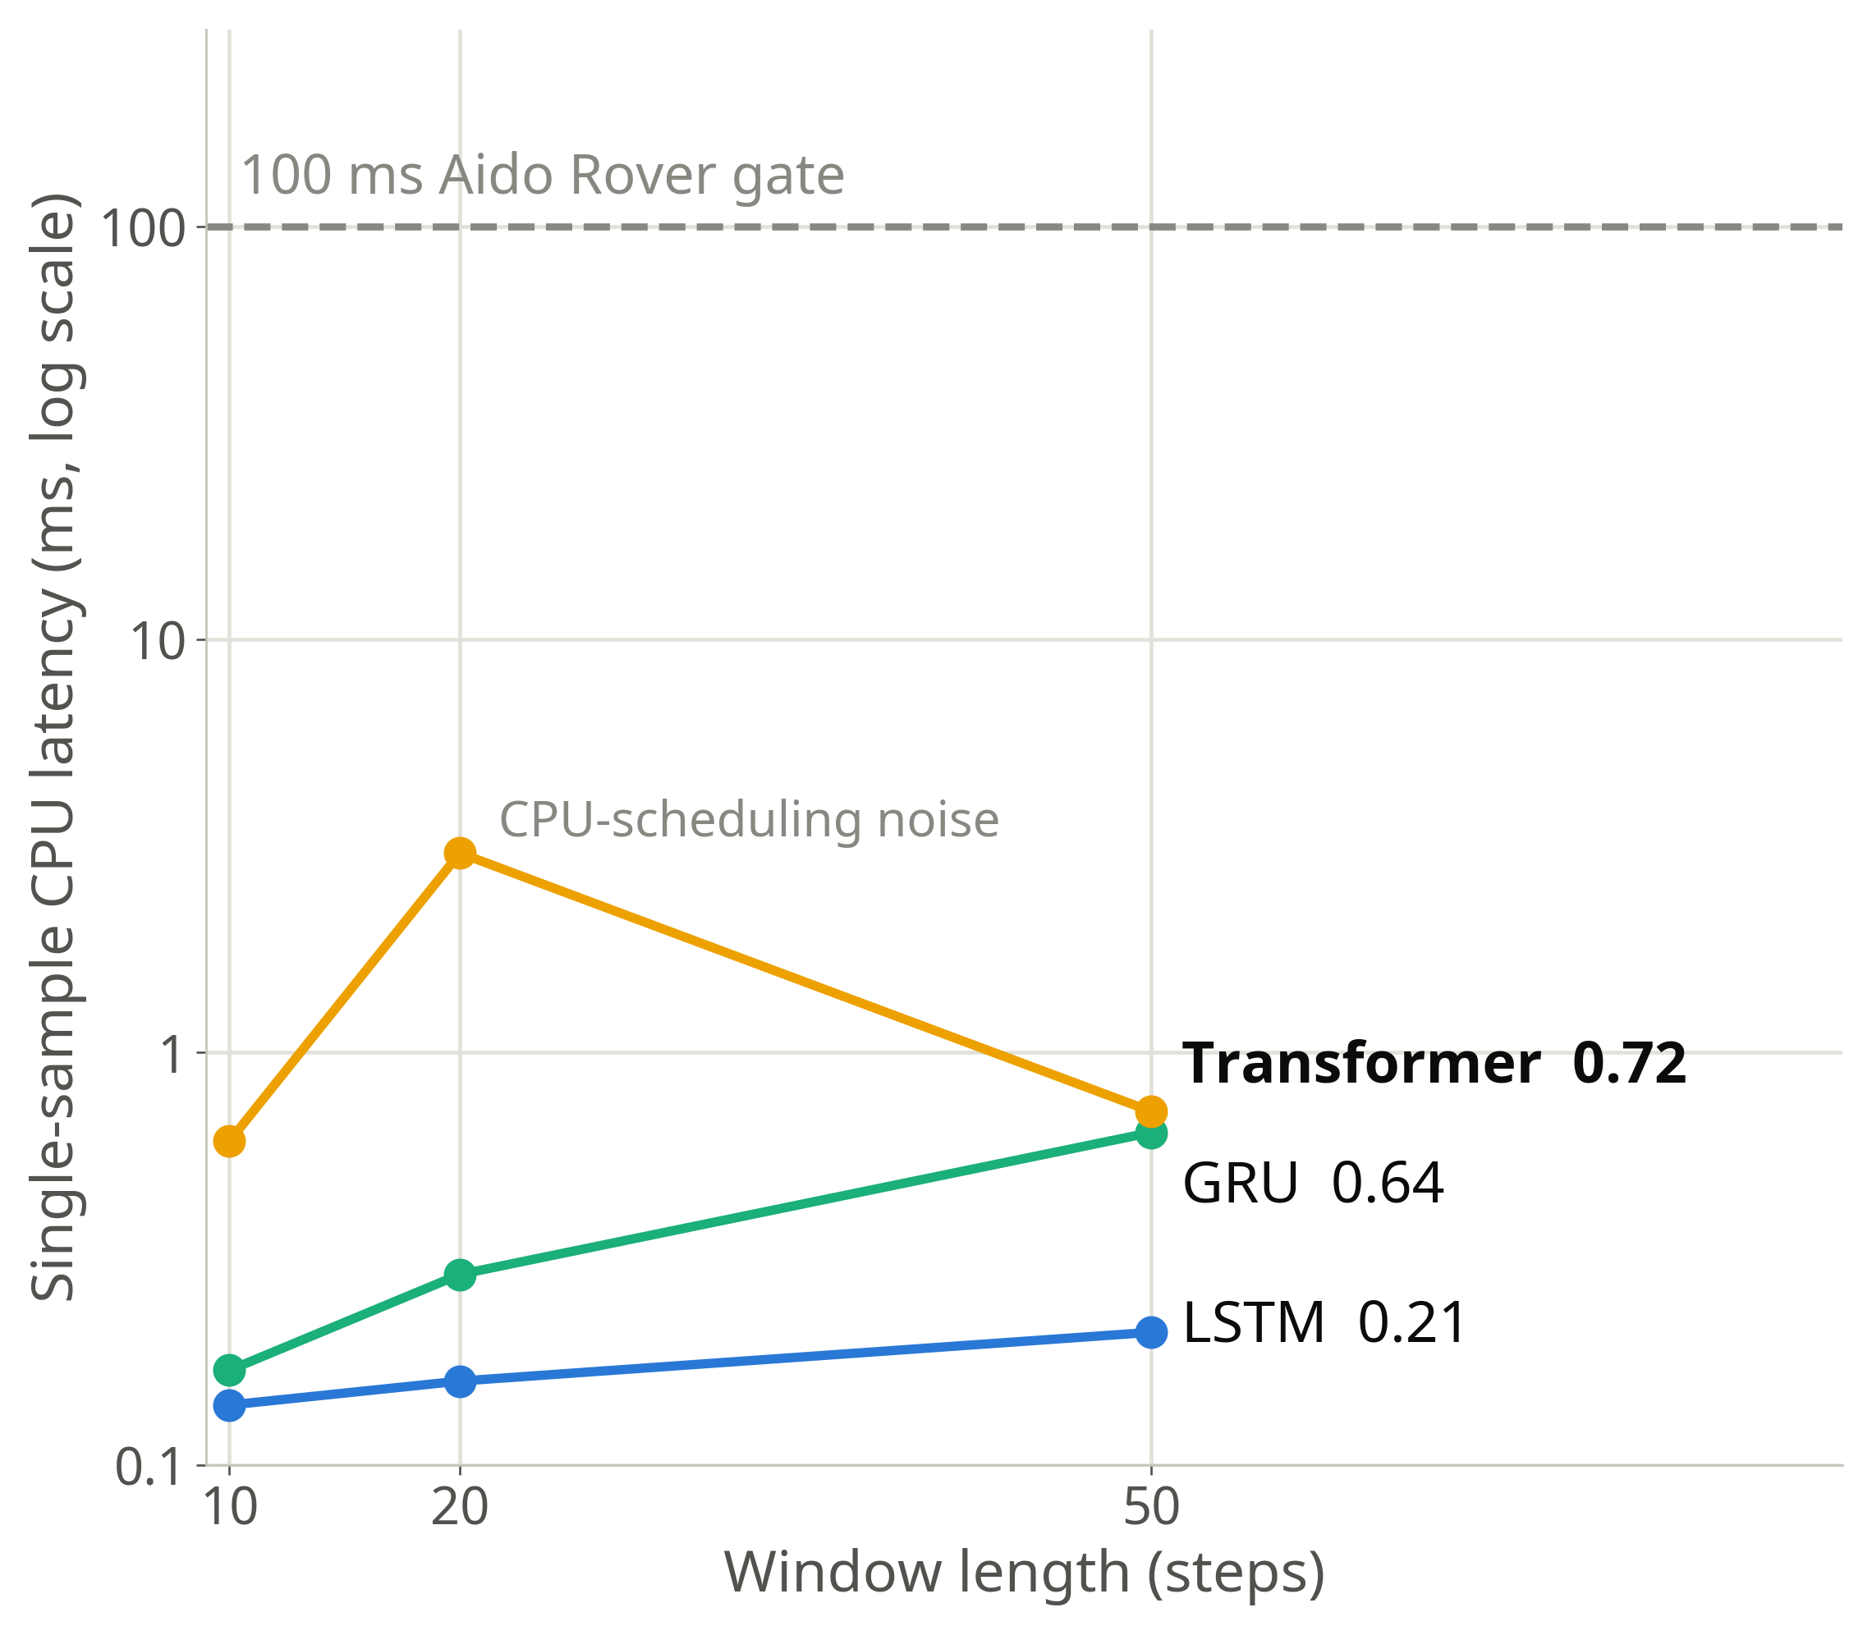
Latency scales with window, but stays orders of magnitude under the gate
Week 3 · single-sample CPU latency at w = 10 / 20 / 50 steps · 100 ms Aido Rover streaming gate
Model | w = 10 | w = 20 | w = 50
LSTM | 0.14 ms | 0.16 ms | 0.21 ms
GRU | 0.17 ms | 0.29 ms | 0.64 ms
Transformer | 0.61 ms | 3.04 ms * | 0.72 ms
* re-measured at 0.26 ms in a repeat run — single-session means, order of magnitude only.
Scaling is real, but overhead-dominated at these windows
RNNs are O(w), attention O(w²) — but neither surfaces at w ≤ 50: a 5× window costs the Transformer only 1.3×. These readings are fixed per-inference overhead, not scaling. The crossover to 100 ms can't be pinned from three noisy points, and needn't be — the operating point sits 140–480× under the gate.
No latency–window tradeoff to make here
w = 50 (5 s) follows the 3.1 s mean fault duration, not the compute budget. Detection does fall off past 25 in-window fault steps, but that band is dominated by stuck-type runs — a fault-type composition effect, not evidence against longer context, which stays on the Phase-D candidate list. The O(w²) concern is real in general; at this platform's sampling rate and fault scale it never activates.
InGen Dynamics · ML & NN Analyst Internship — Mid-Point Review (W1–W4)

Slide 6
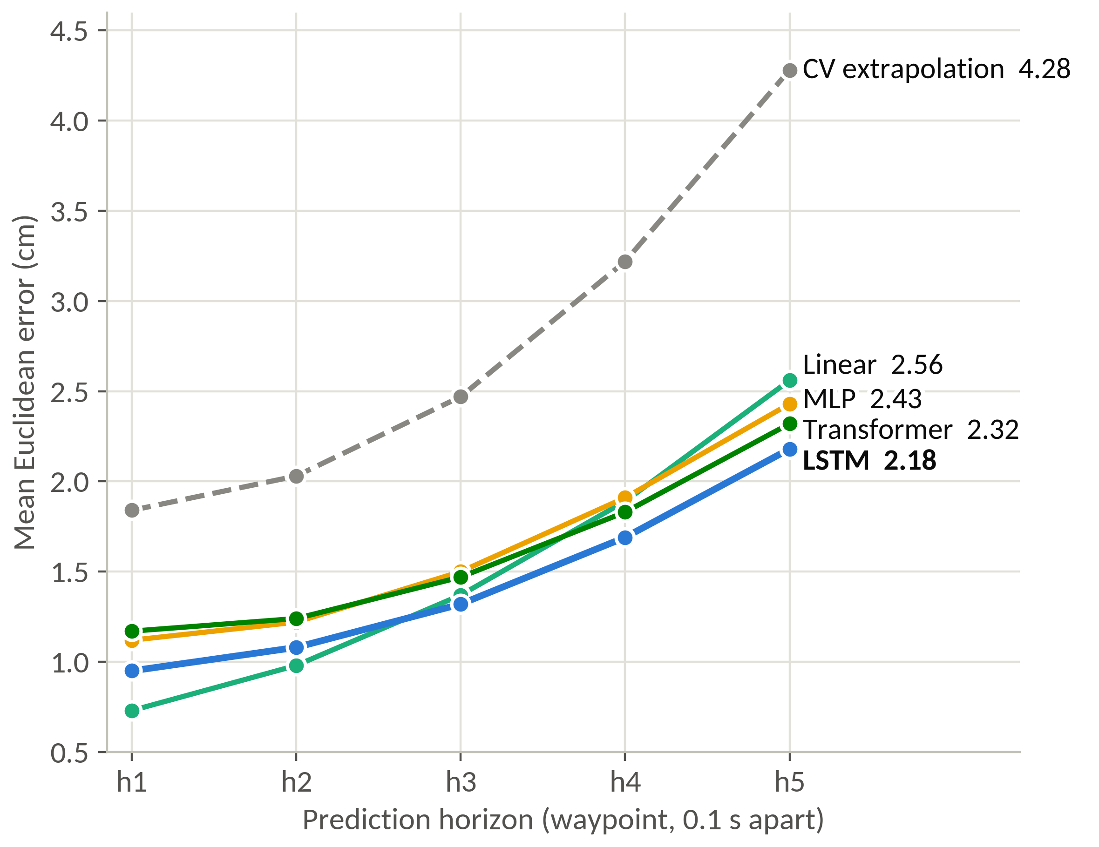
Trajectory error — LSTM best far, Linear best near
Aido Humanoid · 10 steps of state → next 5 waypoints, 0.1 s apart · 5,000 synthetic episodes · 5 seeds · 50 ms planning gate
Model | h1 | h3 | h5 | Mean (cm) | ms
CV extrapolation | 1.84 | 2.47 | 4.28 | 2.77 | 0.003
Linear | 0.73 | 1.37 | 2.56 | 1.50 | 0.09
MLP | 1.12 | 1.50 | 2.43 | 1.63 ± 0.06 | 0.03
LSTM | 0.95 | 1.32 | 2.18 | 1.44 ± 0.04 | 0.34
Transformer | 1.17 | 1.47 | 2.32 | 1.60 ± 0.15 | 0.51
Mean Euclidean error (cm), 5-seed mean ± std; CV / Linear deterministic. All five PASS ≤50 ms.
Error grows superlinearly with the horizon: For every model, near the horizon it is dominated by gait sway and sensor noise; far out, by unanticipated velocity change, which compounds in time — the mechanism that makes long planning horizons expensive for any predictive planner.
The crossover locates the nonlinear part: Linear wins the near waypoints — closed-form least squares is an optimal filter for sway around a quadratic path — and the ordering inverts at the far ones. Almost all the nonlinear gain sits in the obstacle-avoidance episodes, on a single seed; a smaller gap remains on clean ones.
The Transformer does not justify its cost here: slowest, less accurate than the LSTM, and the most seed-sensitive of the three. A param-matched control halves that variance — a data-scale limit, not a tuning miss. The same shrink hurt accuracy in W03, where sequences were longer: a consistent pattern across two tasks, not a proven mechanism.
InGen Dynamics · ML & NN Analyst Internship — Mid-Point Review (W1–W4)

Slide 7
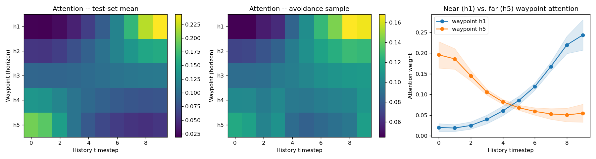
Near waypoints read the present, far waypoints read the trend
Week 4 · Transformer horizon-query decoder · attention over the 10-step history, resolved per output waypoint
The centre of mass slides monotonically earlier
Averaged over the test set, attention mass moves steadily back through the history as the horizon grows — centre of mass 6.7 → 3.1. One decoder, five different read patterns from the same input, none of them specified.
h1 tilts to the latest state, h5 to the earliest
The near waypoint leans on the last couple of steps, where current velocity is close to the answer; the far waypoint leans on the earliest, where the trend to be extrapolated is anchored. A tilt rather than a concentration — most of the mass sits elsewhere in both cases.
The learned analogue of a receding-horizon planner
The avoidance example sharpens the same structure. Instantaneous state for the immediate control step, trend and context for the tail of the horizon — how a predictive planner weights its own window. Read as a description of the attention pattern, not a mechanism the model was shown to use.
InGen Dynamics · ML & NN Analyst Internship — Mid-Point Review (W1–W4)

Slide 8
Latency never binds — quality, stability and interpretability decide deployment
Feasibility verdicts against the platform gates, and the model picks they imply
Aido Rover — 100 ms streaming gate: all PASS
The worst model (RandomForest, 7.9 ms) sits >12× under the gate; the neural models are all sub-millisecond, two to three orders of magnitude under it, and the window-scaling analysis puts the breach point far beyond anything measured fault durations justify.
Aido Humanoid — 50 ms planning gate: all PASS
Plan-defined gate (product docs specify 10 ms whole-body MPC / 150 ms grasp planning — discrepancy recorded, plan wins per convention); every regressor clears it by roughly two orders of magnitude.
Consequence for model selection
Detection quality is a near-tie once capacity is matched, so selection falls to fold stability, cost and interpretability: MLP as the rover anomaly default · Transformer only where fault localisation is operationally worth 4.5× the parameters · LSTM for humanoid trajectory (best accuracy, lowest seed variance).
Open risk carried into Phase C
Stuck-type steady-state faults cap recall (no cross-wheel asymmetry to key on); candidate fixes — longer-horizon context or a terrain-conditioned feature — are queued behind the RL work.
InGen Dynamics · ML & NN Analyst Internship — Mid-Point Review (W1–W4)

