Slide 1
CNN-AlphaGo
——刘浩宁 HKPolyU

Slide 2
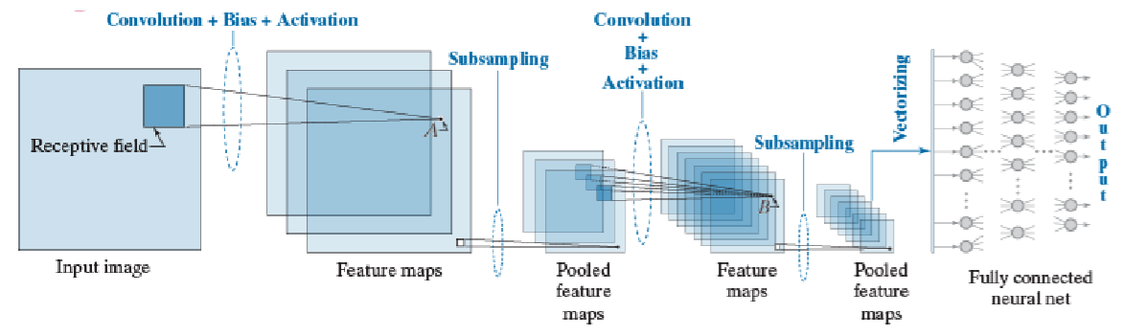
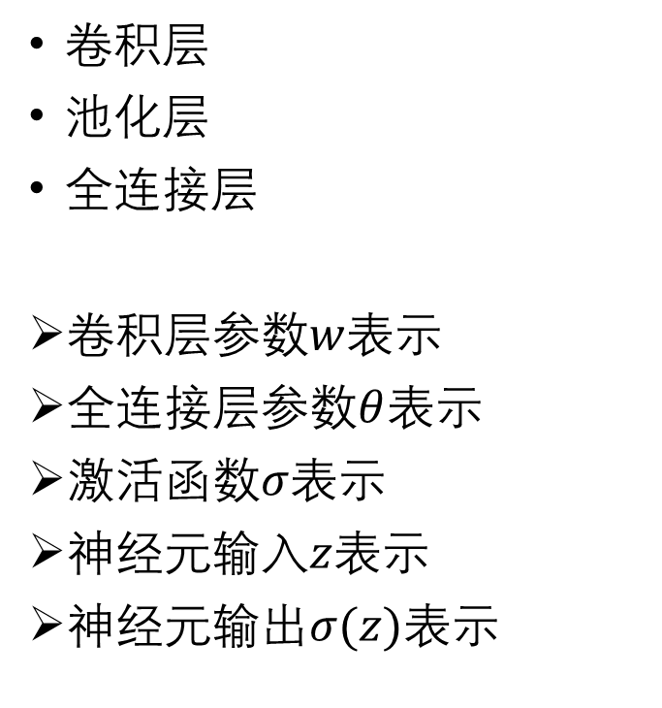
卷积层
池化层
全连接层
卷积层参数$w$表示
全连接层参数$θ$表示
激活函数$σ$表示
神经元输入$z$表示
神经元输出$σ(z)$表示

Slide 3
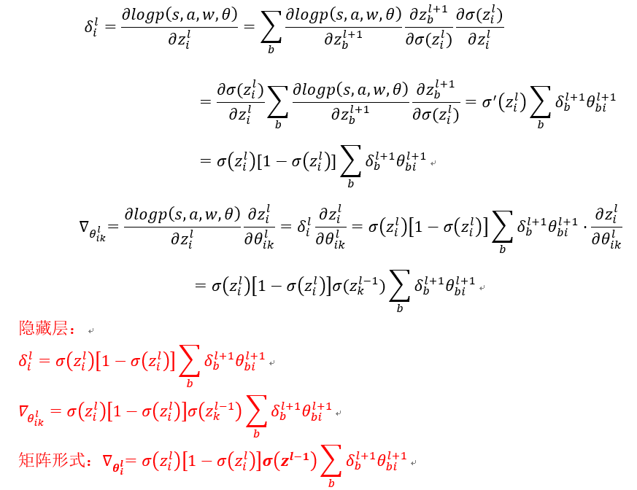
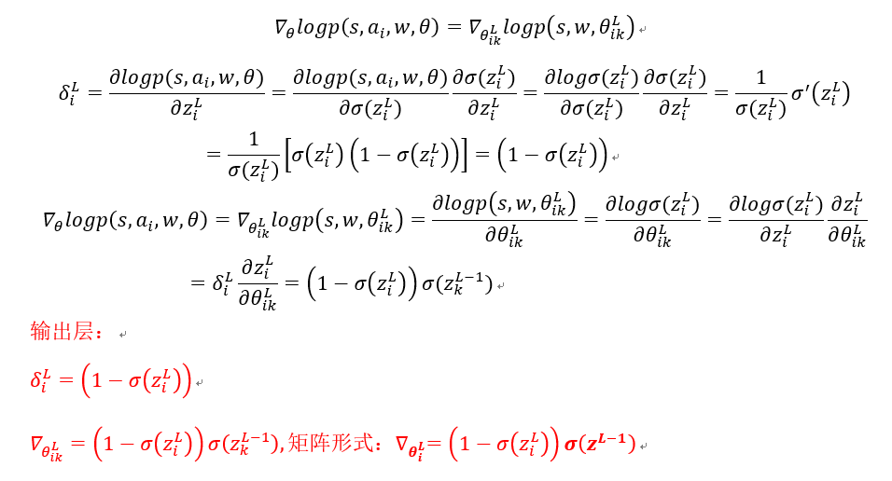

关于$θ$目标函数梯度$∇_{θ}J\left(θ\right)=E_{P}[∇_{θ}logp(s,a,w,θ)Q_{P}(s,a)]$
使用随机梯度上升更新参数${∆θ=α∇}_{θ}J\left(θ\right)=α∇_{θ}logp\left(s,a,w,θ\right)Q_{P}(s,a)$
$logp\left(s,a_{i},w,θ\right)=\sum_{i}{1(a=a_{i})·logp\left(s,w,θ_{ik}^{L}\right)}=logp\left(s,w,θ_{ik}^{L}\right)$
$L$为输出层，$i$为当前层$i^{th}$神经元，$k$为当前层上一层$k^{th}$神经元
求解$∇_{θ}logp\left(s,a,w,θ\right)$. $z_{i}^{l}=\sum_{k}{θ_{ik}^{l}·σ(z_{k}^{l−1})},σ\left(z_{i}^{l}\right)=\frac{e^{z_{i}^{l}}}{\sum_{j}{e^{z_{j}^{l}}}},δ=\frac{∂logp\left(s,a,w,θ\right)}{∂z}$

Slide 4
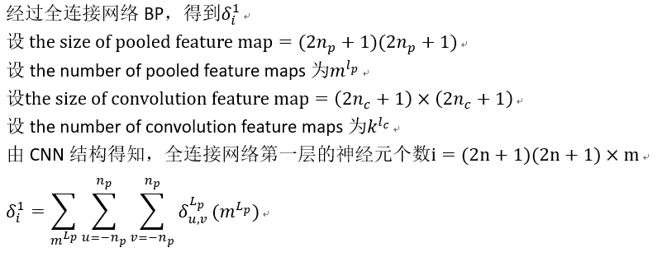
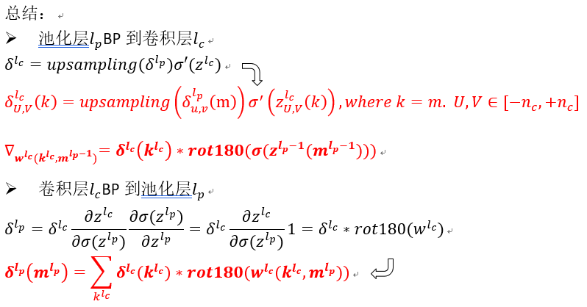
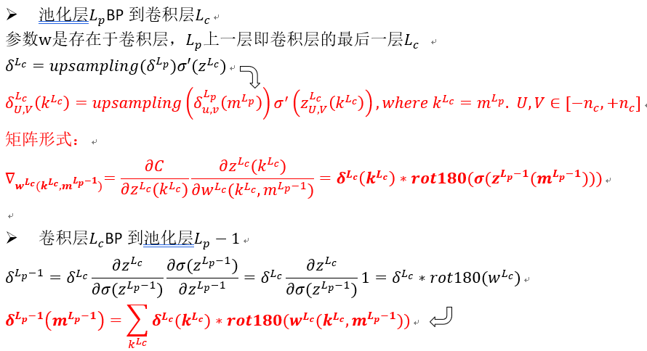
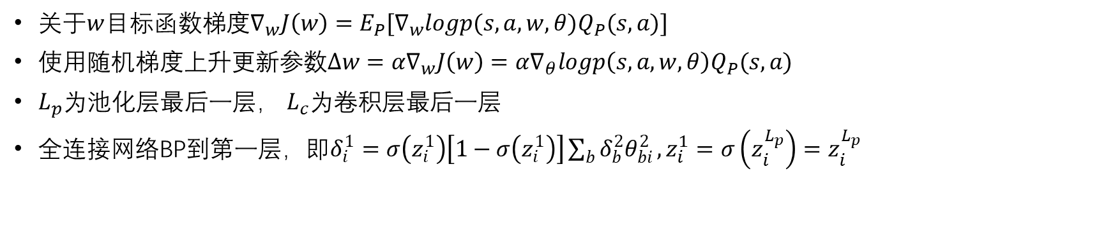
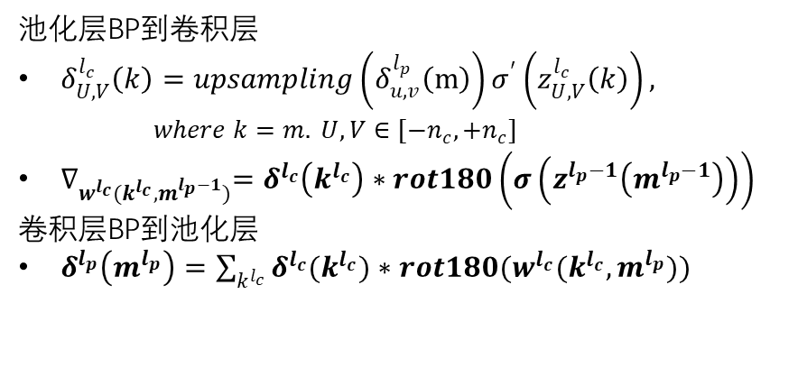
关于$w$目标函数梯度$∇_{w}J\left(w\right)=E_{P}[∇_{w}logp(s,a,w,θ)Q_{P}(s,a)]$
使用随机梯度上升更新参数${∆w=α∇}_{w}J\left(w\right)=α∇_{θ}logp\left(s,a,w,θ\right)Q_{P}(s,a)$
$L_{p}$为池化层最后一层， $L_{c}$为卷积层最后一层
全连接网络BP到第一层，即$δ_{i}^{1}=σ\left(z_{i}^{1}\right)\left[1−σ\left(z_{i}^{1}\right)\right]\sum_{b}{δ_{b}^{2}θ_{bi}^{2}},z_{i}^{1}=σ\left(z_{i}^{L_{p}}\right)=z_{i}^{L_{p}}$
池化层BP到卷积层
$δ_{U,V}^{l_{c}}\left(k\right)=upsampling\left(δ_{u,v}^{l_{p}}\left(m\right)\right)σ^{′}\left(z_{U,V}^{l_{c}}\left(k\right)\right),$
$where k=m. U,V∈[−n_{c},+n_{c}]$
$∇_{w^{l_{c}}(k^{l_{c}},m^{l_{p}−1})}=δ^{l_{c}}\left(k^{l_{c}}\right)∗rot180\left(σ\left(z^{l_{p}−1}\left(m^{l_{p}−1}\right)\right)\right)$
卷积层BP到池化层
$δ^{l_{p}}\left(m^{l_{p}}\right)=\sum_{k^{l_{c}}}{δ^{l_{c}}(k^{l_{c}})∗rot180(w^{l_{c}}(k^{l_{c}},m^{l_{p}}))}$

Slide 5
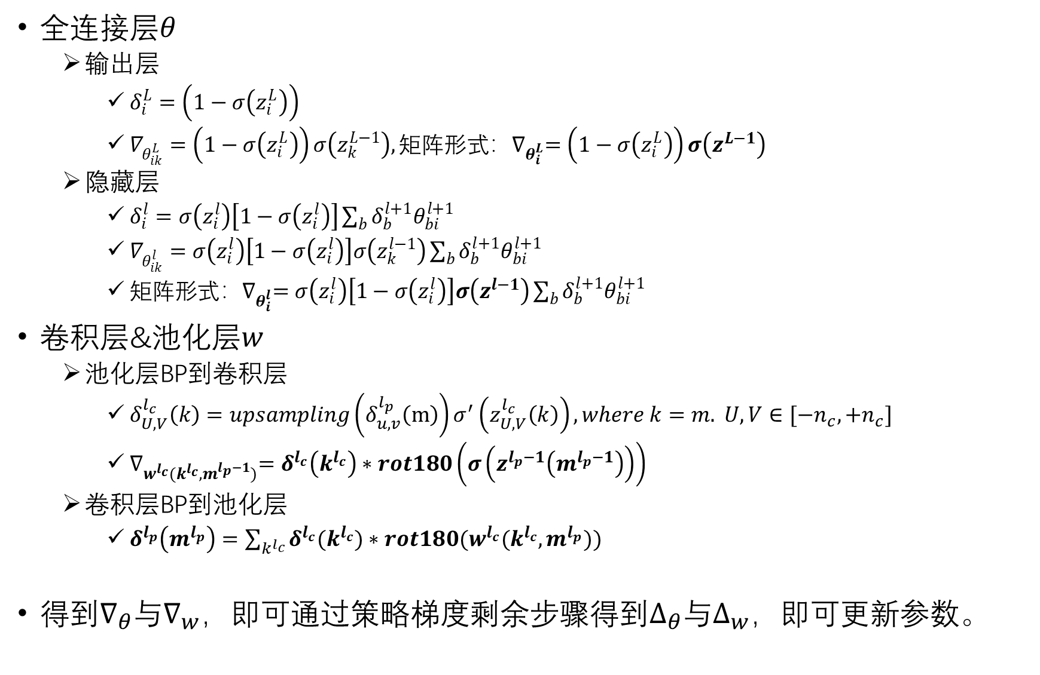
全连接层$θ$
输出层
$δ_{i}^{L}=\left(1−σ\left(z_{i}^{L}\right)\right)$
$∇_{θ_{ik}^{L}}=\left(1−σ\left(z_{i}^{L}\right)\right)σ\left(z_{k}^{L−1}\right),矩阵形式：∇_{θ_{i}^{L}}=\left(1−σ\left(z_{i}^{L}\right)\right)σ\left(z^{L−1}\right)$
隐藏层
$δ_{i}^{l}=σ\left(z_{i}^{l}\right)\left[1−σ\left(z_{i}^{l}\right)\right]\sum_{b}{δ_{b}^{l+1}θ_{bi}^{l+1}}$
$∇_{θ_{ik}^{l}}=σ\left(z_{i}^{l}\right)\left[1−σ\left(z_{i}^{l}\right)\right]σ\left(z_{k}^{l−1}\right)\sum_{b}{δ_{b}^{l+1}θ_{bi}^{l+1}}$
$矩阵形式：∇_{θ_{i}^{l}}=σ\left(z_{i}^{l}\right)\left[1−σ\left(z_{i}^{l}\right)\right]σ\left(z^{l−1}\right)\sum_{b}{δ_{b}^{l+1}θ_{bi}^{l+1}}$
卷积层&池化层$w$
池化层BP到卷积层
$δ_{U,V}^{l_{c}}\left(k\right)=upsampling\left(δ_{u,v}^{l_{p}}\left(m\right)\right)σ^{′}\left(z_{U,V}^{l_{c}}\left(k\right)\right),where k=m. U,V∈[−n_{c},+n_{c}]$
$∇_{w^{l_{c}}(k^{l_{c}},m^{l_{p}−1})}=δ^{l_{c}}\left(k^{l_{c}}\right)∗rot180\left(σ\left(z^{l_{p}−1}\left(m^{l_{p}−1}\right)\right)\right)$
卷积层BP到池化层
$δ^{l_{p}}\left(m^{l_{p}}\right)=\sum_{k^{l_{c}}}{δ^{l_{c}}(k^{l_{c}})∗rot180(w^{l_{c}}(k^{l_{c}},m^{l_{p}}))}$
得到$∇_{θ}$与$∇_{w}$，即可通过策略梯度剩余步骤得到$∆_{θ}$与$∆_{w}$，即可更新参数。

Slide 6
谢谢观看！

