Slide 1
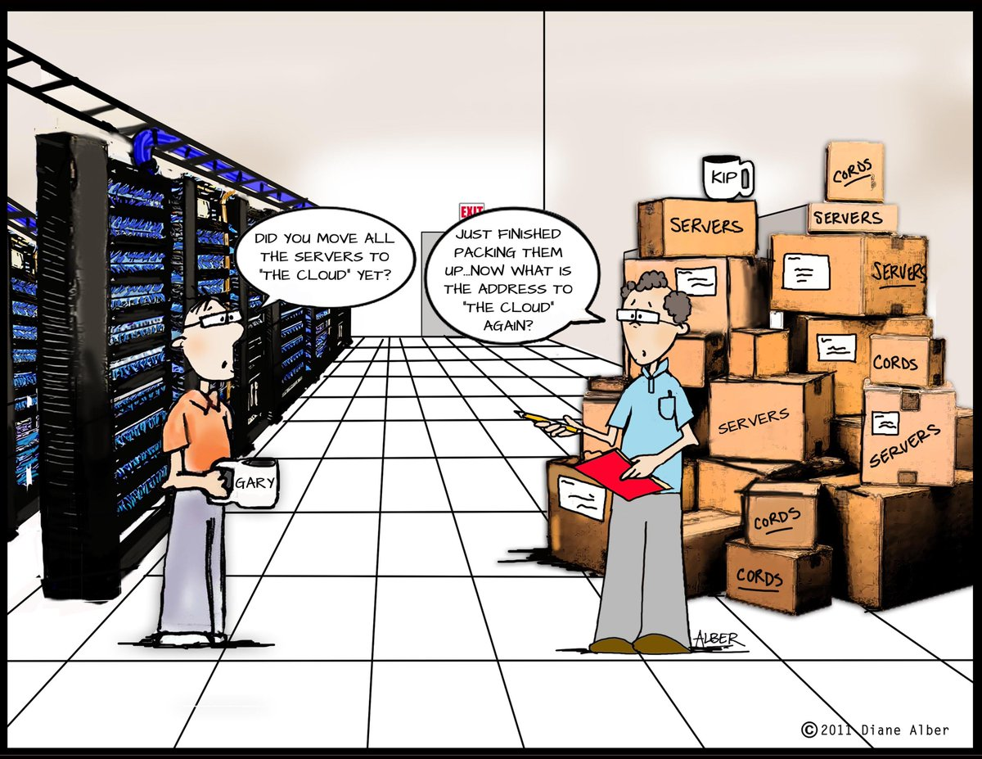
IST346: Servers and Data Centers

Slide 2

Agenda
Discussion
Content
Servers
Data Centers
Wrap-Up

Slide 3
Discussion Questions
What are the three primary server hardware strategies?
Are is the disadvantages of beautiful snowflakes – one service per server? How can this be mitigated?
What is a server appliance? Do you own one?
What is RAID? Why doesn’t it help you in the event of a fire?
What is a data center? What is it not?
Explain strategies for accessing servers in the data center without having to physically be there.
What type of spare equipment should you have in a data center?
Notes:
Give students 1-2 minutes for each question. Its important to provide them with the opportunity to answer the questions based on the reading, labs, and assigned homework.

Slide 4
Server, Client, Service
A Server is a computer which supplies 1 or more services.
A Service is a program running on a computer (typically a server) which is accessible over the network.
A Client is a computer which uses the service. Workstations are clients.

Slide 5
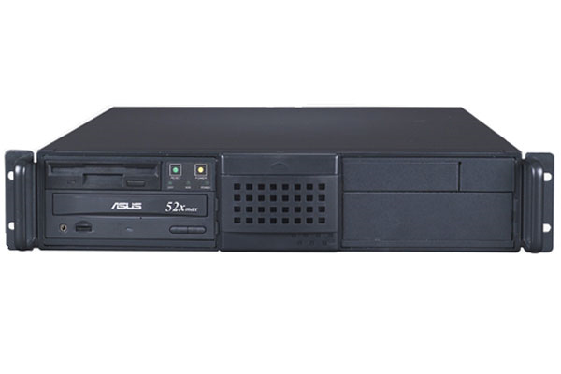
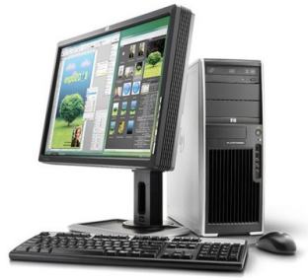
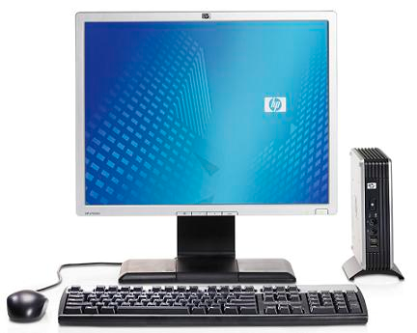
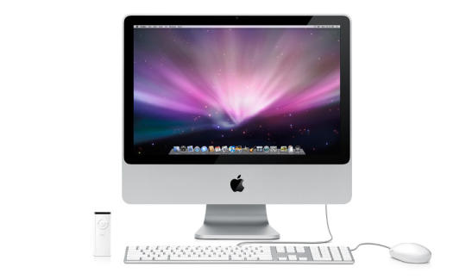
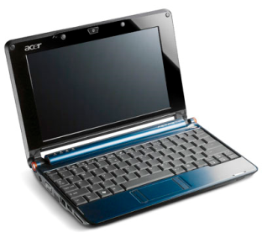
The Client-Server Model
filer.fauxco.com
192.168.1.10
Service: File Sharing using SMB
Server
Workstations
ctl02.fauxco.com
192.168.1.202
ctl04.fauxco.com
192.168.1.204
ctl05.fauxco.com
192.168.1.205
ctl03.fauxco.com
192.168.1.203

Slide 6
Service Drives the design of a Server
Services must be:
Always on
Must be tolerant to faults
Accessible remotely
Therefore servers have these hardware characteristics:
UPS
Network Redundancy
RAID
KVM

Slide 7
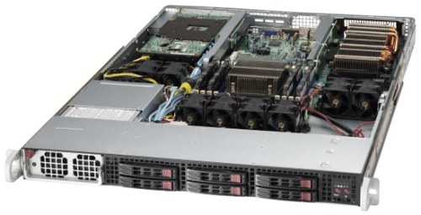
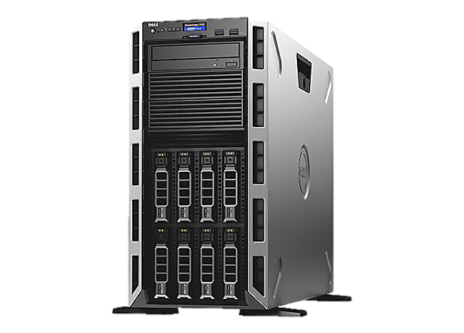
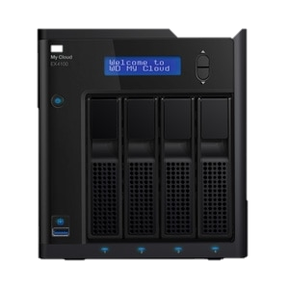
Servers come in different shapes and sizes

Slide 8

Check Yourself
What is the difference between a server and a service?
How is a server different than a workstation?
Why are there different types of servers like Towers, Rack Mounted, and Blades?

Slide 9
Data Center Videos
Syracuse University’s Green Data Center https://www.youtube.com/watch?v=buAoMUQg-SA
Inside Googles South Carolina Data Center https://www.youtube.com/watch?v=XZmGGAbHqa0
Microsoft’s Underwater Data Center https://www.youtube.com/watch?v=AvvJc4Uw3aA

Slide 10
Check Yourself
Why make a data center “green”?
What is Water Cooling?
Why is there so much physical security in a data center?
Besides “Data Center” what common themes are in all 3 videos?

Slide 11
What Are You Outsourcing?
Nothing – your server, your data center
Co-Location – your server, their data center
Infrastructure as a Service (IaaS) – their server, their data center.

Slide 12
Group Activity
Moving Day!

Slide 13
Moving Day!
Divide into teams of 3 for this exercise.
Your small-sized company is planning to relocate from Syracuse, IN to Ithaca, NY to be closer to its East-coast market. The current site has a data center, but the new site does not.
Your options are:
Build a new data center at the new site.
Keep the existing data center at the current site.
Co-locate servers into a commercial data center.
Switch to an IaaS option.
What would you advise? why? What is your strategy for business continuity?
Notes:
You know the existing costs of the current data center. You can weigh those costs against Colocation and IaaS cloud options.
Build a new data center at new site
Keep existing data center at current site

Slide 14

Your To-Do List
What to work on for next class
Notes:
ALWAYS CONSULT THE SYLLABUS

Slide 15
Exit Ticket
Share one thing you learned today that you didn’t know before class!

Slide 16

Questions?

