Slide 1
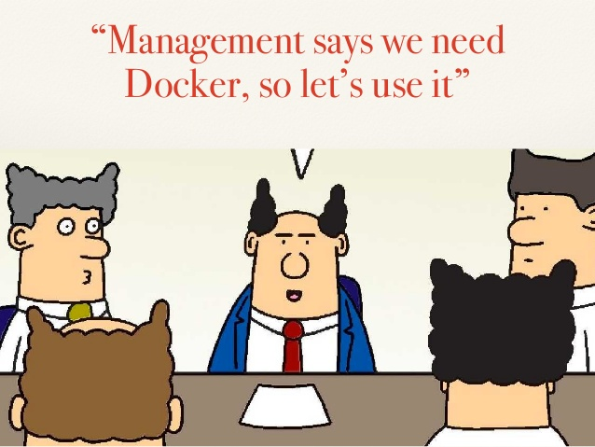
IST346: Virtualization and Containerization

Slide 2

Agenda
Discussion
Content
Virtualization
Containerization
Wrap-Up

Slide 3
Discussion Questions
What is Virtualization? Containerization?
How does Virtualization differ from Containerization?
What is an image how is it different from a container?
What is state? What is irreproducible state?
What is Infrastructure as Code?
Notes:
Give students 1-2 minutes for each question. Its important to provide them with the opportunity to answer the questions based on the reading, labs, and assigned homework.
What is virtualizartion? What is containerization?
Pet computers are unique Cattle computers are a commodity.
State is the data and configurations which make our cattle computers pets. Irreproducible state its tied to a specific system.
IaC allows us to store our systems in a way that makes them reproducible on any hardware.

Slide 4

Lab Debrief
Lab – D
Notes:
Go over the lab questions. With the students. Ask them to take out their answers to the lab questions. And their questions about the lab itself.

Slide 5
Essential Components of any System
Code – The functionality
Data - The inputs and outputs to that system
Infrastructure – The Software required to run the code and store the data
Code
System
Data
Infra- structure
Notes:
Before we define devops, let’s cover a few more things. Every system regardless of whether it includes data science or not consists of there components Code, Data and Infrastructure.
[READ BULLETS]
Consider our hotdog app.
The code is our algorithm to determine whether it’s a hot dog, as well as the mobile app and web api.
The data are the photos we use to train the hot dog detection model and the feedback our users give us when the model is right or wrong.
The infrastructure are the servers needed to run the back end of the web app, store the images, feedback from the users, including the function which predicts if the photo is a hot dog.
Managing the code and data are relatively trivial, but the infrastructure can be a challenge, as we’ll see next.

Slide 6
Infrastructure as Code Methodology
Treat your infrastructure as if it were code!
Store configurations, dependencies and scripts to bootstrap your systems in a source code management (SCM) system like Git.
This allows you set-up and tear down environments quickly and easily and deploy your systems in Dev, Test or Production.
Servers are commodity / utility resources, and not at all strategic.
Notes:
In the Infrastructure as Code methodology we our systems infrastructure as if it were code!
We Store configurations, dependencies and scripts to bootstrap your systems in a source code management (SCM) system like Git.
This allows you set-up and tear down environments and dependencies quickly and easily and deploy your systems in Dev, Test or Production.
In the grand scheme of things the servers (hardware and networks) are simply a commodity or utility and have no strategic value at all.

Slide 7
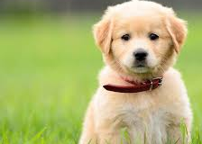
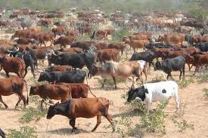
Treat Servers like Cattle, Not Pets
Pet servers
Few of them
Are given names like mail.mycompany.com
Are built to solve the task at hand (email)
When they are “sick” we “nurse them back to health”
Cattle servers
Lots of them
Are given numbers like s0045.mycompany.com
Are built to do the same thing: compute and storage
When they are “sick” we “take them out of commission” and replace with another.
Notes:
A big mantra of DevOps is “Treat Servers like Cattle, Not Pets” It’s important to recognize we’re talking about HARDWARE here not the applications running on the hardware. We want the underlying infrastructure to be a commodity of storage network and compute . So the when we can design our application so that it is free to scale. The big internet companies like Google, Facebook, and Yahoo learned this early on.

Slide 8
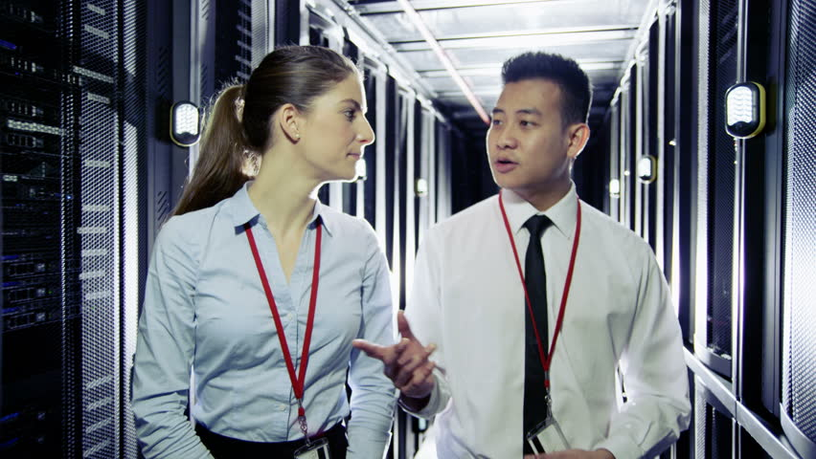
Which one of these runs our email?
Any of them!
Notes:
When you have this mindset, you’re ready for DevOps.

Slide 9
Virtualization and Containerization
Virtualization
Containerization
Web Server
DNS Server
Database Server
Web Server
DNS Server
Database Server
Web App
DNS
Database
Web App
DNS
Database
Docker (Container Runtime)
Linux (OS)
Linux (OS)
Linux (OS)
Linux (Operating System
VMWare ESX (Hypervisor)
VMWare ESX (Hypervisor)
Dell PowerEdge (Hardware)
Dell PowerEdge (Hardware)
Notes:
Discuss the pros and cons of each.

Slide 10
Important Concepts
Host – the computer running the virtual machines or containers.
Guest – the operating system running as a virtual machine.
Image – the software necessary to run an application.
Container – a self-contained unit of software based on an image.

Slide 11
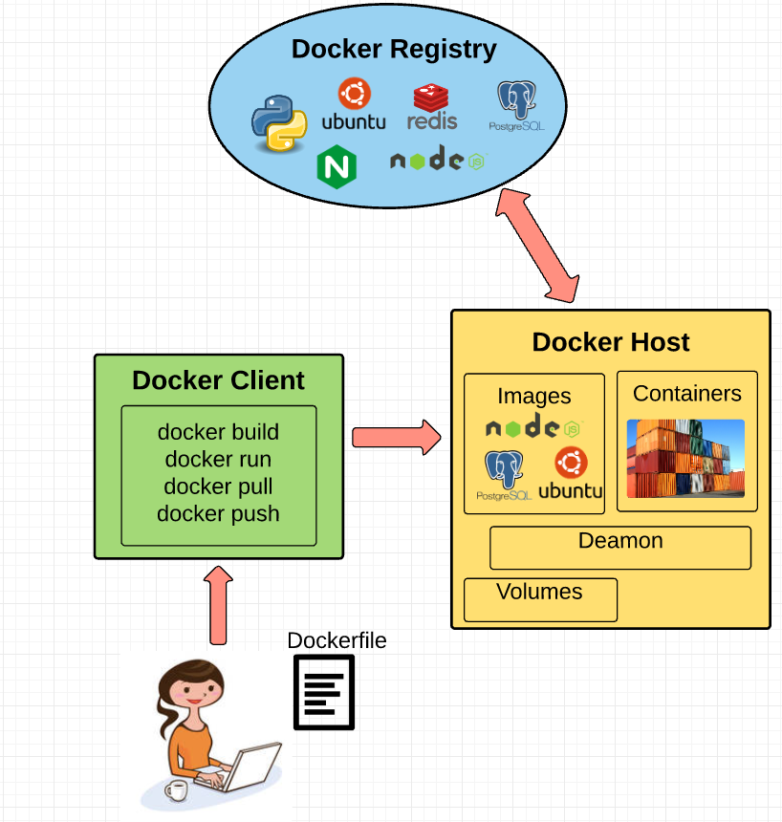
Docker’s Multiple Meanings

Slide 12
Demo: Lab Environment
Notes:
Demonstrate hosts and guests in the lab environment. Host – running downstairs in 027. Guest the windows 10 computer.
The virtual machine “guest” acts as a “host” for docker containers.

Slide 13
Group Activity
Research Virtualization and Container

Slide 14
Details of Group Activity
Product research - Divide into Pairs
The Virtualization we use in this course is VM Ware – research 2 other products which are similar to it.
The Containerization we use in this course is Docker. Research 2 other products which are similar to it.

Slide 15

Your To-Do List
What to work on for next class
Notes:
ALWAYS CONSULT THE SYLLABUS

Slide 16
Exit Ticket
What was the most confusing aspect of this lesson?

Slide 17

Questions?

