Slide 1
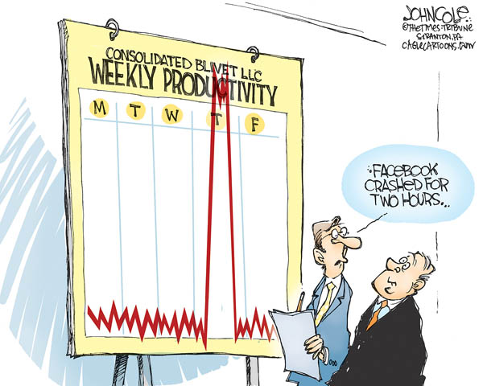
IST346: Services: Monitoring and Logging

Slide 2

Agenda
Discussion
Content
Services
Monitoring
Logging
Wrap-Up

Slide 3
Discussion Questions
What are the 6 characteristics of providing good service?
What aspects of a service should be monitored?
What are the two types of monitoring? Why are both important?
What are the uses of logs and benefits of logging?
What is end-to-end testing?
What is SNMP?
Where are the Linux system logs located?
Notes:
Give students 1-2 minutes for each question. Its important to provide them with the opportunity to answer the questions based on the reading, labs, and assigned homework.

Slide 4
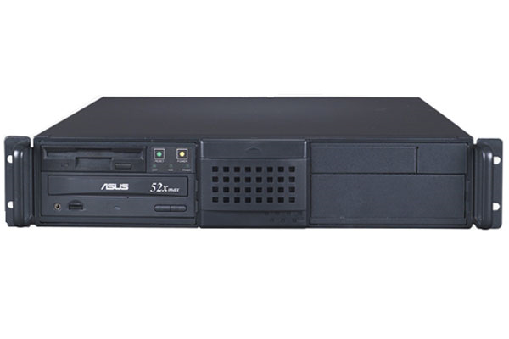


Recall: Server vs. Service
A server is a computer.
A service is an offering provided by server(s).
HTTP, for example
It is software

Slide 5
Services
Background process accessible over a network.
Typical environments have several services, and services often depend on other services.
Some services are simple, and have no interaction’s on the user’s part. (network time, or NTP for example)
It is best to think about any given service in terms of its anatomy and interdependencies.

Slide 6
Anatomy of a service
Instructions for transferring data to/from client/server (transport mechanism)
Protocols
Components
APIs
Rules for accessing or extending the service beyond the components, it may communicate with other systems.
Client and Server software part of the application or service interaction
Notes:
You don’t need all three but most of the time you do have all three of them.

Slide 7

Example: Wordpress
Protocols HTTP, HTTPS, WebDAV, SMTP
Components Web Browsers Apache Web Server PHP Scripting MySQL Database
APIs XML-RPC Atom RSS

Slide 8
Service Interdependencies
Complex interface, several protocols.
Application
Network
Core/Infrastructure
Services at the application level depend on lower-level services for their operation.
Basic interface with underlying protocol.
Essential to all other services. Minimal interface.

Slide 9



Service Dependencies: Example
HTTP, SMTP
DNS, DHCP, LDAP
Application
Network
Core Infrastructure

Slide 10
Services every IT professional should know
Core
NTP – Network time protocol. Keeps the clocks in sync on several hosts
DNS – Domain name system – a method of IP address to host name resolution.
DHCP – Dynamic Host configuration Protocol – a method of assigning IP information over the network.
LDAP – Lightweight Directory Access Protocol – a hierarchal database of directory information (users, groups, organizations, etc)
Kerberos – A network authentication protocol, used for securely evaluating identities over a network

Slide 11
Services every IT professional should know
Network
HTTP – Hypertext transport protocol. The application protocol for the WWW
SSL –Secure Sockets Layer – an encrypted channel for HTTP traffic
SSH / SCP – Secure Shell, Secure Copy. Unix/Linux remote shell and remote file copy protocols.
NFS – Network File System – File sharing for unix-like computers.
RDP – Remote Desktop protocol. A proprietary protocol for accessing Windows hosts over a network.
SMTP – Simple Mail Transport Service. Mail routing protocol.
OAuth2 – for account authentication and authorization.

Slide 12

Check Yourself: Understanding Services
What are the 3 things which make up the Anatomy of any service?
What is a core or infrastructure service? Provide an example.
Provide an example of a service which depends on another service.
A service like Gmail depends on which other services?

Slide 13
Providing a Service
Defined
1
Reliable
2
Scalable 3
Monitored 4
Maintained 5
Supported 6
Any service you provide must be:

Slide 14
Defining your Service
Defined
1
Identify your customers
Formulate an SLA

Slide 15
Service Reliability
Reliable
2
Keep it simple
Don’t be the only expert – rely on the community for support and best practices
Use Open standards

Slide 16
Reliability: Environments
Reliable
2
Any service should have 3 environments
Usually, each environment is on separate hardware
Dev
Test
Prod
Where you build out new features for the service / upgrades
Primary Environment for the Service
Mirror image of prod environment for testing purposes

Slide 17
Scalability
Scalable 3
After
Vertical Scalability:
Before
Load Balancer
Horizontal Scalability:
Before
After
After
After
Notes:
Vertical Scalability – throw more hardware at the problem
Horizontal Scalability – re-engineer the problem

Slide 18
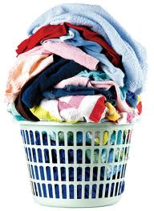
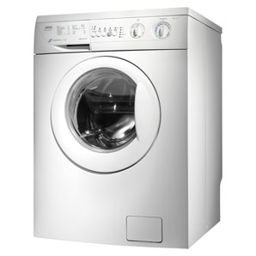
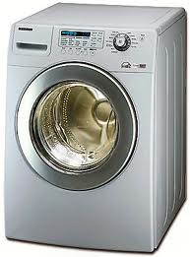
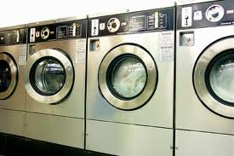
Scaling your Laundry
Scalable 3
You’ve got more laundry than your current washing machine can handle!!
Traffic
Service
Vertical
Horizontal
Use more than one washing machine
Use a bigger, faster washing machine
Notes:
Laundry is the traffic to your service
The washing machine is the service

Slide 19
Service Monitoring & Logging
Monitored 4
You cannot offer good service if you don’t monitor.
You cannot measure unless you are logging activity.
If you’re not measuring it, you’re not managing it.
Monitoring == real-time
Logging == historical

Slide 20
How Monitoring and Logging Work
Server
Log
Service Activity
Service
Network Activity
Internal Service Monitor
External Service Monitor
Event
Event

Slide 21
Example: Simple Web Service Monitoring
Linux Host: website.com
access_log
Service Activity
Nginx
Network Activity
ps –aux | grep “httpd”
nmap website.com
Event: Port unavailable
Event: Service stopped

Slide 22
Logging
Monitored 4
Log files get very large
since they record all activity.
Log file rotation – service points to a different log file after a specified interval.
Lets you backup log files
Keeps the size of the files manageable.
Log files are text and they compress nicely.
How long do you keep logs?
Depends on service, depends on your policy
It’s not a decision the SA should make.
Ship logs to a Big Data system like Hadoop or Elasticsearch
Like an insurance policy. Not very useful until the off chance that you need it... then you’re glad you have it!

Slide 23
Service Maintenance
Maintained 5
Yes, there will come a time when you will need to deny service. (Make it unavailable.)
Upgrades to hardware / OS / Service itself
Plan and advertise your service outages so your users can plan accordingly.
Make sure your outage complies with your SLA.

Slide 24
Supporting your service
Supported 6
Document
Train your Staff
Dev / Test / Prod
One / Some / Many – Phased Roll Out. Get Buy in.
Measure to determine if you need to scale or have issues.
Advertise
Support!

Slide 25
Providing a Service
Defined
1
Reliable
2
Scalable 3
Monitored 4
Maintained 5
Supported 6
Any service you provide must be:

Slide 26
Group Activity
Service Selection

Slide 27
Group Activity: Providing a Service
Break up into teams of 3.
Think of a service you use every day. It can be the same service from the last group activity. Answer these questions to the best of your ability
Define the service
How do they maintain reliability?
How is it scaled, if at all?
How do you think it is monitored?
How is it maintained?
How is it supported?

Slide 28

Your To-Do List
What to work on for next class
Notes:
ALWAYS CONSULT THE SYLLABUS

Slide 29

Exit Ticket
Share one thing you learned today that you didn’t know before class!

Slide 30

Questions?

