Slide 1
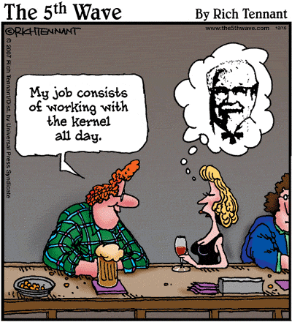

Operating Systems Architecture

Slide 2
Agenda
Learn about operating systems and what they do
Learn some technical details about how they work
Discuss common tasks operating systems
Before we can discuss Operating Systems, we first need to know…..

Slide 3
What is a Computer?

Slide 4
What Is A Computer?
Most people think of this as a personal computer, i.e. a desktop or laptop…
A hundred years ago a computer was a human being
A computer was someone who performed calculations to find the answer to a complex mathematical equation.
They might not have even understood the calculations they were performing
A good computer simply followed very stringent rules.

Slide 5
What Is A Computer?
Over the years the rough definition of a computer has evolved to this:
It must take input of some sort
It must produce output of some sort
It must process the information somehow
It must have some sort of information store
It must have some way of controlling what it does.
A computer still performs calculations
A computer likely doesn’t understand the calculations it is performing (unless you’re talking about an A.I.)
A good computer follows stringent rules

Slide 6
What Is A Computer?
At the heart of any computer you will find a component called a processor, more formally described as a Central Processing Unit, or CPU.
A computer contains volatile memory, otherwise known as RAM. This is where instructions are stored while the computer is running.
Non-volatile storage is present as a place to store data, applications, and other output you want to store. Typically we know these as Hard Drives.
A system bus exists for transferring instructions and data to the various components. The system bus is incorporated in what we know as a Motherboard.
Usage of the computer is accomplished through an Operating System.

Slide 7
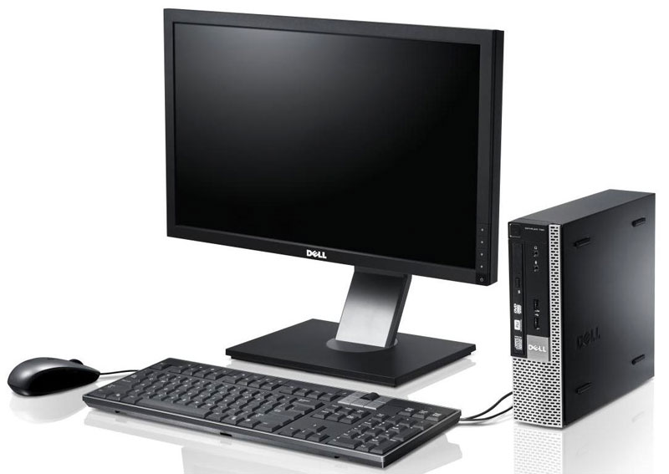
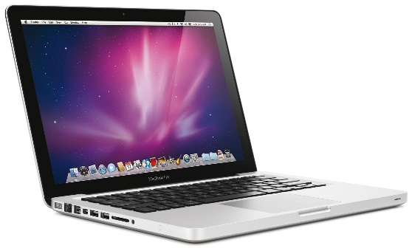
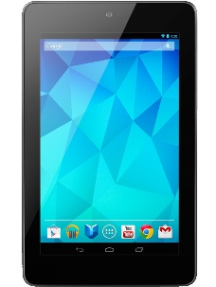
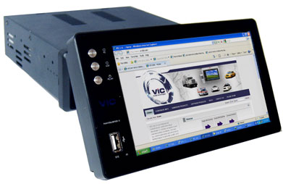
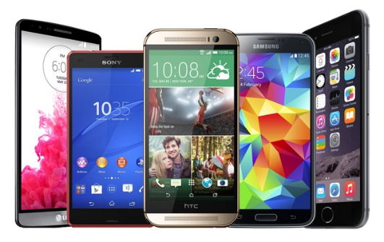
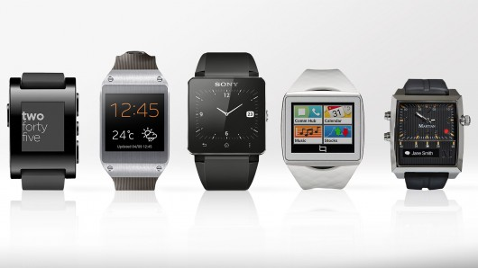
What Is A Computer…any of these

Slide 8
Operating Systems Architecture

Slide 9
Operating System (OS)
The operating system is program that acts as an intermediary between a user of a computer and the computer hardware
In other words, it’s the interface between the hardware and the user.
The primary roles of the operating system are to:
Coordinate executing of programs
Make the computer system convenient to use
Utilize the computer hardware in an efficient manner
The OS provides an abstraction – making it easier for applications to work with each other without causing conflicts.

Slide 10
What Operating Systems Do
For workstations, provides users convenience, ease of use and good performance
For shared computers such as mainframes or servers it must keep all users happy
Users of dedicate systems such as workstations have dedicated resources but frequently use shared resources from servers
Handheld computers are resource poor, so optimized for usability and battery life
Some computers have little or no user interface, such as embedded computers in devices and automobiles

Slide 11
What is an OS?
It’s a resource allocator
Manages all resources
Decides between conflicting requests for efficient and fair resource use
It’s a control program
Controls execution of programs to prevent errors and improper use of the computer
“The one program running at all times on a computer” is the kernel.
Everything else is either
a system program (ships with the operating system) , or
an application program.

Slide 12
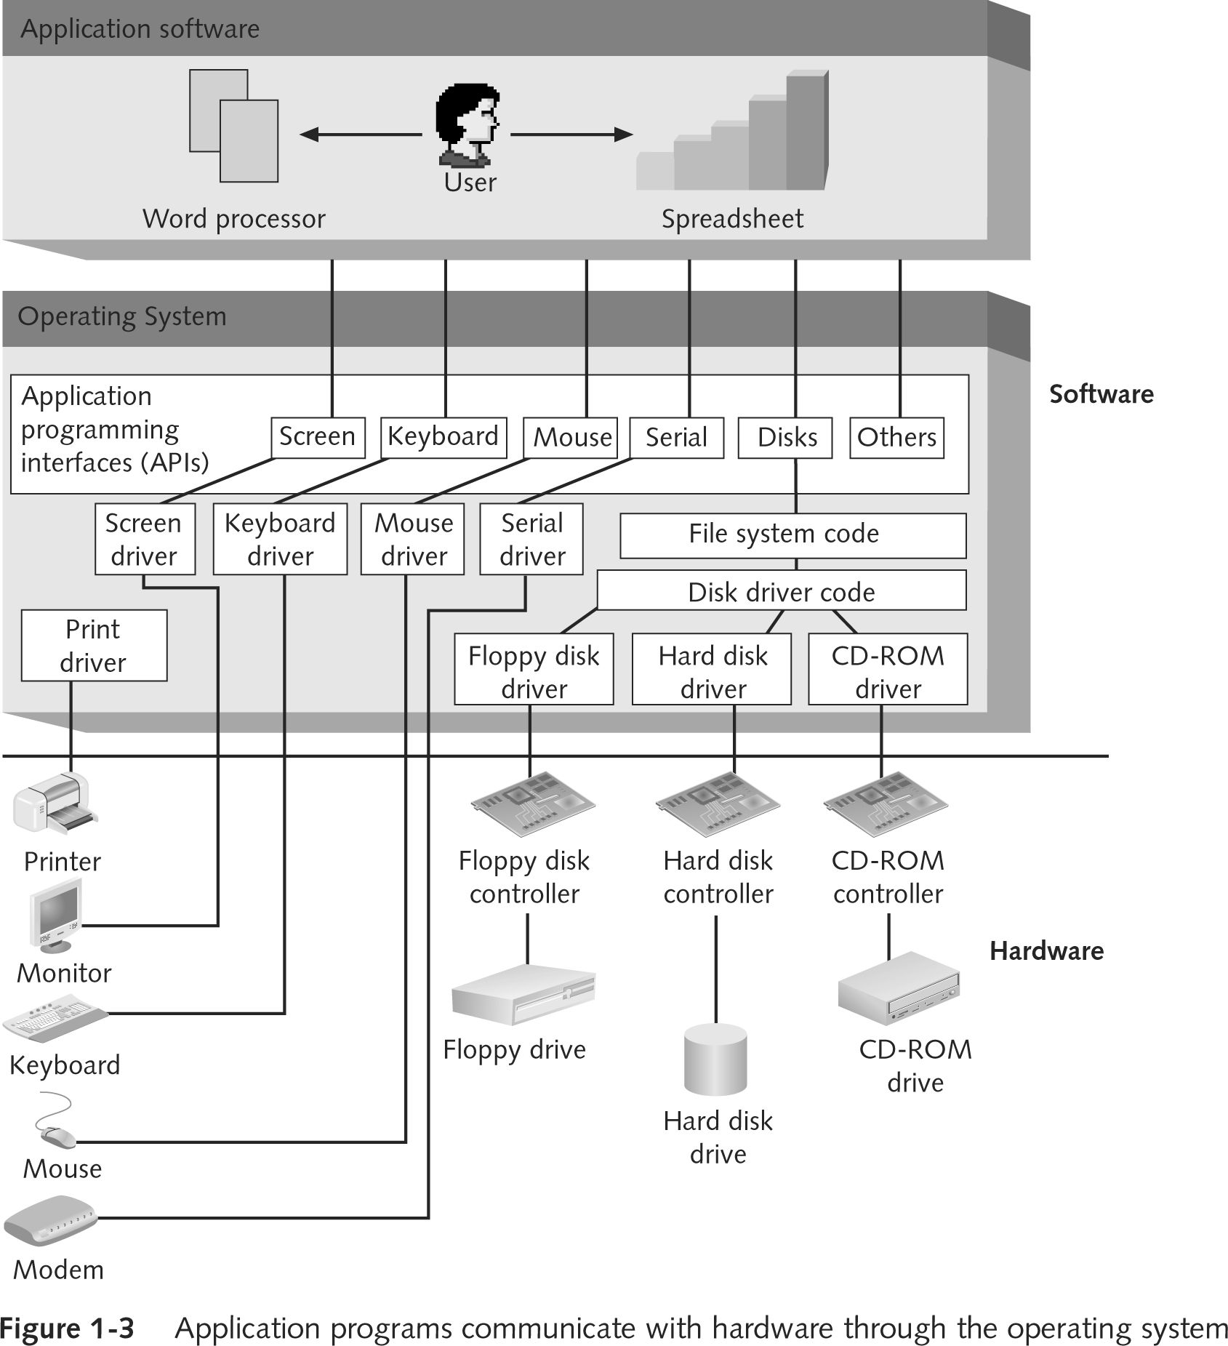
Operating System Architecture
The operating system is an abstraction between the computer hardware and the user.

Slide 13
Popular Components Of Modern Operating Systems
Boot loader – a simple program to load the OS from volatile storage at startup.
Kernel – the heart of the OS. Responsible for processes, memory, protection and devices
File System – an abstraction for the storage of data on disk.
Network Stack – an implementation of network protocols for computer to computer communication
Services – background process to support basic operation.
UI – allows users to interact with the OS. There are command shells like bash or cmd.exe as well as graphical user interface shells, like explorer or finder.

Slide 14
Startup
A bootstrap program is loaded at power-up or restart
Typically stored in ROM or EPROM, generally known as firmware or BIOS
Initializes all aspects of system (hardware)
Loads operating system kernel and starts execution
The kernel takes over and loads the rest of the Operation System.
The kernel continues to provide a connection between the application software and the hardware fro this point forward.

Slide 15
The Key OS Kernel Responsibilities
Process Mgmt
Memory Mgmt
I/O Mgmt
Network Mgmt
Security
Notes:
Process management
Memory management
I/O and Network Management
Protection / Security

Slide 16
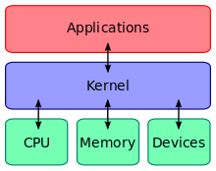
Operating Systems Operations
Dual-mode operations allows an OS to protect itself and other system components
Two modes are User mode and kernel mode
Provides ability to distinguish when system is running user code or kernel code
Some instructions designated as privileged, only executable in kernel mode
System call changes mode to kernel, return from call resets it to user

Slide 17
Process Management
A process is a program in execution. It is a unit of work within the system. A program is a passive entity, a process is an active entity.
A process needs resources to accomplish its task
CPU, memory, I/O, files
Initialization data
Handling programs in initialization, execution, and termination
Task scheduling
Program Execution / Termination
Process termination reclaims any reusable resources
Single-threaded processes have one program counter specifying location of next instruction to execute
Process executes instructions sequentially, one at a time, until completion
Multi-threaded processes have one program counter per thread

Slide 18
Multitasking / Multiprocessing
Multitasking – each application runs as a separate task
Multithreading – parts of the same application can run as separate tasks (video and image processing)
Multiprocessing – when a computer has multiple CPUs / Cores, a single running application can thread across cores
Multiprocessor systems continue to grow in use and importance.
Advantages include:
Increased throughput
Economy of scale
Increased reliability (fault tolerance)
Two types:
Asymmetric Multiprocessing – each processor is assigned a specific task.
Symmetric Multiprocessing – each processor performs all tasks

Slide 19
Memory Management
To execute a program all (or part) of the instructions must be in memory
All (or part) of the data that is needed by the program must be in memory.
Memory management determines what is in memory and when
Optimizing CPU utilization and computer response to users
Memory management activities
Keeps track of which parts of memory are currently being used and by what processes
Deciding which processes and data to move into and out of memory
Allocating and de-allocating memory space as needed

Slide 20
Memory management (cont.)
Virtual memory – the presentation of more memory to applications than is available by using disk.
Paging – a block of continuous memory of a predetermined size
Page faults – occurs when an application accesses a page that has been virtualized to disk and therefore needs to be re-loaded back into memory

Slide 21
Storage Management
The OS provides a uniform, logical view of information storage
Abstracts physical properties to logical storage unit - files
Each medium is controlled by device (i.e., disk drive, tape drive)
File-System management
Organizing of files, usually into directories
Access control to determine who can access what files
OS activities include:
Creating and deleting files and directories
Manipulating files and directories
Mapping files onto secondary storage
Backup files (locally or to separate, non-volatile storage media)

Slide 22
I/O and Network Management
Disk management functions such as free space management, storage allocation, de-fragmentation.
Hardware Devices – Device drivers provide an interface for interaction between the device and the operating system.
Networking – implementation of network protocols for computer to computer communication
One purpose of an OS is to obfuscate hardware devices from the user
I/O subsystem is responsible for
Memory management of I/O including buffering (storing data temporarily while it is being transferred), caching (storing parts of data in faster storage for performance), spooling (the overlapping of output of one job with input of other jobs)
General device-driver interface
Drivers for specific hardware devices

Slide 23
Security
Protection – any mechanism for controlling access of processes or users to resources defined by the OS
Security – defense of the system against internal and external attacks
Huge range, including denial-of-service, worms, viruses, identity theft, theft of service
Systems generally first distinguish among users, to determine who can do what
User identities (user IDs, security IDs) include name and associated number, one per user
User ID then associated with all files, processes of that user to determine access control
Group identifier (group ID) allows set of users to be defined and controls managed
Privilege escalation allows user to change to effective ID with more rights

Slide 24
User Interfaces
“The user interface is the space where interactions between humans and machines occur.”
The goal is to allow effective operation and control of the machine from the human end, while the machine feeds back information that aids the users decision making process.
Typically the goal is to produce a UI which makes it easy (self explanatory), efficient (fast), and enjoyable (user friendly) to operate a machine.
The term user interface is generally assumed to mean the graphical user interface (GUI), but command-line (CLI) interfaces also exist for a deeper interaction with the machine and purposes of automation.

Slide 25
Command-line Interfaces
A command-line interface (CLI) is a means of interacting with a program where the user issues commands to the program in the form of successive lines of text.
The CLI was once the primary means of interaction with most computer systems.
The interface is usually implemented with a command line shell, which is a program that accepts commands as text input and converts commands to appropriate operating system functions.
Command-line interfaces are less widely used by casual computer users, but typically preferred by more advanced computer users, as they often provide a more concise and powerful means to control a program or operating system.
Programs with command-line interfaces are generally easier to automate via scripting.

Slide 26
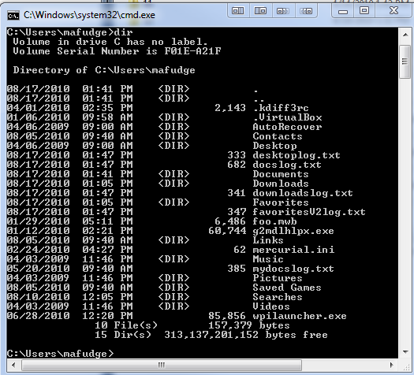
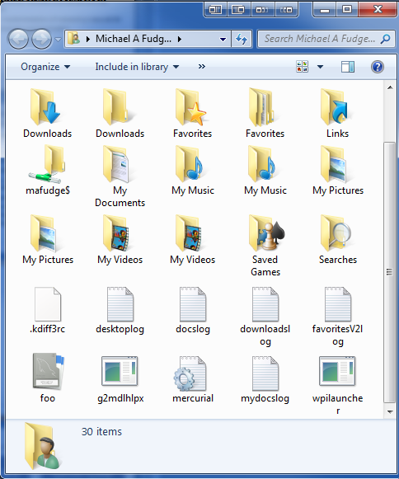
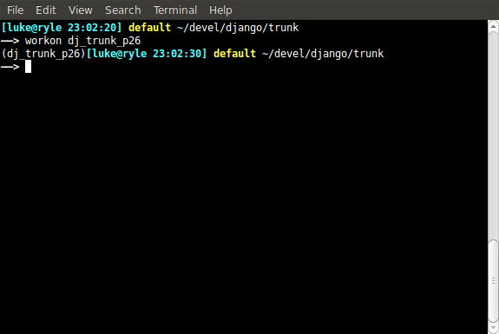
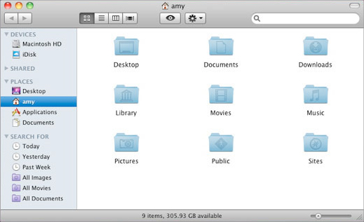
User Interfaces
CLI
GUI

Slide 27
Workstation Operating Systems
Windows
XP
Unix-Like
Linux
Vista
7
FreeBSD
OSX
8
ChromeOS
10
Android
iOS

Slide 28
Questions?
Why are the obituaries found in the "living" section of the newspaper?

