Slide 1
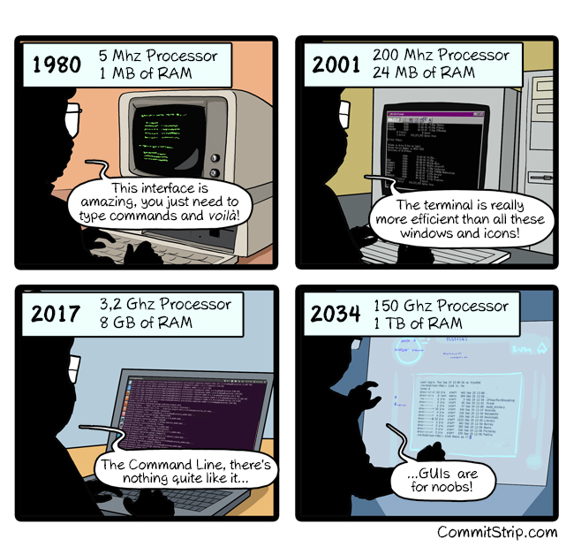
IST346: Operating Systems / Command Line Interfaces

Slide 2

Agenda
Discussion
Content
Computer,
Operating System,
Command Line
Activity
Summary
Homework
Question

Slide 3
Discussion Questions
Some
Questions
Here
Please
Notes:
Give students 1-2 minutes for each question. Its important to provide them with the opportunity to answer the questions based on the reading, labs, and assigned homework.

Slide 4
Lab Questions?
Some
Questions
Here
Please
Notes:
Give students 1-2 minutes for each question. Its important to provide them with the opportunity to answer the questions based on the reading, labs, and assigned homework.

Slide 5
Computer Defined
“an electronic device for storing and processing data, typically in binary form, according to instructions given to it in a variable program.”
-Dictionary.com

Slide 6

Computer Hardware
Input: Keyboard, Mouse
Output: Screen
Processing: CPU
Storage: RAM / SSD
Notes:
Talk a bit about this picture. The ways computers process information is analogous to
Eyes on the screen => output for the computer is input for us.
Hands on keyboard => input for the computer is output for us.
CPU => Brains of the computer Our brain does the same thing. Processing the visual input then commanding our finger to type up a response.
Memory =>Computer has memory. We have memory. You might recall what was said about what your read on the computer screen and draw upon your experience to formulate a reply.

Slide 7
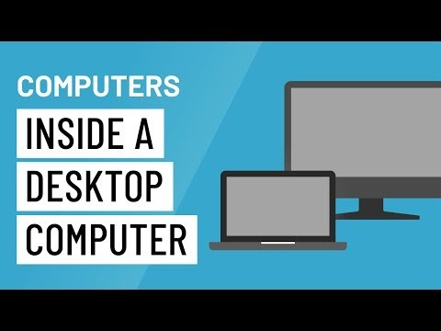
What’s Inside a Computer?

Slide 8
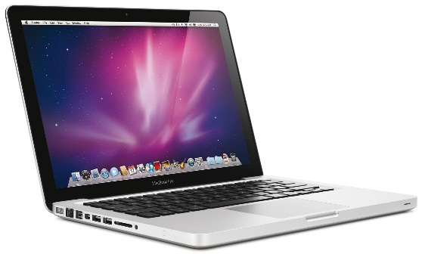
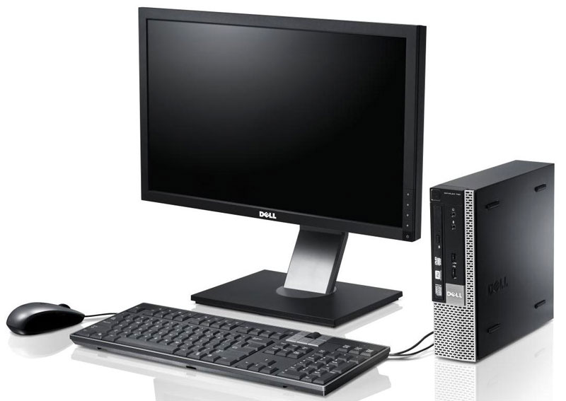
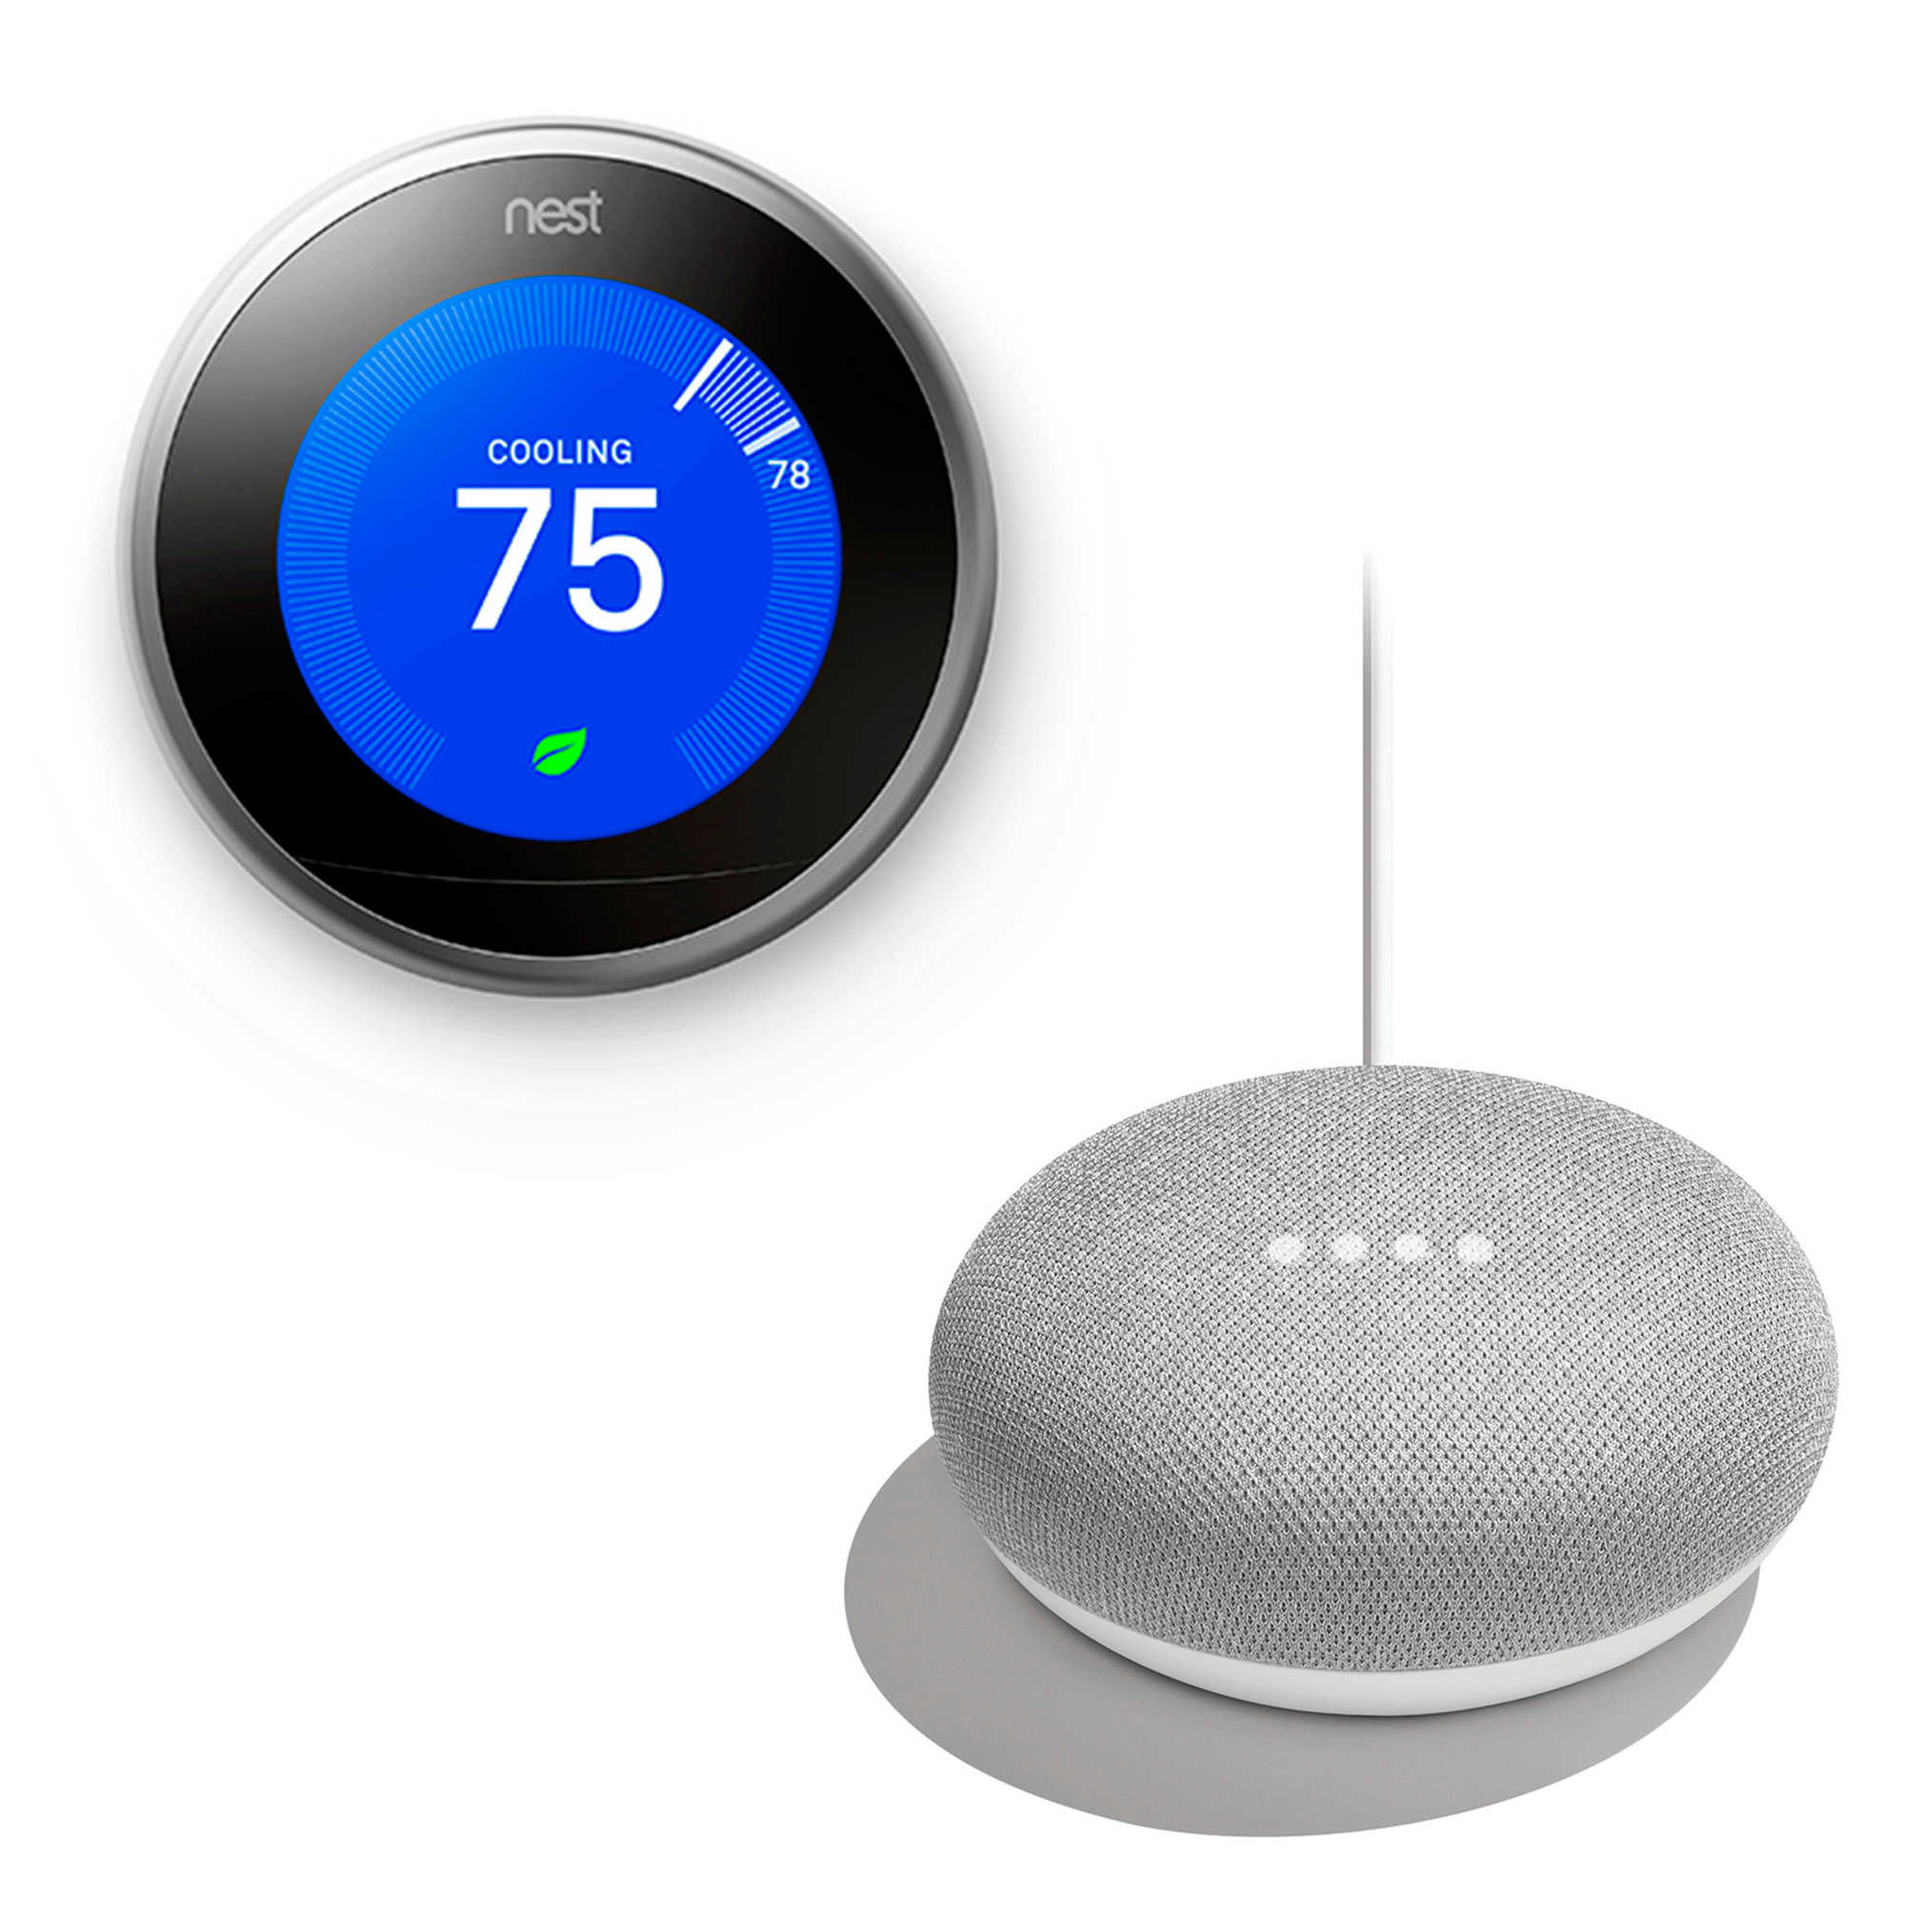
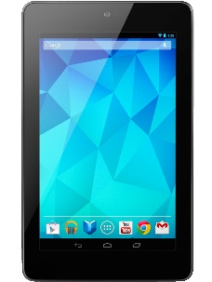
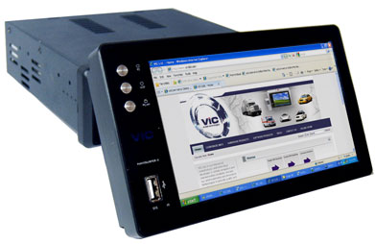
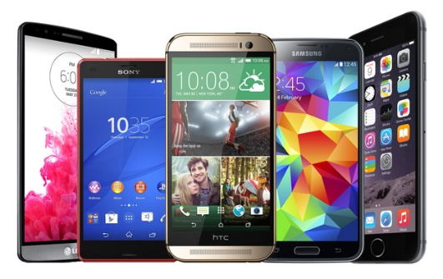
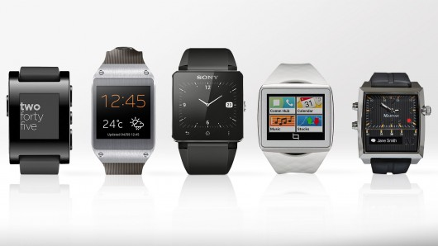
These Are All Computers!

Slide 9
Computer Storage
Primary Storage
Secondary Storage
RAM – Random Access Memory
Fast, Expensive, Limited Resource on the computer
The applications and data you’re using currently are in primary storage.
Hard Disk Drives (HDD) / Solid-State Drives (SSD)
Slower, Less Expensive, Abundant resource on the computer
Applications and data available to use are in secondary storage.

Slide 10

Check Yourself
When you buy a laptop with 16GB RAM and a 1TB hard disk which is Primary Storage? Secondary Storage?
How is storage affected by uninstalling an application?
When your phone is out of space because you have too many photos, which type of storage full?
Micro SD Cards are which type of Storage?
Notes:
16GB== RAM, 1TB = Secondary
It is removed from secondary storage and the space is reclaimed
Secondary storage
Secondary Storage

Slide 11
Operating System
The interface between you and the computer.
Responsibilities:
Manage primary and secondary storage
Move applications and their data between the two types of storage.
Provide support for various hardware devices.
Provide a consistent user interface.

Slide 12
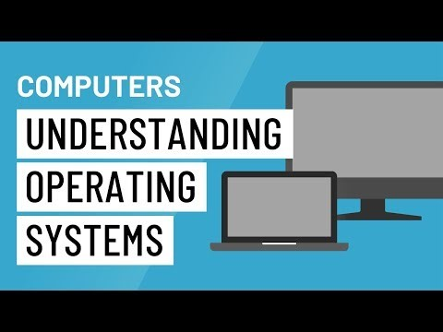
Understanding Operating Systems

Slide 13
Popular Operating Systems
Windows – Desktop / Server
Apple OSX – Desktop / Server
Linux – Desktop / Server
Comes in many distributions Ubuntu, RedHat, etc.
Android – Mobile
iOS – Mobile
ChromeOS - Desktop

Slide 14
Multitasking / Task Switching
Since Primary Storage is limited OS’s cannot load every application in memory.
The currently used application is in RAM, while the other applications are spilled to virtual memory in the background ( a form of secondary storage).
The more applications you load into primary memory, the slower your computer will run as it has to switch between applications.

Slide 15

Demo: Apps on your Phone
Let’s learn about Operating Systems RAM and Secondary Storage with an example from our smart phones.
Notes:
Do a demo with your smart phone where you install an app from the app store. Explain the app store is in the “cloud” and when you download the app it gets placed in secondary storage ( PING PONG KING)
The app does not install in primary storage until you open it. At that point it gets loaded into RAM where it runs about 100x faster than it would off of secondary storage.
While you use the app it creates data. What happened if you restart the phone while in the middle of using the app? Will it save this data? Let’s find out
While it reboots, as a question about primary and secondary storage. When you buy a phone with 128GB is that primary or secondary?
When you re-launch the app did it save your place? If so those changes were persisted to secondary storage at some point.
Show how to see running apps on the phone. How to close running apps.

Slide 16
Check Yourself
Applications can work on any operating system. True or False?
Why is it computers never “run out” of primary storage?
What happens when too many applications are loaded?
Notes:
16GB== RAM, 1TB = Secondary
It is removed from secondary storage and the space is reclaimed
Secondary storage

Slide 17
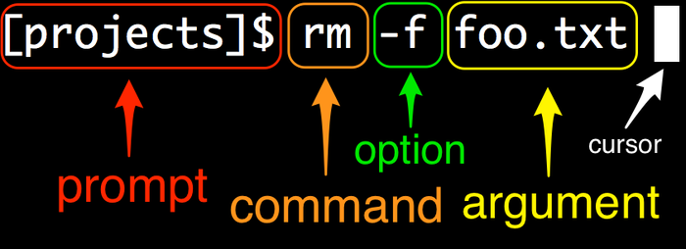
Command Line Interface
A means of interacting with the operating system.
Essential components

Slide 18
Demo: Command Line
You must be direct
Know what you want to say
Know the right way to say it!
There’s no pleasing it:
Does not congratulate you when you’re write
Only complains when you are wrong
Let’s cover some simple Linux commands from the lab.
Notes:
The command line does not pat you on the back when you do something write. It only yells at you when you do something wrong.

Slide 19
Group Activity
Operating System commands

Slide 20
Details of Group Activity
Partner up with someone in the class.
On a 8.5x11 sheet of paper put both your names.
When you are done we will discuss your answers and you will hand them in.
Explain each of these Linux :
Commands: ls, mv, rm, cp, pwd, cd, echo, cat, less, ps , kill
Symbols: ~ > | < ; &&

Slide 21

Your To-Do List
What to work on for next class
Notes:
ALWAYS CONSULT THE SYLLABUS

Slide 22
Your To-Do List For Next Class
Read (XX – Lesson Name)
Reading Something
Homework:
Lab something / homework something

Slide 23
Exit Ticket
Exit Ticket Question – One thing you learned today, etc…

Slide 24

Questions?

