Slide 1
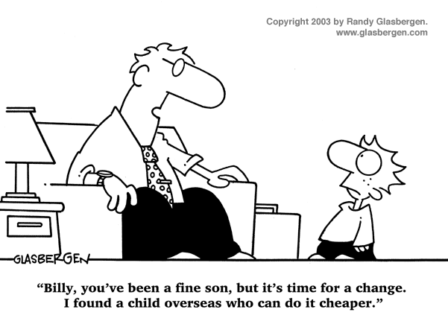
IST346: TEMPLATE

Slide 2

Agenda
Discussion
Content
Something???
Activity
Summary
Homework
Question

Slide 3
Discussion Questions
What is Virtualization? Containerization?
How does Virtualization differ from Containerization?
Explain the Pets vs Cattle analogy for computers?
What is state? What is irreproducible state?
What is Infrastructure as Code?
How does Infrastructure as code help us to treat our computers like cattle?
Notes:
Give students 1-2 minutes for each question. Its important to provide them with the opportunity to answer the questions based on the reading, labs, and assigned homework.
What is virtualizartion? What is containerization?
Pet computers are unique Cattle computers are a commodity.
State is the data and configurations which make our cattle computers pets. Irreproducible state its tied to a specific system.
IaC allows us to store our systems in a way that makes them reproducible on any hardware.

Slide 4
Course Content
Dfhkalsjdf
Asdf
Fasdhfsad
sadf

Slide 5
Essential Components of any System
Code – The functionality
Data - The inputs and outputs to that system
Infrastructure – The Software required to run the code and store the data
Code
System
Data
Infra- structure
Notes:
Before we define devops, let’s cover a few more things. Every system regardless of whether it includes data science or not consists of there components Code, Data and Infrastructure.
[READ BULLETS]
Consider our hotdog app.
The code is our algorithm to determine whether it’s a hot dog, as well as the mobile app and web api.
The data are the photos we use to train the hot dog detection model and the feedback our users give us when the model is right or wrong.
The infrastructure are the servers needed to run the back end of the web app, store the images, feedback from the users, including the function which predicts if the photo is a hot dog.
Managing the code and data are relatively trivial, but the infrastructure can be a challenge, as we’ll see next.

Slide 6
Infrastructure as Code Methodology
Treat your infrastructure as if it were code!
Store configurations, dependencies and scripts to bootstrap your systems in a source code management (SCM) system like Git.
This allows you set-up and tear down environments quickly and easily and deploy your systems in Dev, Test or Production.
Servers are commodity / utility resources, and not at all strategic.
Notes:
In the Infrastructure as Code methodology we our systems infrastructure as if it were code!
We Store configurations, dependencies and scripts to bootstrap your systems in a source code management (SCM) system like Git.
This allows you set-up and tear down environments and dependencies quickly and easily and deploy your systems in Dev, Test or Production.
In the grand scheme of things the servers (hardware and networks) are simply a commodity or utility and have no strategic value at all.

Slide 7
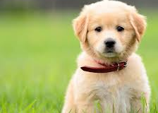
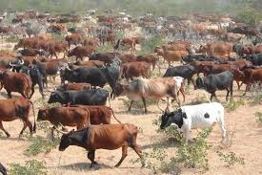
Treat Servers like Cattle, Not Pets
Pet servers
Few of them
Are given names like mail.mycompany.com
Are built to solve the task at hand (email)
When they are “sick” we “nurse them back to health”
Cattle servers
Lots of them
Are given numbers like s0045.mycompany.com
Are built to do the same thing: compute and storage
When they are “sick” we “take them out of commission” and replace with another.
Notes:
A big mantra of DevOps is “Treat Servers like Cattle, Not Pets” It’s important to recognize we’re talking about HARDWARE here not the applications running on the hardware. We want the underlying infrastructure to be a commodity of storage network and compute . So the when we can design our application so that it is free to scale. The big internet companies like Google, Facebook, and Yahoo learned this early on.

Slide 8
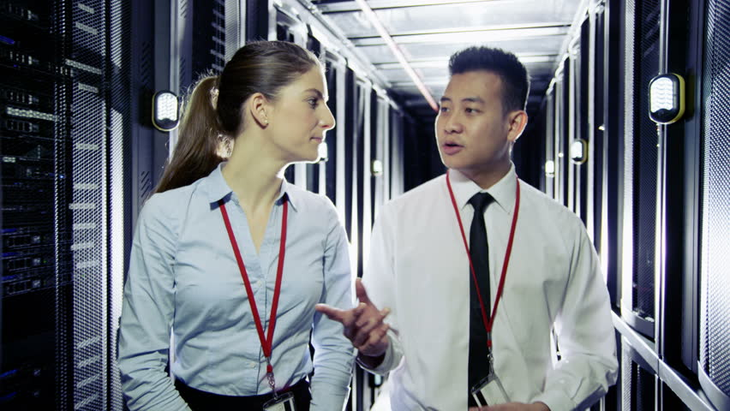
Which one of these runs our email?
Any of them!
Notes:
When you have this mindset, you’re ready for DevOps.

Slide 10
Group Activity
Perform some group activity

Slide 11
Details of Group Activity
Fsadghsadfasd
Fsadgfsad
fashdfas

Slide 12

Your To-Do List
What to work on for next class
Notes:
ALWAYS CONSULT THE SYLLABUS

Slide 13
Exit Ticket
Exit Ticket Question – One thing you learned today, etc…

Slide 14

Questions?

