Slide 1
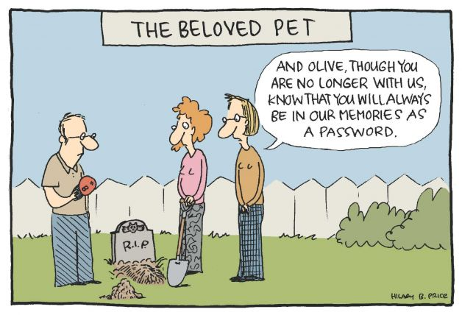

IST346:
Information Security Policy
Monitoring and Logging

Slide 2
Today’s Agenda
Overview of Information Security
SA Activities Surrounding Information Security
Incident Management
System Monitoring and Logging

Slide 3
An overview of Information Security

Slide 4
Security is the relationship among
Assets
Vulnerabilities
Threats
What you’re trying to secure
What you’re securing from
Your weaknesses

Slide 5
Assets
The user’s identity – login account
Network bandwidth – denial of service, bot-nets
Storage / Disk space - warez
Data – the most important asset of them all
Reputation – one incident can ruin a reputation.

Slide 6
Vulnerabilities
Bad default, or weak passwords passwords.
Unused services with open ports.
Un-patched software vulnerabilities.
Transmitting data in clear text.
Open networks
Physical access to systems.
The users themselves

Slide 7
Vulnerabilities - Social Engineering
The human element of security
Users are the weakest link
Preys on people’s inherent trust in others
Kevin Mitnick - Famous Hacker
Author of “The Art of Deception” and “No Tech Hacking”
One of his many social engineering stories
http://www.youtube.com/watch?v=8L76gTaReeg

Slide 8
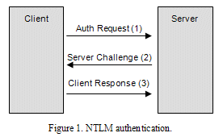
Vulnerabilities - Pass the Hash
Hacking technique that allows an attacker to authenticate to a remote server/service by using the underlying NTLM hash of a user's password, instead of requiring the associated plain text password as is normally the case.

Slide 9
Threats
Financial motives
Identity theft
Phishing
Spam
Extortion
Botnets
Political motives
Danish sites hacked after Mohammed cartoons.
Personal motives
Just for fun.
Insider revenge.

Slide 10
Goals of Security:
Data Protection
System Integrity
System Availability
Data Integrity
Keep data safe
Keep data accurate
Keep systems operational
Keep systems accurate
“To protect and to serve your systems and data.”

Slide 11
Can you beat “them”?
Indefinitely – No. The odds are against you.
One in the “herd“ will be lost due to:
Software exploit
Bad practice
Dedicated Hacker
All servers shouldn’t be lost.
Why?
You don’t choose all of the applications that run in the env.
You don’t write all of the applications that run in the env.
We aren’t all security experts
Compromise – it happens.

Slide 12
Reducing Risks

Slide 13
What we can do?
Defense in Depth
Secure systems at all levels:
OS hardening
Application Hardening
Network Segmentation
Detection of changes
Credential Security
Encrypting data/traffic
Log aggregation (prevents covering of ones tracks)
Review Logs regularly
Security scanning (open ports, suspicious activity)
Security audits (physical, credentials, permissions, pen-tests)
Notes:
Tyranny of the defaults

Slide 14
OS / Server Hardening
Secure the physical system.
Install only necessary software.
Keep security patches up to date.
Delete or disable unnecessary user accounts.
Use secure passwords.
Disable remote access except where necessary.
Setup least privilege access.
Run publicly accessible services in a jail.
Configure firewall on each host.
Document security configuration.
Secure password management.
Use secure management endpoints
Using a management framework (AD?)
Reduce/Remove elevated credentials

Slide 15

Reducing/Removing Elevated credentials
Limited User < Local Administrator < System
Credentials are in Memory
Log Off
Clear text Passwords
Password Hashes
15+ char.
Service configuration
Creating specialized service accounts
Limited users preferred, Local Administrators are a compromise
Don’t run services as your “admin” account

Slide 16
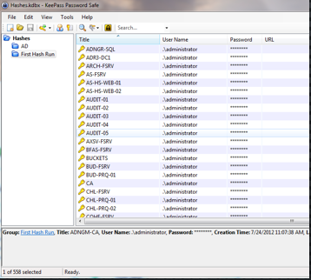
Credential & Password Management
15 + Characters
Length > Complexity
What do you mean password management?
There are two common password management Methods…
Consistent Passwords Reuse
Efficient for you and a Hacker
Passwords are written down
Where?
Is it Encrypted?
DR?
Alternatives - Unique random passwords
USB with Secure Password storage, 2nd factor using Encryption
Rubric – “decoder ring”
Beware of “homemade” hashing functions

Slide 17
Encryption – what is this?
Unencrypted data is called plain text ;encrypted data is referred to as cipher text
Encryption is the conversion of data into a form, called a cipher text, that cannot be easily understood by unauthorized persons or systems.
Decryption is the process of converting encrypted data back into its original form, so it can be understood.
To read an encrypted file, you must have access to a secret key or password that enables you to decrypt it.

Slide 18
Encryption - SSL
Offers secure transmission between client and server at the lowest level – socket level, sits atop TCP.
Two types:
Self-signed – certificate created by the host/service you are connecting to.
CA issued – an intermediate Certificate Authority issues a certificate that both the server and client “trust”
Certificate Authorities can be both public and private.
*Internet-based services ultimately require a Public CA to assure a proper trust chain be established.
Intranet-based services can utilize a Private CA as the trust can be established within the organization.
*Clients trust public CAs if they are able to obtain their public key in the browser certificate store.

Slide 19
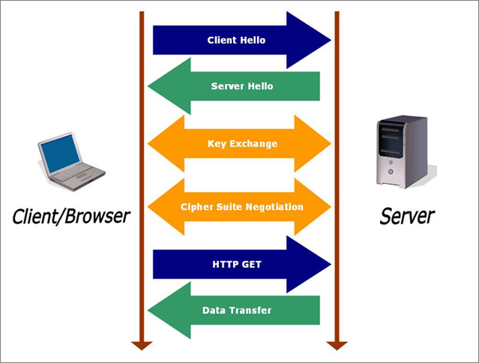
SSL – how it works on the web
Client request
Server response
Key exchange
Cipher negotiate
Client http get
Data transfer

Slide 20
Defenses
Vulnerability mitigation
Use secure authentication systems.
Deploy software in secure configuration.
Patch security flaws quickly.
Restrict physical access to systems
Attack mitigation
Firewalls to prevent network attacks.
IDS to detect attacks.
Virus/spyware scanners.
Disk Encryption
Two-factor authentication
System Administrator & User Education and Awareness
Prevent Social engineering
Prevent Credential Theft

Slide 21
Two-Factor Authentication
Example factors are:
Something the user knows (password, PIN)
Something the user has (token, smart card, cell phone)
Something the user is (biometric characteristic, Physical Location- GPS)
RSA Secure ID, Google Authenticator, Duo Security
Differences?
RSA – Type your full password prior to Logon
Smart Card – don’t type your password, just a PIN
Still In Memory on the Destination

Slide 22
Considering the pivot Points
Pivoting
They will be inside the Datacenter
They will be looking for the next Hop
When a server is hacked – what else will fall?
Does this server NEED to talk to anything else?
What’s on it?
What could it be used for?
Do you have any other lines of defense?

Slide 23
Security Policy / Incident Reporting

Slide 24
Security Policies
User Level Policies
Users must sign before receiving resources.
Acceptable Use Policy
Monitoring and Privacy Policy
Remote Access Policy
Business Level Policies
Network Connectivity Policy
Log Retention Policy

Slide 25
What is an Incident?
Any violation of security policy:
Unauthorized access of information
Unauthorized access to machines
Embezzlement
Virus or worm attack
Denial of service attacks
Email spam or harassment

Slide 26
Incident Response Goals
Determine if a security breach occurred.
Contain intrusion to prevent further damage.
Recover systems and data.
Prevent future intrusions of same kind.
Investigate and/or prosecute intrusion.
Prevent public knowledge of incident.

Slide 27
Monitoring and Logging (Security-focused)

Slide 28
Something we do to Services
Service Monitoring
Service Logging
Observing service activity in real-time
This is done by a computer, not a human.
Important events are passed on to a human (notification).
Keeping a historical records of service activity
This data grows over time and can become quite large.
Only referred to when needed to troubleshoot a problem or trace down a security incident.

Slide 29
Why Bother?
Why do we Monitor?
Why do we Log?
To detect / identify security incidents.
To find out when someone accesses a service that is not supposed to.
To determine if actions need to be taken.
Help to find out the extent of a security breach.
Help us predict security attacks.
Provide historical data or trends.
Report on suspicious activity.
If you’re not measuring it you aren’t managing it

Slide 30
How Monitoring and Logging Work
Server
Log
Access Info
Service
Network Activity
Internal Service Monitor
External Service Monitor
Security Event
Security Event
SA

Slide 31
What to Monitor, what to Log?
Monitor for a condition.
Send alert when the condition is met.
Log the condition whether it sends an alert or not.
Examples: (Why would you monitor/log these?)
User accesses financial database that is not a member of that department.
User attempts to login 50 times in 2 minutes.
User logs in from IP addresses originating from multiple countries (in a short time span)
Unusually high traffic to a service from multiple locations.

Slide 32
Better Security Monitoring
Normal
Normal: When a security incident occurs, you send an alert.
Proactive Monitoring
Proactive: When a user has attempted to login multiple times, send an alert and disable their account for 10 minutes.
Automated Responses
Normal: When an incident occurs, you send an alert.
Automated: When the user has had multiple failed login attempts, disable their account for 10 minutes and send the user and the admins an alert. If this reoccurs, disable the account until further investigation by a human.

Slide 33
Questions?
Security fail (from an actual website):
In addition to your password, please set a passphrase: What is your preferred internet password?

