Slide 1
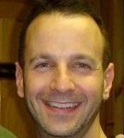

IST346 – Information Technology, Management, and Administration
Instructor:
Tim Jorgensen
tajorgen@syr.edu
t. 315-280-8465
o. 214 Machinery Hall
Our class Teaching Assistant | Course: http://blackboard.syr.edu Labs: http://ist346.syr.edu Contact information on Blackboard

Slide 2
About your Instructor
Education
Syracuse University BA program in Arts 1993-1997
BS/MS in Information Management at iSchool (in progress)
Microsoft Certified Systems Engineer
Employment
20+ years in the IT field.
10 years as an IT consultant, designing infrastructure needs for various corporations across the country
9+ years at Syracuse University, currently employed as a senior IT Analyst (glorified term for System Architect/Administrator)
Teaching IST346 this term

Slide 3
What will we learn in this course? (in no particular order)
IT Organizations
What is systems administration? Why is this person important?
How are IT shops organized; how they operate
The basics of the Windows and Linux operating systems: How to
Configure and manage them in a corporate environment
Setup and configure services to run on these operating systems
Diagnose, and debug problems with systems
Make different platforms interoperate with each other
The managerial aspects of administering IT
Planning for new systems and services
Conducting a thorough analysis of IT infrastructure, TCO and ROI calculations
Disaster recovery, Data Integrity, Data Centers, Ethics
With plenty of anecdotes and personal experiences from your instructor, of course. ☺

Slide 4
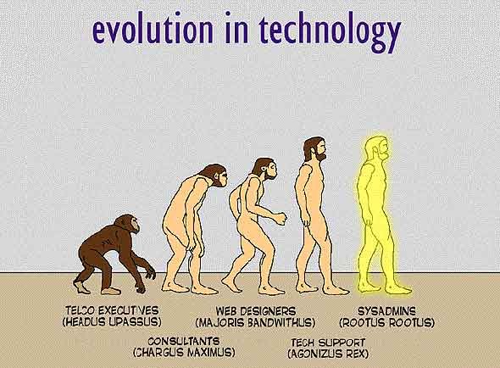
A SysAdmin, in a Nutshell

Slide 5
“Theory to Practice” Ratio for IST346

Slide 6

Course Materials
Optional - The Practice of System and Network Administration: 2nd Edition, Limoncelli, Hogan, Chalup. ISBN (13): 978-0-321-49266-1, ISBN (10) 0-321-49266-8
Various online articles and videos as assigned by your instructor

Slide 7
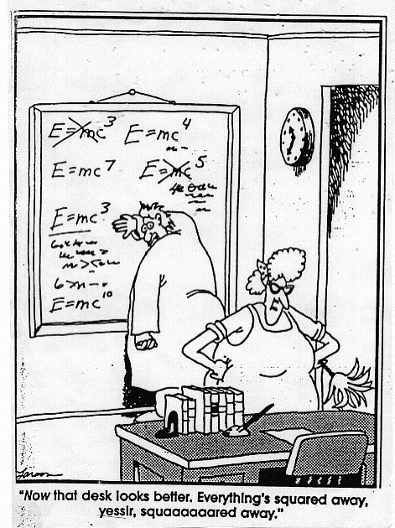
https://blackboard.syr.edu
All of the course content from class lectures and labs are here.
You will hand in your deliverables in class or via Blackboard as instructed.
Assignments will not be emailed directly.
I will contact you using the Blackboard and email, so be sure to sign in frequently.

Slide 8

Blackboard feature tour
Blackboard = our class Learning Management System
What will we use this for?
Announcements
Assignments
Course Content (weekly modules)
Course information (syllabus, outline, contacts)
Readings
Discussion boards
Grades
Groups

Slide 9
Methods of Evaluation
Assessment | Quantity | Notes/Due Dates | Points Each | Points Total
Lecture Participation | n/a | Class attendance and participation in lecture topics. Unexcused missed classes will result in deduction of final letter grade, details outlined in course syllabus. | n/a | n/a
Quizzes | 12 | Q01-Q12, due each week to recap previous week's topics. Completed before end of the week. | 12 | 120
Labs | 10 | Practical labs, work on in class on scheduled lab days. Lab Deliverables(L01-L10) assigned for some to be completed before start of the following class. | 10 | 100
Exams | 2 | 2 Exams, E01-E02. Completed in class only on dates assigned. | 50 | 100
Lab Practical | 2 | 2 Lab practical exams, LP01-LP02. Completed and submitted by dates assigned. | 30/70 | 100
Research Project | 1 | Project deliverables, P01-P03. To be submitted by 11:30 pm on dates assigned. | 80 | 80
 |  |  | Total: | 500

Slide 10
General Course Policies
Anything handed in with the exception of quizzes and lab deliverables must be submitted before the day’s end. (by 11:30 pm on the day it’s due)
All due dates are posted on the Course Outline, please plan accordingly.
No make up work will be permitted.
No late work is accepted
Show up before attendance is taken or you will be marked absent
Class attendance and Lecture participation is easy, and it can impact your final grade negatively. (every 3 absences recorded reduces your final letter grade, ex: an “A” becomes an “A-”)

Slide 11
Quizzes
Issued online after Lectures for the week are completed.
Should only take 10-15 minutes.
Individual effort. Work alone.
Quizzes are timed, so use any reference materials you desire, but be mindful of the time limit.
I’m not trying to trick you, just ensure you’re keeping up with the required readings.
Anything covered in class or assigned outside of class is fair game for the quiz.
Quizzes are due before start of the next week (Sunday evening).
No make-ups for quizzes as you are given several days to completed them each week.

Slide 12
Labs
Lab dates are marked on the course calendar. We meet in the lab on those days.
Individual effort. Work Alone.
Most labs have a deliverable, which is a script that checks your work and emails me the results.
Lab deliverables are assigned on the day the lab is assigned, but due before the start of the next week’s lab.
You are responsible for completing lab work outside of class if you are not complete it during the designated time.
No make-ups, or late labs are allowed.

Slide 13
Exams and Lab Practical
In-class deliverable; Individual effort
2 Exams, 2 Lab Practical Exams
Exam dates posted on course outline.
All dates are firm so plan accordingly.
Exams are a culmination of lectures to date.
Lab Practical is a culmination of lab work to date. You will have to apply what you’ve learned in the labs to complete the lab practical.
A portion of the lab practical will need to be completed before the lab practical date.

Slide 14
Project Overview
Out of class deliverable
Project work done in groups of up to three. You get to choose your partners, but they will be chosen for you if you are unable to make this decision.
Once groups are chosen they are locked in for the Semester, so choose your partners wisely.
You will have to research topics assigned to your groups in detail and present these to the class.
Details will be posted to blackboard.

Slide 15
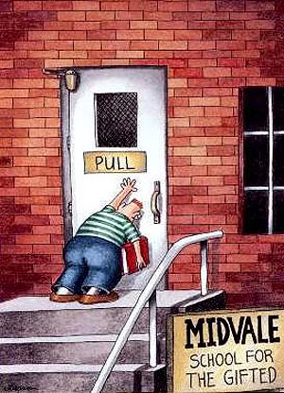
Recipe for course success!
#1 Keep and eye on those due dates!
#2 Come to class prepared.
Read and review the required materials before class
Make the most of your face time with me
The course build upon itself so if you fall behind you will get lost quickly
#3 Take an interest in the course material
Be passionate; have fun.
How does it apply to your career? everyday life?
How can you put the knowledge you learn in class to practice outside of class?
#4 Ask for help instead of falling behind!

Slide 16

This week’s deliverable – breaking the ice
After class…introduce yourself on our Blackboard discussion forum (this is counts towards class participation)
To find this, click “Discussions” on the left navigation pane in this course, and reply to the thread under the “Introductions” forum.
Your Name
And what you’d like to be called (title)
A Photo
Notes field: Year (Fr, So, Jr, Sr.) Hometown Why you chose this Major? Some interesting tidbits about yourself Any Operating Systems you’re familiar with: Windows, Linux, OSX, etc…
Technology-oriented website that you visit regularly

Slide 17
Questions?
Why is the person who invests all your money called a 'broker'?

