Slide 1
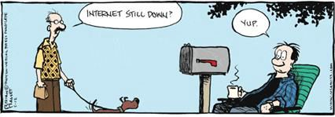

IST346:
Networking Fundamentals

Slide 2
Agenda
What is a Network?
Common network devices
Core networking services
What is TCP/IP
What is a Protocol
What is DNS
What is a Gateway
What is a Subnet
Common Utilities

Slide 3
What is a network?

Slide 4
Computer Network Definition
A computer network is two or more computers connected together using a telecommunication system for the purpose of communicating and sharing resources.
A connection between any two communicating devices (computer and printer, for example) could also be considered a network.

Slide 5
Why do we need a network?
To communicate and share resources (files and peripheral devices) between multiple computers
To connect to other networks (Internet)
Question: What would you do today with computers that are not networked?

Slide 6
Typical resources to share
Internet connectivity
Printers
Storage
Email
Website content
Databases
Audio/video

Slide 7
Typical network components
Computers
Hubs
Switches
Routers
Firewalls
Network interface cards (NICs)
Wireless access points (WAPs)

Slide 8
Network Interface Card (NIC)
A circuit board or card that is installed in a computer so that it can be connected to a network.
Provides the computer with a dedicated, full-time connection to a network.
Can employ wired and/or wireless network connectivity.

Slide 9
Wireless Access Point (WAP)
Networking hardware device that allows a Wi-Fi compliant device to connect to a wired network.
Typically connects to a router (via a wired network) as a standalone device, but it can also be an integral component of the router itself.
A WAP is different from a hotspot, which is the physical location where Wi-Fi access to a WLAN is available.

Slide 10
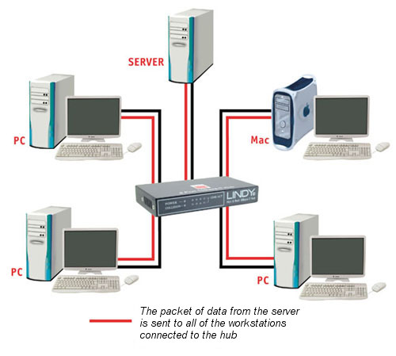
Hubs
Connect multiple Ethernet devices together
Hubs merely repeat signals out to all other ports (broadcast)
Inexpensive, simple way to connect computers
No smarts, unmanaged

Slide 11
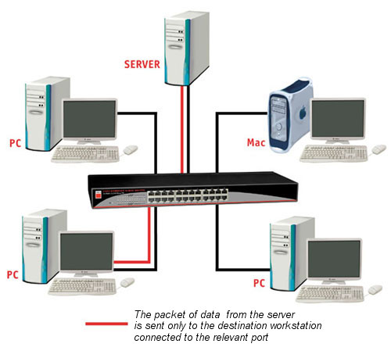
Switches
Connect multiple Ethernet devices together
Switches isolate ports by passing only data meant for that port.
Filters data packets, and only sends to the port which is connected to the destination address.
Offer a variety of management options.

Slide 12
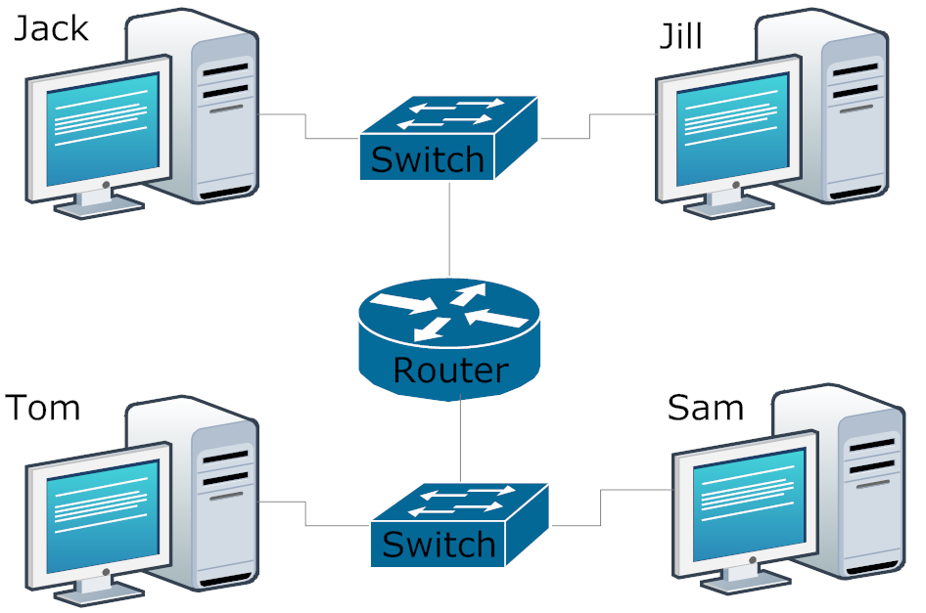
Routers
Act as a junction between two networks, and transfer data between them
Routers do most of the hard work on a network
They make decisions about where all messages travel on a network and whether to pass them between various networks.
They “bridge” different networks together.
Can provide additional networking features, i.e.
DHCP
NAT
DMC
Firewall
VPN

Slide 13
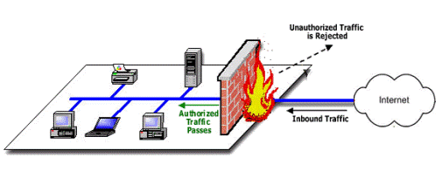
Firewalls
Filter messages or keep users and devices out of private networks.
Keeps unwanted traffic from reaching specific computing devices (inbound firewall)
Also can keep devices from talking to anything but their desired networks and/or devices (outbound)

Slide 14
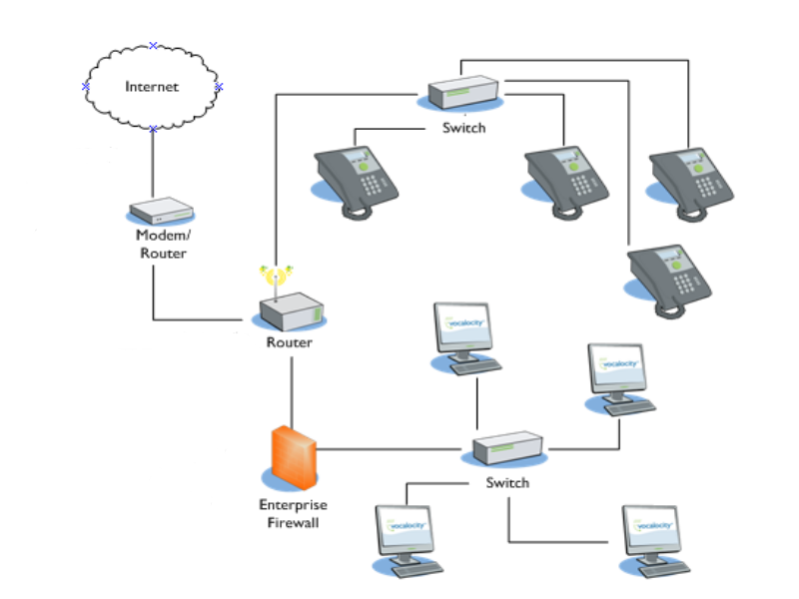
Network Component Overview

Slide 15
Core Network services

Slide 16
What is a Protocol
Standard used to define a method of exchanging data over a computer network
This defines a set of rules that end points on networks use when they communicate.
Commonly used protocols include:
TCP/IP
HTTP
SMTP

Slide 17
TCP/IP
Transmission Control Protocol/Internet Protocol
Basic communication language or protocol of the Internet.
Also be used as a communications protocol in private networks.
Allows computing devices to send messages to or get information from others that utilize TCP/IP.
Two parts
Upper layer - Transmission Control Protocol manages assembling of messages into smaller packets for transmission.
Lower layer – Internet Protocol, handles the address part of each packet so that it gets to the right destination.

Slide 18
IP Address – IPv4
Required for modern computers to send and receive data across a network.
Allows computers to find the destination of another computer or device.
A unique address that devices use to identify and communicate with each other on a network
Format of xxx.xxx.xxx.xxx, where xxx is 0 to 255
192.168.0 is a class C subnet (containing 255 addresses)
192.168.0.10 is an address of a specific device on that subnet
A subnetwork or subnet is a logical subdivision of an IP network.
Utilizes 32bits for internet addresses
Allows 4.29 billion possible unique addresses

Slide 19
IP Addresses – Public vs. Private
Two basic classifications of IP addresses exist
Private
Not accessible on the internet
Typically hidden behind devices with a public IP address (NAT or Router)
Used for devices on private networks that don’t need to be communicated with (inbound) on the internet
Ex: Desktops, laptops, printers, etc…
Public
Accessible anywhere on the internet (pending any firewall restrictions)
Used for devices that need to be reachable on the internet
Ex: Web servers, Email servers, etc…

Slide 20
IPv6
As the Internet and technology evolve, demand for IP addresses increases.
To resolve this demand, there are two types of addresses used today, IPv4 and IPv6.
Likely will only deal with an IPv4 address in your local home, school, or small office.
IPv6 is the sixth revision to the Internet Protocol and the successor to IPv4.
Similarly to IPv4, providing unique, numerical IP addresses necessary for Internet-enabled devices to communicate.
Utilizes 128-bit addresses, providing more addresses to use.
Example of an IPv4 address:
45.79.151.23
Example of an IPv6 address:
2601:681:4200:c5c0:516:f0bb:ac3b:46bd

Slide 21
Common Network Services
DHCP – dynamic host configuration protocol
Service that automatically assigns IP addresses to connecting devices
DNS – domain name services
Allows translation of names to IP addresses.
Clients use DNS caches to store recently obtained Name/IP Address pairs.
NAT – network address translation
Allows a router to present a single IP address to the Internet.
Keeps private networks private, while still able to communicate with external resources.

Slide 22
Common Tools

Slide 23
Commands Everyone Should Know
Ipconfig / ifconfig
For retrieving IP configuration of a device
Ping
To test communications with another device on a network.
Nslookup
To resolve an IP Address to a DNS Name
Nmap
To test open TCP ports on a network endpoint
Tracert (traceroute)
For tracing the entire path a packet traverses to reach and endpoint
Netstat
For viewing all active communications (inbound and outbound).

Slide 24
Questions?
Text here

