Slide 1
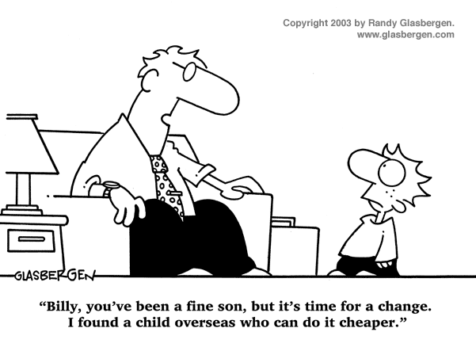

IST346:
Centralization / Decentralization

Slide 2
Centralized vs. Decentralized IT
What is the difference?
Centralized: one focus of control
Decentralized: many focuses of control
SU is currently both a centralized and decentralized IT organization
What can you think of that is centrally controlled?
What can you think of that is controlled within individual colleges or departments?

Slide 3
Classic Arguments for Centralized IT
Some advantages of centralizing IT processes
Possibly Improved efficiencies (reduced costs) by having standards and “economics of scale”
Consolidation: consolidate services onto fewer hosts (either via virtualization or not)
Specialization: staff can specialize on one or a few tasks and become an expert at them vs. a decentralized staff being fair to good at a broader range of tasks

Slide 4
Classic Arguments for Decentralized IT
Improved response times to customer requests and better meeting customers needs. Better customer service.
Taylor IT to the specific area(s). Create customized solutions that can make the organization more competitive.
Less single points of failure. Distributed systems do not suffer from the ‘all eggs in one basket’ issues.
Many units may not need ‘enterprise’ class IT features which many centralized IT organizations require.
Examples include:
Commodity storage vs. large fiber channel SAN’s.
Disaster Recovery techniques may differ if you’re running 100 virtual machines vs. 1500 virtual machines.

Slide 5
Why Not Do Both?
Centralize some of your common services
“Lowest Common Denominator” services (common to everyone)
Email
IP space
ERP systems (at SU we use PeopleSoft)
Active Directory or authentication services
Decentralize specific needs
Faculty support (not all faculty members require the same thing)
Specialized departmental support that may have special needs
Dining centers, Dome offices, etc.. (non standard hours of operation)
In a decentralized organization, try to adopt some classic centralized attributes
Bulk PC / Server purchases (we do this at SU)
Organize some information sharing functions and discussion making processes.
Build an expert(s) list. Through contacts / networking, discover who might be a expert in a specific subject area.

Slide 6
Outsourcing
Selecting a company(ies) that can provide a specific task(s) to your organization. Idea is that they specialize in the(se) tasks and as such, cost less than if you had to do this yourself.
Be very specific on the contract. Always have a way out if it isn’t working for you.
Create metrics or ways of measuring vendor success or failure.
Do research with your ‘peers’ on how they are dealing with the problem. Get referrals and follow up.
Off-shoring is a term for outsourcing when you outsource over-seas.

Slide 7
Summary
De-centralized IT vs. Centralized IT can co-exist together as long as each group knows that it is responsible for.
Both Centralized IT and De-centralized IT have advantages and disadvantages
Outsourcing IT is possible. Get good contract in place!
Off-shoring it outsourcing over-seas.

Slide 8
Questions?
If a man with multiple personalities threatens to kill himself, is it considered a hostage situation?

