Slide 1


IST346:
Data Centers

Slide 2
Data Centers
What is a datacenter?
Page 129, “ a data center is a place where you keep machines that are a shared resource”
A.K.A
Server room
Machine room
Server closet (hopefully not literally a “closet”)

Slide 3
Data Centers - Options
Build
Rent
$100 - $400 per square foot to build
This is known as a “co-location Facility”
IaaS
Paas
you don’t care about the physical servers, just the services running on them. Everything you do is for the services.

Slide 4
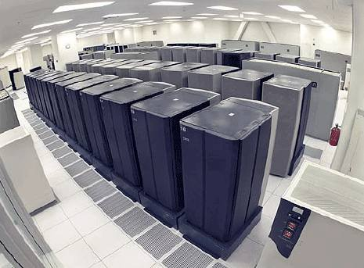
Data Center- Major Components
What makes a data center more than just a closet with a bunch of servers?
Location
Access
Security
Power, Cooling, Humidity
Fire Suppression
Racks
Cable Management
Communications
Console Access
Workbench
Tools, parts, etc

Slide 5
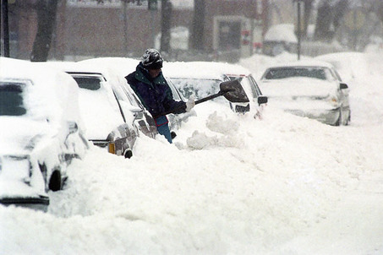
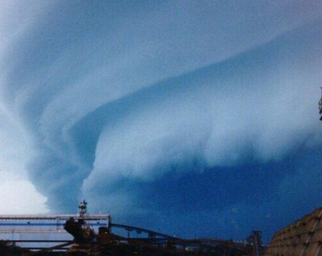
Location
Talking geography and on site.
If your area is susceptible to flooding, don’t put your data center in the basement.
“One company I’ve read about has two data centers, one in Florida and one in Colorado. They change primary data centers every 6 months.”
Why?
Florida → hurricanes
Colorado →snow storms.

Slide 6
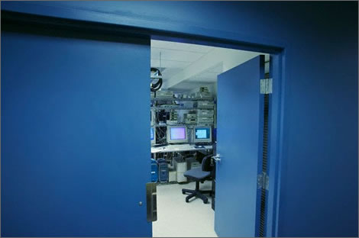
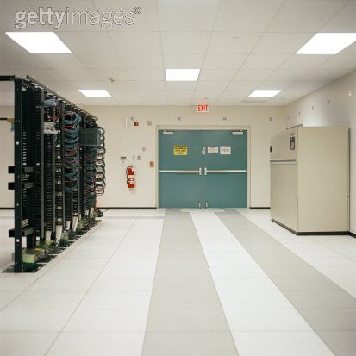
Access
What type of access is required?
Wheelchair, ramps, loading docks to unload equipment?
Some equipment is wider than the average sized door. Need double-doors.
Restrict access to people who don’t need it.

Slide 7

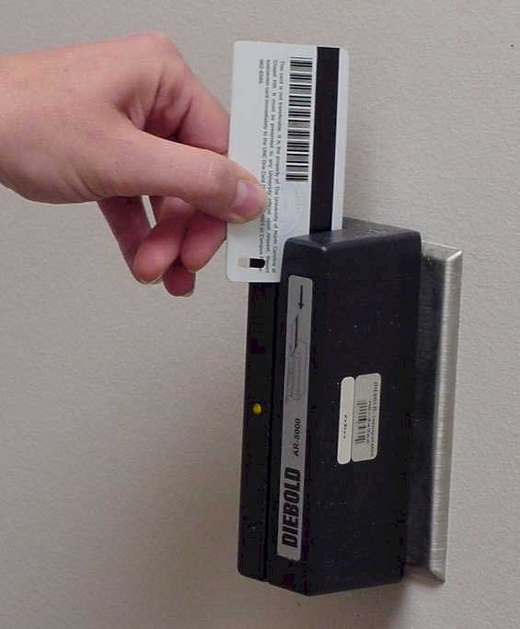
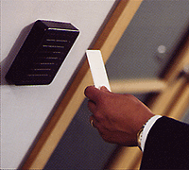
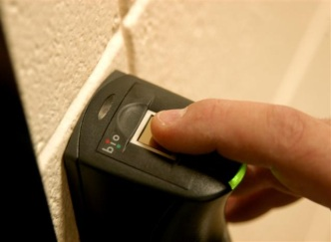
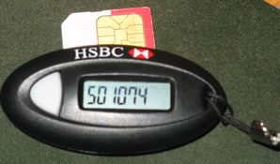
Security
What type of security do you require?
Numeric key pads – bad idea. Anyone can share the code. No way of knowing who came in.
Keys, - better, at least you know who you gave the key to originally
Card swipes – even better, logs entry information and controls access
Proximity detectors – better still, same advantages as card swipes but more convenient
Biometrics – almost there. Thumb print reader or voice recognition. Disadvantages ?
Two Factor, -best, something you have and something you know. A numeric keypad that requires both a static or non-changing code and a one-time-password security token.

Slide 8
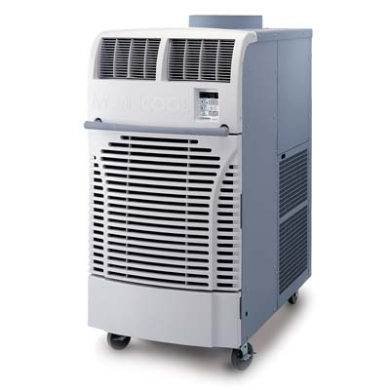
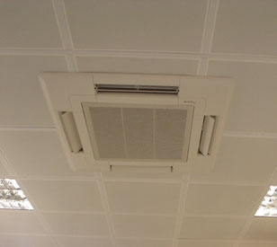
Cooling
For every watt of power used in the data center, you need to plan for the same amount of power to cool your equipment.
Direct your cool air where you need it
New types of cooling concepts, “cool the servers, not the entire room” (SU Green DC)
Rear door heat exchangers. Cools only the servers and not surrounding room air. Most efficient.

Slide 9
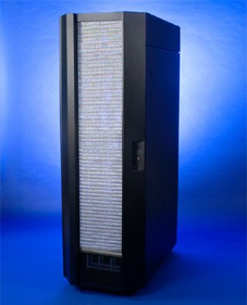
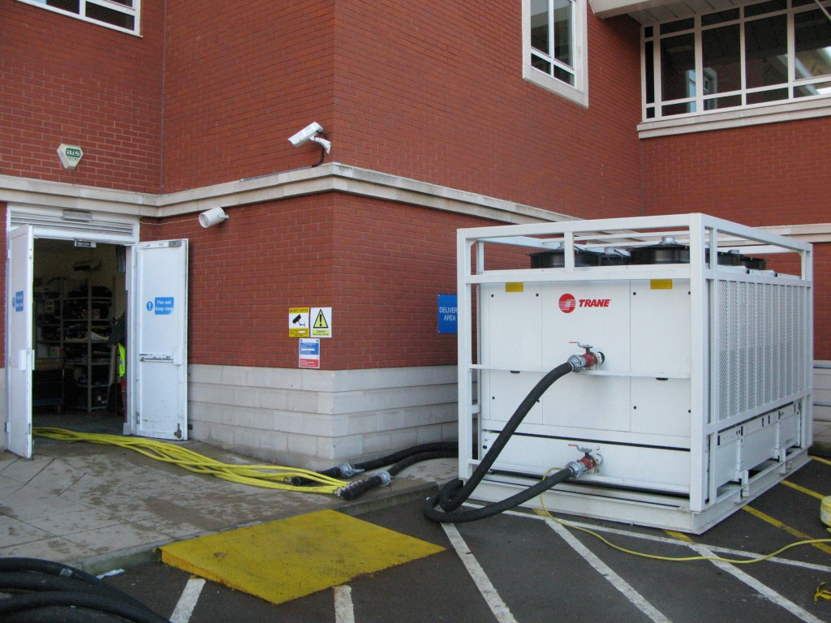
Large Data Center Air Conditioner and Rear Door Heat Exchanger

Slide 10
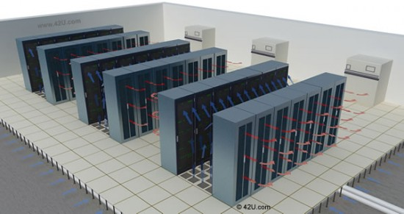
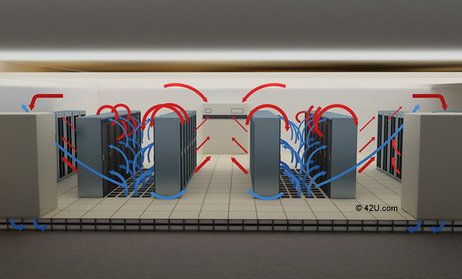
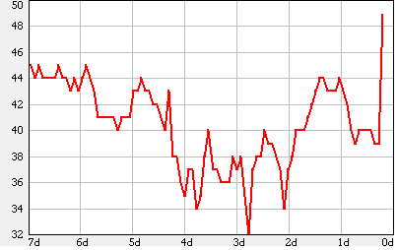
Hot and Cold Isles and Humidity
Cold air goes in front of rack, heated by server, exited out back.
Arrange your data center so the backs of the racks are towards each other. This forms hot and cold isles.
Easier to collect the hot air. Heat rises.
Keep server room humidity between 45% - 55%. Too low, static, too high, condensation.

Slide 11
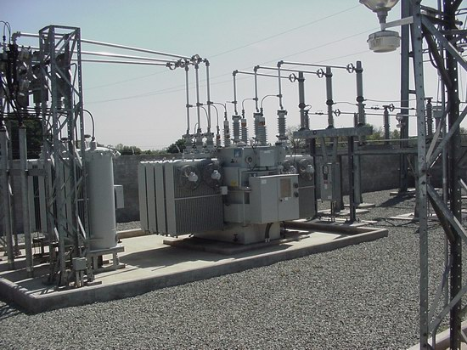
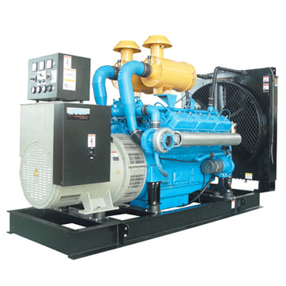
Power
Multiple sources of electricity.
Multiple feeds from multiple substations.
Generator, not only for emergencies but also for normal operations.
What type of power does it produce, do you need? 110V, 220V, 480V?
Discussion is driven by what type of power your servers require. Not all servers require 110V “standard line power”.
Can you use DC power? 240 Volts? More efficient than 110V. Save up to 4% in electric usage.
Be “Green” in your data center. Where does your electricity come from?

Slide 12
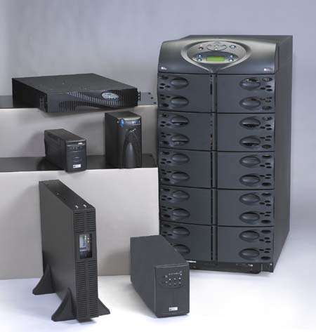
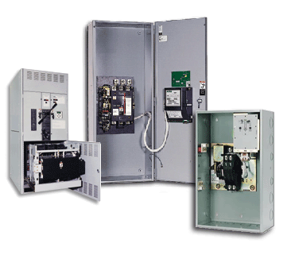
Power
Do you have a Uninterruptable power supply (UPS)? How big?
How long does it need to last, 10 minutes, 1 hour, 4 hours?
Varies depending if you have a generator or not.
Do you have automatic transfer switches, (ATS)?
Switches that ‘sense’ if line power or in Syracuse, National Grid power if present, and if not, automatically starts generator and transfers load. When line power returns, shuts off generator and returns load to line power.

Slide 13
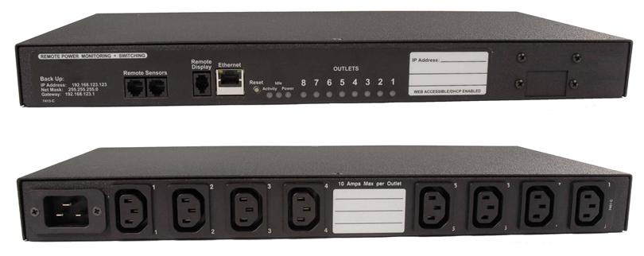
Power Distribution Unit (PDU)
Looks like a power strip, much more.
Can be horizontally or virtually mounted
Monitor, record, and control each outlet remotely via network.
Should have two per server, one connected to line power and one connected to UPS / Generator power
A PDU is not a UPS. They’re different.

Slide 14
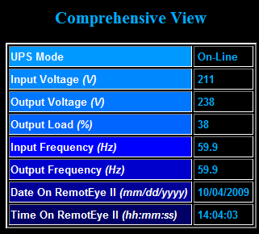
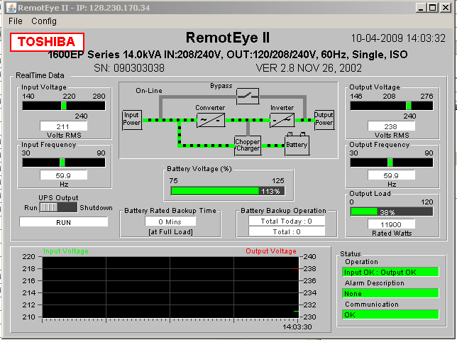
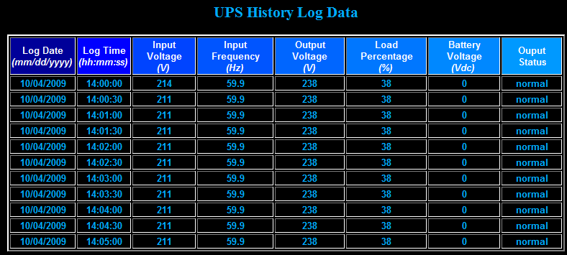
Monitor your Power

Slide 15
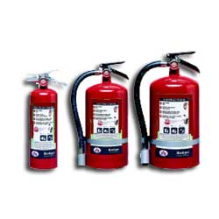
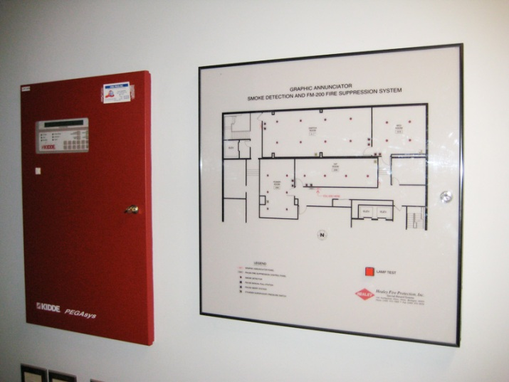
Fire Suppression
Require Fire suppression methods; required by law /code
Conventional (Water and Sprinklers) = Bad
Many other methods
CO2 & Halon, good for servers, bad for people
Conventional extinguishers
Consult local fire authorities
Cost plays a large factor.

Slide 16
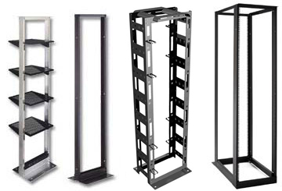
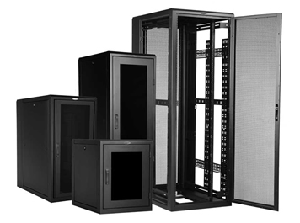
Racks
The ‘spine’ of the data center
Dictate other components
Wiring, cooling, power, etc
Not inexpensive, up to $10,000 per rack with required products (power, cooling, networking, etc)
Standard 19” wide, width of standard mountable equipment. 19” between posts.
Some telecomm equipment is wider. Special order
May purchase racks wider and deeper than your needs as to leave room for networking, power, cooling, etc.
2 or 4 posts
4 is better but more expensive.
Rack equipment in U’s or rack units,
1.75 inches per “U”
Can use square nuts or screws to mount equipment

Slide 17
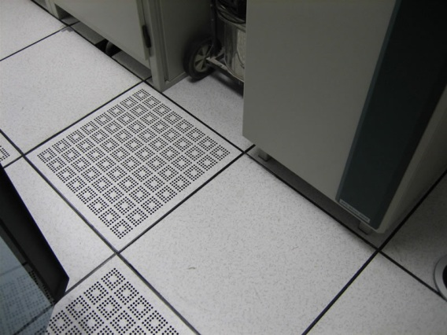
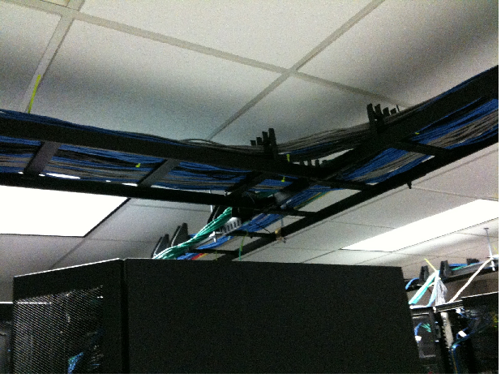
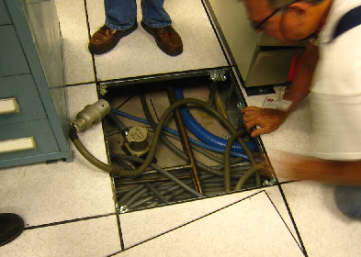
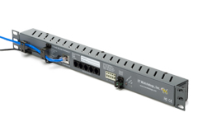
Rack Cooling
Racks are typically open at the bottom to allow cool air to flow in.
Heat rises exits out the back
Not a location to run wires. Run cabling overhead with above-the-racks wire trays
Keep doors and sides on if using raised floor, off it using standard air-conditioning
Monitor temperature inside racks
iSchool uses a device called “Weather Goose”

Slide 18
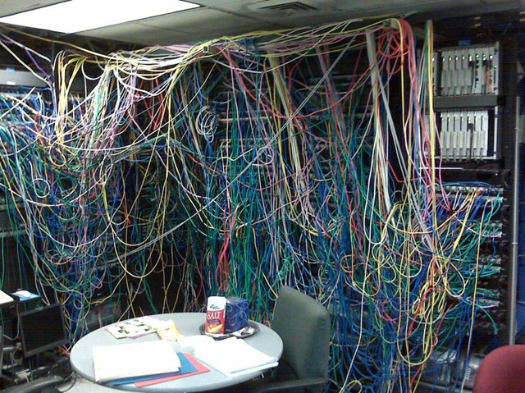
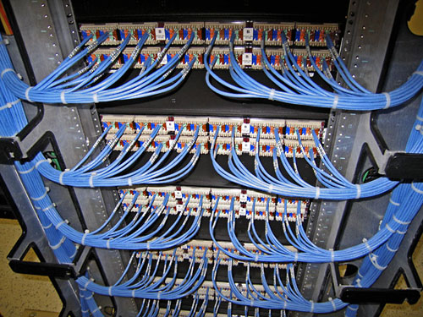
Racks Determine Cable Management
A good cabling job is a pleasure to work with.
Don’t ‘build-your-own’ cables. Purchase cat6 (category 6) cables.
Purchase special cable management products.
Easily identify which cable connects to what.
Color code or label your cables
Separate power from network cables. Power down one side, network cables down the other

Slide 19
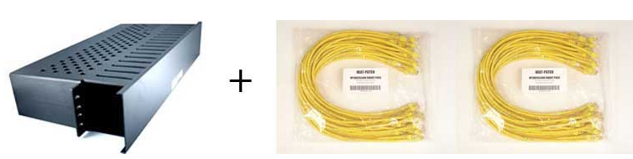
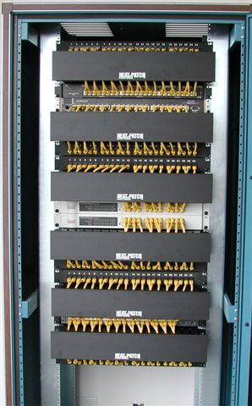
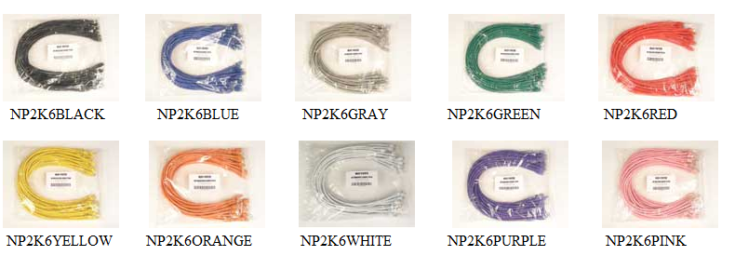
Cable Management Images

Slide 20
Come up with cabling Guidelines
Blue / Green – production network
Red / Orange – storage network (iSCSI)
Yellow – KVM
White – Private NAT

Slide 21
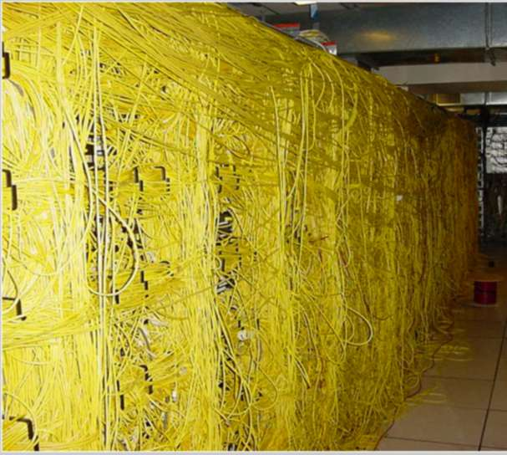
And why do we need cabling guidelines?
Bob, can you connect the email server to the new storage device, it’s the yellow wire.

Slide 22
Communications
Put a telephone in your server room incase you need to call someone in for assistance or be speaking with a vendor while standing in front of the server.
“Bridge” the telephone line into a infrequently used circuit to save money.
Don’t rely on cell phones. Can be difficult to hear plus more interference in server room.

Slide 23
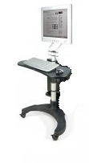
Console Access - KVM
Discussed already
In-band vs. out-of-band management
KVM usage
If no KVM or out-of-band management, consider using a ‘crash cart’ or setup cart.
Basically a vertical cart with a keyboard, mouse, and monitor used when 1st setting up servers or if they crash so bad you can’t use other management techniques

Slide 24
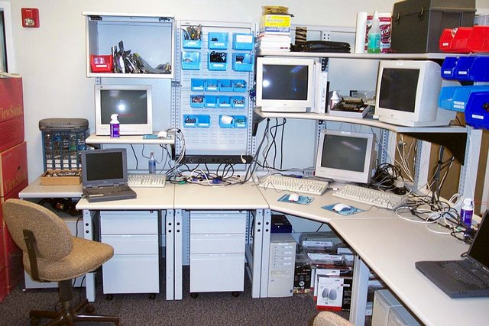
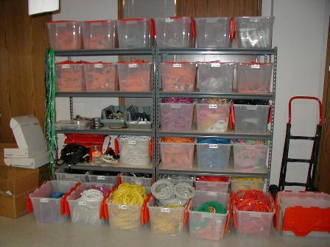
Workbench, Tools, Parts
Have a place where your staff can test out or ‘burn in’ a server before putting it into production.
Place to troubleshoot failed servers
Have extra patch cables, nuts, bolts, “spare parts” on hand.

Slide 25
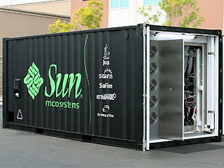
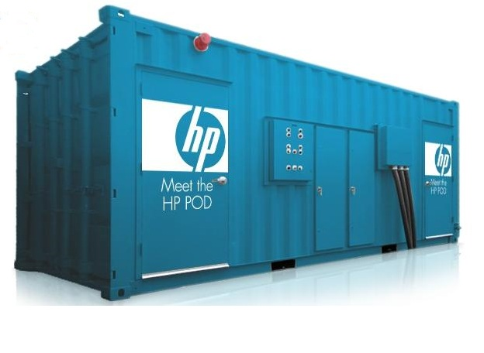
Alternative data centers
Sometimes you have to think “outside the box”…or in these cases, in a different box!

Slide 26
Summary
Data center is much more than a standard room or closet.
Many things make a server room unique.
$100 / $400 or more per square foot to create a server room.
Look for alternatives, outsource
If you are going to build it, do it right the first time.

Slide 27
Questions?
“There are 10 kinds of people in the world, those that understand binary and those that don’t”

