Slide 1
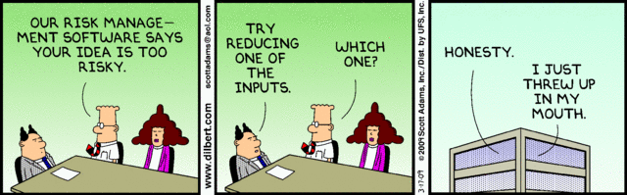

IST346:
Disaster Recovery
Data Integrity
Backups

Slide 2
Today’s Agenda
Risk Analysis
Disaster Recovery
Business Continuity
Data Integrity
Backups

Slide 3
Risk Analysis

Slide 4
Risk Analysis: Some basic terms
Disaster any event that causes a massive outage to services and/or a loss of data.
Severity of any disaster depends on:
How many people are affected (size)
Which aspects of the business are affected (cost)
Risk the expected value of the disaster happening in the future.
Risk is measured as a probability

Slide 5
User Errors
Disk Failure
System Failure
Power Failure
Network Failure
Security Breach
Natural Disaster
SA Errors
Types of Disasters

Slide 6
Ways we mitigate disasters
Fault Tolerance the property that enables a service to continue operation amidst a failure
Redundancy the duplication of components in a system to increase reliability
Backups copies of point in time data stored separately from the source.
Snapshots point in time copies of data stored on the same source.
Service Contracts lower vendor response times in your service contracts. Store parts on the shelf.

Slide 7
Disaster Mitigation
Accidental File Deletion
Snapshots
Disk Failures
RAID 1,5, etc…
Power Failures
UPS
System Failures
Clustering
Backups
Natural Disasters
Off-site Redundancy
Off-site backups
Backups
Generators
Hot-spares

Slide 8
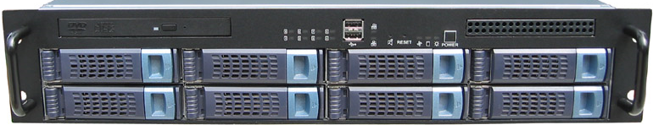
Example: Calculating risk
Example:
8 Drive disk array
Lifetime 5 years (43,829 hours)
MTBF for each drive is 200,000 hours
Array Rebuild rate 10 hours.
Warranty: 4 hour response, 48 hour replacement of spare parts
Risk:
RAID 0: MTBF = 200,000/8 = 25,000
Almost guaranteed chance it will fail over its lifetime 43,829/25,000 (high risk)
Of course you would almost certainly use RAID 5 in this case…

Slide 9
Example: Calculating risk
Risk:
RAID 5: System does not fail until you lose 2 disks thanks to one level of redundancy.
So where is the risk? Losing another drive in the window between when one fails and the array is rebuilt with the replacement drive.
Risk window: your response to the fault + vendor response time + time for replacement part + array rebuild time
Risk window: 4 + 4 + 48 + 10 = 66 hours
MTBF of remaining array 200,000/6 = 33,333
Risk Rate: 66/33,333 = 0.2% or 1 in 500.

Slide 10
Example: Calculating risk
Risk Rate:
Is a 0.2% chance of failure an acceptable amount of risk?
How can we lower the amount of risk in this case?
If we can lower the risk by a factor of 10 to 0.02% for a cost of $25,000 is it worth it?
What does the acceptability of this risk (or any risk) depend upon?
For example, are these two risks the same?
0.2% chance of failing a course vs. A 0.2% chance of dropping out of school.

Slide 11
Budgeting for Risk Mitigation
Risk Budget = Risk Rate * (Estimated cost of disaster – Estimated cost of mitigation)
Example (from before) when that storage array becomes unavailable it will cost the company $10,000/day and be down for 10 business days.
Risk budget = 0.002 * ($100,000 – $0) = $2,000
That $2,000 could be spent on hot-spare and perhaps a RAID6 configuration.

Slide 12
Budgeting for Risk
Single Events
Cost should datacenter be destroyed: $60 million
Risk of Flood one in 1 million
Risk of Earthquake one in 3000
Flood Risk budget = (0.000001)*$60,000,000 = $60
Earthquake Risk budget = (0.000333 )*$60,000,000 = $20,000
So, you should budget and plan for an earthquake but not a flood. Why?

Slide 13
Budgeting for risk
A small on-line retailer cannot make $$$ when their internet connection is down.
It goes down, on average for 2.5 hours each month (every 30 days), in periodic intervals. As per the ISP’s Terms of Service.
The company estimates they lose an average of $15,000 for each hour their connection is down.
What is the Rate of failure for this internet connection?
2.5 hours / 30*24 hours = 0.0035 This is the risk rate each month
What is the loss of business each month?
2.5 * $15,000 = $37,500 /month
What should the monthly Risk budget be?
0.0035 * ($37,500 - $0) = $131.50
It makes sense to get a secondary internet connection if you can find one for less than $131.50/month.

Slide 14
Disaster Recovery and Business Continuity

Slide 15
Disaster Recovery Plan
Defined: The process that allows a company to recover all systems, data, services, etc. May take hours, days, or weeks depending on number of systems used and their complexity.
Help prevent a IT Disaster From Happening in the 1st place:
Implement fault tolerance components and a solid backup and recovery strategy
Types of Fault Tolerance components:
RAID’ed hard drives
Redundant paths to your IPS or redundant IPS’
Backup power via UPS or generator (or both)
Mirrored copies of data located off-site
Mirrored servers (clusters)
VMWare or imaged servers
Read manuals and pay attention to what you are doing.
Isolate systems from other systems or to restate, don’t run multiple services on the same server.

Slide 16
What is a Disaster Recovery Plan?
A DR Plan…
Considers potential disasters.
Describes how to mitigate potential disasters.
Makes preparations to enable quick restoration of services.
Identifies key services and how quickly they need to be restored and in what order.
Only High-Risk / High cost plans should be considered

Slide 17
Disaster Recovery Plans
Define (un)acceptable loss.
Data? Productivity? Re-Creatable data? At what cost?
Back up everything.
Backup data, metadata (config), and instructions on how to restore your system.
Organize everything.
Can you find the backup tapes you need when disaster strikes? Make sure everything is clearly labeled.

Slide 18
Disaster Recovery Plans
Protect against disasters.
Natural disasters with high probability and many more.
Document what you have done.
Plan must be detailed enough for people to follow in a disaster w/o additional info. Hardcopies are key.
Test, test, test.
A disaster recovery plan that has not been tested is not a plan; it's a proposal.

Slide 19
Disaster Recovery Plan Ideas
Many places have a DR plan that says something like “buy new hardware, re-install our OS, applications, then restore our databases or data files from the previous backups”
What’s wrong with this plan ?
How long do you think this will take, a week, 2 weeks, a month?
What ‘data’ do you need to include? Is it up-to-date at your “DR” location?
To protect against or minimize data loss, data can be ‘copied’ either periodically (asynchronous) or in real-time (synchronous) from one server to another for DR processes.
Ideally the servers should be in different buildings, campuses, or even states as to guard against large scale natural disasters.

Slide 20
Asynchronous Replication
Defined: Data is refreshed or synchronizes periodically (most commonly done once per day) during periods of inactivity (night).
Advantages of asynchronous replication
Typically is less expensive. Don’t need to invest in sometimes expensive data replication software. Can use free tools, ex: Robocopy.
Can be used to restore data from.
If your data files are only refreshed nightly, the target location can be used to restore data from in the event a user deletes or corrupts data during the day or a user deletes a file.
Disadvantages:
Data is not kept 100% up-to-date at secondary site. If you run a bank or hospital, this may cause health, legal, or financial issues !

Slide 21
Synchronous Replication
Defined: Data is replicated from primary site to secondary site in “real-time - automatically”. No period sync process
Advantages of synchronous replication
Data is always up-to-date at secondary site. Don’t need to worry about what ‘work’ needs to be re-entered by your users.
If you are replicating from SAN to SAN, you may be able to use some of the DR hardware at secondary site for non-production purposes (allows your servers to do double-duty) such as to run reports. If needed, this DR hardware can quickly be re-setup for production need. Works great if you are using virtualization.
Disadvantage:
Costs money, may requires additional products (cost), and adds complexity to running systems

Slide 22
Business Continuity
The organization’s ability to continue to function during and after the disaster.
Think of BC as your fallback plan for the disaster.
It is not the same as disaster recovery, but ultimately a part of it.
Example:
Labor Day storm 1998. Power was out for 10 days.
The company I worked for had a BC plan. They’d better they were in the business of selling generators!
Sales and Rentals would be processed manually (on paper) and then recorded into the system when it came back on-line.

Slide 23
Business Continuity, another example
Snowstorm in 1997. Computers across an entire organization’s site were down when snow took out their terrestrial satellite links (wide area network for them at the time.
The company I worked for had about 2000 employees and manufactured medical diagnostic equipment, so had to perform support for doctors offices, hospitals, and surgeons daily.
The customer service departments kept printed and bound copies of all of the service manuals for every piece of equipment the company had ever designed at their desks. When the network was down they could not access the electronic manuals, so the were able to fallback to the printed copies.

Slide 24
Backups and Data Integrity

Slide 25
Why Backups?
Data gets lost
People delete data by mistake (or on purpose)
Archival Purposes
Legal Issues / Subpoenas
Data gets corrupted
Systems crash / Disks fail
Notebooks get lost / stolen
You need your backups to be reliable.

Slide 26
Multiple Ways to Backup
Image Backups
“Classic” Tape Backups
Disk-to-disk-to-tape backups (D2D2T)
Disk-to-disk-to-disk backups (disks are cheap)
Offsite Backup services (backup over the internet)

Slide 27
Why restores?
Most Common: Accidental File Deletion / corrupt data
So common that snapshot technology is used.
Mac “time machine” / Windows VSS / system restore
Pull from Archives
Historical snapshots of data.
Need recovery of user’s files or email after they’ve left the org.
Least Common: Storage Failure
Fault-Tolerant system (RAID) failure
Loss of data and loss of service, too

Slide 28
Data Integrity
Data Integrity – ensuring your data is accurate.
How does it become corrupted?
Viruses / Malware
Buggy Software
Hardware failures
User Error
How to you ensure data integrity?
Hashing – compare file to its checksum MD5/SHA256
Keep anti-malware software current

Slide 29
Types of Backups
A full backup (level 0) is a complete copy of a partition.
A differential backup (level 1) is an archive of only the files that have changed since the last full backup.
An incremental backup (level 2, 3, etc) is an archive of only the file that have changed since the last backup (not necessarily full backup.
Backup | Sun (F) | Mon | Tue | Wed | Thu | Fri | Sat
Full | 2TB | 2TB | 2TB | 2TB | 2TB | 2TB | 2TB
Diff. | 2TB | 1GB | 1.2GB | 1.6GB | 1.9GB | 2.3GB | 2.8GB
Incr. | 2TB | 1GB | 0.2GB | 0.4GB | 0.3GB | 0.4GB | 0.5GB

Slide 30
Differential or Incremental?
Differential backup Advantages: quicker recovery time, requiring only a full backup and the latest differential backup to restore the system. Disadvantage: for each day elapsed since the last full backup, more data needs to be backed up, especially if a majority of the data has been changed.
Incremental backup Advantages: quicker backup times, as only changed files need to be saved. Disadvantage: longer recovery times, as the latest full backup, and all incremental backups up to the date of data loss need to be restored.

Slide 31
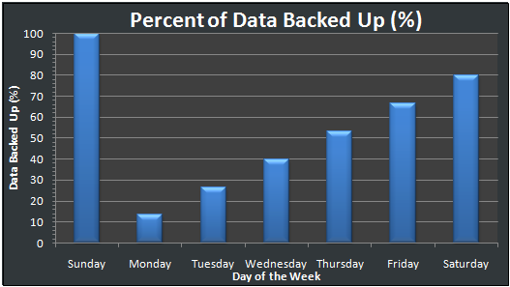
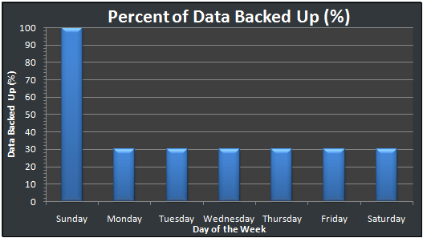
Differential vs. Incremental
Differential
Incremental

Slide 32
Testing Backups
Periodically test your backups by performing restores.
Why? The only way you know your backups are working is to restore data from them and test.
Backups are no good if you can’t restore from them.
Backups are one of the most understated processes in IT management but one of the more important.

Slide 33
Backup Strategy
You can’t backup everything all the time and keep it around forever.
It’s just not realistic.
You need a combination of short-term and long-term backups.
What if you need files from 12 months ago?
You should draft a backup and restore SLA
Through the SLA, customers know what to expect
Plan your backups around the SLA
Mitigate risk
Don’t store your backups next to your servers!
The restore requirements govern your backup strategy.

Slide 34
Backup Strategy #1
Backup
Sunday L0
Monday – Saturday L1 (Diff)
Each week, an L0 is saved for a year.
Week 52 is saved as year-end backup (not reused)
Can this strategy Restore
A file from 4 days ago?
A file from 5 weeks ago?
A file from Last July, that was deleted in August?

Slide 35
Backup Strategy #2
Backup
Full 1st Day of each month
Differential each remaining day of the month.
Media on 1st day of the month not reused.
Can this strategy Restore
A file from 25 days ago?
A file from 60 days ago?
A file from 1 year ago that was around for 2 months.

Slide 36
Questions?
If money doesn’t grow on trees then why do banks have branches?

