Slide 1
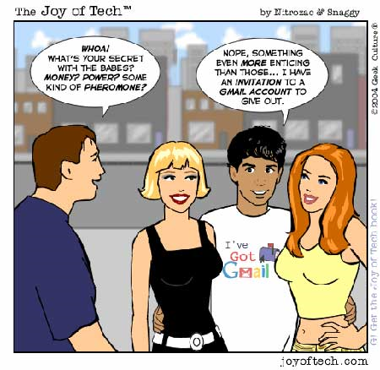

IST346:
Services, Monitoring, Logging

Slide 2
Agenda
Learn the various taxonomies and classifications of computing services.
Familiarize ourselves with popular services
Understand the IT management issues surrounding services
Requirements for a successful service
Design principles for services
Scalability issues
Open architectures
Monitoring and logging for adequate service

Slide 3
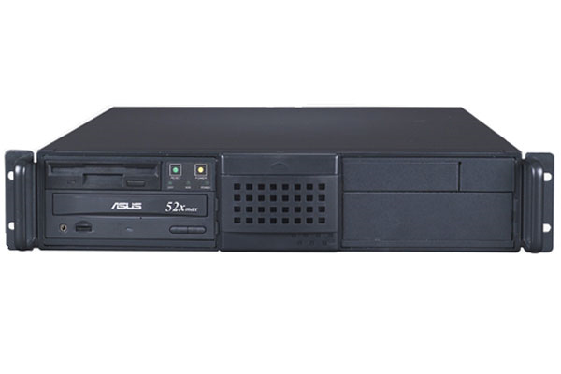

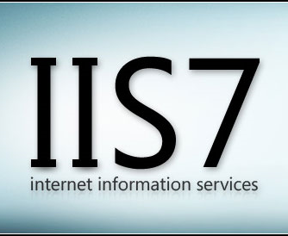
Recall: Server vs. Service
A server is a computer.
A service is an offering provided by server(s).

Slide 4
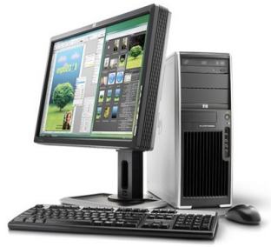
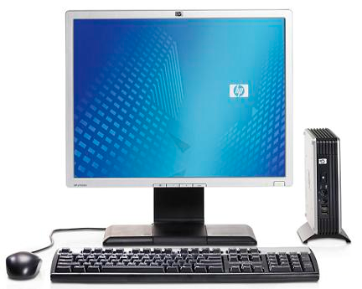
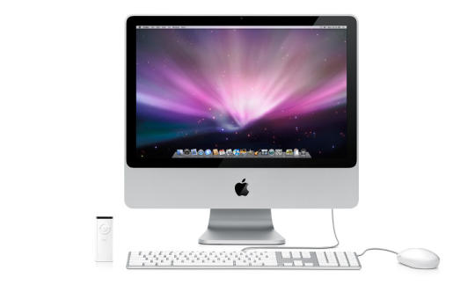

Recall: The Client-Server Model
filer.fauxco.com
192.168.1.10
File Sharing Service
Server
Workstations
ctl02.fauxco.com
192.168.1.202
ctl03.fauxco.com
192.168.1.203
ctl04.fauxco.com
192.168.1.204
ctl05.fauxco.com
192.168.1.205

Slide 5
Services
Unify a set of workstations into a distributed computing environment, since they share common resources.
Typical environments have several services, and services often depend on other services.
Some services are simple, and have no interaction’s on the user’s part. (network time, or NTP for example)
It is best to think about any given service in terms of its components and interdependencies.

Slide 6
Components: An Anatomy of a service
Instructions for transferring data to/from client/server (transport mechanism)
Protocols
Components
APIs
Rules for accessing or extending the service beyond the components
Client and Server software part of the application or service interaction

Slide 7

Example of a service anatomy
Protocols HTTP, WebDAV, SMTP
Components Web Browsers Apache Web Server PHP Scripting MySQL Database
APIs XML-RPC Atom RSS

Slide 8
Service Dependencies
Application
Network
Core/Infrastructure
Complex interface, several protocols.
Services at the application level depend on lower-level services for their operation.
Basic interface with underlying protocol.
Essential to all other services. Minimal interface.

Slide 9
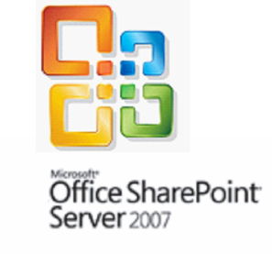


Service Dependencies: Example
HTTP, SMTP
DNS, DHCP, LDAP
Application
Network
Core Infrastructure

Slide 10
Services every IT professional should know
Core
NTP – Network time protocol. Keeps the clocks in sync on several hosts
DNS – Domain name system – a method of IP address to host name resolution.
DHCP – Dynamic Host configuration Protocol – a method of assigning IP information over the network.
LDAP – Lightweight Directory Access Protocol – a hierarchal database of directory information (users, groups, organizations, etc)
Kerberos – A network authentication protocol, used for securely evaluating identities over a network

Slide 11
Services every IT professional should know
Network
HTTP – Hypertext transport protocol. The application protocol for the WWW
SSL –Secure Sockets Layer – an encrypted channel for HTTP traffic
SMB/CIFS – Server Message Block / Common Internet File System. The Microsoft Windows File / Printer Sharing protocol. In Linux, it is implemented using the SAMBA service.
SSH / SCP – Secure Shell, Secure Copy. Unix/Linux remote shell and remote file copy protocols.
NFS – Network File System – File sharing for unix-like computers.
RDP – Remote Desktop protocol. A proprietary protocol for accessing Windows hosts over a network.
SMTP – Simple Mail Transport Service. Mail routing protocol.

Slide 12
Providing a Service
Defined
1
Reliable
2
Scalable 3
Monitored 4
Maintained 5
Supported 6
Any service you provide must be:

Slide 13
Defining your Service
Defined
1
Customers are the reason for your service
How will they use it?
What features do they need? Want?
How critical is this service?
What are the required levels of availability and support?
Formulate a SLA (Service Level Agreement)
This will define the service being offered
Clarify the expectations for support levels and response time

Slide 14
Service Reliability
Reliable
2
Keep it simple
Simple systems are more reliable and easier to maintain
Make the trade-off between features and reliability
Use reliable hardware, of course!
Take advantage of vendor relationships
Have them provide recommendations (they should be the experts!)
Let multiple vendors compete for your business
Choose a vendor based on not only features but the stability of their company and product

Slide 15
More Reliability
Reliable
2
Use Open Architecture:
Open protocol standards and file formats
RFC’s from the IETF http://www.rfc-editor.org
Pros
Bigger selection of products and vendors to choose from
Decoupled client and server selection
Avoids being locked in to a specific platform or vendor
Con
Sometimes open standards don’t go far enough
Google-Worthy
Service-Oriented Architecture is changing the game a bit, as most services are gravitating towards interoperability (working with each other)

Slide 16
Last Slide on Reliability
Reliable
2
Any service should have 3 environments
Usually, each environment is on separate hardware
Dev
Test
Prod
Where you build out new features for the service / upgrades
Primary Environment for the Service
Mirror image of prod environment for testing purposes

Slide 17
Scalability
Scalable 3
Scalability
A service’s ability to grow with its demand.
Helps maintain performance levels.
You should try to plan for scalability when designing your service.
Two types of scalability:
Vertical (scale up) – Increasing the size of the node. Eg. add more RAM or an extra CPU to a server, buy a bigger washing machine,
Horizontal (scale out) – Adding more nodes to the service. Eg. purchase three more servers and balance their load, buy another washing machine, but keep your old one.

Slide 18
Scalability: H vs. V
Scalable 3
After
Vertical Scalability:
Before
Load Balancer
Horizontal Scalability:
Before
After
After
After
Notes:
Vertical Scalability – throw more hardware at the problem
Horizontal Scalability – re-engineer the problem

Slide 19
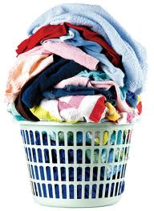
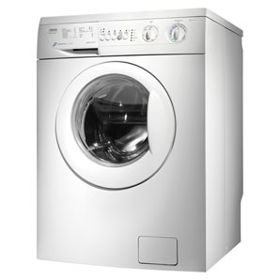
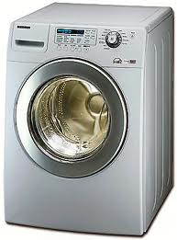
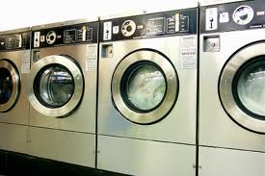
Scaling your Laundry
Scalable 3
You’ve got more laundry than your current washing machine can handle!!
Vertical
Horizontal
Use more than one washing machine
Use a bigger, faster washing machine
Notes:
Laundry is the traffic to your service
The washing machine is the service

Slide 20




Tangent:How do they scale their apps?
How they scale their apps? http://bit.ly/9FnwRc
Approaches:
Application Partitioning
Data / HTML Caching
Indexing data
Data Partitioning
Denormalization
Monitor Closely and react accordingly.
Notes:
Flickr – social photo sharing
Livejournal – one of the first social networking apps. Set the stage for how to scale large web sites
Last FM – internet radio
Application Partitioning is separating an application into components that run on multiple servers. Programming languages and development systems that support this architecture, known as "three-tier client/server," may allow the program to be developed as a whole and then separated into pieces later.
Data Partitioning is the process of logically and/or physically partitioning data into segments that are more easily maintained or accessed. Current RDBMS systems provide this kind of distribution functionality. Partitioning of data helps in performance and utility processing.
Denormalization is the process of attempting to optimize the read performance of a database by adding redundant data or by grouping data. In some cases, denormalization helps cover up the inefficiencies inherent in relational database software. A relational normalized database imposes a heavy access load over physical storage of data even if it is well tuned for high performance.

Slide 21
Monolithic Deployment
Production
Application
WordPress
Everything is on one server
Inefficient use of hardware
The only way to scale is to upgrade the hardware.
Easy to administer and secure
Need to duplicate the same environment in dev, test and prod which is wasteful.
App Dependencies / Libraries
PHP, MySQL, Nginx, Etc.
Operating System
Ubuntu Linux
Server (Hardware)
Dell PowerEdge
Test
Development
Application
WordPress
Application
WordPress
App Dependencies / Libraries
PHP, MySQL, Nginx, Etc.
App Dependencies / Libraries
PHP, MySQL, Nginx, Etc.
Operating System
Ubuntu Linux
Operating System
Ubuntu Linux
Server (Hardware)
Dell PowerEdge
Server (Hardware)
Dell PowerEdge
Notes:
Everything is on one server
Inefficient use of hardware –Dedicated hardware for test and development usually sits idle.
The only way to scale is to upgrade the hardware. – Buy more memory or upgrade the server.
Easy to administer and secure – There’s only 3 operating systems to administer and harden
Need to duplicate the same environment in dev, test and prod which is wasteful – high hardware costs.

Slide 22
Horizontal Scaling
Production - Web
Production - Database
Application
WordPress Website
Application
WordPress Database
Break up components / services into their own server
This separates concerns and makes the system easier to secure and manage.
Costs of multiple hardware and operating systems to maintain.
Maintain extra versions for test and development
App Deps / Libraries
PHP, Nginx
App Deps / Libraries
MySQL
OS
Ubuntu Linux
OW
Ubuntu Linux
Server (HW)
Dell Server
Server (HW)
IBM Server
Test - Web
Test - Database
Dev - Web
Dev - Database
Notes:
Break up components / services into their own server –we know scaling this way is good, but its also costly
This separates concerns and makes the system easier to secure and manage – we can use the web server and the database server independently. We don’t need to install extra libraries on the server – only those needed to accomplish the job.
Costs of multiple hardware and operating systems to maintain. – This example has 2X the hardware!
Maintain extra versions for test and development – more hardware and operating systems.

Slide 24
Service Monitoring
Monitored 4
Layered Monitoring: PPS!
Ping: Monitor the host
Port: Monitor the port for the service
Service: Connect to the port; verify the response
A Monitoring agent should send an alert to the IT team when things aren’t right.
What, When, Where
Without adequate monitoring you cannot offer good service!

Slide 25
Monitoring and Logging
Monitored 4
Service Monitoring
Service Logging
Observing service activity in real-time
This is done by a computer, not a human.
Important events are passed on to a human (notification).
Keeping historical records of service activity
This data grows over time and can become quite large.
Only referred to when needed to troubleshoot a problem or trace down a security incident.

Slide 26
Why Bother?
Monitored 4
Why do we Monitor?
Why do we Log?
To detect / identify problems quickly.
Ideally you want to know about it before your users do.
To determine if resources are being constrained or over utilized.
Help get to the root cause of an issue or incident.
Help us predict problem and avoid them.
Provide historical data or trends for service usage.
Report on service activity.
If you’re not measuring it you aren’t managing it
Notes:
Service monitoring: SCOM
Service logging: Splunk, its-stats-box

Slide 27
How Monitoring and Logging Work
Server
Log
Service Activity
Service
Network Activity
Internal Service Monitor
External Service Monitor
Event
Event
SA

Slide 28
Example: Simple Web Service Monitoring
Linux Host: web.syr.edu
access_log
Service Activity
Apache HTTPD
Network Activity
ps –aux | grep “httpd”
nmap web.syr.edu
Event: Port unavailable
Event: Service stopped

Slide 29
Example: Email Service Monitoring
Exchange eMail
http
access_logs
Service Activity
Web mail service
Network Activity
Windows IIS web service monitor
SCOM test-mailflow.ps1script
Event: Port unavailable
Event: Service stopped

Slide 30
What to Monitor, what to Log?
Monitored 4
Monitor for a condition.
Send alert when the condition is met.
Log the condition whether it sends an alert or not.
Examples: (Why would you monitor/log these?)
CPU utilization stays at 100% for X minutes.
Free disk space drops below 10%.
Port does not respond for 1500 ms
HTTP request take more than 5 sec to get response.

Slide 31
Better Monitoring
Monitored 4
Normal
Normal: When a service fails you send an alert.
Proactive Monitoring
Proactive: When a service show signs it is about to fail you send an alert. (100% cpu, Long responses, etc.)
Automated Responses
Normal: When a service fails you send an alert.
Automated: When the service fails, you attempt to restart it. If the restart fails, you send an alert.
PM and AR are difficult and time-consuming to implement, but are time savers for difficult problems with no permanent fix.
A layered approach is always better.

Slide 32
Alerts!
Monitored 4
Types:
Email
TXT message
SMS Page
Automated dialer calls phone.
Pick the appropriate Alert for the appropriate Event and time.
Don’t send email when you’re not going to check it!
In a layered approach, you might send an email, and if the problem persists send a TXT, etc…

Slide 33
Logging
Monitored 4
Log files get very large
since they record all activity.
Log file rotation – service points to a different log file after a specified interval.
Lets you backup log files
Keeps the size of the files manageable.
Log files are text and they compress nicely.
How long do you keep logs?
Depends on service, depends on your policy
It’s not a decision the SA should make.
Like an insurance policy. Not very useful until the off chance that you need it... then you’re glad you have it!

Slide 34
Service Maintenance
Maintained 5
Yes, there will come a time when you will need to deny service. (Make it unavailable.)
Upgrades to hardware / OS / Service itself
Plan and advertise your service outages so your users can plan accordingly.
Make sure your outage complies with your TOS.

Slide 35
Supporting your service
Supported 6
After your service is up and running, but before rolling it out you should:
Document how the service should be used and maintained by your IT staff
Train your IT staff how to support the new service
Train the users, if required
Build out self-help support for the service to reduce calls to the helpdesk.
Don’t forget to advertise the new service to your users.
Roll it out using “One – Some - Many” so you can get a handle of any unforeseen issues.

Slide 36
Can you provide a service?
Class activity, break into your project groups.

Slide 37
Providing a Service
Defined
1
Reliable
2
Scalable 3
Monitored 4
Maintained 5
Supported 6
Any service you provide must be:

Slide 38
Questions?
If you try to fail, and succeed, which have you done?

