Slide 1
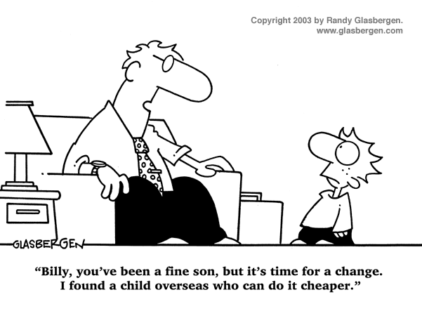
IST346: Managing IT

Slide 2

Agenda
Discussion
Content
Managing IT
IT Calculations
Centralization vs Decentralization
Wrap-Up

Slide 3
Discussion Questions
What is WIP? Who often generates the “W” in WIP?
What two systems can be used to manage WIP?
What does the author mean by “SA”?
Why is it important to identify where your IT team spends its time?
Explain the small batches principle.
What is a MVP?
Notes:
Give students 1-2 minutes for each question. Its important to provide them with the opportunity to think about their answer before calling on them. These answers are based on the reading, labs, and assigned homework.

Slide 4

Lab Debrief
Lab - A
Notes:
Go over the lab questions. With the students. Ask them to take out their answers to the lab questions. And their questions about the lab itself.

Slide 5
Information Technology Management
The process of overseeing the systems, services, people resources, and processes within an IT organization.

Slide 6

Managing IT: Mission Impossible?
Keeping essential services operational, while trying not to work 24x7x365.
Providing people access to the resources they need, but not access to the resources they don’t.
Keeping internal costs down, but productivity up.
Fixing problems reported by end-users, with a keen eye towards strategic planning.
Managing the work and keeping everyone happy. ☺

Slide 7
Manage The Work
Do Not Get So Bogged Down in the Operational That you Neglect Strategic Work!
Operational
Strategic
Problems / Issues
Feature Requests
Training End-Users
Maintenance / Patches / Upgrades
Migrations to new Platforms
Identifying Black Holes / Time Drains
Alignment with Organizational Strategy
Innovation
Notes:
Operational work is user-generated or system generated work. It is not strategic but commoditized.
- Problem and issues with systems, people or processed.
- Requests for new features or upgrades to software.
- Training / education
- Maintenance of systems such as patching software, replacing old hardware or freeing up disk space, etc.
Strategic work is game-changing. It drives innovation and makes IT a differentiator within your organization, saving people time and the organization money.
Migrations to new platforms or systems. Such as moving email to the cloud.
Identifying the problem or issues which consume the most time or resources
Aligning the IT with the strategy within the organization
IT innovation. Generating new ways to leverage IT to improve the way the organization works.

Slide 8
Helpdesks
The “public face” of your organization
Interaction with end-users (customers).
Helpdesk should be a friendly, pleasant experience.
Define hours of operations and have instructions for what your customers can do and expect off-hours.
A Helpdesk generates operational work in progress
Strategic managers use helpdesk data to demonstrate where time is spent, identify black holes and drive IT innovation.

Slide 9
Managing Operational Work
Track ALL Operational Work in a system.
Use A Ticketing System to track work.
End-Users file requests, or they are logged through the helpdesk.
A Triage process assigns work to those qualified to complete it and prioritizes it.
Use A Kanban board to manage the work
Helps to organize what should be done when as there is only a finite number of hours in the week.
Notes:
I used to have

Slide 10
Group Activity
Managing Operational Work

Slide 11
Draw a Workflow Diagram
Partner up with someone in the class.
On a 8.5x11 sheet of paper put both your names.
Draw a workflow diagram for managing IT operations – user requests from start until completion.
Make sure the helpdesk, end-users, IT staff at minimum are on the diagram.
When you are done we will discuss your diagrams, and you will hand them in.

Slide 12
IT Services Models
Centralized – One service is managed and supported across the entire enterprise.
Distributed – One service is managed and supported by individual units with the enterprise.
Decentralized – Multiple iterations of the same service are managed and supported by individual units within the enterprise.

Slide 13
Centralized vs Decentralized
Centralized
Decentralized
Economies of Scale – improved efficiencies and reduced costs.
Encourages specialization among IT staff as they become proficient in managing at scale.
Faster response times and more agility.
No single point of failure within a service.
Core infrastructure services should be centralized, services strategic to the operations of a unit should be decentralized.

Slide 14
ROI and TCO calculations

Slide 15
TCO: Total Cost of Ownership
TCO a calculation designed to help managers assess the economic value of an investment through its cost.
In the IT world, your investment is typically a service or asset.
TCO is a useful way to compare similar investments.
TCO calculations consist of both direct and indirect costs
Direct Costs: Are directly accountable to the investment. Eg. Hardware, Software, Operation, and Admin. Costs
Indirect Costs: Are not directly accountable to the investment. Eg. End user operations (support), Downtime, Loss of Productivity, Switching Costs
Notes:
Direct Costs are the costs you can budget and measure.
Indirect Costs are costs of running helpdesks, the costs of users who support themselves and others, and downtime

Slide 16
TCO Example – Indirect cost comparison
I can host my Wordpress Blog:
On wordpress.com for $48/year. TCO₁
Or in my basement on an old PC for “free” (let’s assume electricity costs add up to about $35/year. TCO₂
TCO₁=$48 + Indirect Costs₁ TCO₂=$35 + Indirect Costs₂ $48 + Indirect Costs₁ == $35 + Indirect Costs₂ $8 + Indirect Costs₁ == Indirect Costs₂
TCO₁ Costs $8 more than TCO₂, but who supports Wordpress, Updates it, and deals with power outages as part of those indirect costs in TCO₂? Me.
Is my time worth more than $8 year? YES! Thus TCO₁ is lower.
Notes:
One way to use the TCO formula is to compare indirect costs.

Slide 17
ROI: Return on Investment
ROI is a type of calculation designed to help managers assess the economic value of an investment through its potential
ROI = (gain-cost)/cost
Example gain=$7,500 cost=$5,000 ROI=50%
Positive ROI is good, negative is bad.
ROI is used in IT to help compare similar IT investments.
In IT, typically ROI is calculated over the expected lifecycle of a system or over 3 years (average life expectancy)

Slide 18
ROI Example: Selling Products on the Web
You work for a parts distributor. Currently you do not sell products on line.
A recent TCO study has revealed it will cost $12,000/year to begin selling products on the web.
If you would like a 25% ROI, what is the expected gain?
If another option is to partner with Amazon.com to sell your parts on line at a cost of $5,000/year What is the expected gain for the same 25% ROI? Is it better?
If the marketing department claims that by spending $5,000 next year on local advertising they can generate an additional $9000 in additional sales.
Which option has the best ROI?

Slide 19
ROI Example: Selling Products on the Web
.25 = (gain – 12000)/12000 3000 = gain-12000 gain = 15000
.25 = (gain – 5000)/5000 1250 = gain – 5000 gain = 6250
ROI = (9000-5000)/5000 ROI = 4000/5000 = .8
Option C has the highest ROI. In this example it is the best option.
Option A and B have the same ROI but option B has a lower TCO so…
Option B is better than option A

Slide 20

Check Yourself
Fudgeco has determined that switching from in-house accounting to a cloud accounting system will save the company $5000 /year. If it costs, $2000 /year to host the cloud accounting system, what is the ROI?
It costs $2000 / year to host accounting in the cloud, but $5000 over 3 years to rent an appliance from the same company and store it in your data center. Assuming the same indirect costs, which has lower TCO?
Now do an indirect costs comparison. At which point is the other option viable?
Notes:
ROI = (gain – cost) / cost
ROI = (5000 – 2000) / 2000
ROI = 3000 / 2000
ROI = 150%
A = 2000 * 3 = 6000 over 3 years
B = 5000 over 3 years
B has lower TCO assuming identical indirect costs
In reality the indirect costs of option B need to be more than $1000 over three years for option A to be viable.

Slide 21

Your To-Do List
What to work on for next class
Notes:
ALWAYS CONSULT THE SYLLABUS

Slide 22

Exit Ticket
What was the most confusing thing we covered in this lesson?

Slide 23

Questions?

