Slide 1
Virtualization and Containerization

Slide 2
So just what is “Virtualization”?

Slide 3
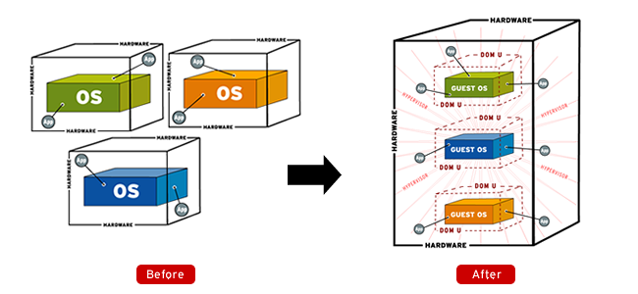
Virtualization – a definition
In computing, this is the creation of a virtual (rather than actual) version of something, such as a hardware platform, operating system (OS), storage device, or network resources.
Generally referred to as “server virtualization”, but can mean a few things.

Slide 4
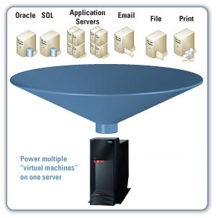
What can we virtualize?
Hardware (server)
Desktop (VDI)
Software
Memory
Storage
Network
Data

Slide 5
Hypervisor
A Hypervisor is the kernel or the core of a virtualization platform. The Hypervisor is also referred to as the Virtual Machine Monitor.
The Hypervisor has access to the physical host hardware.
Of the total amount of disk space taken for a virtualization platform, the Hypervisor is by far, the smallest part.

Slide 6
Hypervisors – two basic types
Type-1 Hypervisor
Type-2 Hypervisor
In a Type-1, or Bare Metal Virtualization platform there really isn’t a host operating system besides the Hypervisor.
VMWare ESX
Hyper-V Windows Core
XEN
For a Type-2 Hypervisor, the host operating system is whatever operating system those applications are installed into.
VMWare Workstation
VMWare Fusion
VirtualBox
Hyper-V on Windows 10

Slide 7
Host vs. Guest
A host system would be the primary & first installed operating system.
Your host is what your VMs will run on and will manage them.
A guest system (guest operating system) is a virtual guest or virtual machine (VM) that is installed under the host operating system.
Guests are the VMs that you run within your virtualization platform.

Slide 8
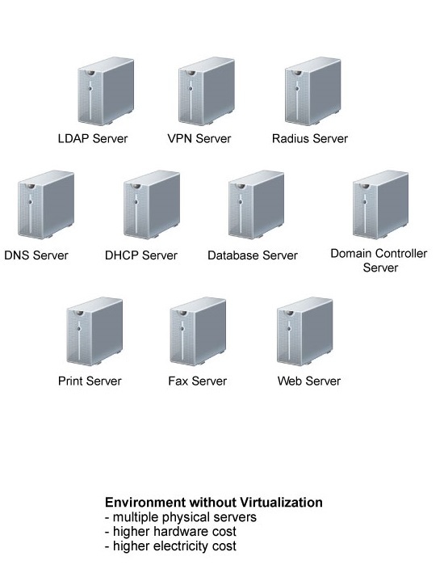
Before Server Virtualization
Multiple servers each on its own hardware
Separate physical servers for each OS/Application
Server sprawl
Inefficient use of resources – most servers sit idle doing their “one job”

Slide 9
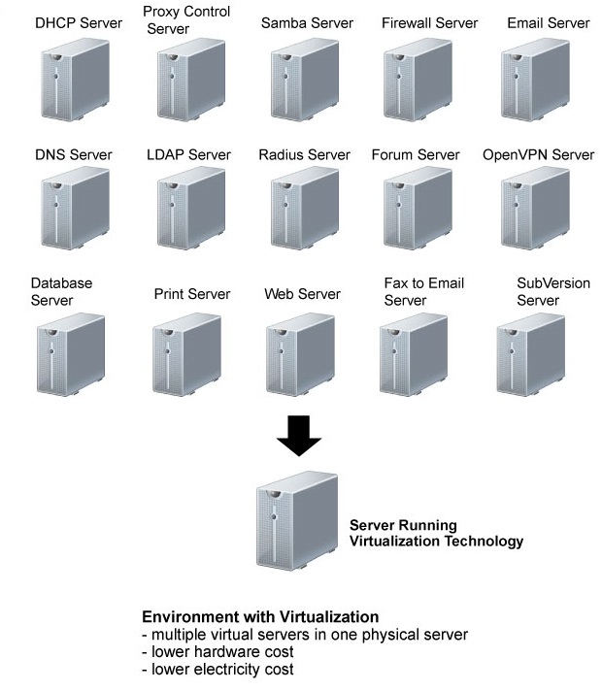
After Server Virtualization
Virtual Servers
Still have multiple servers but, fewer physical hosts
Smaller hardware footprint, uses less energy and data center space.
Maximizes use of hardware /compute resources, Enables IT departments to run more with less.
Actual Hardware

Slide 10
Advanced Capabilities

Slide 11
More That Virtualization Offers Over Physical Hardware
Live Migration
High availability (failover)
Network isolation without network hardware
Snapshotting
Cloning
Teleportation
Consolidated backup
Resource pooling
P2V conversion

Slide 12
Live Migration
Allows for the moving of virtual workloads from one physical host to another with no downtime.
Moving of a running VM to a different physical machine without disconnecting the guest or applications running on it.
Memory, storage, and network connectivity are transferred from original host to the destination.
Typically down-time of a VM during a live migration is not noticeable by end-users. This is referred to as a seamless live migration.

Slide 13
High availability (failover)
Utilizing “Clustering” concepts to use more than one physical host configured and managed as a single resource.
Allows VMs to be run from multiple physical hosts.
In HA configurations, if the physical host becomes unavailable, a VM can be serviced by another host in the cluster.
This is typically configured for Real Time failovers (no loss of a VM’s operation), but there are situations where their will be delays (disaster recovery in hot/cold sites).
Utilizes Live Migration

Slide 14
Network isolation (virtual networking)
Using software to create “virtual networks” without additional network hardware.
Allows you to run multiple identical copies of an environment.
Uses the creation of “virtual networks” to keep computers within from either contacting external networks, or from external devices communicating in.
Some reasons why we would want to do this:
Labs
Test environments
Development
Research
Security

Slide 15
Snapshotting
Dumping the entire machine state to a backup file
Can include contents of memory (live snapshots)
Allows for full system state restore in case of failure or changes made
Can merge the changes from snapshots into the master if needed
Warning: snapshots increase complexity and disk space, so they need to be monitored and removed when no longer needed.

Slide 16
Cloning
A clone is a copy of an existing virtual machine
Changes made to the clone do not affect the parent machine
Two types of clones, Full (independent) and Linked.
Full clone is just that, a full and independent copy that shares nothing with the parent VM. This requires more disk space but keeps the VMs completely independent of one another.
Linked clone is a copy that shares virtual disks with the parent VM in an ongoing manner. This conserves disk space and allows multiple VMs to use the same software configuration.

Slide 17
Consolidated backup
Provides a single location to backup from, simplifying backup strategies.
Can reduce or eliminate network traffic by keeping backups local to the Hosts.
Allows for backup management from a single point.
Can perform file level or complete VM backups.
Restores can be of individual files or bare-metal (whole VM)

Slide 18
Resource Pooling
Ability to “Pool” physical resources together to get more “bang for your buck”
Manually or Dynamically allocate resources to highest priority servers as needed.
Pools are typically defined by CPU and memory resources

Slide 19
P2V conversion
Physical to Virtual conversion
Refers to the migration of an Operating System (along with its applications and data) from a physical computer’s hard disk to a virtual machine.
Allows the conversion to virtualized machines without having to rebuild computers.
Without this you had to reinstall the OS, reinstall all applications, copy all data, and reconfigure the applications and services running (tedious process).
Typically used to accomplish server virtualization.

Slide 20
Benefits of Virtualization
Reduces hardware footprint (physical servers)
Reduces operating costs (long term)
Server hardware
Infrastructure costs
Servers can be created quickly (and removed)
Reduce admin overhead (single console)
Maximizes investment in hardware
Virtualized servers have the same hardware configuration
Easier to power virtual machines on and off

Slide 21
What is Containerization?

Slide 22
Containerization
Containerization is a form of virtualization at the application level
Containers run on the host operating system or in a host-based virtual machine
It was designed to overcome a key limitation of host virtualization

Slide 23
Host Virtualization Is Heavy
With host virtualization the services share hardware resources only
The operating system and configuration settings must be maintained on each virtual host
This creates a maintenance nightmare as it is easy to setup virtualized hosts but difficult and time consuming to maintain them.
Web Server
DNS Server
Database Server
Web App
DNS
Database
Linux (OS)
Linux (OS)
Linux (OS)
VMWare ESX (Hypervisor)
Dell PowerEdge (Hardware)

Slide 24
Benefits of Containerization
Application components run in a container on the operating system
Operating system and dependencies and configuration of each service are no longer an issue.
Can easily re-create the environment multiple times for development and testing
Take up less disk space when compared to host virtualization, since one operating system is used.
Web Server
DNS Server
Database Server
Web App
DNS
Database
Docker (Container Runtime)
Linux (Operating System
VMWare ESX (Hypervisor)
Dell PowerEdge (Hardware)

Slide 25
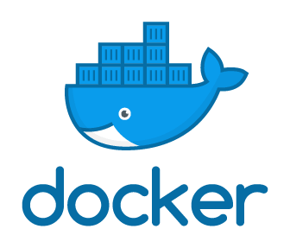
Docker
Docker is a popular container application. It manages:
Building of images
Running of containers and managing their run-time resources like memory, CPU, disk and network.
Sharing of containers with other people (via registry).

Slide 26
Container Concepts
Image – holds the software, it dependencies and information necessary to run the application
Container – Self-contained unit of software. It is a running image plus the configuration and state. At the time the container runs network and storage information is provided.
Volume – persistent storage mechanism for the container.
Network – containers have virtual network similar to host-based virtualization
Registry – an online source of images.
Image
Volume (Config)
Network (Config)
Container

Slide 27
Docker Compose
We use docker-compose in the labs.
Docker-compose is a tool for running multi-container docker applications.
All aspects of each running container are included in the compose file.
Image
Network
Volumes
The containers within the compose file are deployed as a single unit.

