Slide 1
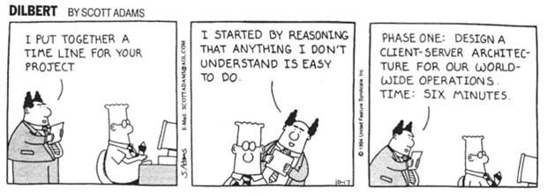
IST346: Services: Application Architecture

Slide 2

Agenda
Discussion
Content
Application Architectures
Wrap-Up

Slide 3
Agenda
Discussion
Content
Application Architectures
Wrap-Up

Slide 4
Discussion Questions
What is a Service? What are the qualities of a good service?
Why are Services Important?
What is an SLA? Purpose?
Explain primary and external dependencies for a service?
What is Service-Oriented Architecture? Microservices?
Notes:
Give students 1-2 minutes for each question. Its important to provide them with the opportunity to answer the questions based on the reading, labs, and assigned homework.

Slide 5

Lab Debrief
Lab F

Slide 6
Service
All the parts which make an application work.

Slide 7
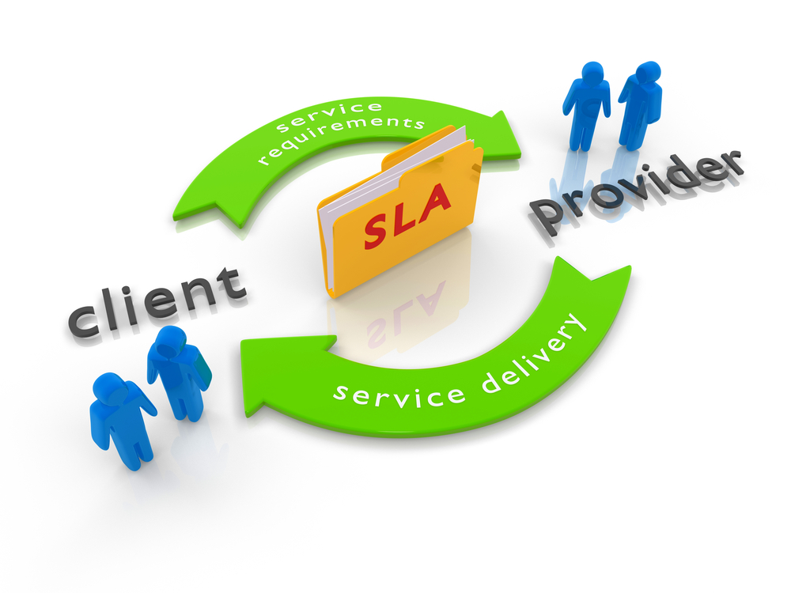

Slide 8

Check Yourself: Service Dependencies
Consider a service like Dropbox.com or Google Drive.
What are the features?
What are the primary dependencies?
What are the external dependencies?
What constitutes a reasonable SLA? For this type of service?

Slide 9
Components of An Application
Presentation
Code and layout responsible for the user interface
Business Logic
Data Access
Create, Read, Update and Delete (CRUD) operations
Data
Transformational logic at the heart of what the application actually does.
Data storage and retrieval of Relevant Data.
Notes:
An application consists of code + data

Slide 10
Check:
Example ➔
Code:
Presentation?
Business Logic ?
Data Access?
Data
Business Data ?

Slide 11
Application Architectures
Monolithic
Monolithic over distributed storage
Two-tier thin client
Two-tier fat-client
Three Tier
N-Tier
Enterprise Service Bus
Micro Services
Complexity

Slide 12
Check Yourself: Classify These!
What does it do?
Educated guess of the application architecture?
Is it thin client? Fat client? Both?
Salesforce.com
Dropbox.com or Google Drive?
Slack ?
Powerapps.com

Slide 13
Group Activity
Service Research!

Slide 14
Research a service:
Divide up into teams of 2 or 3. Think of a service you use every day either on campus or for personal use.
What are the features?
What are the primary dependencies?
What are the external dependencies?
What constitutes a reasonable SLA? For this type of service?

Slide 15

Your To-Do List
What to work on for next class
Notes:
ALWAYS CONSULT THE SYLLABUS

Slide 16

Exit Ticket
Share one thing you learned today that you didn’t know before class!

Slide 17

Questions?

