Slide 1
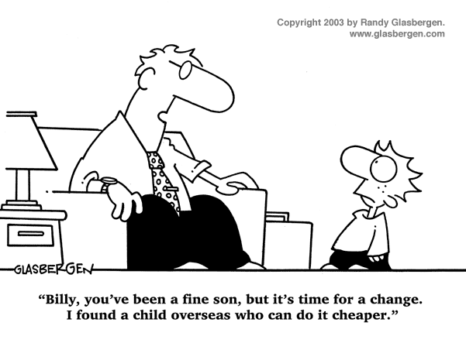
IST346: TEMPLATE

Slide 2

Agenda
Discussion
Content
Something
Wrap-Up

Slide 3
Discussion Questions
Some
Questions
Here
Please
Notes:
Give students 1-2 minutes for each question. Its important to provide them with the opportunity to answer the questions based on the reading, labs, and assigned homework.

Slide 4

Lab Debrief
Lab ?

Slide 5
Course Content
Dfhkalsjdf
Asdf
Fasdhfsad
sadf

Slide 6
Group Activity
Perform some group activity

Slide 7
Details of Group Activity
Fsadghsadfasd
Fsadgfsad
fashdfas

Slide 8

Your To-Do List
What to work on for next class
Notes:
ALWAYS CONSULT THE SYLLABUS

Slide 9

Exit Ticket
Share one thing you learned today that you didn’t know before class!

Slide 10

Questions?

