Slide 1
IST346 Information Technology Management & Administration
Notes:
Pass Out the Syllabus while People are getting settled

Slide 2
About Me
Education
Employment

Slide 3
About You
Your Name
Year
Where are you from?
Do you have any IT Experience?

Slide 4
About This Course
IST346

Slide 5

What Will You Learn in This Course ?
Discuss the strategic role that technology plays in today's competitive business environment.
Understand the role that IT plays in improving business processes by helping organizations cut costs and become more competitive.
Survey several technologies and assess the implications of implementing them to solve business problems in an enterprise environment.
Evaluate information technology services through the lenses of: support, management, cost, security, value, and functionality.

Slide 6
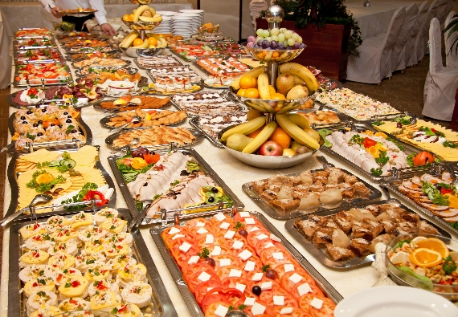
It’s a Survey Course!
We will introduce you to several IT related topics
You will master none of them
The purpose is to provide a broad understanding of the IT landscape.
It has labs to help you understand how the IT is applied in practice.

Slide 7
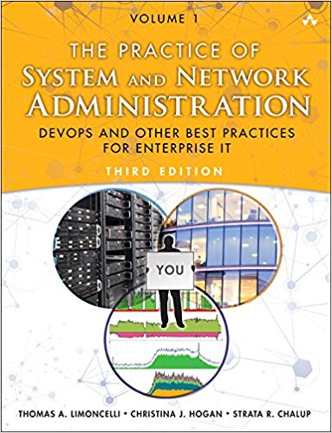
Text book Is Required
The Practice of System and Network Administration, 3rd Edition.
ISBN: 0321919165
Buy $50, Rent $15
On Reserve at the Library

Slide 8

Also, You Need a 8.5x11 Notebook and a Writing Instrument!
Bring it with you to every class.
Pen and paper in the digital age?
Oh, the humanity! What’s next? Cat and dogs living together in harmony?!?!?

Slide 9
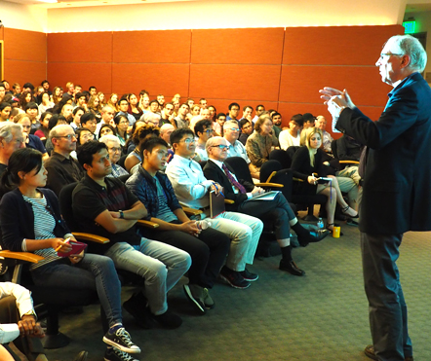
This Class uses the “Un-Lecture” format
Our class sessions are not information dumps. That’s the internet!
Instead we discuss what you have learned and reinforce important concepts.
You must come prepared to discuss the readings
Have your homework completed and bring it with you to class.
You will be called upon, and it will count for a grade.
You will complete a lot of ungraded work.

Slide 10
Let’s Go Over The Syllabus!
Methods of Evaluation
How you will be graded.

Slide 11
How This Course is Organized
Three Parts
Part one: IT Foundations
What is IT? Networking, Command line, Virtualization, etc…
Part two: IT Fundamentals
Clients and Servers, Hardware, Services, Security, etc…
Part three: IT Architectures in Practice
Web, IoT, Mobile, Email

Slide 12
Course Schedule
Notes:
Go over the schedule from the syllabus

Slide 13
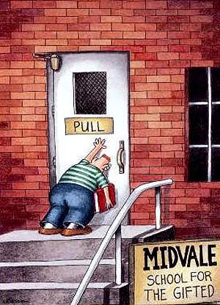
Recipe for Success!
#1 Come to class prepared.
Read and review the required materials before class
Make the most of your face time with me
#2 Take an interest in the course material
Be passionate; have fun.
How does it apply to your career? everyday life?
How can you put the knowledge you learn in class to practice outside of class?
#3 Ask for help instead of falling behind!

Slide 14

Your To-Do List
What to work on for next class
Notes:
ALWAYS CONSULT THE SYLLABUS

Slide 15

Questions?

