Slide 1
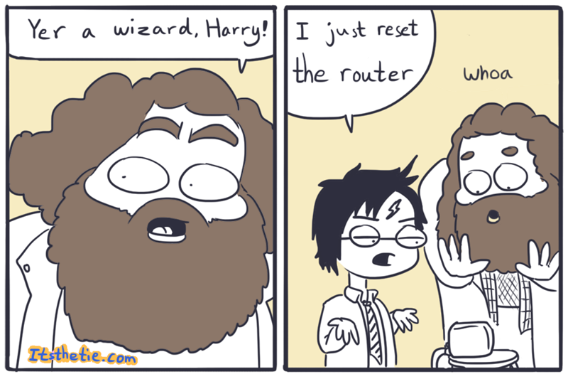
IST346: Networking Fundamentals

Slide 2

Agenda
Discussion
Content
Networking
TCP/IP
Core Services
Common Utilities
Summary
Homework
Questions

Slide 3
Discussion Questions
What does DHCP stand for?
Describe what DHCP does?
What is the difference between a hub and a switch?
Explain what is meant by a public / private internet address?
Notes:
Give students 1-2 minutes for each question. Its important to provide them with the opportunity to answer the questions based on the reading, labs, and assigned homework.

Slide 4
ROI / TCO Homework
TODO
Notes:
Give students 1-2 minutes for each question. Its important to provide them with the opportunity to answer the questions based on the reading, labs, and assigned homework.

Slide 5

What is a Computer Network?

Slide 6
Computer Network Definition
A computer network is two or more devices connected together using a telecommunication system for the purpose of communicating and sharing resources.
A connection between any two communicating devices (computer and printer, or headset and smartphone) could also be considered a network.

Slide 7
Why do we need a network?
To communicate and share resources between multiple computers
To connect to other networks. The Internet is a connection of networks.
Question: What would you do today with computers that are not networked?

Slide 8
Typical Resources to Share
Internet Connectivity
Printers / Speakers / Devices
Storage
Email / Messages
Web Content
Databases
Audio / Video

Slide 9
“The Network is the Computer”
In 1984, John Gage a co-founder of Sun Microsystems coined this phrase.
He had no idea how right he was!
Here are just a few things that are useless without a network…

Slide 10
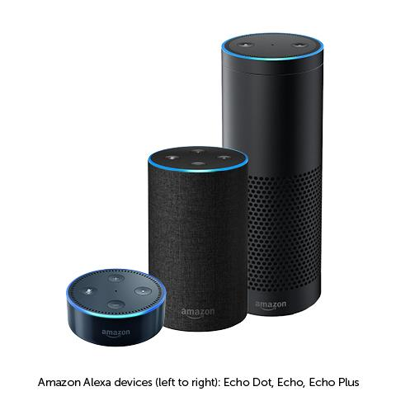

Slide 11
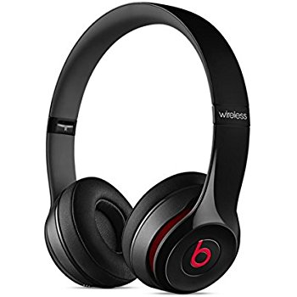

Slide 12


Slide 13
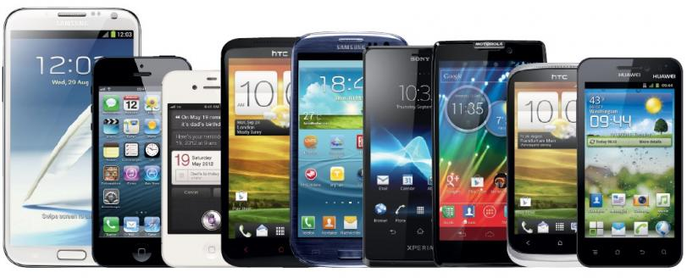

Slide 14

Check Yourself
What are some components of a network for which you are familiar?

Slide 15
Typical Components of a Network
Computers and Peripherals:
Desktops, Laptops, Phones, Gaming Consoles, Servers
Printers, Speakers, Scanners, TV’s, “Smart” devices like bathroom scales and thermostats.
Network Equipment:
Hubs, Switches, Routers, Firewalls, Wireless Access Points

Slide 16
Network Interface Card (NIC)
A circuit board or card that is installed in a computer so that it can be connected to a network.
Provides a computer with a dedicated, full-time connection to a network.
Can employ wired and/or wireless network connectivity.

Slide 17
Wireless Access Point (WAP)
Networking hardware device that allows a Wi-Fi compliant device to connect to a wired network.
Typically connects to a router (via a wired network) as a standalone device, but it can also be an integral component of the router itself.
A WAP is different from a hotspot, which is the physical location where Wi-Fi access to a WLAN is available.

Slide 18
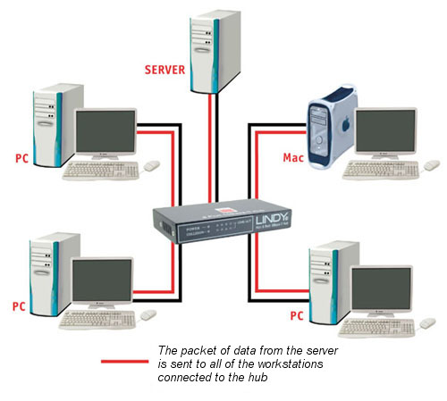
Hubs
Connect multiple Ethernet devices together
Hubs merely repeat signals out to all other ports (broadcast)
Inexpensive, simple way to connect computers
No smarts, unmanaged
Older Technology

Slide 19
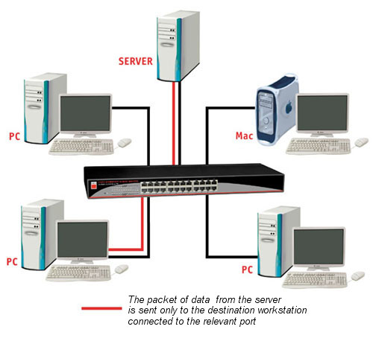
Switches
Connect multiple Ethernet devices together
Switches isolate ports by passing only data meant for that port.
Filters data packets, and only sends to the port which is connected to the destination address.
Offer a variety of management options.

Slide 20
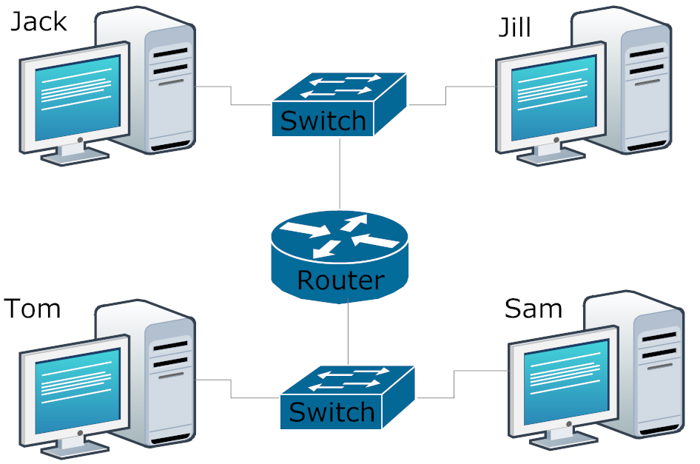
Routers
Act as a junction between two networks, and transfer data between them
Routers do most of the hard work on a network
They make decisions about where all messages travel on a network and whether to pass them between various networks.
They “bridge” different networks together.
Can provide additional networking features: DHCP, NAT, DMZ, Firewall, VPN

Slide 21
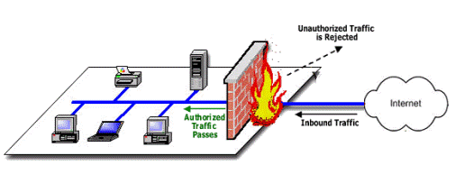
Firewalls
Filter messages or keep users and devices out of private networks.
Keeps unwanted traffic from reaching specific computing devices
Keeps devices from talking to anything but their desired networks and/or devices.

Slide 22
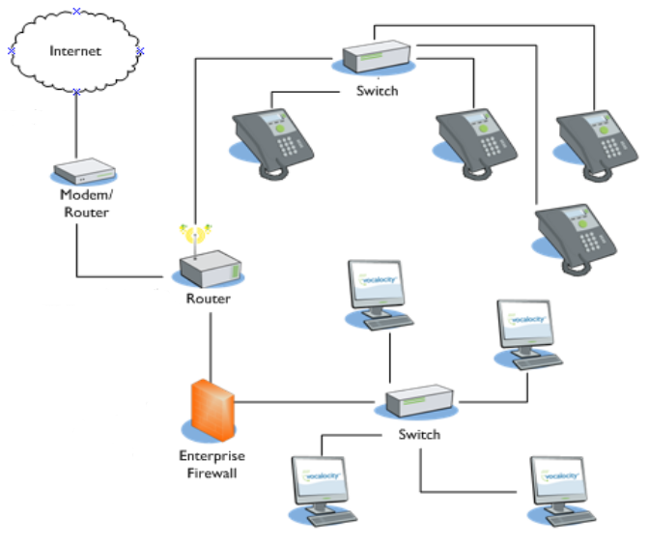
Putting It All Together

Slide 23
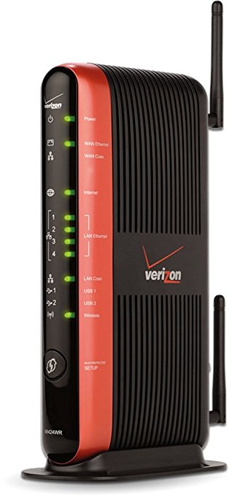
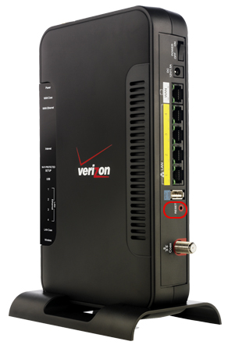
Check Yourself
What is this?
Hub
Switch
Router
Firewall
Wireless Access Point
Notes:
You’re probably seen one of these before in your home. It’s the device your Internet service provider leases to you so that you can access the internet. What type of network device is this?

Slide 24
Core Network services

Slide 25
What is a Protocol?
Standard used to define a method of exchanging data over a computer network
This defines a set of rules that end points on networks use when they communicate.
There are basically 3 types of protocols:
Application Layer like HTTP or SMTP.
Network Functionality like TCP/IP or ICMP
Media Access Layer like 4G LTE, Ethernet, WiFi
Notes:
Application Layer protocols defines how an application exchanges data. Such as in the case of HTTP where it defines how a web browser communicates with a website. Or SMTP which defines how a mail message is sent.
Network functionality layer protocols define how information is transported from one device to another and how the network governs access to a device, similar to how street addresses help us figure out how to get to a destination.
The media access layer protocols define how the device is physically connected to the network, whether by cable, short range, or long range radio signals.

Slide 26

TCP/IP
Transmission Control Protocol/Internet Protocol
Basic communication language or protocol of the Internet or private networks.
Consists of IP address + Logical Port
IP Address == Destination Device
Port == “Channel” under which communication occurs.

Slide 27
IP Addresses
IPv4
IPv6
Utilizes 32bits for internet addresses
Allows 4.29 billion possible unique addresses
Format of xxx.xxx.xxx.xxx, where xxx is 0 to 255
192.168.0 is a class C subnet (containing 255 addresses)
192.168.0.10 is an address of a specific device on that subnet
A subnetwork or subnet is a logical subdivision of an IP network.
Designed to address the increasing need for internet addresses.
Utilizes 128-bit addresses, providing more addresses to use.
340 undecillion possible unique addresses.
First 48 bits are the network.
Example of an IPv6 address:
2601:0681:4200:c5c0:516:f0bb:ac3b:46bd

Slide 28
Common Network Services
DHCP – dynamic host configuration protocol
Service that automatically assigns IP addresses to connecting devices
DNS – domain name services
Allows translation of names to IP addresses.
Clients use DNS caches to store recently obtained Name/IP Address pairs.
NAT – network address translation
Allows a router to present a single IP address to the Internet.
Keeps private networks private, while still able to communicate with external resources.
Used with port forwarding for inbound connections.

Slide 29






NAT with Port Forwarding Example
Request
HTTP Request: Translate: 1.2.3.4 to 192.168.0.15 port 80 to port 8888
HTTP Request: To: 1.2.3.4 on port 80 From: 9.8.7.6
HTTP Request
To: foo.com
From: 9.8.7.6
Public Internet
Home Web Server IP: 192.168.0.15
Port: 8888
Router / Firewall / DHCP Pub IP : 1.2.3.4 Prv IP : 192.168.0.1
DNS Server foo.com is 1.2.3.4
IP: 192.168.0.16
IP: 192.168.0.99
IP: 9.8.7.6

Slide 30
NAT with Port Forwarding Example
Response
HTTP Response: To: 9.8.7.6
From: 1.2.3.4
HTTP Response: To: 9.8.7.6
From: 192.168.0.15
Public Internet
NAT
HTTP Response: To: 9.8.7.6
From: 1.2.3.4
Home Web Server IP: 192.168.0.15
Port: 8888
Router / Firewall / DHCP Pub IP : 1.2.3.4 Prv IP : 192.168.0.1
IP: 192.168.0.16
IP: 192.168.0.99
IP: 9.8.7.6

Slide 31
Check Yourself
Which service translates names such as www.syr.edu to IP addresses?
Which service translates IP addresses, Typically between public and private?
Which service translates Ports, from public facing ports to a port on a private network?
Notes:
DNS
NAT
Port Forwarding

Slide 32
Commands Everyone Should Know
ipconfig / ifconfig
For retrieving IP configuration of a device
ping
To test communications with another device on a network.
nslookup
To resolve an IP Address to a DNS Name
nmap
To test open TCP ports on a network endpoint
tracert (traceroute)
For tracing the entire path a packet traverses to reach and endpoint
netstat
For viewing all active communications (inbound and outbound).
Notes:
Demonstrate commands if you have time
Ifcofnig / ipconfig
Ping host
Nslookup host
Nmap host
Tracacert host (does not work on docker)
Netstat -n

Slide 33

Your To-Do List
What to work on for next class

Slide 34
Exit Ticket
What one thing did you learn today that you didn’t know before class began?

Slide 35

Questions?

