Slide 1
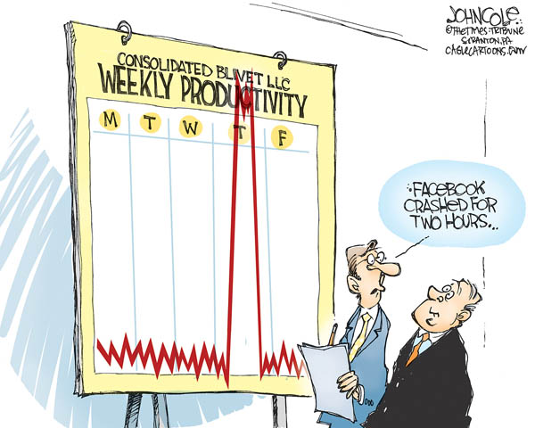
IST346: Services: Monitoring and Logging

Slide 2

Agenda
Discussion
Content
Services
Monitoring
Logging
Wrap-Up

Slide 3
Discussion Questions
What are the 6 characteristics of providing good service?
What aspects of a service should be monitored?
What are the two types of monitoring? Why are both important?
What are the uses of logs and benefits of logging?
What is end-to-end testing?
What is SNMP?
Where are the Linux system logs located?
Notes:
Give students 1-2 minutes for each question. Its important to provide them with the opportunity to answer the questions based on the reading, labs, and assigned homework.

Slide 4
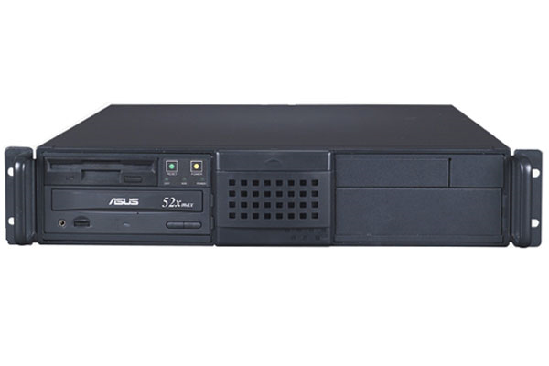


Recall: Server vs. Service
A server is a computer.
A service is an offering provided by server(s).
HTTP, for example
It is software

Slide 5
Services
Background process accessible over a network.
Typical environments have several services, and services often depend on other services.
Some services are simple, and have no interaction’s on the user’s part. (network time, or NTP for example)
It is best to think about any given service in terms of its anatomy and interdependencies.

Slide 6
Anatomy of a service
Instructions for transferring data to/from client/server (transport mechanism)
Protocols
Components
APIs
Rules for accessing or extending the service beyond the components, it may communicate with other systems.
Client and Server software part of the application or service interaction
Notes:
You don’t need all three but most of the time you do have all three of them.

Slide 7

Example: Wordpress
Protocols HTTP, HTTPS, WebDAV, SMTP
Components Web Browsers Apache Web Server PHP Scripting MySQL Database
APIs XML-RPC Atom RSS

Slide 8
Service Interdependencies
Complex interface, several protocols.
Application
Network
Core/Infrastructure
Services at the application level depend on lower-level services for their operation.
Basic interface with underlying protocol.
Essential to all other services. Minimal interface.

Slide 9



Service Dependencies: Example
HTTP, SMTP
DNS, DHCP, LDAP
Application
Network
Core Infrastructure

Slide 10
Services every IT professional should know
Core
NTP – Network time protocol. Keeps the clocks in sync on several hosts
DNS – Domain name system – a method of IP address to host name resolution.
DHCP – Dynamic Host configuration Protocol – a method of assigning IP information over the network.
LDAP – Lightweight Directory Access Protocol – a hierarchal database of directory information (users, groups, organizations, etc)
Kerberos – A network authentication protocol, used for securely evaluating identities over a network

Slide 11
Services every IT professional should know
Network
HTTP – Hypertext transport protocol. The application protocol for the WWW
SSL –Secure Sockets Layer – an encrypted channel for HTTP traffic
SSH / SCP – Secure Shell, Secure Copy. Unix/Linux remote shell and remote file copy protocols.
NFS – Network File System – File sharing for unix-like computers.
RDP – Remote Desktop protocol. A proprietary protocol for accessing Windows hosts over a network.
SMTP – Simple Mail Transport Service. Mail routing protocol.
OAuth2 – for account authentication and authorization.

Slide 12

Check Yourself: Understanding Services
What are the 3 things which make up the Anatomy of any service?
What is a core or infrastructure service? Provide an example.
Provide an example of a service which depends on another service.
A service like Gmail depends on which other services?

Slide 13
Providing a Service
Defined
1
Reliable
2
Scalable 3
Monitored 4
Maintained 5
Supported 6
Any service you provide must be:

Slide 14
Defining your Service
Defined
1
Customers are the reason for your service
How will they use it?
What features do they need? Want?
How critical is this service?
What are the required levels of availability and support?
Formulate a SLA (Service Level Agreement)
This will define the service being offered
Clarify the expectations for support levels and response time

Slide 15
Service Reliability
Reliable
2
Keep it simple
Simple systems are more reliable and easier to maintain
Make the trade-off between features and reliability
Use reliable hardware, of course!
Take advantage of vendor relationships
Have them provide recommendations (they should be the experts!)
Let multiple vendors compete for your business
Choose a vendor based on not only features but the stability of their company and product

Slide 16
More Reliability
Reliable
2
Use Open Architecture:
Open protocol standards and file formats
RFC’s from the IETF http://www.rfc-editor.org
Pros
Bigger selection of products and vendors to choose from
Decoupled client and server selection
Avoids being locked in to a specific platform or vendor
Con
Sometimes open standards don’t go far enough
Google-Worthy
Service-Oriented Architecture is changing the game a bit, as most services are gravitating towards interoperability (working with each other)

Slide 17
Last Slide on Reliability
Reliable
2
Any service should have 3 environments
Usually, each environment is on separate hardware
Dev
Test
Prod
Where you build out new features for the service / upgrades
Primary Environment for the Service
Mirror image of prod environment for testing purposes

Slide 18
Scalability
Scalable 3
Scalability
A service’s ability to grow with its demand.
Helps maintain performance levels.
You should try to plan for scalability when designing your service.
Two types of scalability:
Vertical (scale up) – Increasing the size of the node. Eg. add more RAM or an extra CPU to a server, buy a bigger washing machine,
Horizontal (scale out) – Adding more nodes to the service. Eg. purchase three more servers and balance their load, buy another washing machine, but keep your old one.

Slide 19
Scalability: H vs. V
Scalable 3
After
Vertical Scalability:
Before
Load Balancer
Horizontal Scalability:
Before
After
After
After
Notes:
Vertical Scalability – throw more hardware at the problem
Horizontal Scalability – re-engineer the problem

Slide 20
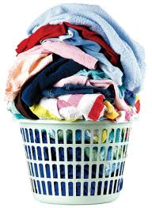
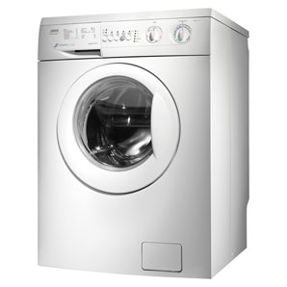
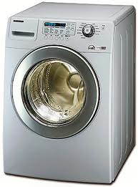
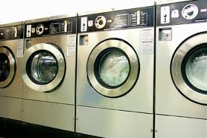
Scaling your Laundry
Scalable 3
You’ve got more laundry than your current washing machine can handle!!
Vertical
Horizontal
Use more than one washing machine
Use a bigger, faster washing machine
Notes:
Laundry is the traffic to your service
The washing machine is the service

Slide 21
Service Monitoring
Monitored 4
Layered Monitoring: PPS!
Ping: Monitor the host
Port: Monitor the port for the service
Service: Connect to the port; verify the response
A Monitoring agent should send an alert to the IT team when things aren’t right.
What, When, Where
Without adequate monitoring you cannot offer good service!

Slide 22
Monitoring and Logging
Monitored 4
Service Monitoring
Service Logging
Observing service activity in real-time
This is done by a computer, not a human.
Important events are passed on to a human (notification).
Keeping historical records of service activity
This data grows over time and can become quite large.
Only referred to when needed to troubleshoot a problem or trace down a security incident.

Slide 23
Why Bother?
Monitored 4
Why do we Monitor?
Why do we Log?
To detect / identify problems quickly.
Ideally you want to know about it before your users do.
To determine if resources are being constrained or over utilized.
Help get to the root cause of an issue or incident.
Help us predict problem and avoid them.
Provide historical data or trends for service usage.
Report on service activity.
If you’re not measuring it you aren’t managing it
Notes:
Service monitoring: SCOM
Service logging: Splunk, its-stats-box

Slide 24
How Monitoring and Logging Work
Server
Log
Service Activity
Service
Network Activity
Internal Service Monitor
External Service Monitor
Event
Event
SA

Slide 25
Example: Simple Web Service Monitoring
Linux Host: web.syr.edu
access_log
Service Activity
Apache HTTPD
Network Activity
ps –aux | grep “httpd”
nmap web.syr.edu
Event: Port unavailable
Event: Service stopped

Slide 26
Example: Email Service Monitoring
Exchange eMail
http
access_logs
Service Activity
Web mail service
Network Activity
Windows IIS web service monitor
SCOM test-mailflow.ps1script
Event: Port unavailable
Event: Service stopped

Slide 27
What to Monitor, what to Log?
Monitored 4
Monitor for a condition.
Send alert when the condition is met.
Log the condition whether it sends an alert or not.
Examples: (Why would you monitor/log these?)
CPU utilization stays at 100% for X minutes.
Free disk space drops below 10%.
Port does not respond for 1500 ms
HTTP request take more than 5 sec to get response.

Slide 28
Better Monitoring
Monitored 4
Normal
Normal: When a service fails you send an alert.
Proactive Monitoring
Proactive: When a service show signs it is about to fail you send an alert. (100% cpu, Long responses, etc.)
Automated Responses
Normal: When a service fails you send an alert.
Automated: When the service fails, you attempt to restart it. If the restart fails, you send an alert.
PM and AR are difficult and time-consuming to implement, but are time savers for difficult problems with no permanent fix.
A layered approach is always better.

Slide 29
Alerts!
Monitored 4
Types:
Email
TXT message
SMS Page
Automated dialer calls phone.
Pick the appropriate Alert for the appropriate Event and time.
Don’t send email when you’re not going to check it!
In a layered approach, you might send an email, and if the problem persists send a TXT, etc…

Slide 30
Logging
Monitored 4
Log files get very large
since they record all activity.
Log file rotation – service points to a different log file after a specified interval.
Lets you backup log files
Keeps the size of the files manageable.
Log files are text and they compress nicely.
How long do you keep logs?
Depends on service, depends on your policy
It’s not a decision the SA should make.
Ship logs to a Big Data system like Hadoop or ElastiSearch
Like an insurance policy. Not very useful until the off chance that you need it... then you’re glad you have it!

Slide 31
Service Maintenance
Maintained 5
Yes, there will come a time when you will need to deny service. (Make it unavailable.)
Upgrades to hardware / OS / Service itself
Plan and advertise your service outages so your users can plan accordingly.
Make sure your outage complies with your TOS.

Slide 32
Supporting your service
Supported 6
After your service is up and running, but before rolling it out you should:
Document how the service should be used and maintained by your IT staff
Train your IT staff how to support the new service
Train the users, if required
Build out self-help support for the service to reduce calls to the helpdesk.
Don’t forget to advertise the new service to your users.
Roll it out using “One – Some - Many” so you can get a handle of any unforeseen issues.

Slide 33
Providing a Service
Defined
1
Reliable
2
Scalable 3
Monitored 4
Maintained 5
Supported 6
Any service you provide must be:

Slide 34
Check Yourself: Service Dependencies
Consider a service like Dropbox.com or Google Drive.
What are the features?
What are the primary dependencies?
What are the external dependencies?
What constitutes a reasonable SLA? For this type of service?

Slide 36
Group Activity
Provide A Service

Slide 37
Group Activity: Providing a Service
Break up into teams of 3.
Choose a servic

Slide 38

Your To-Do List
What to work on for next class
Notes:
ALWAYS CONSULT THE SYLLABUS

Slide 39

Exit Ticket
Share one thing you learned today that you didn’t know before class!

Slide 40

Questions?

