Slide 1
Service Application Architectures

Slide 2
What do we mean by Service?
A Service is a running application or process accessible by users and other applications.
Email is an example of a Service Application.
Most services are complex, consisting of multiple dependent services.
For example to offer a web-based Email service application like Gmail you need these dependent services at minimum:
Web server (HTTP)
Message transfer agent (SMTP)
Message Store (IMAP)

Slide 3

What is Application Architecture?
Defines how the workloads of a service are partitioned or subdivided over a network.
This is done so that:
More than one client can access the service
The workload can be distributed to achieve better performance
Also Known As…
Multitier Architecture
Multilayered Architecture
Client-Server Architecture

Slide 4
Layers of An Application
Presentation
Code and layout responsible for the user interface
Business Logic
Data Access
Create, Read, Update and Delete (CRUD) operations
Data
Transformational logic at the heart of what the application actually does.
Data storage and retrieval of Relevant Data.
Notes:
An application consists of code + data

Slide 5
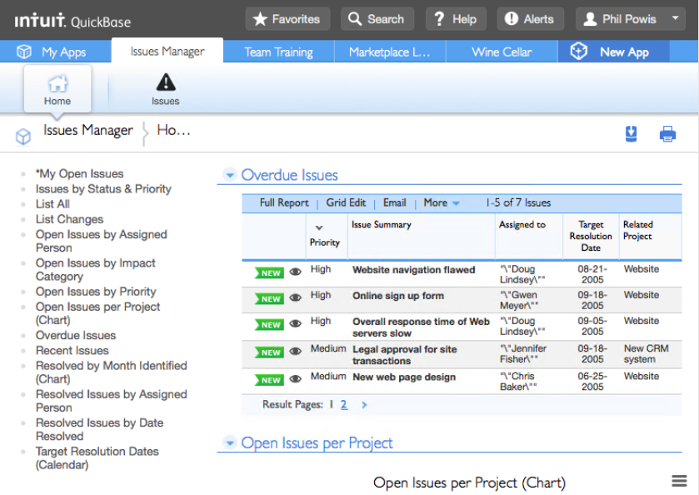
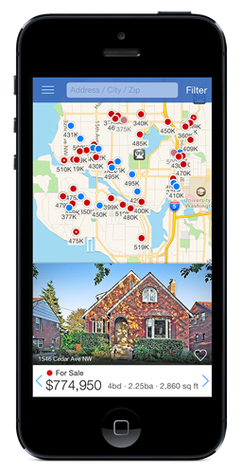
Presentation Layer
Code which addresses User interface concerns
Web: HTML and CSS
Mobile: Xcode interface builder / Android studio
Windows / Mac / Linux: Varies
Notes:
Any code responsible for user interface concerns is considered the presentation layer. In web applications the presentation layer is HTML and CSS. In mobile you build the layout using tools like Xcode or Android studio.

Slide 6
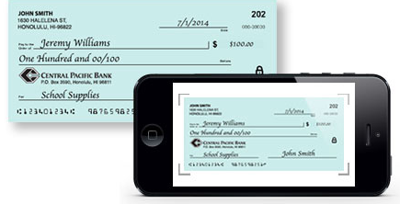
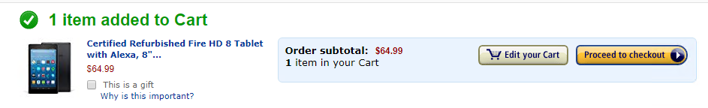
Business Logic Layer
Code to address the Transformational Logic of the application; part of the application’s functionality
Written in a programming language: Java, JavaScript, Python, C#, etc…

Slide 7
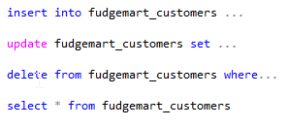
Data Access Layer
Responsible for CRUD (Create, Read, Update, Delete) Operations
Code which transforms operations into the DSL (Domain specific Language) to communicate with the database. (Typically SQL).

Slide 8
Types of Application Architectures
Monolithic
Monolithic over distributed storage
Two-tier thin client
Two-tier fat-client
Three Tier
N-Tier
Enterprise Service Bus
Micro Services
Complexity

Slide 9

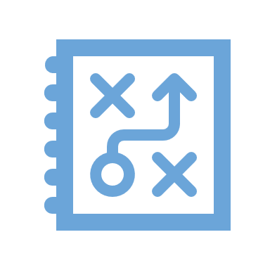
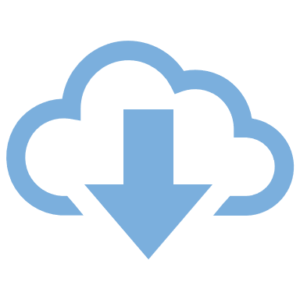
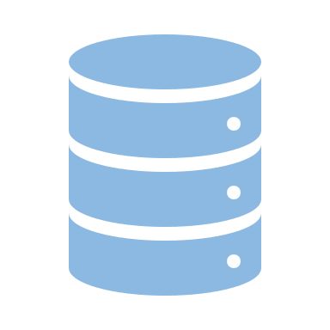
A Monolithic Application
All layers within a single system
Simplest design
Single-User. Single Site. No Scale.
Multiple uses, multiple instances.
Example: MS Word, application on your phone.
Presentation
Business Logic
Data Access
Data

Slide 10
Example: Monolithic Application
Can two people work on the same PowerPoint file at the same time? No!
Can everyone in your group edit the same word document at the same time? No!

Slide 11
Monolithic over Distributed Storage
Data storage is over a network but the rest of the application is monolithic.
Single-user multi-site.
Example: Two people share a word document over Google Drive.
Presentation
Clients
Business Logic
Data Access
File Storage
Data
Notes:
For example if you place a Microsoft access database in a cloud file sharing service like drop box, more than one user can access the database, but you still need the MS Access application to use the database and drop box does not handle concurrency issues for you like when more than one person updates the data at the same time.

Slide 12
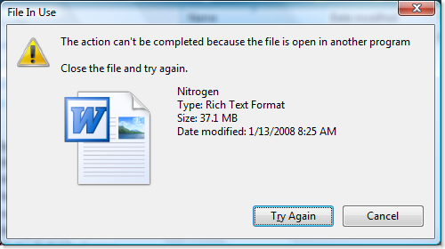
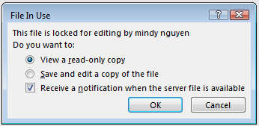
Classic Issue With Monolithic + Storage
Concurrency was not built into the application!

Slide 13
Scaling Up
We re-design / program the application to support multiple users by breaking up / splitting the layers.
Presentation
Clients
Presentation
Business Logic
Business Logic
Scale Up
Monolithic
Network + Middleware
Data Access
Data
Data Access
Server
Data
Notes:
We scale up data-oriented applications by separating the layers of the application into their own independent services which communicate over the network.
This allows more users to access the application, yet introduces some design complexity.
ADVANCE SLIDE
When an application’s layers are segmented we must introduce middleware between the applications of each layer in order for them to communicate. For example we might use ODBC middleware so that the data access layer can communicate with the database itself. Or in the case of the diagram you see an ODATA REST API so that the business logic can communicate with the data access layer.

Slide 14
Breaking Up Is Hard To Do!
When you separate an application into parts and run them separately they now require a way to communicate with each other!
“Hey Data Access Layer, I would like you to save this new order for me.”
Presentation
Data Access
Clients
Middleware
Server
Business Logic
Data
“Okay, business Logic. I saved it for you the order ID is 909242”

Slide 15
Middleware
Middleware is software which provides inter-process communications between the layers of an application.
It is required whenever an application is split into layers over a network.
There are different types of middleware for access between the different layers.
Notes:
Soap – simple object access protocol, ODBC -open database connectivity, ODATA -

Slide 16
Middleware Alphabet Soup
Name | What is it / What it does
ODBC (open database connectivity) | Database management systems access
CORBA (common object request broker architecture) | Business logic procedure call and data exchange
REST (representational state transfer) | A “pattern” that uses HTTP protocol for business logic / data exchange. Foundation of most web API’s
SOAP (simple object access protocol) | Like REST but more overhead / payload.
ODATA (open data protocol) | A spec for CRUD over HTTP using the REST patters

Slide 17
2-Tier Client/Server
In 2 Tier client/server the application is split in two parts separated by one layer of middleware.
This makes the application multi-user and multi-Site.
Common architecture in the pre-consumer Internet era of the 90’s.
Presentation
Clients
Business Logic
Network + Middleware
Data Access
Server
Data

Slide 18
Where is the Business Logic?
“Fat Client”
“Thin Client”
Clients
Presentation
Presentation
Clients
Business Logic
Network + Telnet (example)
Data Access
Business Logic
Network + ODBC (example)
Server
Data Access
Data
Server
Data
Notes:
Thin clients might use display only middleware protocols like RDP, Telnet or SSH. The presentation layer simply draws the screen and handles input. The rest of the application runs on a single server. Thin clients are easier to maintain as the business logic (and therefore most of the code) is found in one place on the server.
Fat clients have most of the application on the client and only the database is on the server. For example you might create a window application which writes to SQL Server or MySQL using ODBC.
Thin clients do not scale as well as fat clients as most of the work is being on expensive server hardware. Fat clients are more difficult to maintain than thin clients as the application codebase is installed on every client.

Slide 19
Thin-Client, Fat-Client examples
Fat Clients:
The application itself must be installed before you can use it.
Playing a game like Madden or Fortnite
Microsoft Outlook for Email
Thin Clients:
Nothing needs to be installed for specific to the application for it to be used.
Playing a game in your Web Browser
Gmail or Yahoo Mail

Slide 20
3-Tier Client/Server
In 3 Tier client/server the application is split into 3 parts. Typically with a business logic and data access layer in the middle tier.
Multi-user, Multi-Site.
Scales Vertically better than 2-tier
Majority of business logic is on the server
Common architecture during the Internet boom.
Presentation
Clients
Business Logic
Network + CORBA (Ex)
Business Logic
Server
Data Access
Network + ODBC (Ex)
Data
Data
Notes:
There needs to be some business logic in the client, mainly to package up messages to be sent to the server.

Slide 21
Web 3-Tier Example (Wordpress)
Presentation
HTML/CSS
Browser
Business Logic
JavaScript
Here’s is how the popular web application WordPress is architected.
HTTP / HTTPS
Business Logic
Apache+PHP
Server
Data Access
PHP ezSQL
ODBC
Data
Data
MySQL

Slide 22
N-Tier
Presentation
Browser
Break Up the Business Logic Even More… into as many Tiers as required.
That’s a lot of middleware. How do we deal with all that inter-process communication?
Business Logic
Web API
Business Logic
Business Logic
Services
Data Access
Data
Database
School of Information Studies | Syracuse University

Slide 23
Enterprise Service Bus
The ESB is a software application which manages the commuinication among independent systems.
It provides a consistent messaging API and guarantees delivery of information.
It’s a more robust middleware replacement used as the message backbone for N-tier applications.
Multiple applications share messages across the same bus. This is the foundation of Service-Oriented Architecture

Slide 24
Service-Oriented Architecture
TXT Msg
Enter-
Prise
Service
Bus
Business Logic
Presentation
Website
Business Logic
CRM API
Business Logic
Presentation
Mobile App
Business Logic
Business Logic
Data Access
Application Back-End
Presentation
CRM App
Business Logic
Database

Slide 25
Web As Middleware and Microservices
The Internet ushered in major changes for application development.
The SOAP and REST protocols over HTTP made it easy for developers to divide up the layers of their application and split business logic into manageable microservices.
These microservices manage a single responsibility, making the application easier to update and manage.

Slide 26
Typical Micro Services Responsibilities
Business Capability
Customers
Orders
Inventory
Messaging
Email
Push Notification
TXT Alert
Function / Task
Transcode Video
Convert a File
Close-Caption Video
Machine Learning
Other Data
Write Log Information
Usage Statistics (Telemetry)

Slide 27
Micro Services
Presentation
Presentation
CLIENTS
Browser
Mobile App
Business Logic
Business Logic
HTTP REST
Web API
Business Logic
HTTP REST
Business Logic
Business Logic
Services
…
SERVERS
Data Access
Data Access
ODBC
ODBC
…
Data
Database
School of Information Studies | Syracuse University
Database

Slide 28
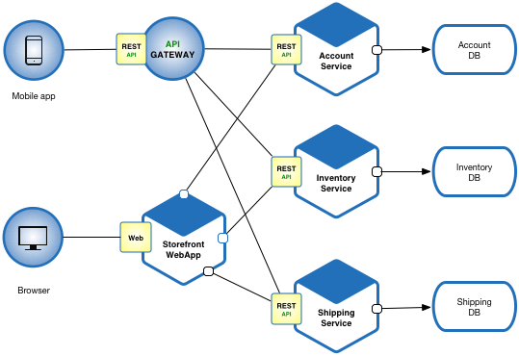
Micro Services Example
Brower and Mobile app are clients
HTTP and REST API’s are the Middleware
Separate Services for each business capability of the application

