Slide 1
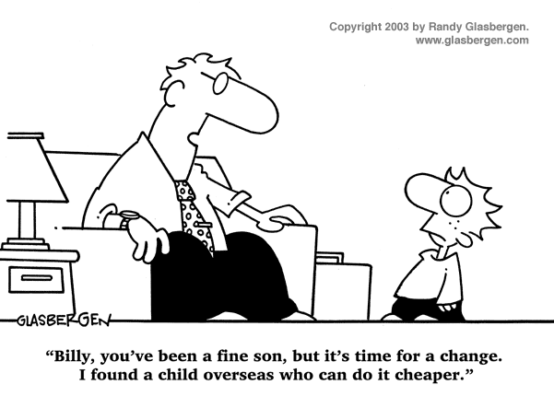
IST346: TEMPLATE

Slide 2

Agenda
Discussion
Content
Activity
Summary
Homework
Question

Slide 3
Discussion Questions
Some
Questions
Here
Please
Notes:
Give students 1-2 minutes for each question. Its important to provide them with the opportunity to answer the questions based on the reading, labs, and assigned homework.

Slide 4

Lab Debrief
Lab ?

Slide 5
Course Content
Dfhkalsjdf
Asdf
Fasdhfsad
sadf

Slide 6
Group Activity
Perform some group activity

Slide 7
Details of Group Activity
Fsadghsadfasd
Fsadgfsad
fashdfas

Slide 8

Your To-Do List
What to work on for next class
Notes:
ALWAYS CONSULT THE SYLLABUS

Slide 9

Exit Ticket
Share one thing you learned today that you didn’t know before class!

Slide 10

Exit Ticket
What was the most confusing thing we covered in this lesson?

Slide 11

Questions?

