Slide 1
Final Project
Pokemon Analysis

Slide 2
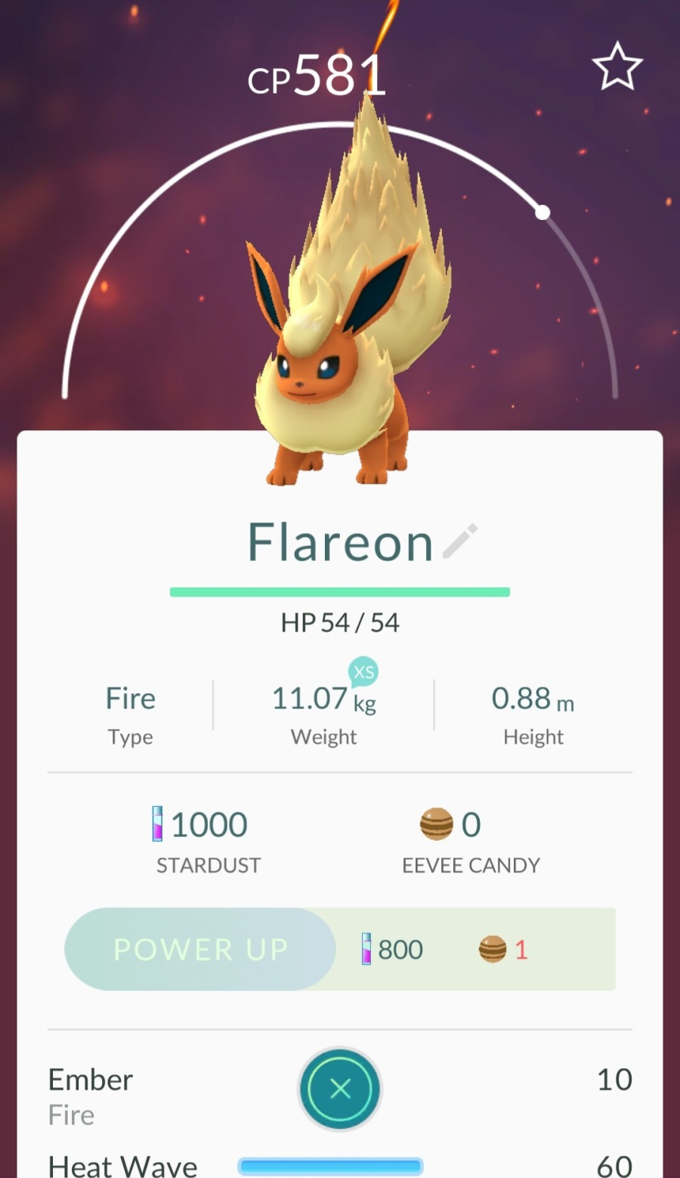
Type of the Pokemon
CP
HP
Stardust for power up
Level of the Pokemon
Grading:
35 base + ranking

Slide 3
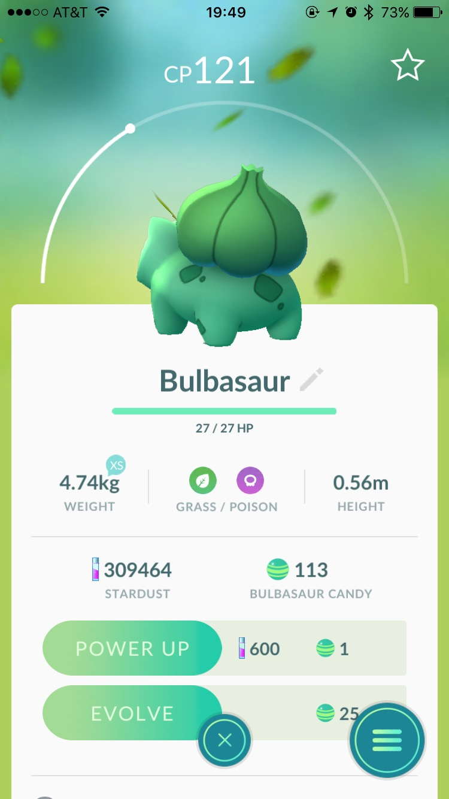
Dataset Description
The dataset has two parts:
train: for training
val: for validation. You could use “test.m” to calculate scores of these validation images for your trained model and tune the parameters.
Ground truth label could be found in image file name, e.g.: 136_CP581_HP54_SD800_8769_1.jpg
136_CP581_HP54_SD800_8769_1.jpg
Required stardust
CP
136_CP581_HP54_SD800_8769_1.jpg
001_CP121_HP27_SD600_8769_2.jpg
Pokemon ID
HP

Slide 4
Project Requirements
Report: problem description and your detailed solution
model.mat: the parameters for feature extraction, the parameters of your classifiers and detectors, etc.
pokemon_stats.m: The function you need to implement. * Please do not change the input and output name of the function.
[ID, CP, HP, stardust, level] = pokemon_stats (image)
ID number
Pokemon Level
(Indicated by the point on the semi circle)

