Slide 1
Simulation

Slide 2
Options
Required Simulation Types: DLTS – Dynamic Lap Time Simulation TRP – Track Replay SLS – Straight Line Simulation
Simulation Options:
AV Simulations → : Flexible Vehicle Setup: Quickly adjust parameters like Cx, Cz, CoG, suspension, and tires via GUI or Python API.
Sensitivity Analysis: Automate parameter sweeps (Cx, Cz, CoG, weight) and collect performance metrics such as lap time, stability, and braking.
Multi-Vehicle Comparison: Easily switch between different vehicle models for controlled, comparative studies.
Visualization: Plotting tool kit doesn’t exist, users are required to use MATLAB to extract and plot data.
Quote: $87-100K AUD for standalone SCANeR software (Perpetual License)
AVL Simulations → : Multiple levels
go_Race: Marketed towards smaller teams, locks the vehicle model but allows parameterization of changeable parts [quotes requested], planned for planned for mid-2026 launch. The go_Race Simulation is marketed towards lower tier teams. Approaching AVL to have a partnership working towards a validated model, which would incentivize lower tier teams to use the product, and in return we would get their simulation resources.
AVL VSM™ RACE: Fully customizable simulation tool, marketed towards would need extra packages to make use of it such as AVL DRIVE™ RACE, and AVL Simbook™ RACE [quotes requested].
Canopy Simulations → : Reliable lap time simulation with the ability to modulate and adjust parameters, visualization of sensitivities is also available as a package.
ChassisSim: Discrete lap time simulations, suitable for individual simulations but won’t be applicable for an easy approachable simulation sweep.
OptimumG: Contains parameters that users are able to change, doesn’t natively have sensitivity capabilities.
V8 Supercars MATLAB simulations as detailed below as in house simulation
Crowd Source: Require competitors to give detailed simulations are with discrete values. Competitors can manipulate the data sets here, such as flat Cz Maps, but a good first step in understanding sensitivities.

Slide 3
Supercars Simulation
Iterative Build Strategy:
Phase 1: Point Mass QSS
Single friction circle
No individual tires
Validate against simple test cases
Get lap time sensitivity working
Deliverable: Working BOP tool with Cx, Cz, mass sensitivities
Phase 1a: Add ▲Z Elevation profile / banking
Addition to Phase 1, adding elevation parameter)
Deliverable: Compare lap times to flat track
Phase 2: Add Load Transfer
Keep point mass for now
Calculate weight transfer
Use it to modify available grip (lighter loaded tires have less grip)
Deliverable: More accurate under/oversteer effects, CoG height sensitivity
Phase 3: Add Yaw Balance
Front/rear axle forces
Steady-state yaw moment balance
Simple linear tire model (Cα·α)
Deliverable: Understeer/oversteer balance, CoG position sensitivity
Phase 4: Individual Tire Forces
Four-corner load transfer
Track brake bias, differential effects
Deliverable: Detailed setup sensitivity (brake bias, diff settings)
Phase 5: Nonlinear Tire Model
Pacejka or brush model
Combined slip
Deliverable: High-fidelity predictions
Phase 6: Consider Transient Dynamics (optional)
If QSS isn't accurate enough, move to full dynamic simulation
Add suspension compliance, aero platform sensitivity
Much slower but captures transient weight transfer
Phase 7: Solid Body analysis
Add functionality to calculate the load through all joints.
Phase 8: Damper development
7 Post Vehicle Model, Damper development.
Parallelization
2 Months
Non-Matlab toolbox implementation
Opening new instances instead of MATLAB
Required Software:
MATLAB - $1,585 annual/3,960 perpetual
Perpetual license already owned for following
MATLAB
MATLAB Compiler
MATLAB Report Generator
Statistics and Machine Learning Toolbox
Motec API - $2,000

Slide 4
Report Automation
Use MATLAB to automate reports
Ensure that handling can be done for MATLAB to
Access, sort, and augment without user intervention
Motec API is needed to achieve this
Involves pulling data automatically to produce reports that require time to analyse but shouldn’t require time to retrieve the data
Brief session overviews should be available
Timing analysis – Timing and scoring data
Tyre pressure comparison (validation for drag strip analysis) – Telemetry
Tyre pressure stabilization
Lateral acceleration comparison – Telemetry
Longitudinal comparison – Telemetry
Top speed comparison – Telemetry
Other requests from management – Telemetry
API Complexities
API licenses are locked to hardware
Transfer complexities
Additional costs - ~$2k
Would need to purchase a second to transfer to the timing stand
C# used to convert to from Motec to a struct – would then be useable by all uses to do large augmentation on the datasets
Data is also accessible without a motec device, for non matlab users python can also access import scipy.io mat = scipy.io.loadmat('file.mat’)
While time inefficient, compiled code can be used to test with API license on Jeffs machine

Slide 5
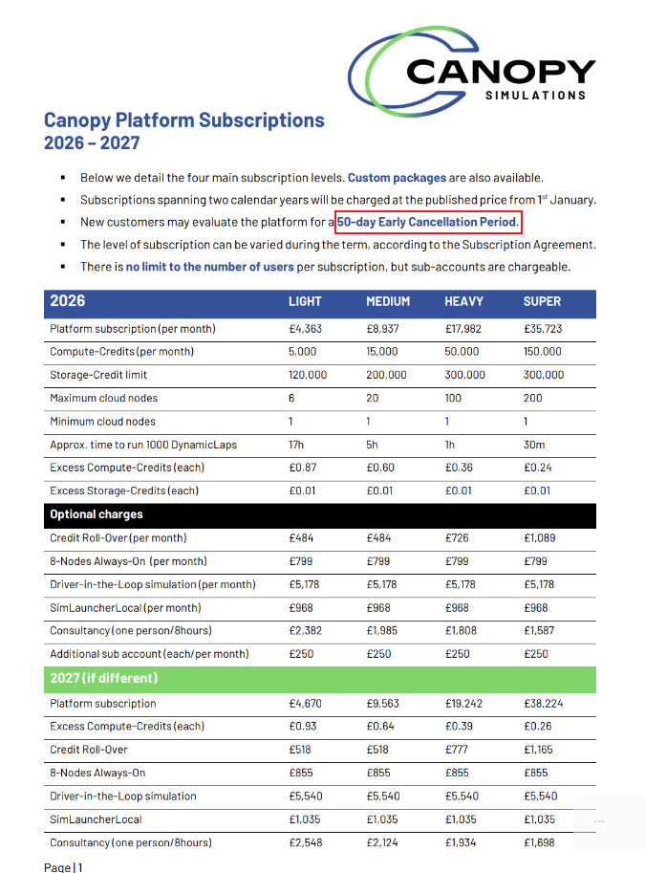
Quotes
€ 4,363 x 12 months) = ~$83k AUD Annual Unrealistic

Slide 6
Projection
Using AVL or AV simulations platform to, validate, test and develop future cars, while leasing or having an agreement which allows them the distribution and sale of our validated model.

