Slide 1
Supercars PR E07 TSV Plot Request Report 2026
Sessions:
Q21
Teams:

Slide 2
Contents
#
Title
Math Op
Plot Type
Colours
#
Title
Math Op
Plot Type
Colours
1
Three Ford Fastest Lap Compare
none
timeseries_align
driver
20
Three Chevrolet Fastest Lap Compare
none
trace_scatter_all
driver
2
Three Chevrolet Fastest Lap Compare
none
timeseries_align
driver
21
Three Chevrolet Fastest Lap Compare
none
trace_scatter_all
driver
3
Tyre Temperature Sensitivity
mean non zero
scatter
manufacturer
22
Driver Smoothness
change
scatter
manufacturer
4
Tyre Pressure Sensitivity
mean non zero
scatter
manufacturer
5
Tyre Locking Timer
mean non zero
scatter
manufacturer
6
Wheel Slip
mean non zero
scatter
manufacturer
7
Wheel Speed Compare
none
timeseries
manufacturer
8
Track GPS
none
scatter_trace
manufacturer
9
Tyre Lateral Acceleration
mean non zero
scatter
manufacturer
10
Tyre Temperature Sensitivity
mean non zero
scatter
manufacturer
11
Three Ford Fastest Lap Compare
none
trace_scatter_all
manufacturer
12
Tyre IGL
mean
sessionlapwise
manufacturer
13
Tyre Pressure Sensitivity
mean non zero
scatter
manufacturer
14
Fuel Consumption
change
scatter
manufacturer
15
Fuel Consumption
change
scatter
manufacturer
16
Three Ford Fastest Lap Compare
none
trace_scatter_all
driver
17
Three Toyota Fastest Lap Compare
none
trace_scatter_all
driver
18
Three Chevrolet Fastest Lap Compare
none
trace_scatter_all
driver
19
Three Chevrolet Fastest Lap Compare
none
trace_scatter_all
driver

Slide 4
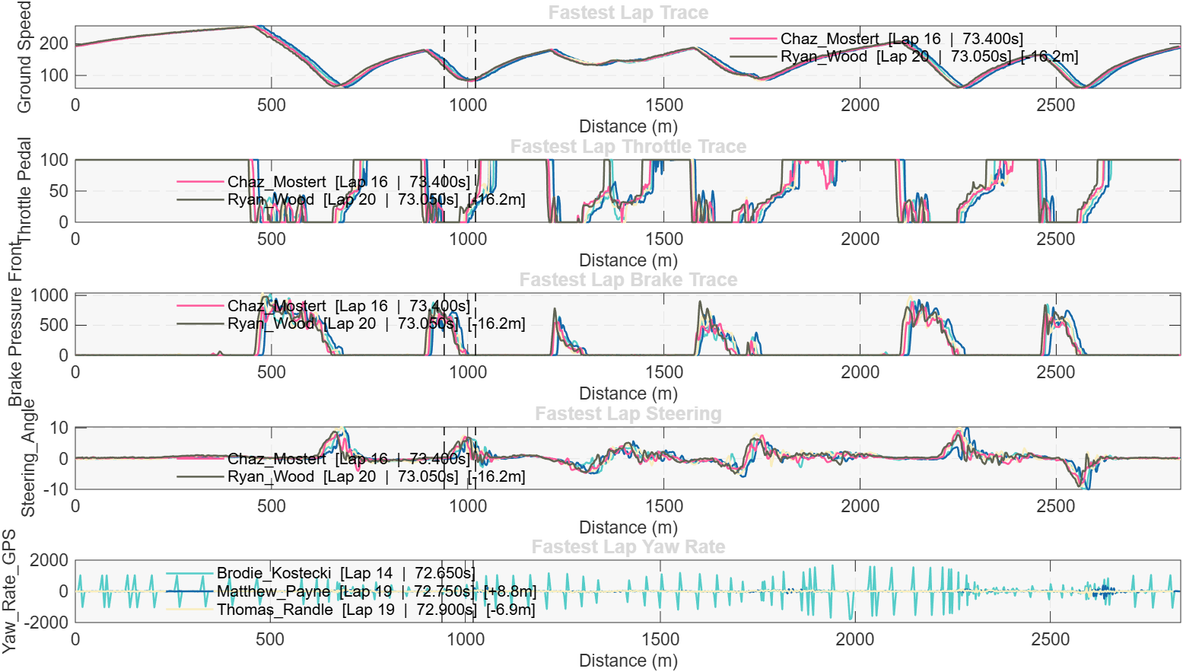
Three Ford Fastest Lap Compare

Slide 5
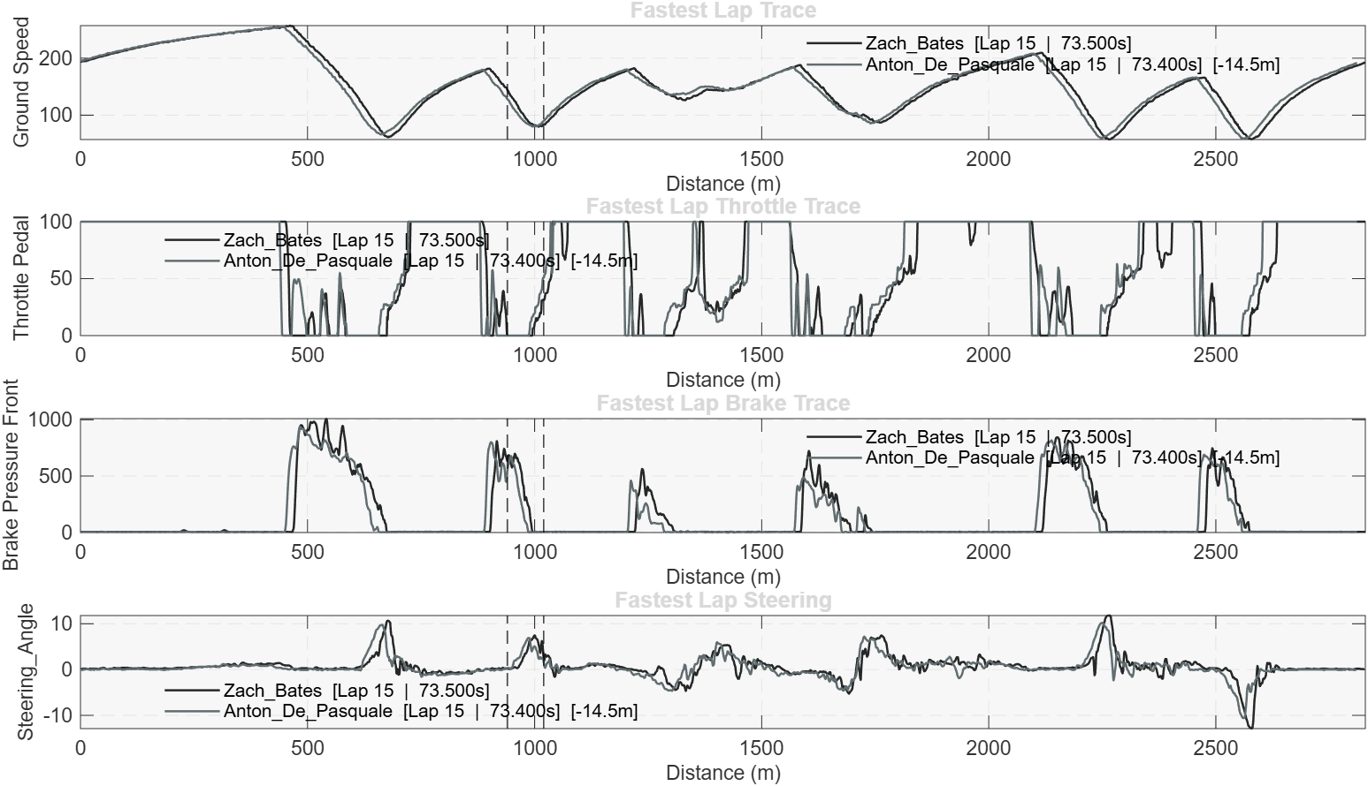
Three Chevrolet Fastest Lap Compare

Slide 6
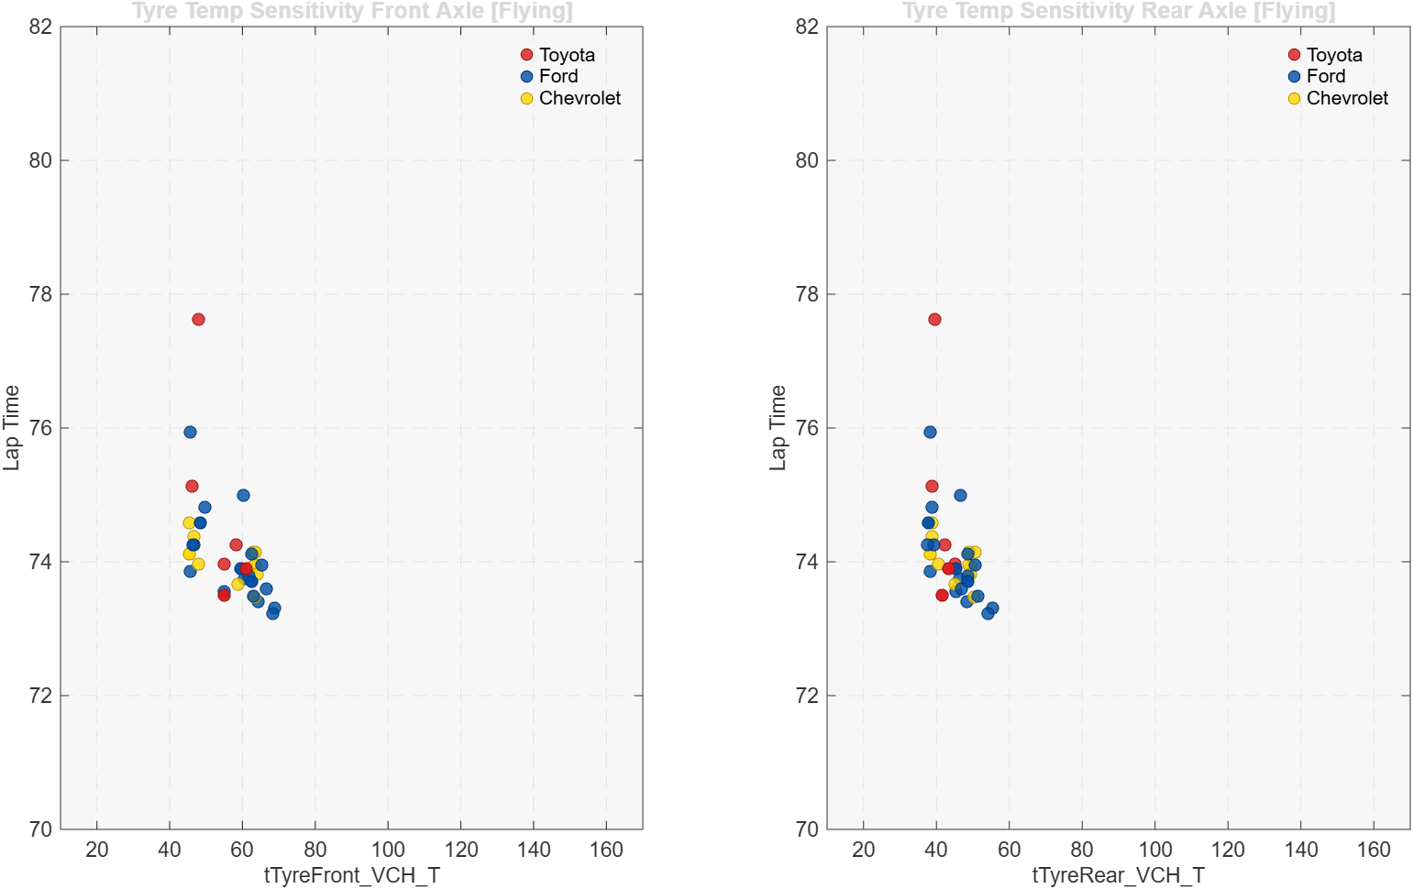
Tyre Temperature Sensitivity

Slide 7
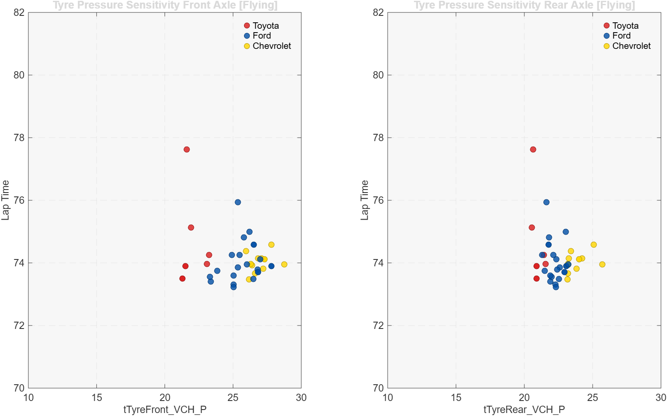
Tyre Pressure Sensitivity

Slide 8
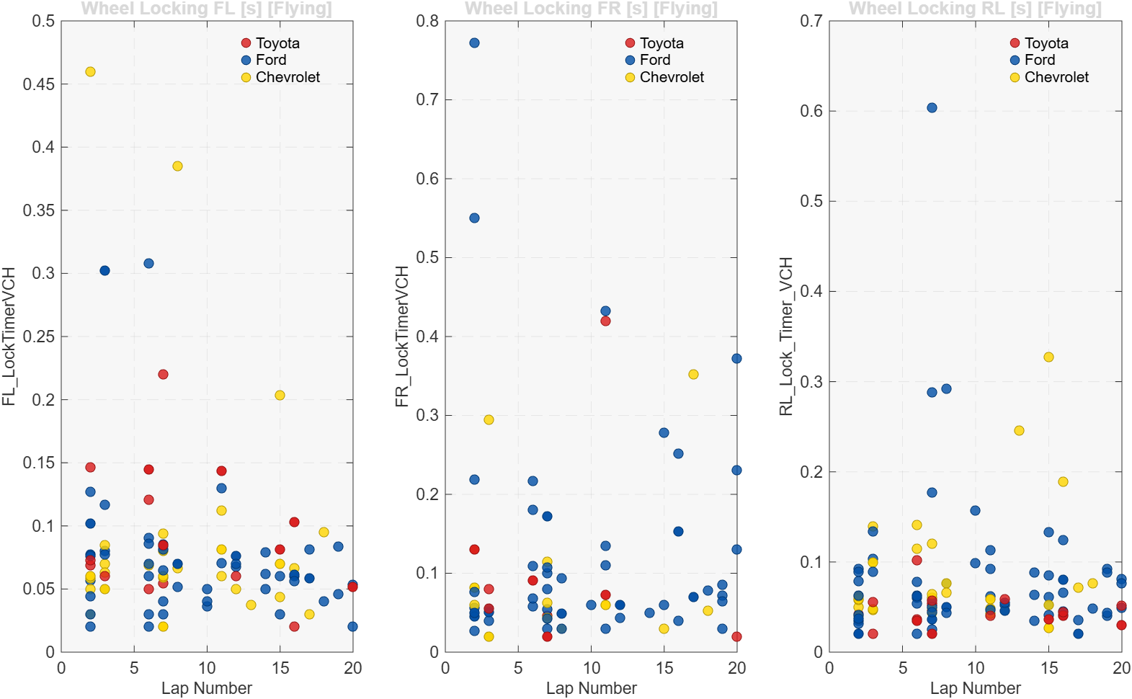
Tyre Locking Timer

Slide 9
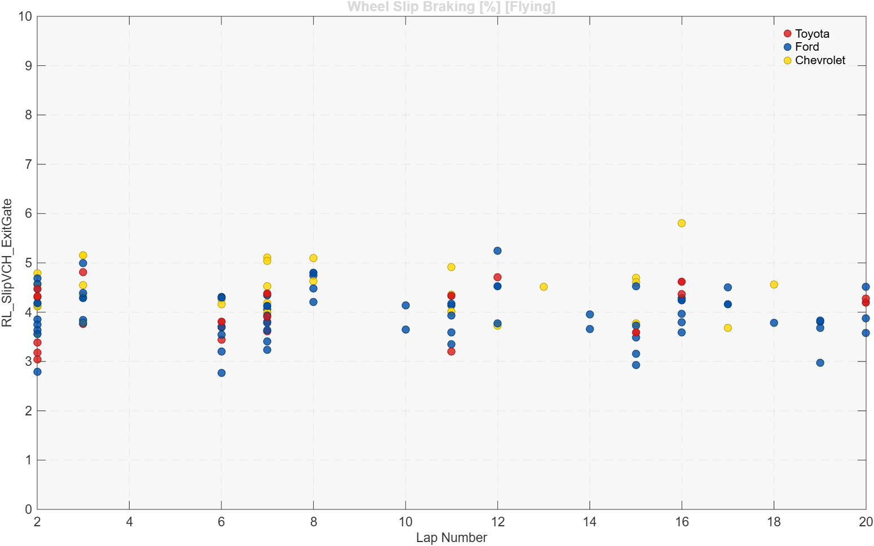
Wheel Slip

Slide 10
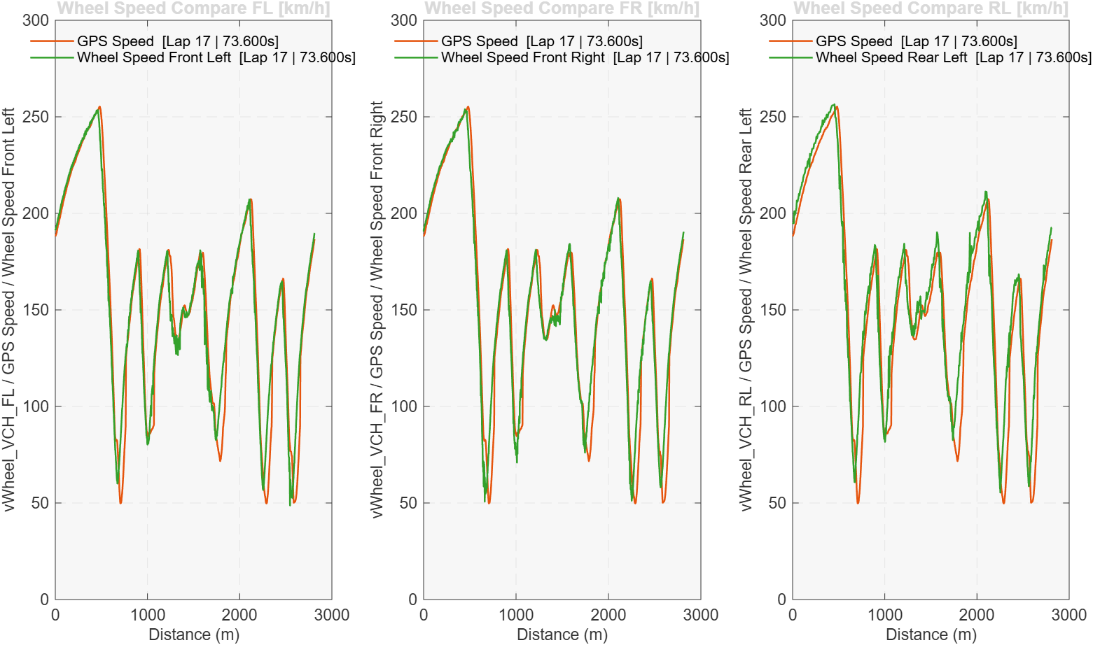
Wheel Speed Compare

Slide 11
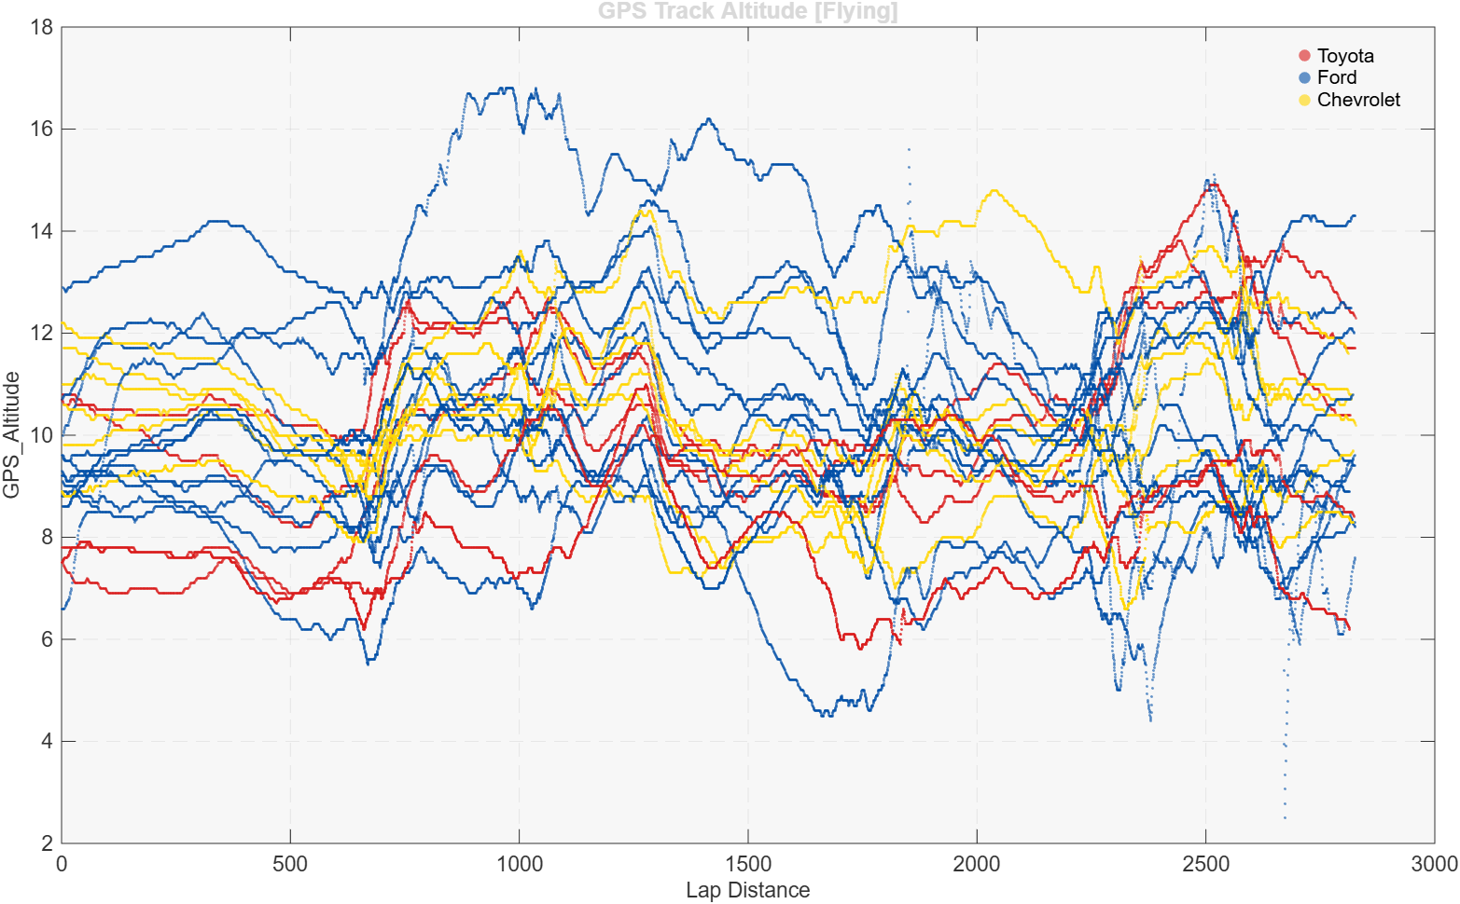
Track GPS

Slide 12
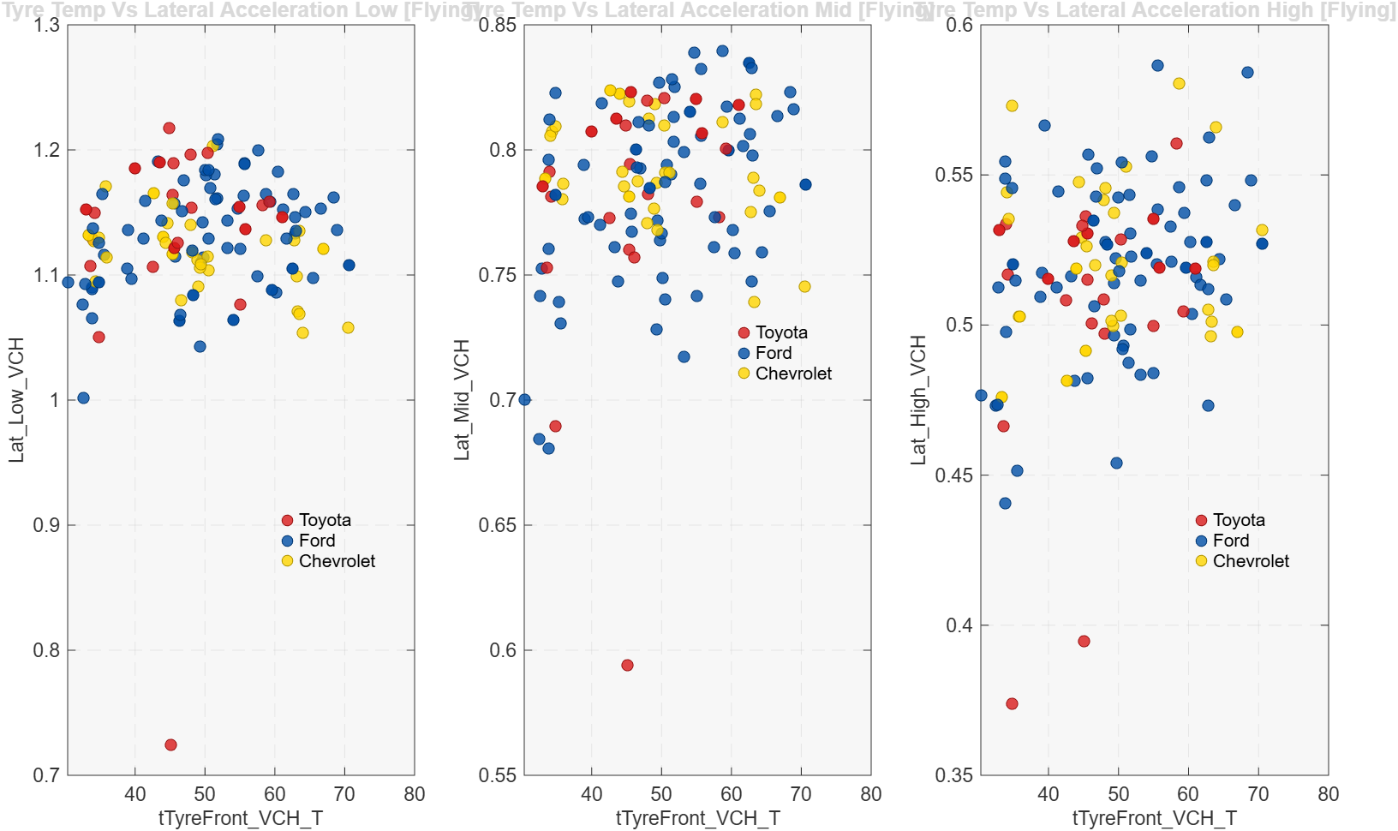
Tyre Lateral Acceleration

Slide 13
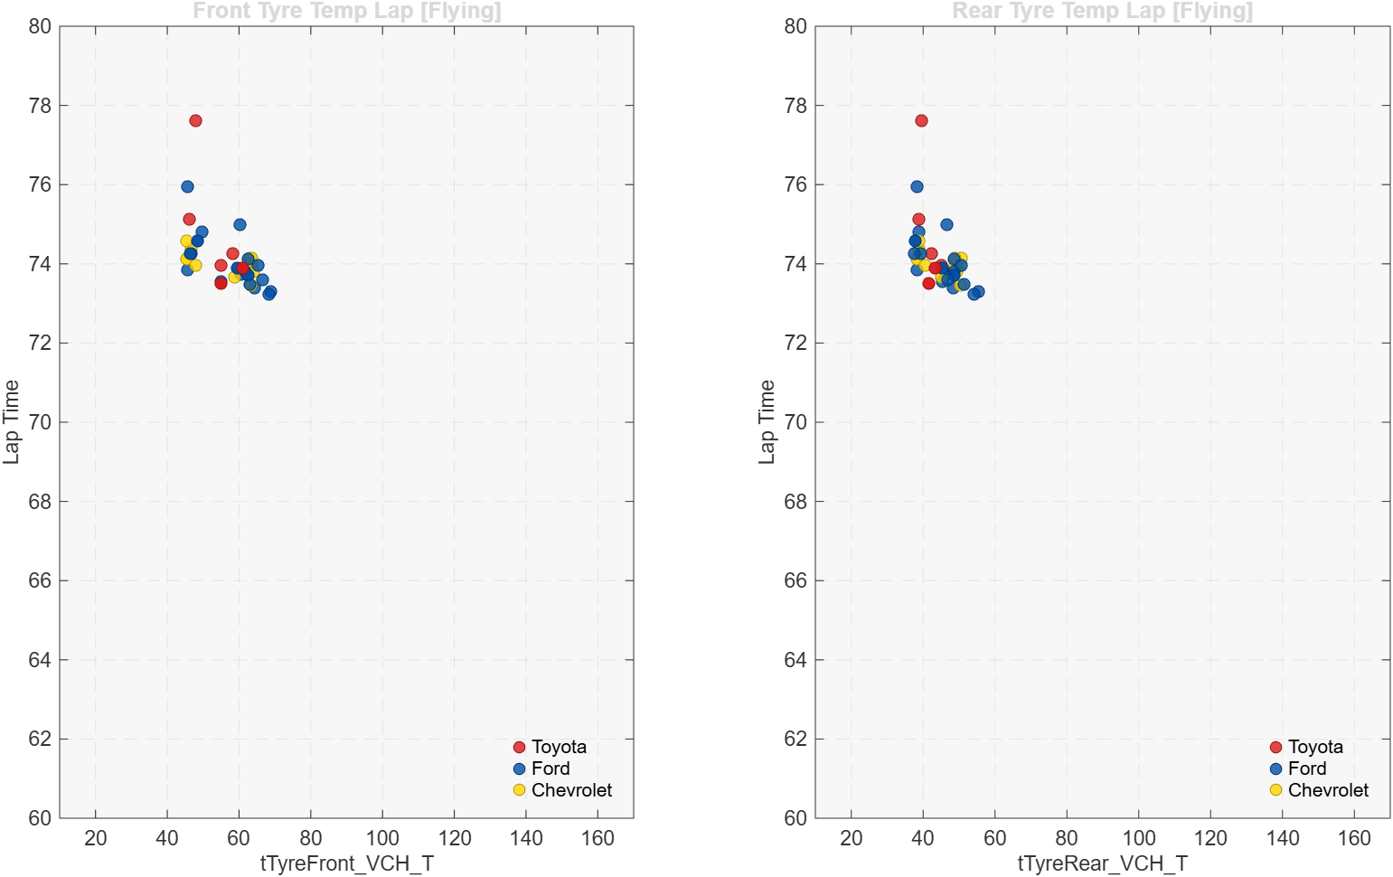
Tyre Temperature Sensitivity

Slide 14
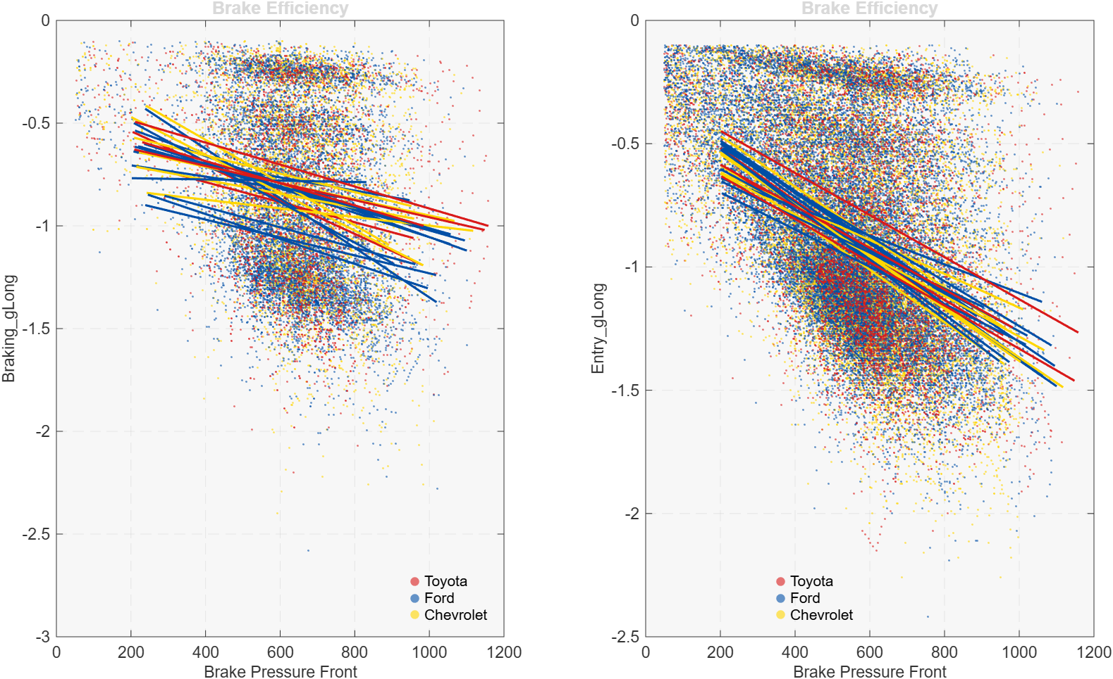
Three Ford Fastest Lap Compare

Slide 15
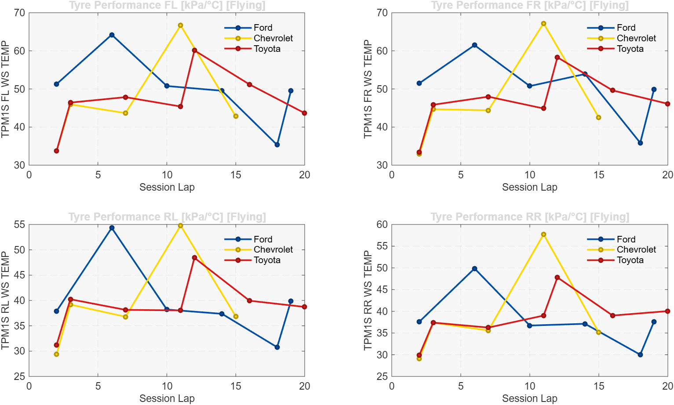
Tyre IGL

Slide 16
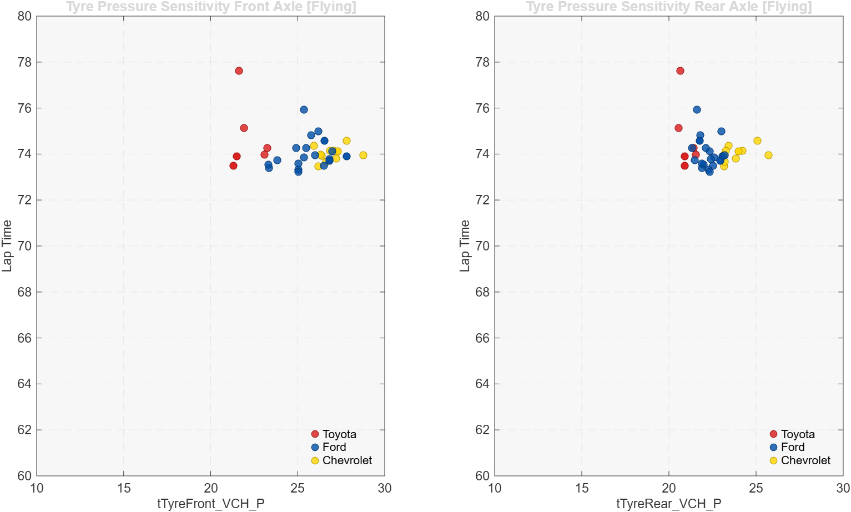
Tyre Pressure Sensitivity

Slide 17
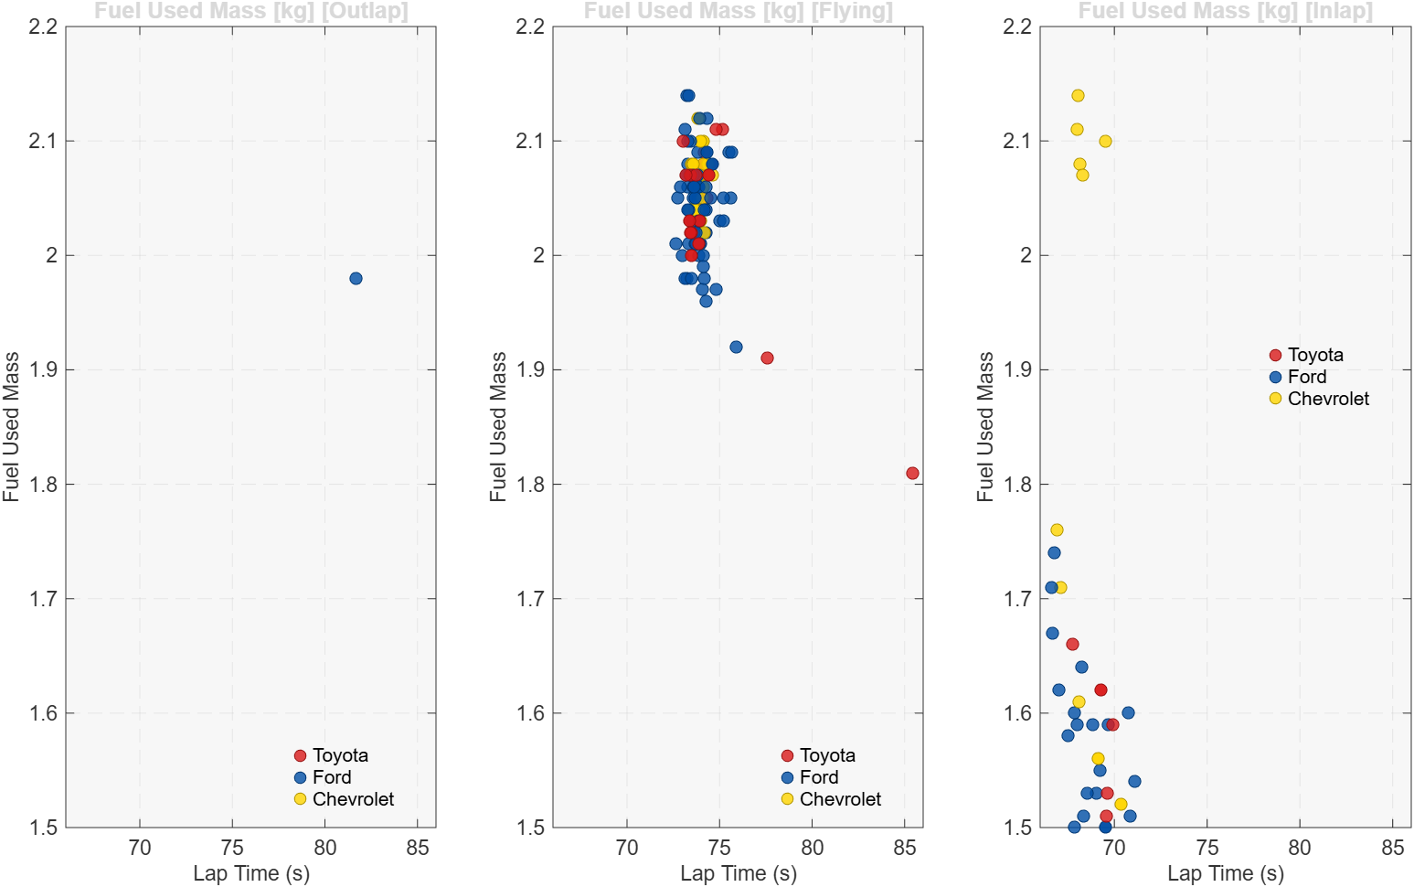
Fuel Consumption

Slide 18
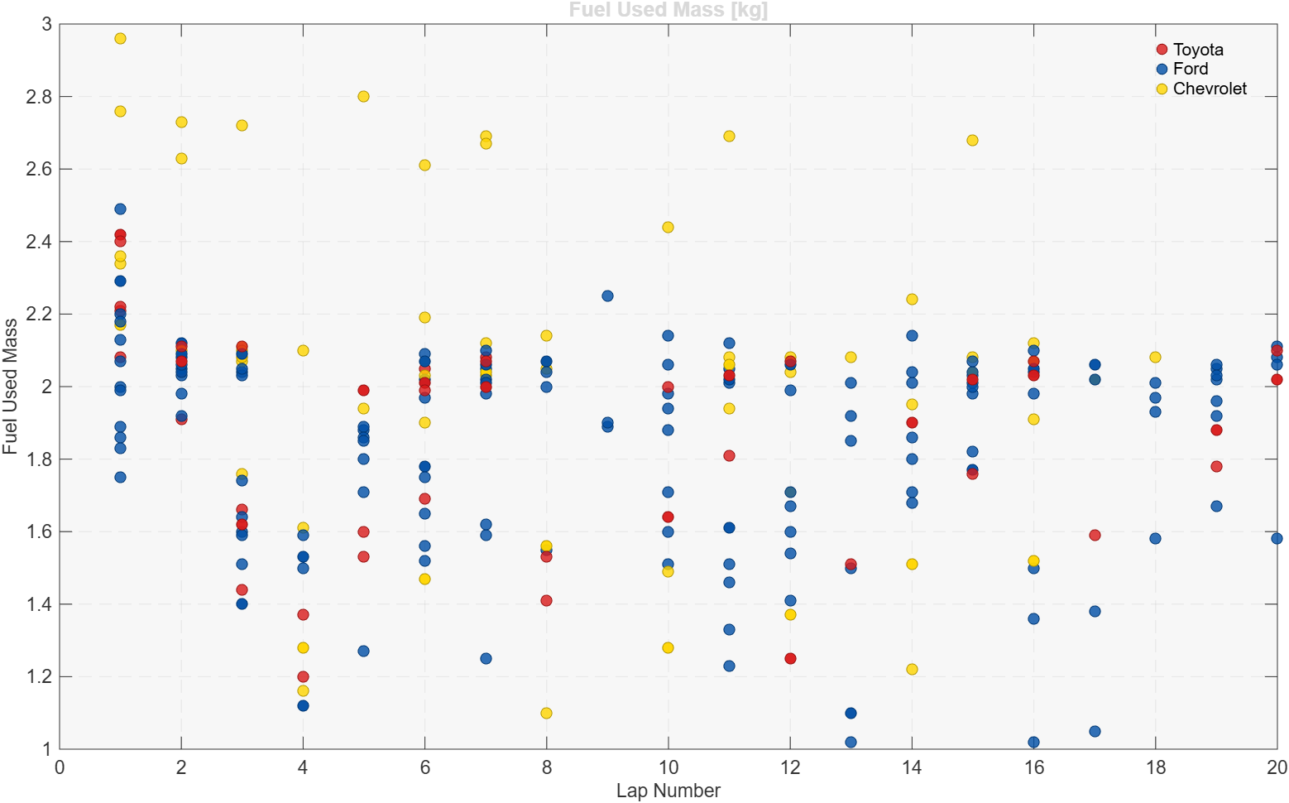
Fuel Consumption

Slide 19
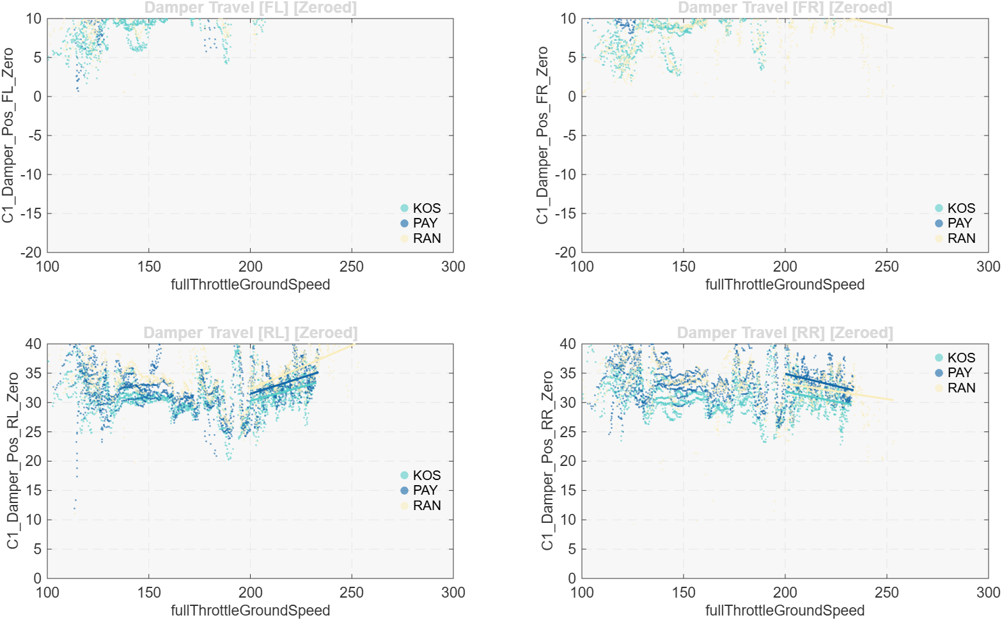
Three Ford Fastest Lap Compare

Slide 20
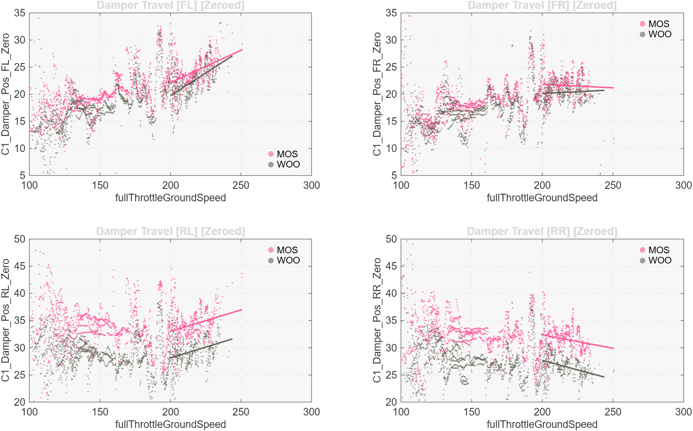
Three Toyota Fastest Lap Compare

Slide 21
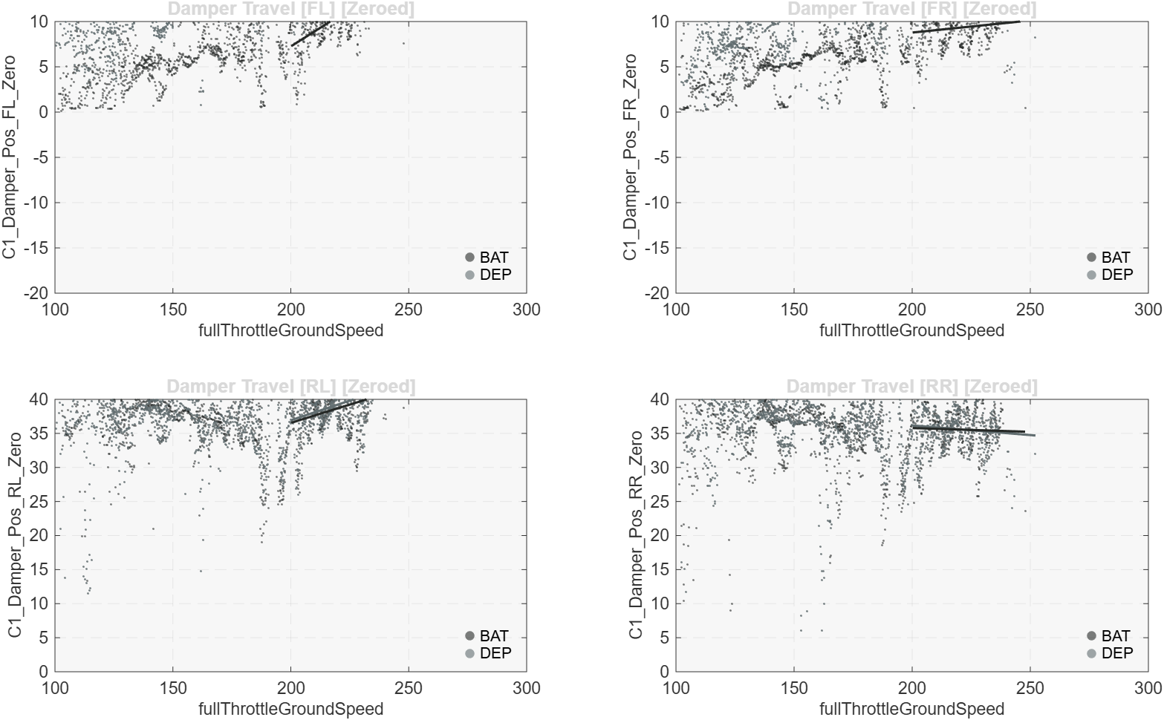
Three Chevrolet Fastest Lap Compare

Slide 22
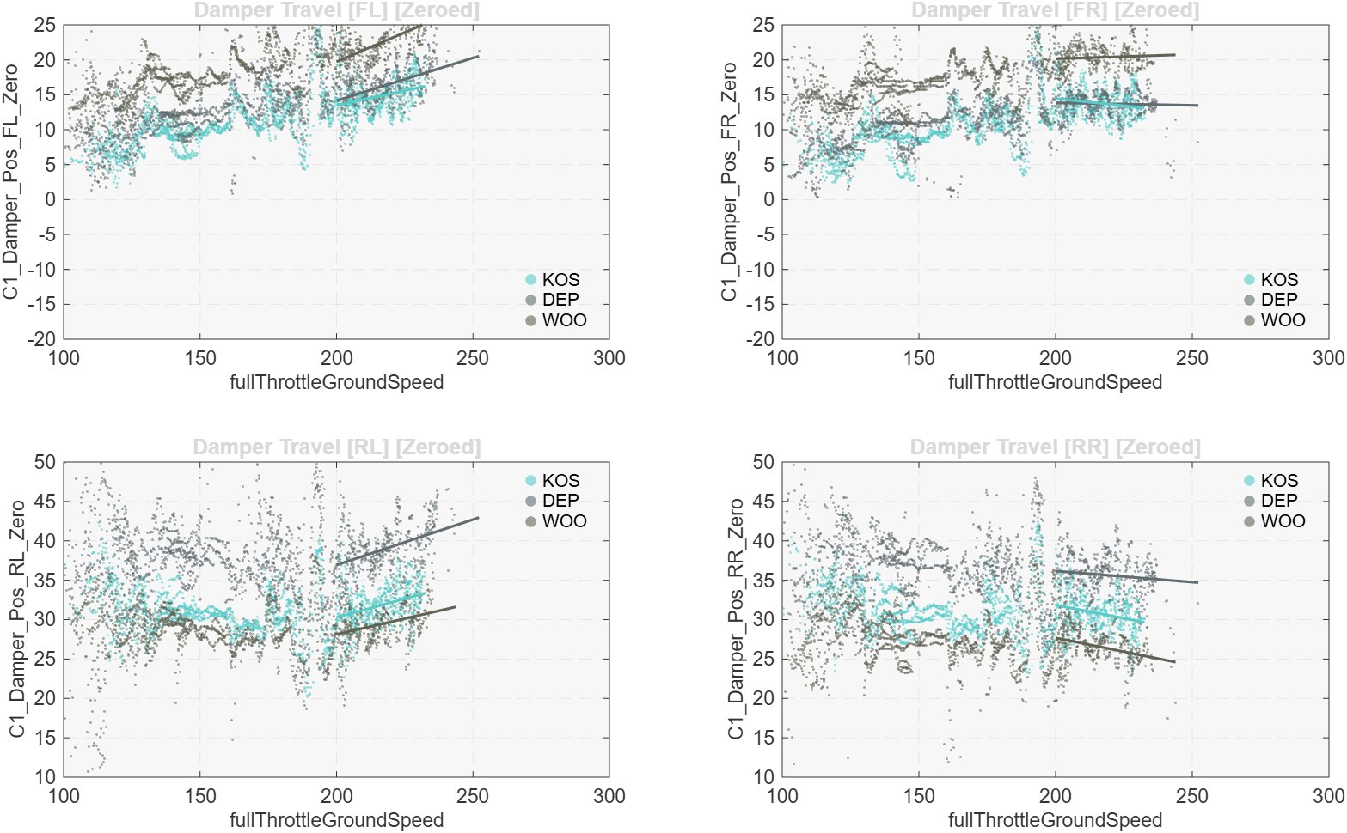
Three Chevrolet Fastest Lap Compare

Slide 24
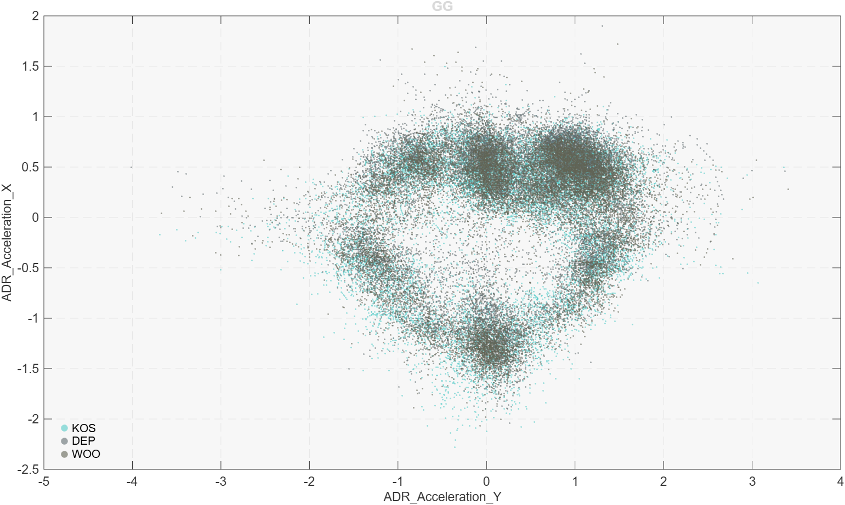
Three Chevrolet Fastest Lap Compare

Slide 25
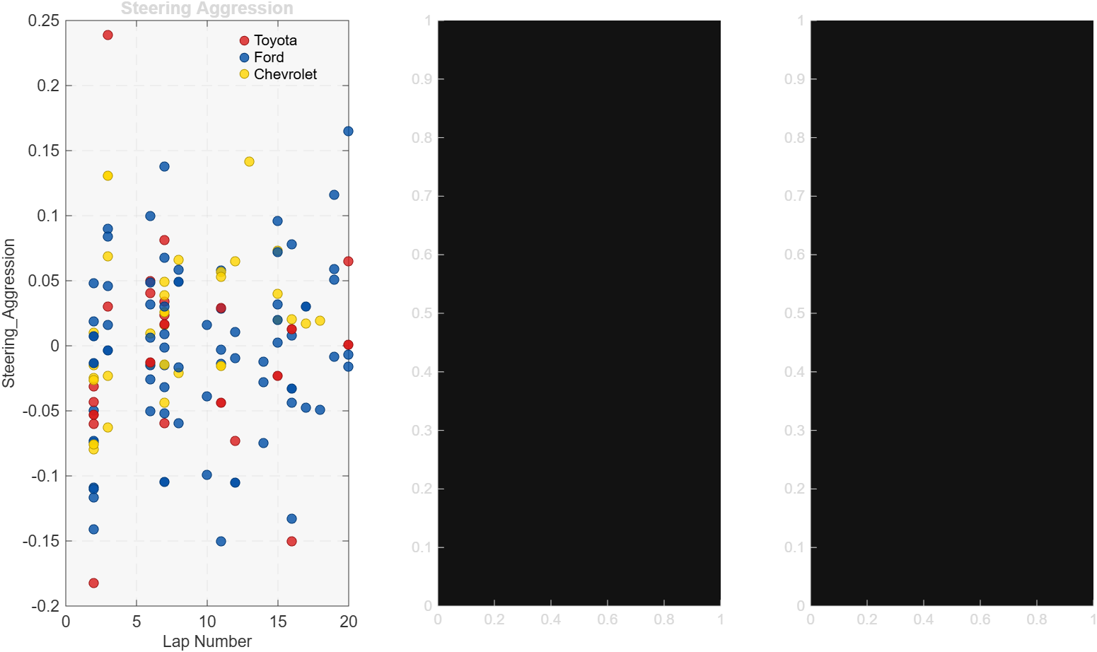
Driver Smoothness

