Slide 1
Supercars Performance Report 2026
Sessions:
R18
Teams:

Slide 2
Contents
#
Title
Math Op
Plot Type
Colours
1
Three Ford Fastest Lap Compare
none
timeseries_align
driver
2
Three Toyota Fastest Lap Compare
none
timeseries_align
driver
3
Three Chevrolet Fastest Lap Compare
none
timeseries_align
driver
4
Three Chevrolet Fastest Lap Compare
none
timeseries_align
driver
5
Tyre Temperature Sensitivity
mean non zero
scatter
manufacturer
6
Tyre Pressure Sensitivity
mean non zero
scatter
manufacturer
7
Tyre Locking Timer
mean
scatter
manufacturer
8
Wheel Slip
mean non zero
scatter
manufacturer
9
Wheel Speed Compare
none
timeseries
manufacturer
10
Track GPS
none
scatter_trace
manufacturer
11
Tyre Lateral Acceleration
mean non zero
scatter
manufacturer
12
Tyre Temperature Sensitivity
mean non zero
scatter
manufacturer
13
Three Ford Fastest Lap Compare
none
scatter_trace
manufacturer
14
Tyre IGL
mean
sessionlapwise
manufacturer
15
Tyre Pressure Sensitivity
mean non zero
scatter
manufacturer
16
Fuel Consumption
change
scatter
manufacturer
17
Fuel Consumption
change
scatter
manufacturer

Slide 6
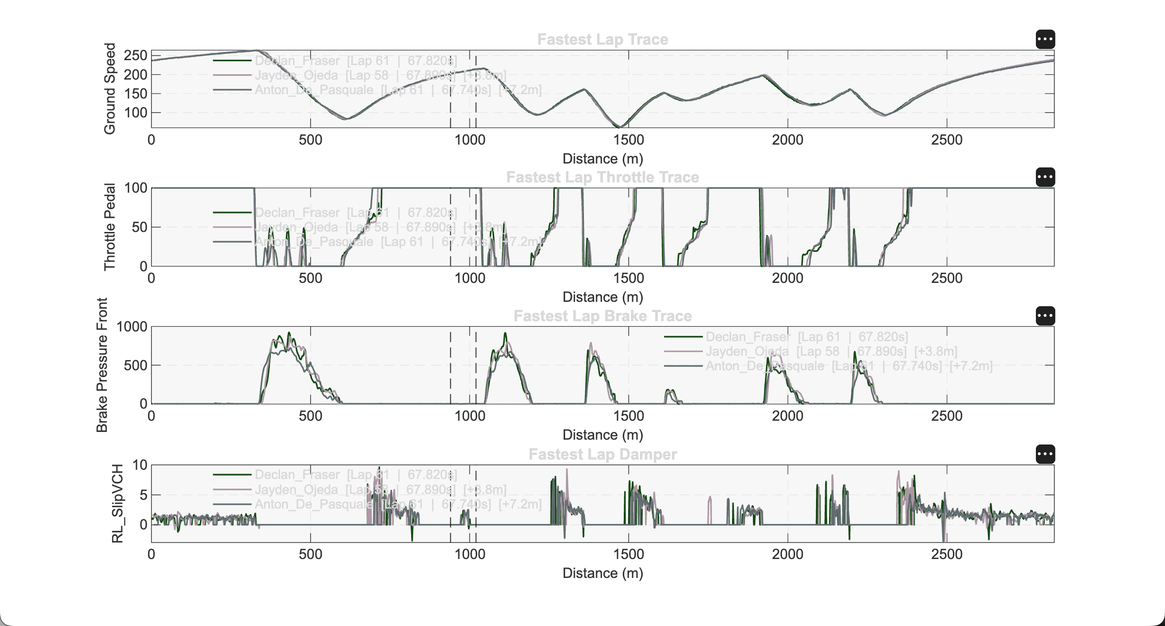

Slide 18
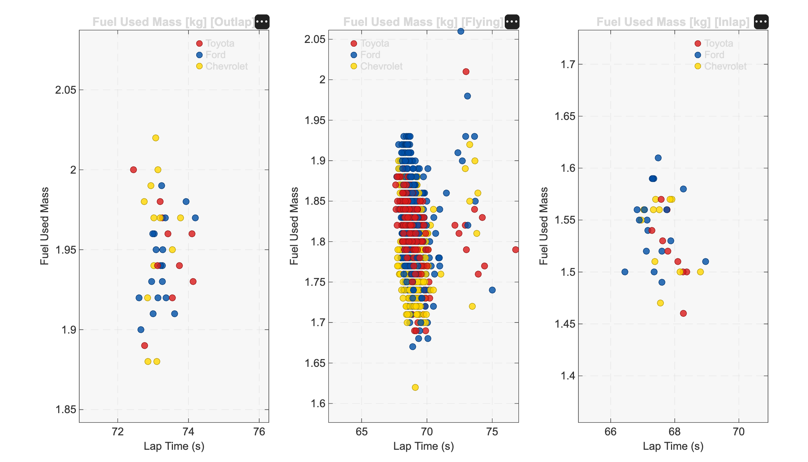

Slide 19
