Slide 1
Supercars Systems Report 2026
Sessions:
R19
Teams:

Slide 2
Contents
#
Title
Math Op
Plot Type
Colours
1
Driver Monitor
mean
sessionlapwise
custom
2
Driver Helmet Monitor
mean
sessionlapwise
custom

Slide 4
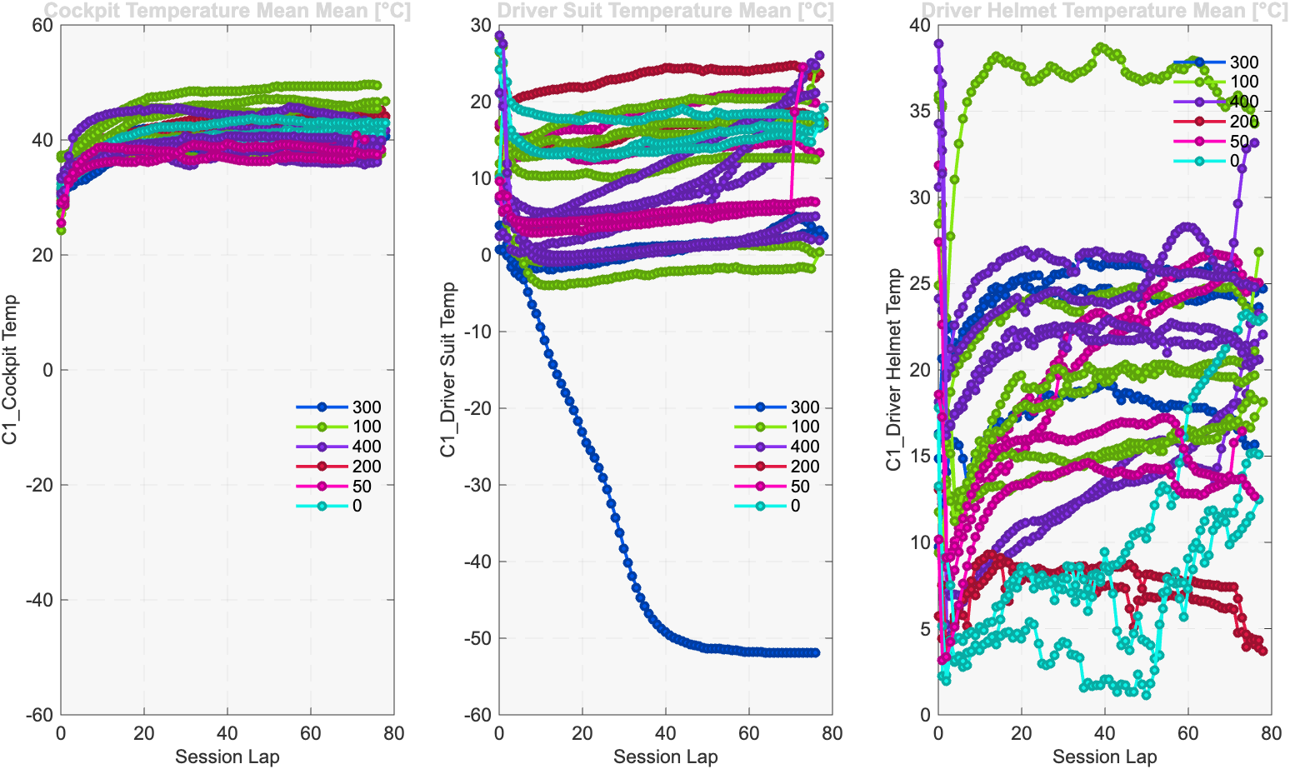

Slide 5
