Slide 1


Evaluating Large Language Models for Character Identification in Italian Renaissance Epics
A Case Study on “Orlando Furioso”
Text2Story’26 Workshop @ ECIR'26
Delft, The Netherlands - March 29th, 2026
Gaudenzia Genoni¹, Alfio Ferrara^{1,2}, Stefano Montanelli¹
¹University of Milan, Department of Computer Science, Via Celoria, 18-20133 Milan, Italy
²University of Milan, Department of Literary Studies, Philology and Linguistics, Via Festa del Perdono, 7-20122 Milan, Italy

Slide 2
Introduction
Research Question
Can LLMs identify characters in the low-resource literary domain of Italian Renaissance epic poetry?
Challenges
Linguistic complexity
Segmentation into smaller textual units
Case Study
The first twelve cantos of Orlando Furioso (The Frenzy of Orlando).

Slide 3
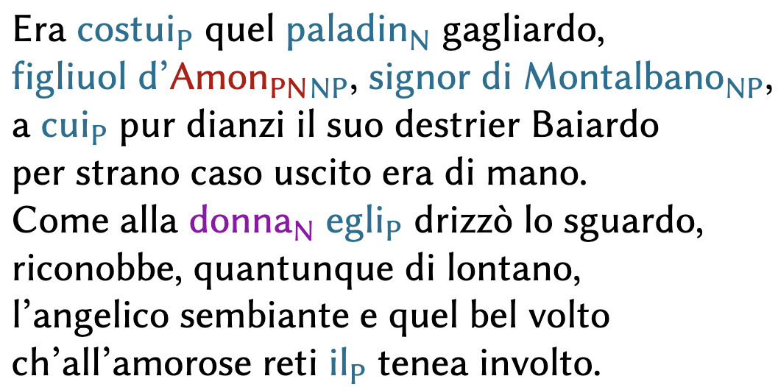
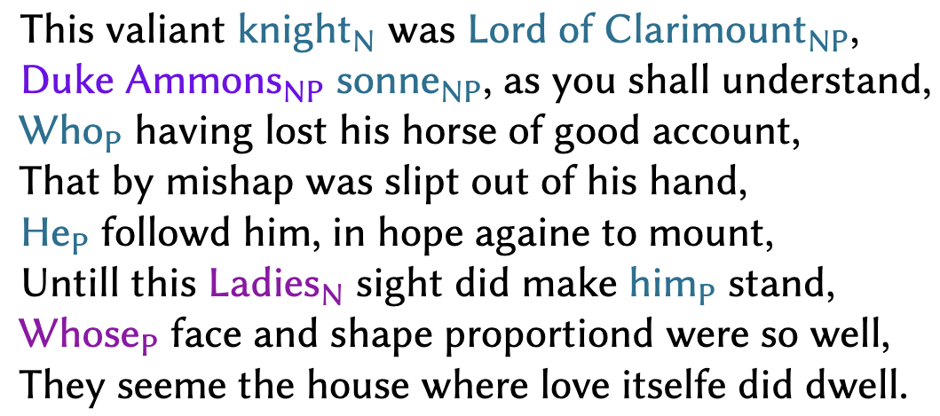
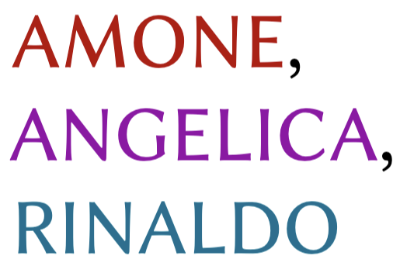
Data
Annotation Example: Canto I, Stanza 5
Annotation Process
Proper names (PN)
Nouns (N) / Noun Phrases (NP)
Pronouns (P)
Constraints
Narratological level
Individual identity
Proper-name attribution
Entity type
English translation
Resulting Dataset
1,890 character occurrences
64 unique characters
106 stanzas with no character mentions
Ground-Truth Entries

Slide 4
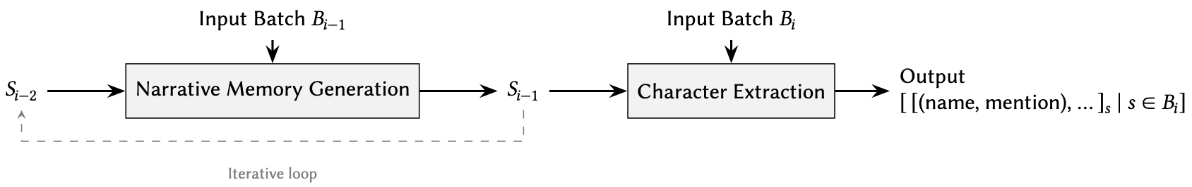
Methodology
The poem is split into batches of n stanzas and processed by a character identification pipeline.
Figure 1. Character identification pipeline.

Slide 5
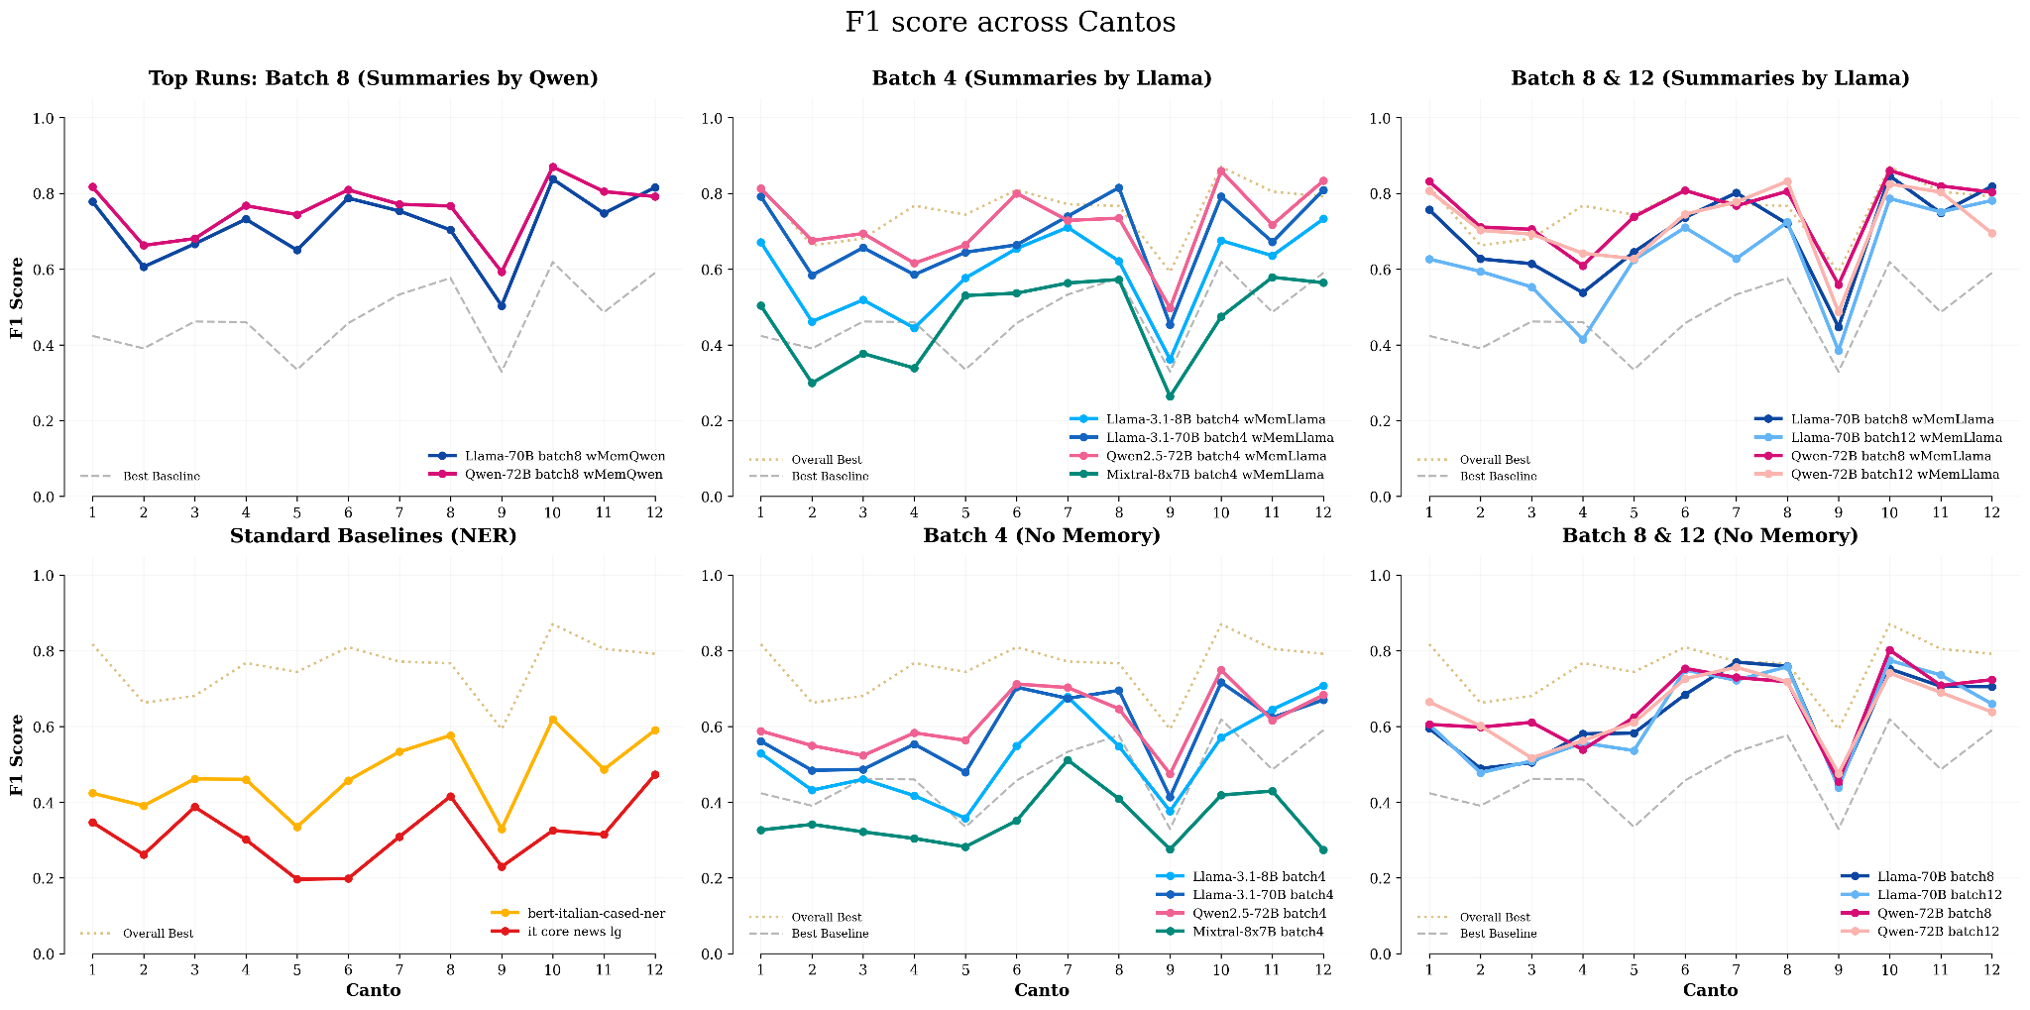
Experimental Results
Two NER baselines and four LLMs are evaluated; LLMs are tested at 𝑛 ∈ {4, 8, 12}, with/without narrative memory.
F1 score
0.758
Figure 2. F1 score across Cantos I-XII for each experimental configuration.

Slide 6
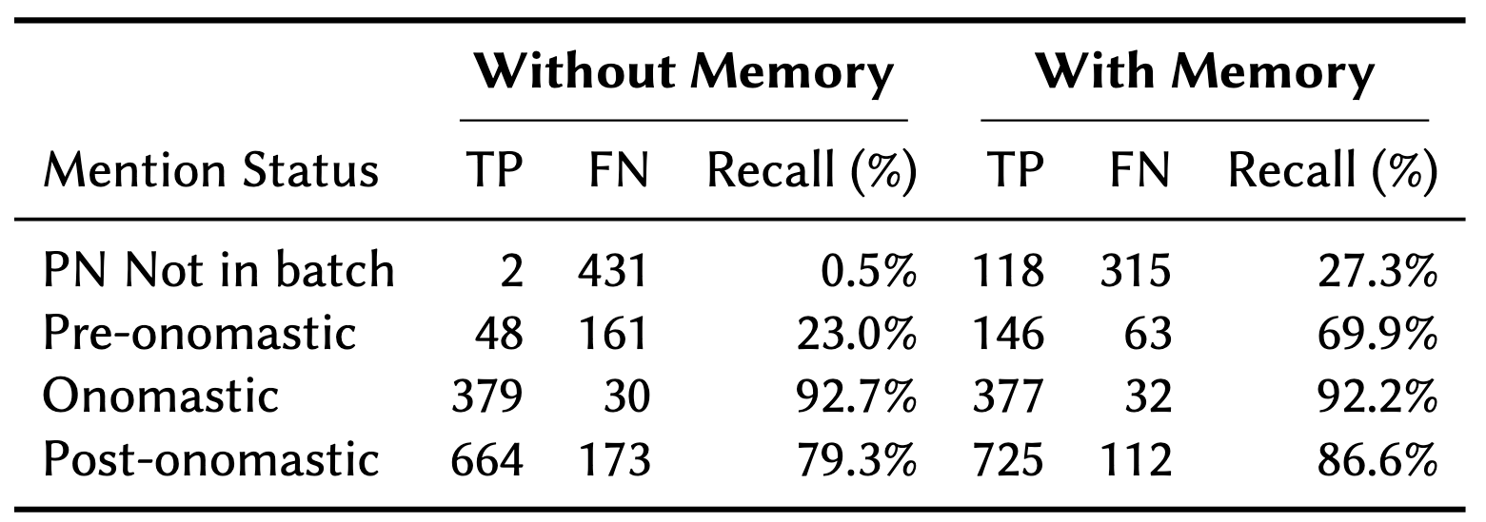
Narrative Memory Impact
Mean F1 improvement of +8.1 points.
Improves intra-batch character identification for pre- and post-onomastic mentions.
Enables inter-batch identification when a character’s proper name never appears within the batch.
Table 1. Impact of narrative memory injection for Qwen-2.5-72B (𝑛 = 8).

Slide 7
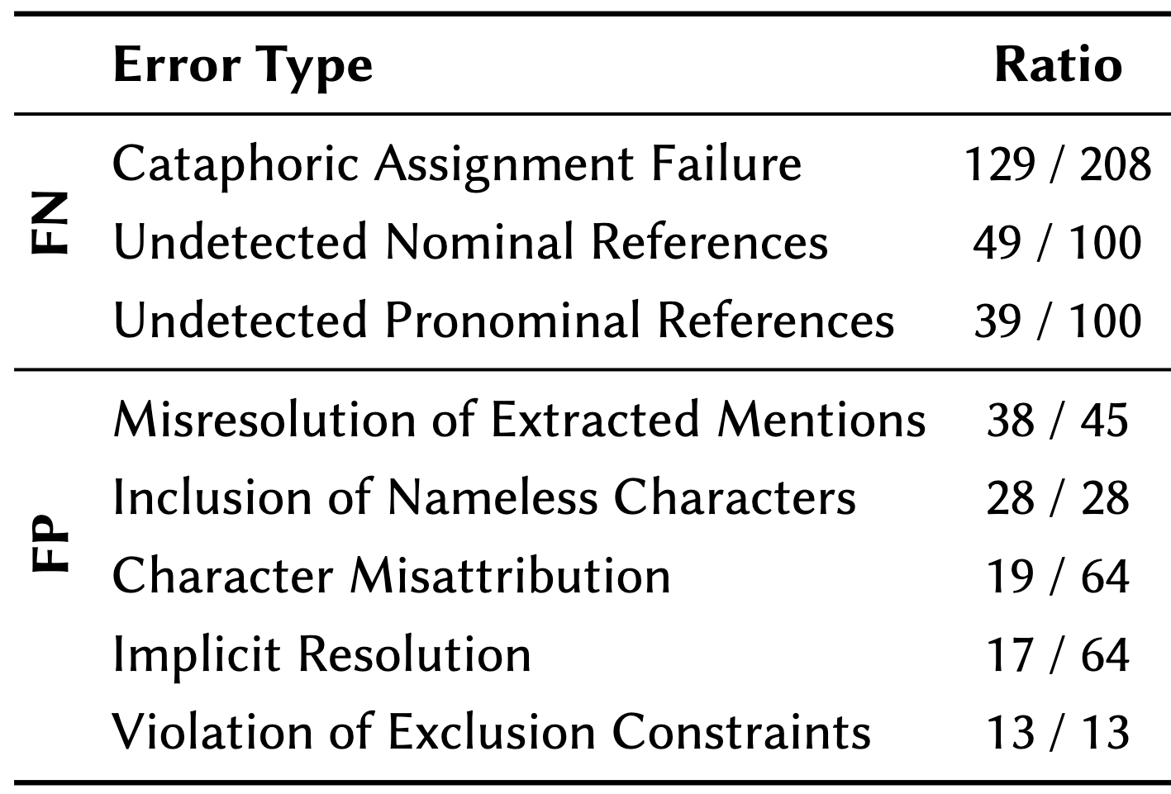
Error Analysis Insights
Characters introduced anonymously generate cataphoric references whose resolution requires retrospective narrative integration not supported by the current pipeline.
Hallucinations based on inferred character presence from narrative actions, in the absence of the required linguistic markers, point to the model’s sensitivity to character agency.
Table 2. Error taxonomy for the top-ten FNs and FPs in the optimal configuration.

Slide 8
Future Work
Redefining the task as character presence detection grounded in narrative agency, beyond nominal and pronominal markers.
Tracking characters as anonymous entities linked to stable attributes, and resolving them through clustering and name resolution.
Using structured, ontology-based narrative representations to model plot dynamics and story vs. narration order.

Slide 9
Main References
R. Campos, A. Jorge, A. Jatowt, S. Bhatia, M. Litvak, The 8th international workshop on narrative extraction from texts: Text2Story 2025, in: C. Hauff, C. Macdonald, D. Jannach, G. Kazai, F. M. Nardini, F. Pinelli, F. Silvestri, N. Tonellotto (Eds.), Advances in Information Retrieval, Springer Nature Switzerland, Cham, 2025, pp. 345–351.
G. Genoni, Un grafo per il “Furioso”. Prime annotazioni di una ricerca sperimentale, AOQU (Achilles Orlando Quixote Ulysses). Rivista di epica 3 (2022) 241–290.
J. Li, A. Sun, J. Han, C. Li, A survey on deep learning for named entity recognition, IEEE Transactions on Knowledge and Data Engineering 34 (2022) 50–70.
G. Martinelli, B. Gatti, R. Navigli, xCoRe: Cross-context coreference resolution, in: C. Christodoulopoulos, T. Chakraborty, C. Rose, V. Peng (Eds.), Proceedings of the 2025 Conference on Empirical Methods in Natural Language Processing, Association for Computational Linguistics, Suzhou, China, 2025, pp. 34264–34278.
F. Pianzola, L. Cheng, F. Pannach, X. Yang, L. Scotti, The Golem ontology for narrative and fiction, Humanities 14 (2025).
P. Ranade, S. Dey, A. Joshi, T. Finin, Computational understanding of narratives: A survey, IEEE Access 10 (2022) 101575–101594.
B. Santana, R. Campos, E. Amorim, A. Jorge, P. A. Silvano, S. Nunes, A survey on narrative extraction from textual data, Artificial Intelligence Review 56 (2023) 8393–8435.
C. Santini, L. Melosi, E. Frontoni, Named entity recognition in historical Italian: The case of Giacomo Leopardi’s Zibaldone, 2025.

Slide 10
Thank you for your attention!

