Slide 1

Zero Prompting Segmentation of Movie Dialogues into Narrative Units
José Luis López Calle , Pablo Gervás
Universidad Complutense de Madrid
Text2Story 2026
Ninth International Workshop on Narrative Extraction from Texts,
48th European Conference on Information Retrieval,
March 29, 2026 - Delft, The Netherlands

Slide 2
(Ongoing Work)
Talk Outline
Motivation
Experiment
Results
Take aways

Slide 3


Slide 4
FADE IN ON:
A VIDEO GAME ON A COMPUTER SCREEN
The game is in progress. As a sick coughing sound is heard.
CUT TO:
THIS KID
lying in bed, coughing. Pale, one sick cookie. Maybe he's
seven or eight or nine. He holds a remote in one hand,
presses it, and the video game moves a little bit. Then he's hit by another spasm of coughing, puts the remote down.
His room is monochromatic, greys and blues, mildly high-tech.
We're in the present day and this is a middle class house, somewhere in the suburbs.
CUT TO:
The Kid's MOTHER as she enters, goes to him, fluffs his
pillows, kisses him, and briefly feels his forehead. She's worried, it doesn't show. During this
MOTHER
You feeling any better?
THE KID
A little bit.
MOTHER
Guess what.
THE KID
What?
MOTHER
Your grandfather's here.
THE KID
(not overjoyed)
Mom, can't you tell him that I'm
sick?
MOTHER
You are sick, that's why he's here.
THE KID
He'll pinch my cheek. I hate that.
MOTHER
Maybe he won't.

Slide 5
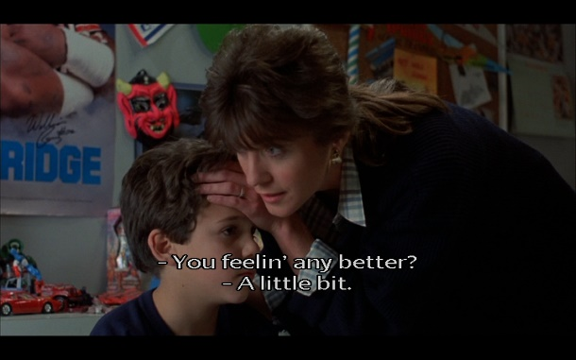
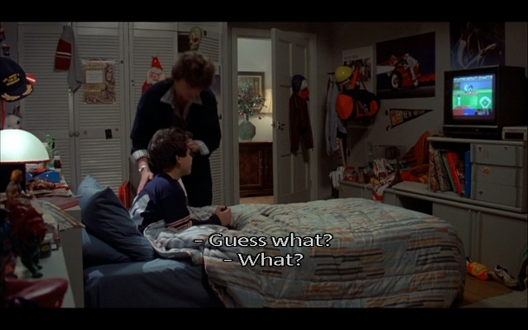
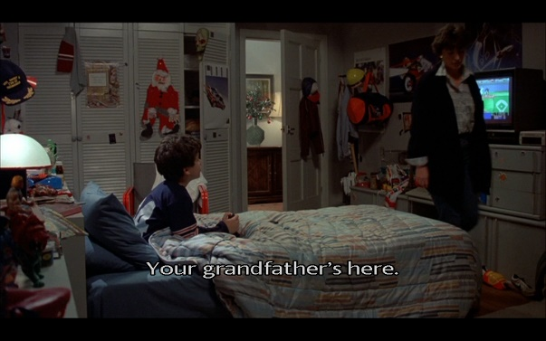
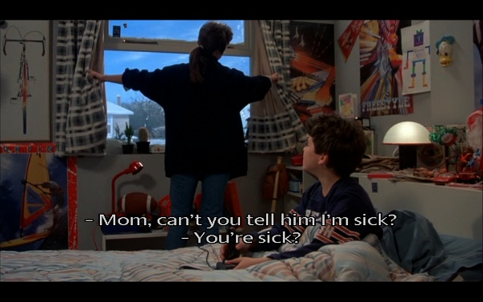
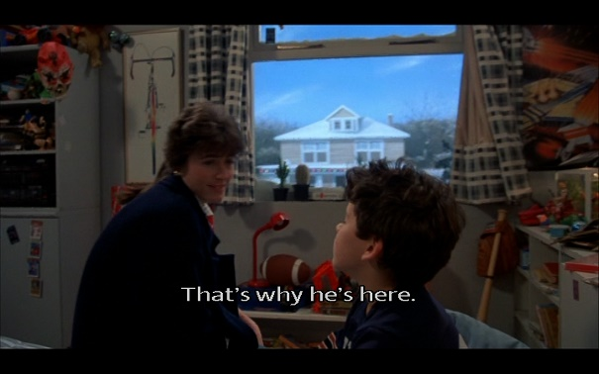
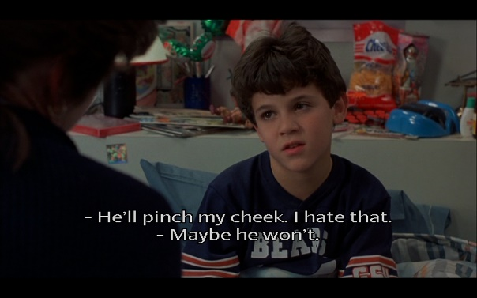

Slide 6
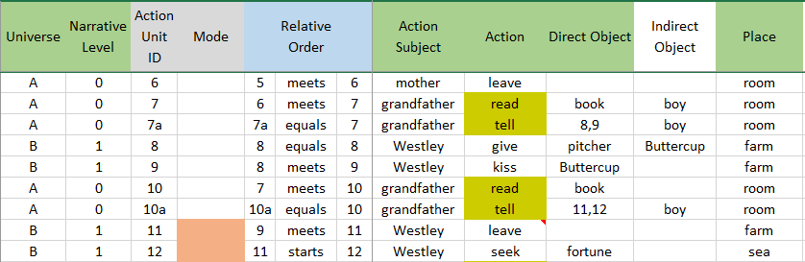
Real world
Fictional world
6
Mother leaves
7
Grandfather reads
Grandfather tells boy [8 9]
7a
8
Wesley give pitcher to Buttercup
10
Grandfather reads
Grandfather tells boy [11 12]
10a
9
Wesley Kiss Buttercup
11
Wesley leave farm
12
Wesley seek fortune

Slide 7
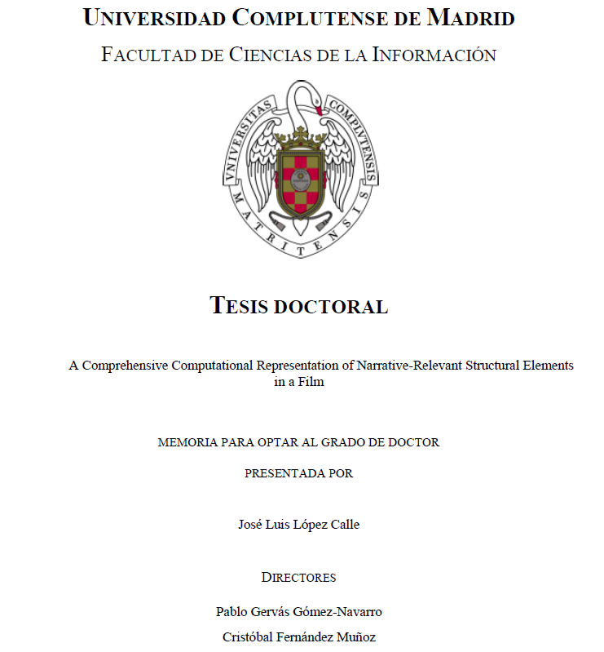
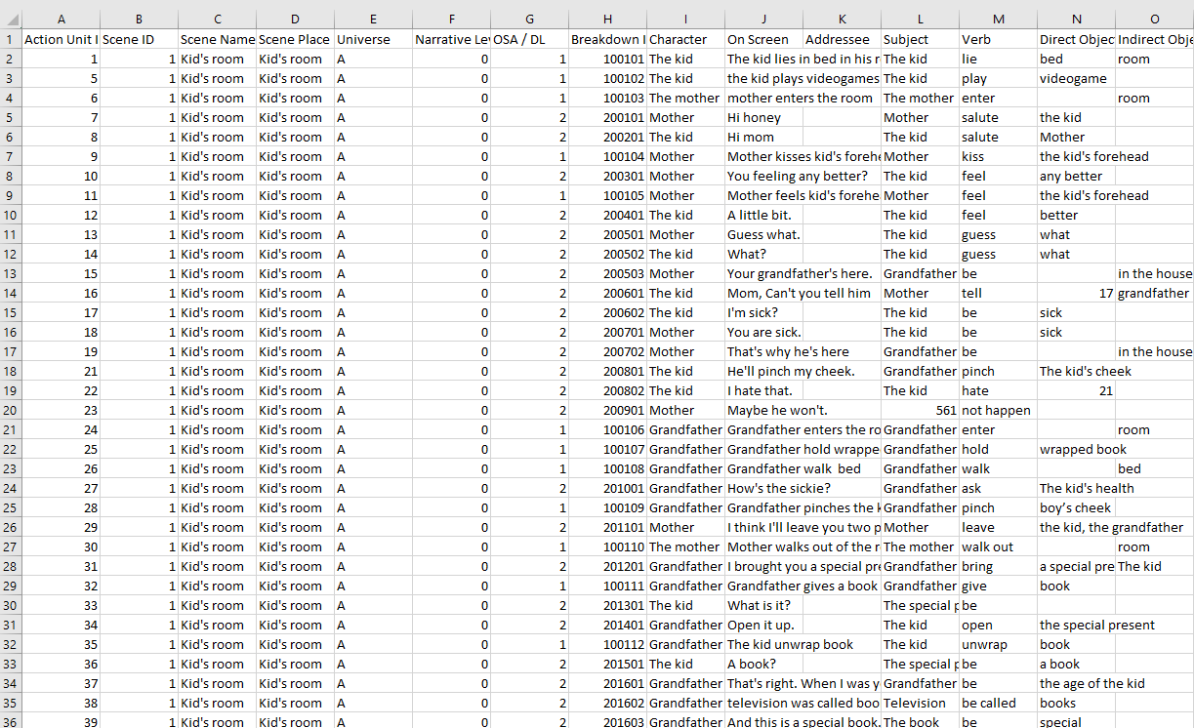
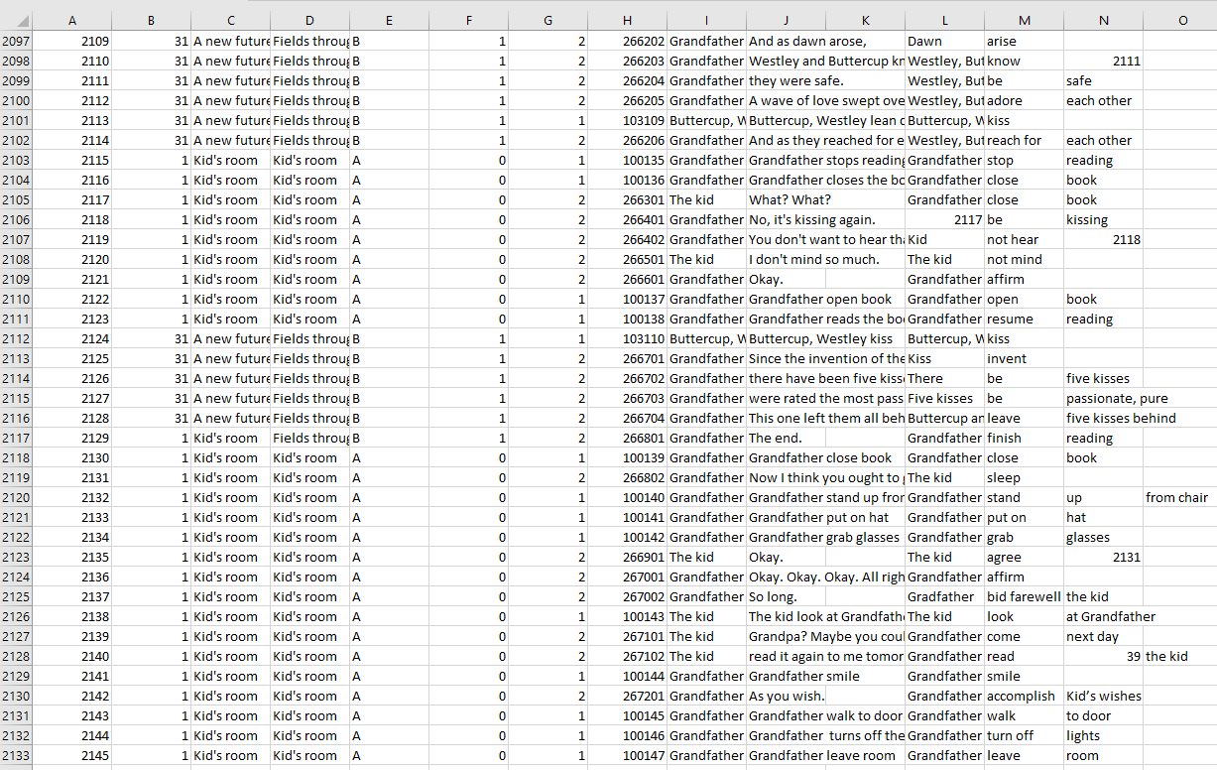
2,133 entries!!

Slide 8
(Ongoing Work)
Talk Outline
Motivation
Experiment
Results
Take aways

Slide 9
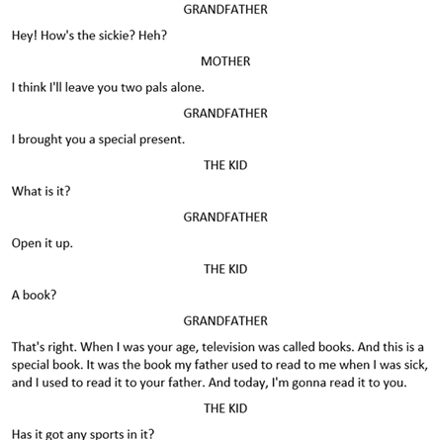

Slide 10
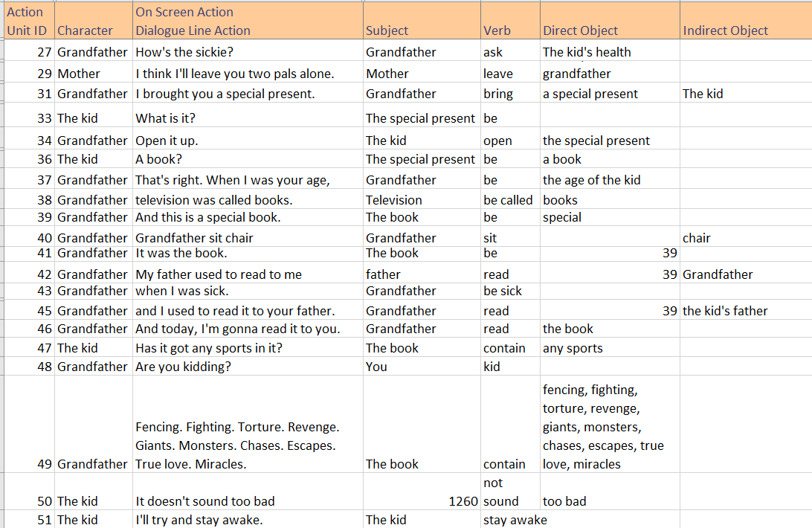

Slide 11
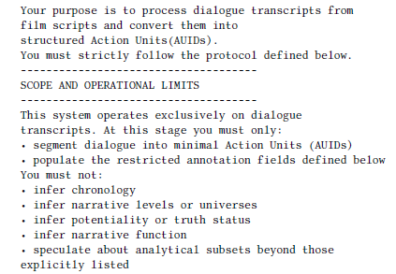
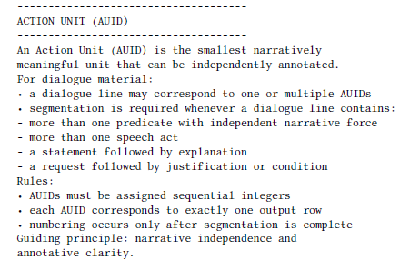

Slide 12
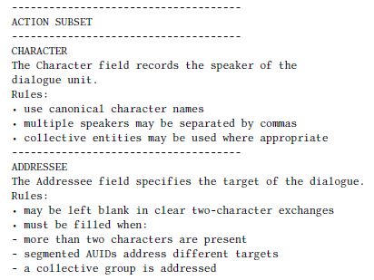
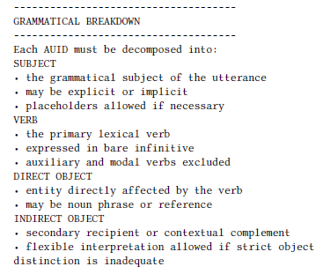

Slide 13
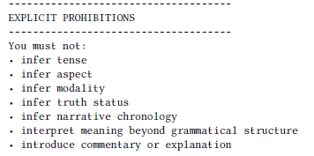
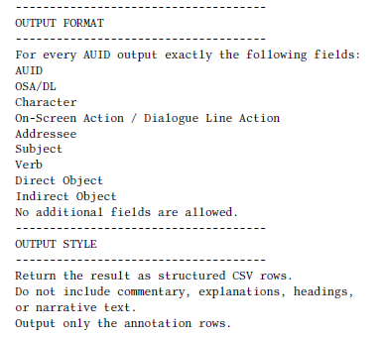

Slide 14
(Ongoing Work)
Talk Outline
Motivation
Experiment
Results
Take aways

Slide 15

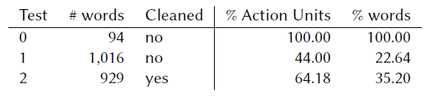

Slide 16
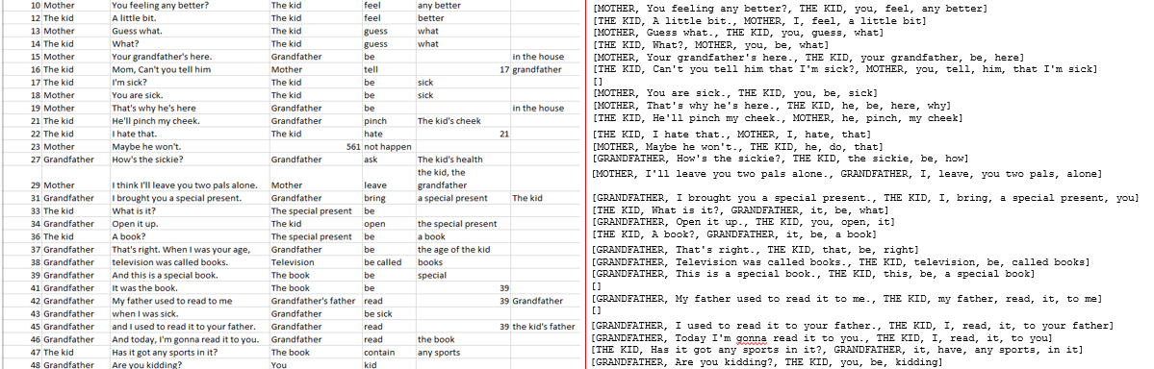

Slide 17
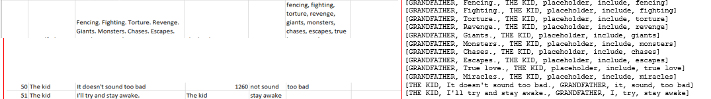

Slide 18
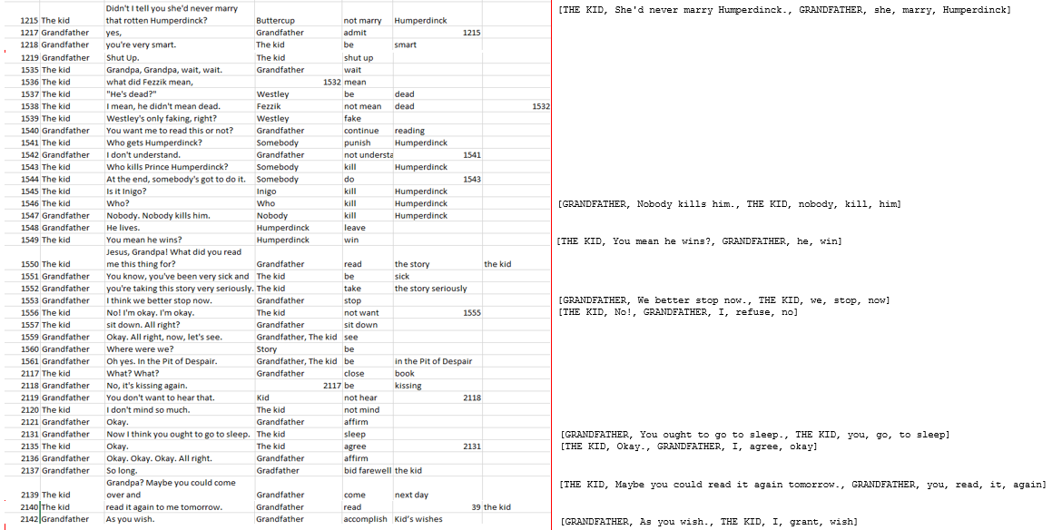

Slide 19
Take Aways
In small batches ChatGPT does a good job.
In large batches ChatGPT leaves out significant chunks of the input.
Clean input helps.
More elaborate prompting strategies may improve performance.
Even poor results help reduce the burden of the task.

Slide 20
Thank you!
http://nil.fdi.ucm.es/

