Slide 1


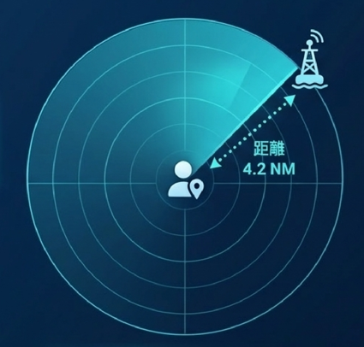

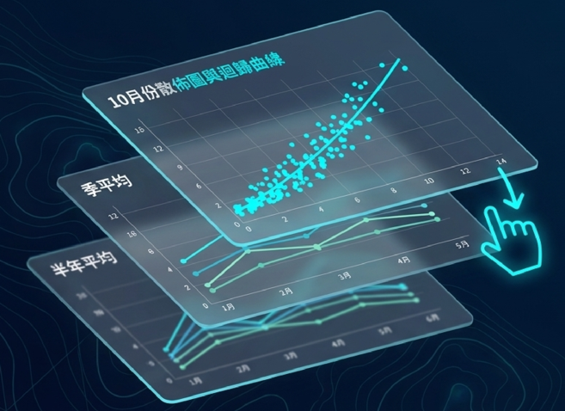
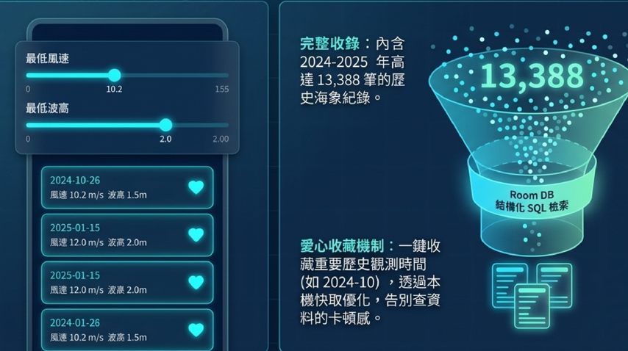
ESG Green Energy Benefit Calculator
Real-time Information Dashboard
Maintenance and Inspection Records
Walrus Statistics Visualization
Historical data search

