Slide 1
Financial Services Hub
Team 18 :
Binghan Geng - A20482350
Mingxi Xia - A20473026
Yixuan Liang - A20490865

Slide 2
Introduction
Topic: Financial Services Hub, to search, apply, review for financial services and products, ATM, loans, financial instruments, cryptocurrency services, etc.
Name: BestFinance
Description: To search, apply, review for Loans, Insurance, Investments

Slide 3
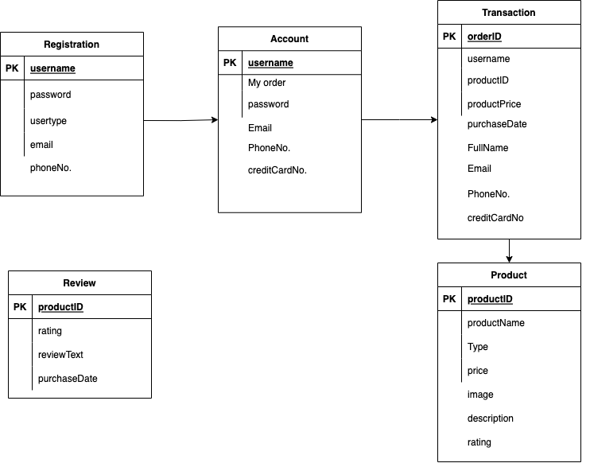

Slide 4
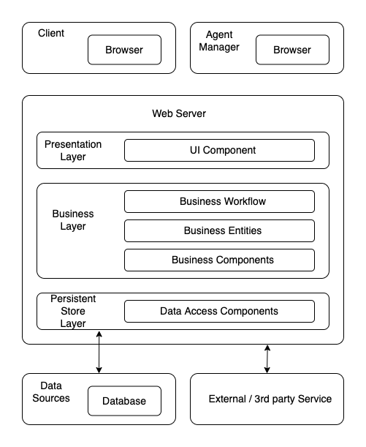

Slide 5

Technologies

Slide 6
