Slide 1


Course work M – Geo Localisation Web Science COMPSCI4077/COMPSCI5107/COMPSCI5078
Joemon M Jose

Slide 2
(i)
A data set will be given to you (on the Teams channel). Develop software to organise tweets into grids of 1km x 1km. Draw heatmap and histogram to analyse the distribution of data.
The coordinate system we used is
London = [-0.563, 51.261318, 0.28036, 51.686031]
[40]

Slide 3
solution
Software to compute distance between two points
Software to partition grids
10 marks
Software to allocate tweets
Describe the statistics
10 marks

Slide 4
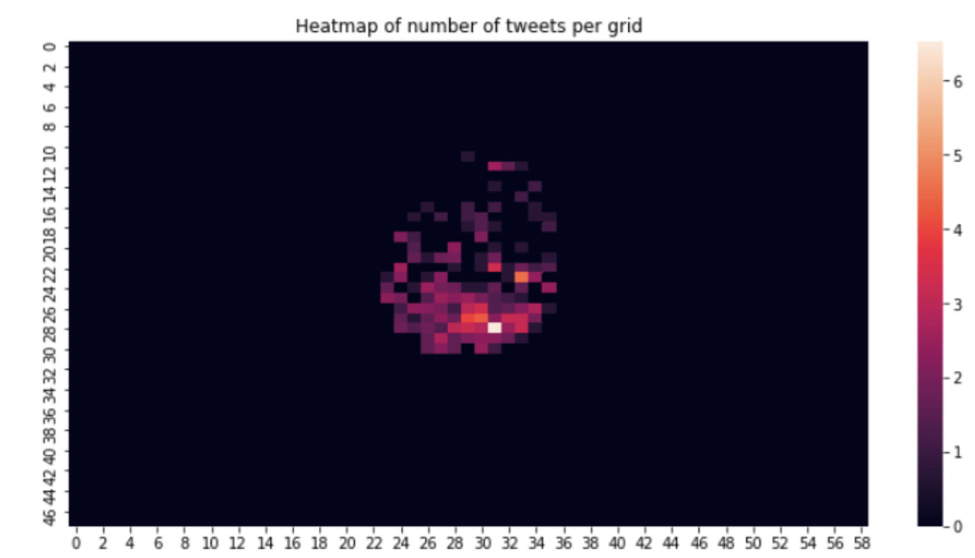
Heat map – example. (10 marks) how do you interpret?

Slide 5
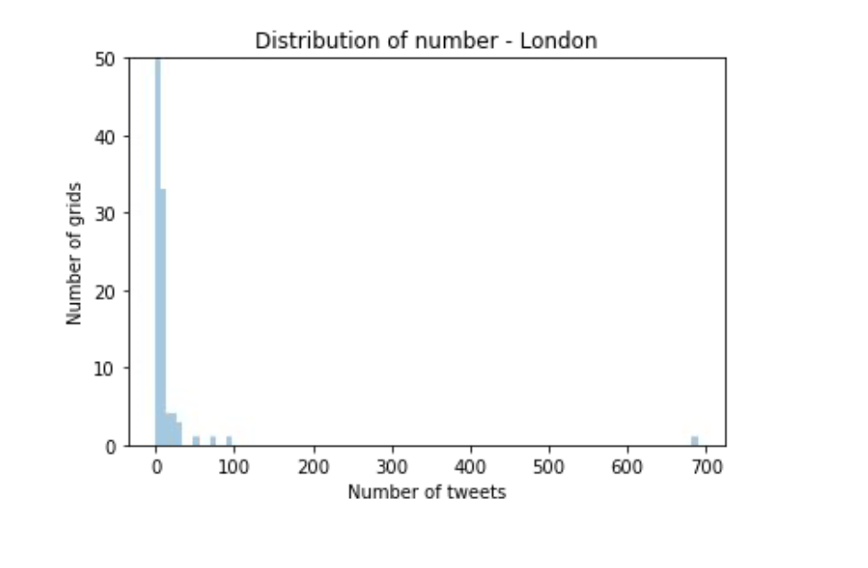
Data distribution? How do you interpret (10 marks)

Slide 6
(ii)
You will be given a set of high-quality tweets and low-quality tweets. Develop newsworthy scoring method based on this dataset.
[30]

Slide 7
solution
Lecture slides on newsworthiness scoring
Straight forward implementation
Software – 20 marks
Critical Discussion – 10 marks
Scoring method quality
Your high and low quality dataset

Slide 8
(iii)
Use the above newsworthy scoring techniques to analyse the geo-tagged data set given above and discuss the results
[30]

Slide 9
solution
Take each tweet in the data set
Score its newsworthiness
Remove the one is not newsworthy?
Keep the one that is newsworthy
Count the statistics
10 marks
Redraw the heatmap and histogram
10 marks
Critically comment
10 marks

