Slide 1

KI – Institute for Artificial Intelligence
Analytic Computing
Machine Learning
6 Decision Trees
Prof. Dr. Steffen Staab
Nadeen Fatallah Osama Mohamed
Daniel Frank Yi Wang Akram Sadat Hosseini Tim Schneider
Rodrigo Lopez
https://www.ki.uni-stuttgart.de/

Slide 2

based on slides by
Thomas Gottron, U. Koblenz-Landau
https://west.uni-koblenz.de/de/studying/courses/ws1718/machine-learning-and-data-mining-1
This lecture material for „Machine Learning and Data Mining“ is licensed under a Creative Commons Attribution-ShareAlike 4.0 International License.

Slide 3
Learning Objectives
Entropy, Cross-entropy, Kullback-Leibler divergence
What is a decision tree?
How to construct a decision tree from training data?
What is information gain?
Why to use gain ratio?
How to prune a decision tree?
How to split attribute values?
What is overfitting?
What is binning and how does it work?

Slide 4
Measuring Distributions

Slide 5
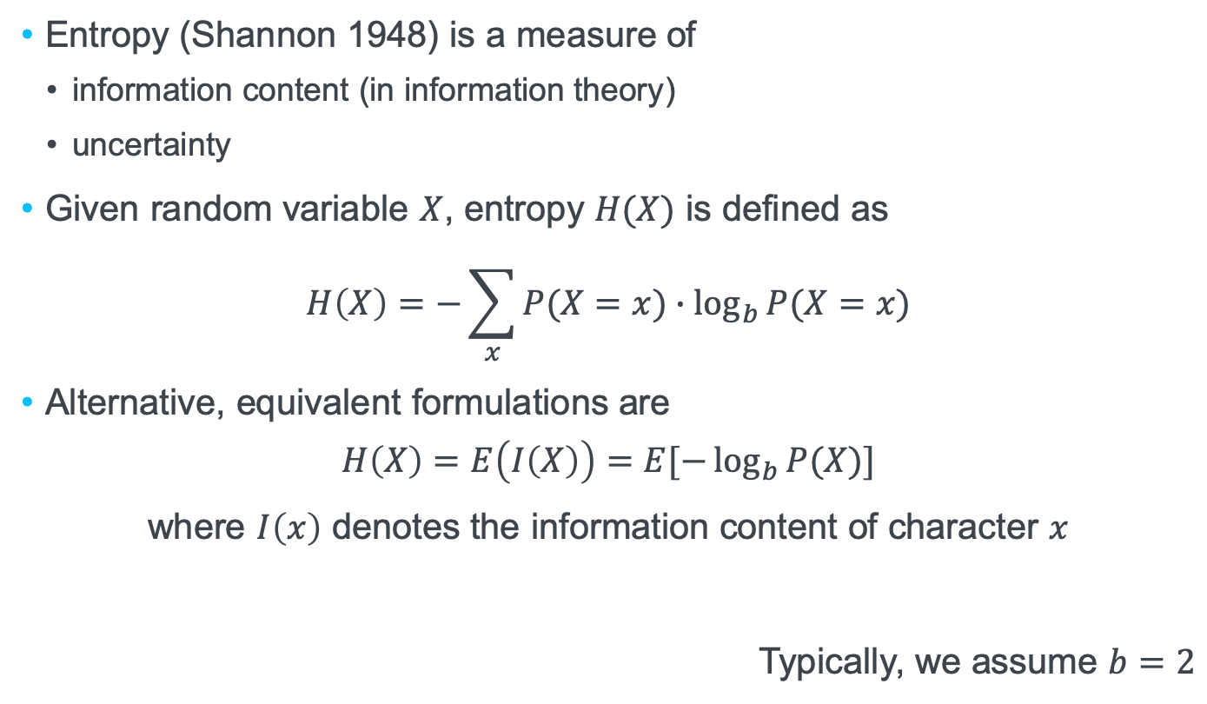
Entropy
Entropy (Shannon 1948) is a measure of
information content (in information theory)
uncertainty
Given random variable $X$, entropy $H(X)$ is defined as
$$H\left(X\right)=−\sum_{x}{P(X=x)}∙\log_{b}{P(X=x)}$$
Alternative, equivalent formulations are
$$H\left(X\right)=E\left(I\left(X\right)\right)=E[−\log_{b}{P(X)}]$$
where $I\left(x\right)$ denotes the information content of character $x$
Typically, we assume $b=2$

Slide 6
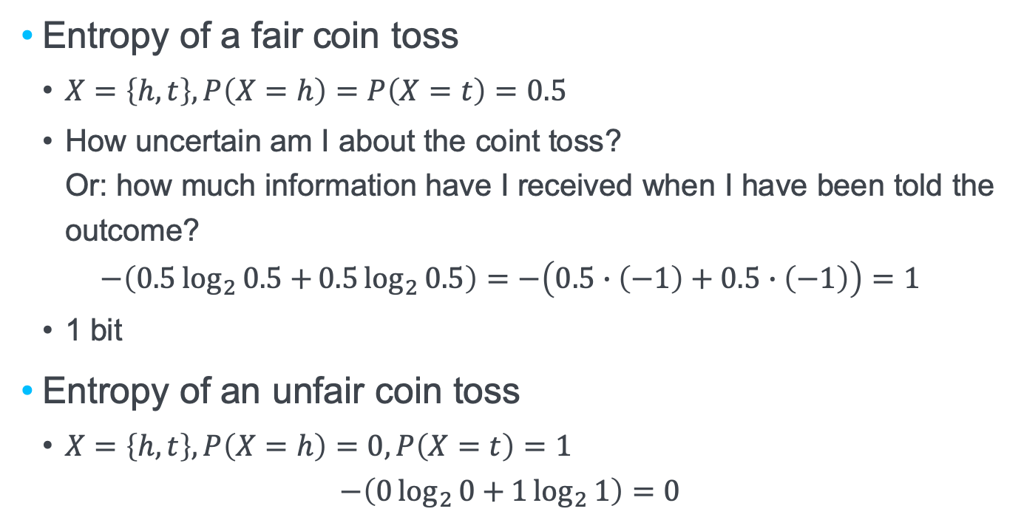
Entropy of coin tosses
Entropy of a fair coin toss
$X=\left\{h,t\right\}, P\left(X=h\right)=P\left(X=t\right)=0.5$
How uncertain am I about the coint toss? Or: how much information have I received when I have been told the outcome?
$$−\left(0.5\log_{2}{0.5+}0.5\log_{2}{0.5}\right)=−\left(0.5∙\left(−1\right)+0.5∙\left(−1\right)\right)=1$$
1 bit
Entropy of an unfair coin toss
$X=\left\{h,t\right\}, P\left(X=h\right)=0, P\left(X=t\right)=1$
$$−\left(0\log_{2}{0+}1\log_{2}{1}\right)=0$$

Slide 7
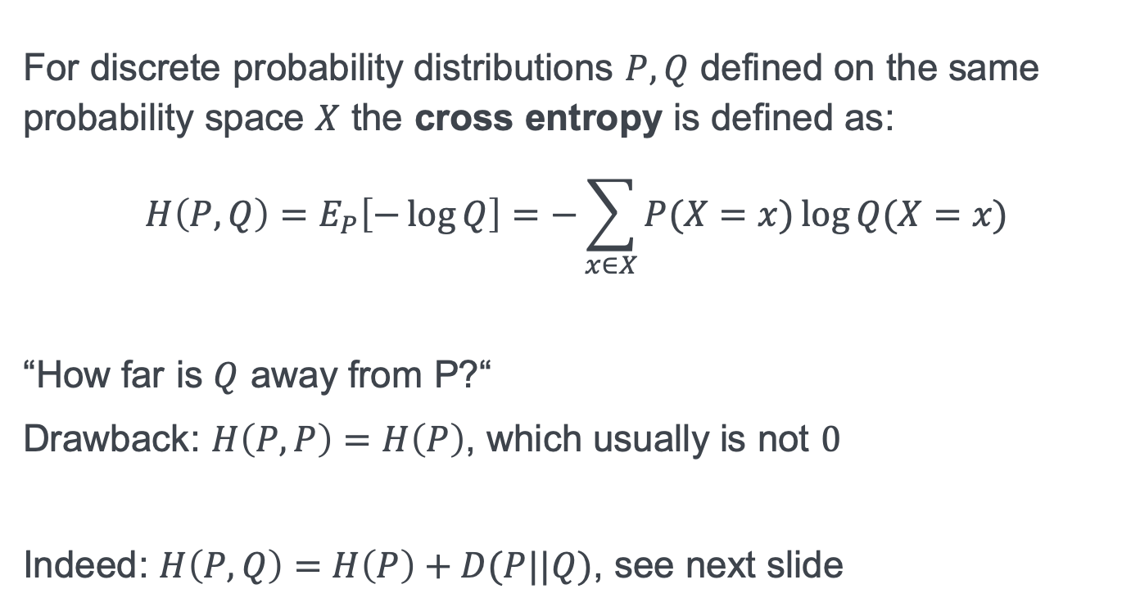
Cross Entropy
For discrete probability distributions $P,Q$ defined on the same probability space $X$ the cross entropy is defined as:
$$H\left(P,Q\right)=E_{P}\left[−\log{Q}\right]=−\sum_{x∈X}{P(X=x)\log{Q(X=x)}}$$
“How far is $Q$ away from P?“
Drawback: $H\left(P,P\right)=H\left(P\right)$, which usually is not $0$
Indeed: $H\left(P,Q\right)=H\left(P\right)+D(P||Q)$, see next slide

Slide 8
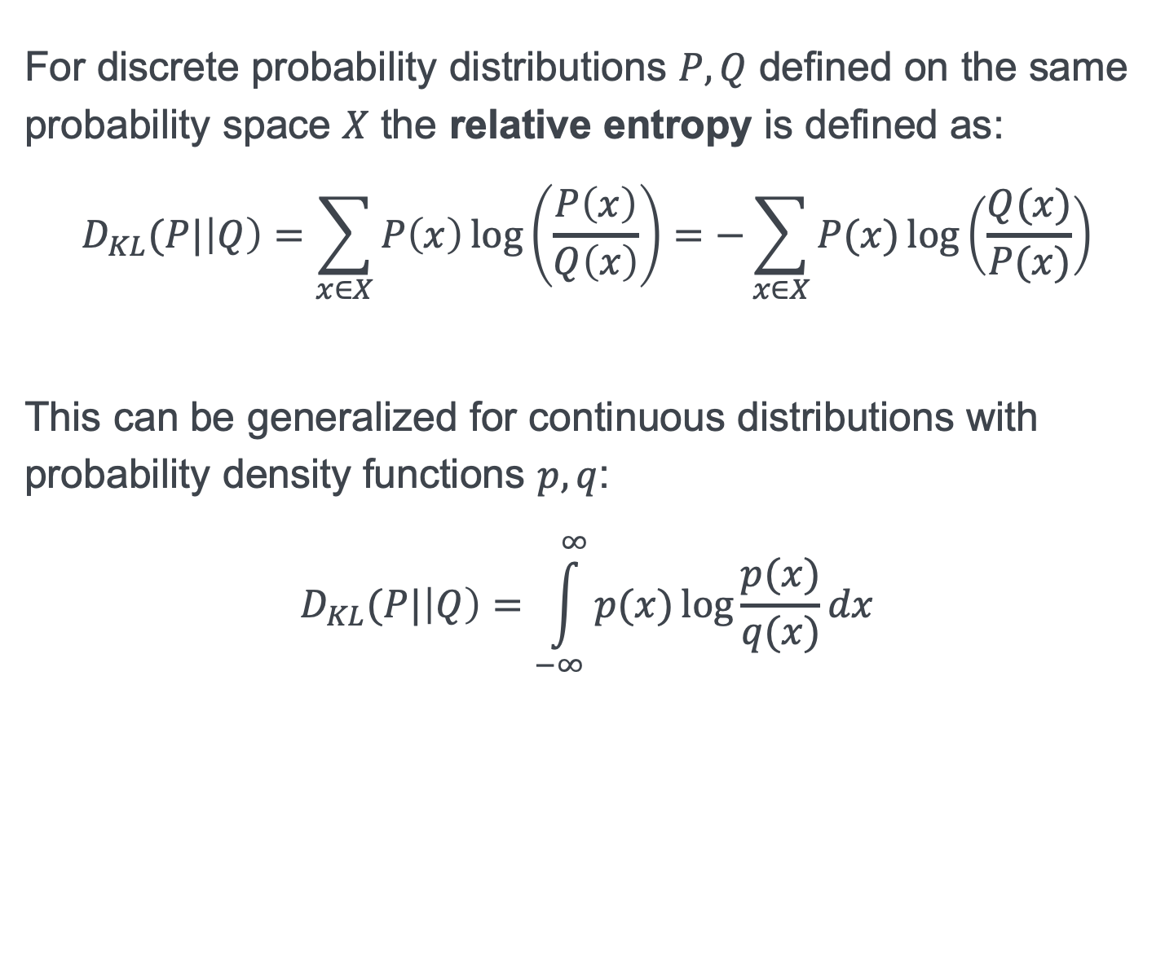
Relative Entropy (Kullback-Leibler Divergence)
For discrete probability distributions $P,Q$ defined on the same probability space $X$ the relative entropy is defined as:
$$D_{KL}(P|\left|Q\right)=\sum_{x∈X}{P\left(x\right)\log\left(\frac{P\left(x\right)}{Q\left(x\right)}\right)}=−\sum_{x∈X}{P(x)\log\left(\frac{Q(x)}{P(x)}\right)}$$
This can be generalized for continuous distributions with probability density functions $p,q$:
$$D_{KL}(P|\left|Q\right)=\int_{−∞}^{∞}{p(x)\log{\frac{p(x)}{q(x)}dx}}$$

Slide 9
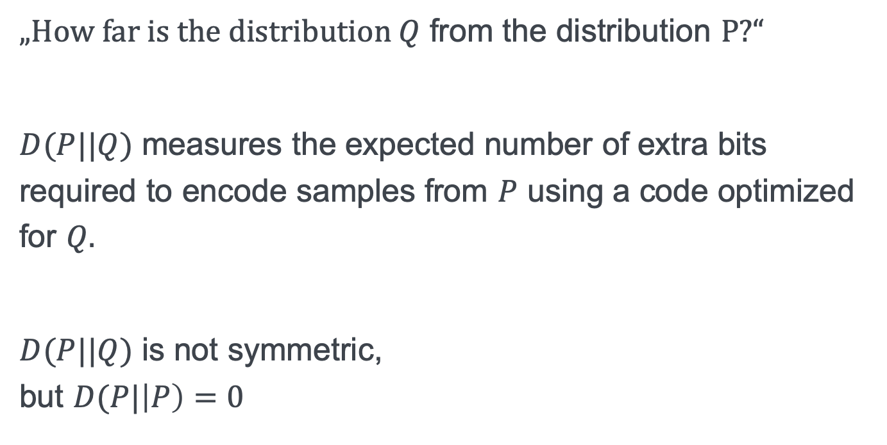
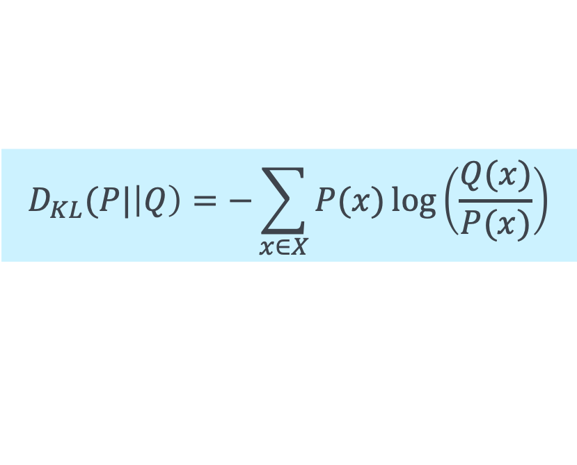
Interpretation of relative entropy
„How far is the distribution $Q$ from the distribution $P$?“
$D(P||Q)$ measures the expected number of extra bits required to encode samples from $P$ using a code optimized for $Q.$
$D(P||Q)$ is not symmetric, but $D(P|\left|P\right)=0$
$$D_{KL}(P|\left|Q\right)=−\sum_{x∈X}{P(x)\log\left(\frac{Q(x)}{P(x)}\right)}$$

Slide 10
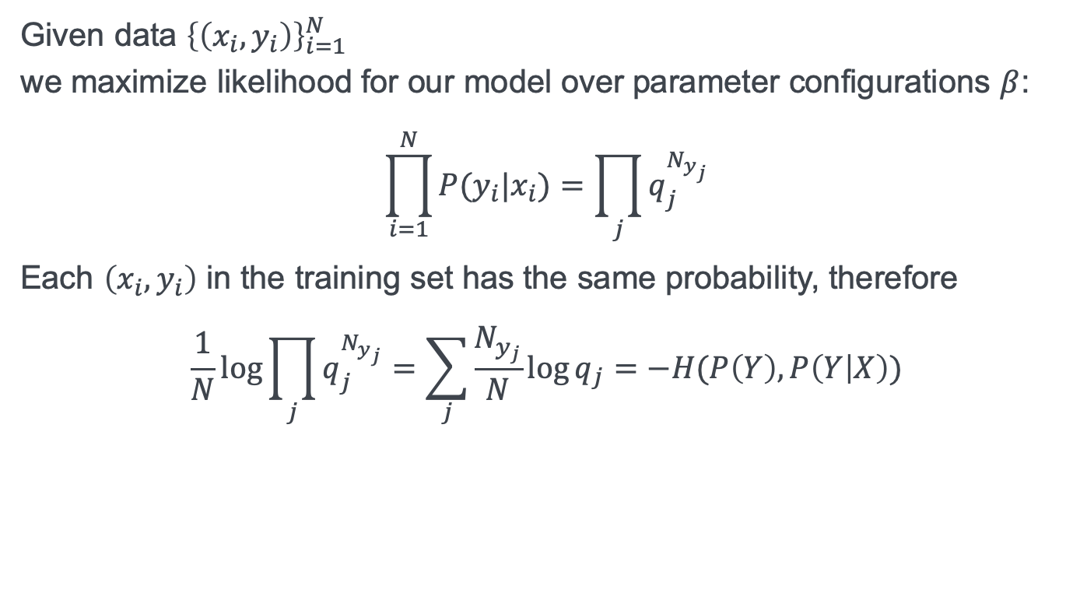
Relating cross entropy to maximum likelihood
Given data ${\left\{\left(x_{i},y_{i}\right)\right\}}_{i=1}^{N}$ we maximize likelihood for our model over parameter configurations $β$:
$$\prod_{i=1}^{N}{P(y_{i}|x_{i})}=\prod_{j}{q_{j}^{N_{y_{j}}}}$$
Each $\left(x_{i},y_{i}\right)$ in the training set has the same probability, therefore
$$\frac{1}{N}\log{\prod_{j}{q_{j}^{N_{y_{j}}}}}=\sum_{j}{\frac{N_{y_{j}}}{N}}\log{q_{j}}=−H(P\left(Y\right),P\left(Y | X\right))$$
nicer explanation
https://medium.com/konvergen/cross-entropy-and-maximum-likelihood-estimation-58942b52517a
Maximizing likelihood is equivalent to minimizing cross entropy

Slide 11
?
?
Question:
1 Information measures
?
?
?
?
Notes:
Question A
What is the entropy of the 26 letter alphabet according to the probabilities given here:
https://en.wikipedia.org/wiki/Letter_frequency
4,2297103
Question B
How many letters would we need for the same information content assuming optimal use of all letters?
19

Slide 12
Decision Trees

Slide 13
Structure of a Decision Tree
Each inner node
Labeled with one attribute name (univariate)
Outgoing edges
labeled with values from domain of the attribute
represent n-ary discrete decision based on single named attribute
Child nodes
segment the data
Leaf nodes: classification
Assign one class label
cap-shape
x
b,f,s
habitat
edible
u
d,g,m,p
poisonous
edible

Slide 14
Classification using a Decision Tree
Classification process:
Object “follows” the paths in the tree until it reaches a class label
(x,d,...)
cap-shape
x
b,f,s
habitat
edible
u
d,g,m,p
poisonous
edible

Slide 15
Decision Tree: Divide and conquering the object space

Slide 16
Decision Trees
Model can be interpreted by humans quite well
unless the tree is too deep and/or too broad
Which tree is a good tree?
Loss function
though it was/is not called ”loss function” wrt decision trees
Efficient construction needed
too many trees to try and compare all of them…

Slide 17
?
?
Question:
2 Structure of Decision Trees
?
?
?
?
Notes:
Given a decision tree based on attributes x1, x2, x3,.. and an inner node labeled with x1.
Which of the following might be a valid labeling of an outgoing edge from this node?
x1 ={a,c}
x2={...}
1 < x1 < 2
x1 * x2 < 4
x1 + x2 < 5
x2 >3

Slide 18
Inductive Construction of Decision Trees

Slide 19

General Idea
Tree grows from root
root is assigned no intension (i.e. no attributes)
root is assigned total extension (i.e. all training objects)
Inductive principle: Each node grows children which are more „pure“ in their prediction quality over the training data
Children have one more attribute restriction (i.e. larger intension)
Children partition the extension
When stopping criteria is met nodes are labeled with classes
$$x_{i}$$
A
B
C

Slide 20
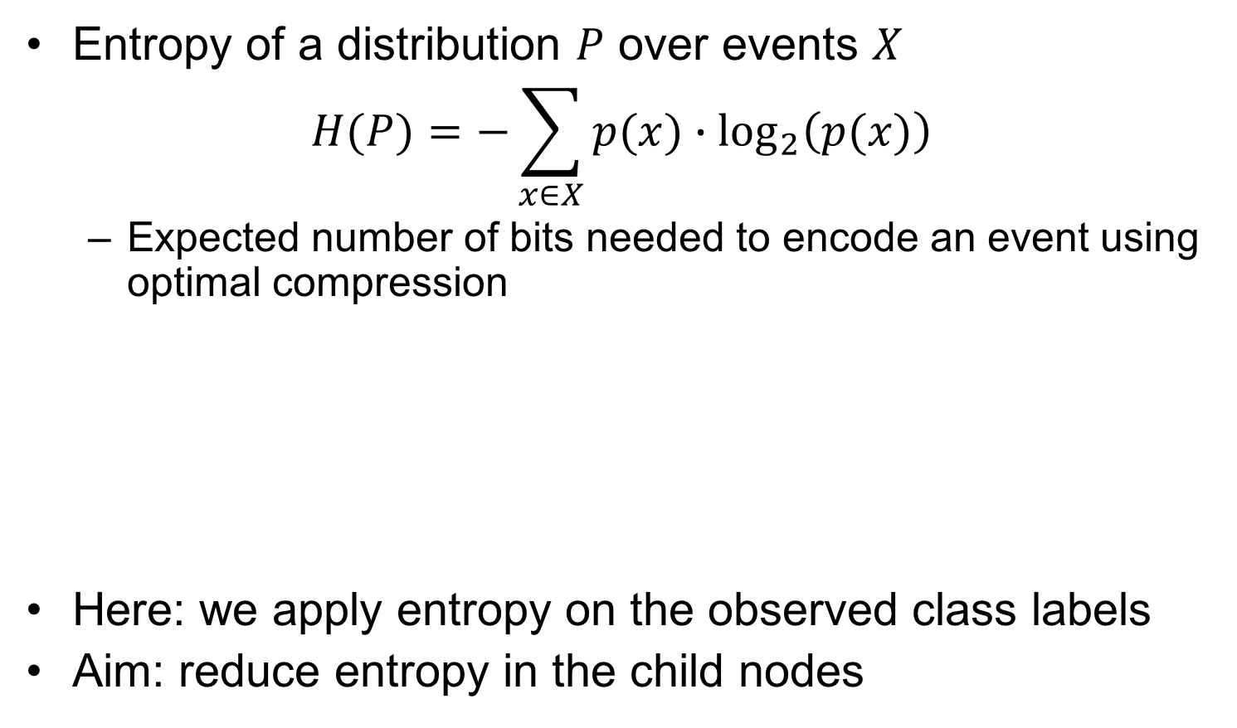



Central metrics: Entropy and Information Gain
Entropy of a distribution $P$ over events $X$
$$H(P)=−\sum_{x∈X}{p(x)∙{\text{log}}_{2}\left(p(x)\right)}$$
Expected number of bits needed to encode an event using optimal compression
Here: we apply entropy on the observed class labels
Aim: reduce entropy in the child nodes
P₁ | 26% | 20% | 37% | 17%
$$H\left(P_{1}\right)=1.935$$
Low Entropy means skewed distribution
P₂ | 1% | 97% | 1% | 1%
$$H\left(P_{2}\right)=0.242$$
Skewed distributions provide more insights
P₃ | 25% | 25% | 25% | 25%
$$H\left(P_{3}\right)=2.000$$

Slide 21

Central metrics: Entropy and Information Gain
Example
Parent node:
10 orange, 8 blue objects
Entropy H = 0.997
Child Node A:
1 orange, 6 blue objects
Entropy H = 0.592
Child Node B:
4 orange, 2 blue objects
Entropy H = 0.918
Child Node C:
5 orange, 0 blue objects
Entropy H = 0
$$x_{i}$$
A
B
C

Slide 22
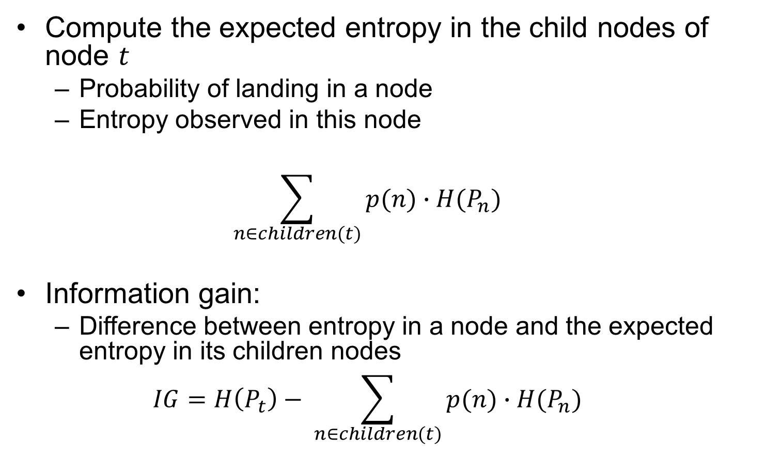
Central metrics: Entropy and Information Gain
Compute the expected entropy in the child nodes of node $t$
Probability of landing in a node
Entropy observed in this node
$$\sum_{n∈children(t)}{p(n)∙H(P_{n})}$$
Information gain:
Difference between entropy in a node and the expected entropy in its children nodes
$$IG=H\left(P_{t}\right)− \sum_{n∈children(t)}{p(n)∙H(P_{n})}$$

Slide 23
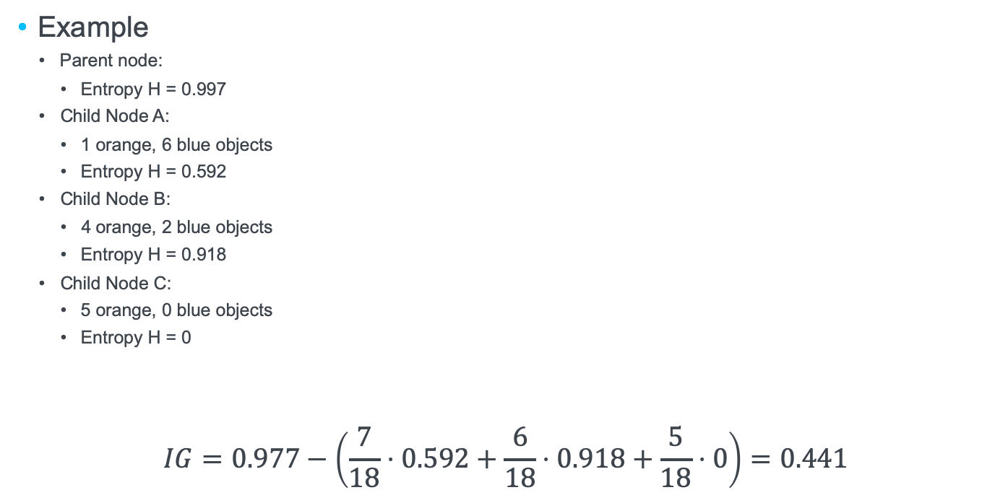
Central metrics: Entropy and Information Gain
Example
Parent node:
Entropy H = 0.997
Child Node A:
1 orange, 6 blue objects
Entropy H = 0.592
Child Node B:
4 orange, 2 blue objects
Entropy H = 0.918
Child Node C:
5 orange, 0 blue objects
Entropy H = 0
$$IG=0.977−\left(\frac{7}{18}⋅0.592+\frac{6}{18}⋅0.918+\frac{5}{18}⋅0\right)=0.441$$
$$x_{i}$$
A
B
C

Slide 24
Decision Tree Induction
Top down approach
Start from “empty” root node.
Apply GrowTree to root node
GrowTree (empty node):
If stop criterion does match node
Render node into a label
Use most frequent class
Else
Render node into decision node
Chose attribute to maximize information gain
Introduce empty child nodes
Apply GrowTree to child nodes
Stop criteria: zero entropy, too few instances or all attributes have equal values

Slide 25
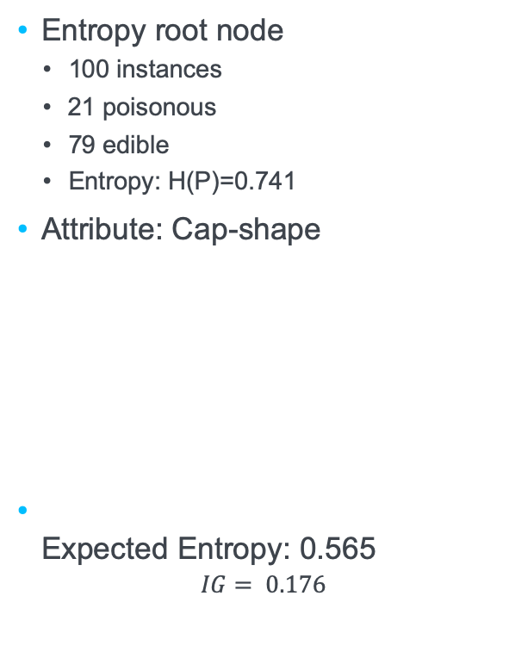
Example
Entropy root node
100 instances
21 poisonous
79 edible
Entropy: H(P)=0.741
Attribute: Cap-shape
Expected Entropy: 0.565
$$IG= 0.176$$
???
value | p | e | total | entropy
b | 0 | 29 | 29 | 0
f | 1 | 13 | 14 | 0.371
s | 0 | 3 | 3 | 0
x | 20 | 34 | 54 | 0.951

Slide 26
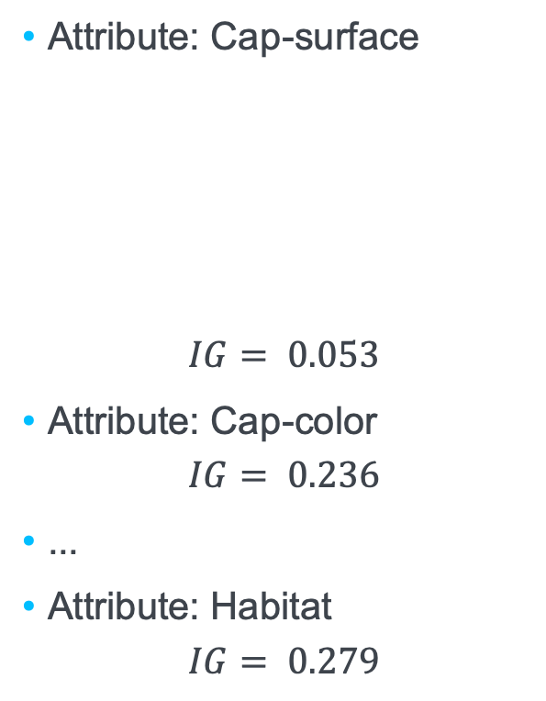
Example
Attribute: Cap-surface
$$IG= 0.053$$
Attribute: Cap-color
$$IG= 0.236$$
...
Attribute: Habitat
$$IG= 0.279$$
???
value | p | e | total | entropy
f | 0 | 14 | 14 | 0
s | 8 | 29 | 37 | 0.753
y | 13 | 36 | 49 | 0.835

Slide 27

Example
Attribute: Cap-surface
$$IG= 0.053$$
Attribute: Cap-color
$$IG= 0.236$$
...
Attribute: Habitat
$$IG= 0.279$$
???
value | p | e | total | entropy
f | 0 | 14 | 14 | 0
s | 8 | 29 | 37 | 0.753
y | 13 | 36 | 49 | 0.835
value | p | e | total | entropy
d | 0 | 8 | 8 | 0
g | 8 | 28 | 36 | 0.764
m | 0 | 28 | 28 | 0
p | 0 | 8 | 8 | 0
u | 13 | 7 | 20 | 0.934

Slide 28
Example
habitat
d
g
m
p
u
???
???
???
???
???
p:0
e:8
p:8
e:28
p:0
e:28
p:0
e:8
p:13
e:7
value | p | e | total | entropy
d | 0 | 8 | 8 | 0
g | 8 | 28 | 36 | 0.764
m | 0 | 28 | 28 | 0
p | 0 | 8 | 8 | 0
u | 13 | 7 | 20 | 0.934

Slide 29
Example
habitat
d
g
m
p
u
edible
???
edible
edible
???
value | p | e | total | entropy
d | 0 | 8 | 8 | 0
g | 8 | 28 | 36 | 0.764
m | 0 | 28 | 28 | 0
p | 0 | 8 | 8 | 0
u | 13 | 7 | 20 | 0.934
Merge nodes
(typically: post processing)

Slide 30

Example
Next node
36 instances
8 poisonous
28 edible
Entropy: H(P)=0.764
Attribute: Cap-shape
Expected Entropy: 0.651
$$IG= 0.113$$
habitat
d,m,p
g
u
edible
???
???
value | p | e | total | entropy
b | 0 | 8 | 8 | 0
f | 1 | 6 | 7 | 0.592
s | 0 | 0 | 0 | 0
x | 7 | 14 | 21 | 0.918
value | p | e | total | entropy
d | 0 | 8 | 8 | 0
g | 8 | 28 | 36 | 0.764
m | 0 | 28 | 28 | 0
p | 0 | 8 | 8 | 0
u | 13 | 7 | 20 | 0.934

Slide 31

Example
Attribute: Cap-surface
$$IG= 0.113$$
...
Attribute: Gill-size
$$IG= 0.32$$
habitat
d,m,p
g
u
edible
???
???
value | p | e | total | entropy
b | 0 | 20 | 20 | 0
n | 8 | 8 | 16 | 1

Slide 32
Example
Attribute: Cap-surface
$$IG= 0.113$$
...
Attribute: Gill-size
$$IG= 0.32$$
habitat
d,m,p
g
u
edible
gill-size
???
value | p | e | total | entropy
b | 0 | 20 | 20 | 0
n | 8 | 8 | 16 | 1
b
n
???
???
p:0
e:20
p:8
e:8

Slide 33
Example
Attribute: Cap-surface
$$IG= 0.113$$
...
Attribute: Gill-size
$$IG= 0.32$$
habitat
d,m,p
g
u
edible
gill-size
???
value | p | e | total | entropy
b | 0 | 20 | 20 | 0
n | 8 | 8 | 16 | 1
b
n
edible
???

Slide 34
Example
Next node
20 instances
13 poisonous
7 edible
Entropy: H(P)=0.934
...
habitat
d,m,p
g
u
edible
gill-size
???
b
n
edible
???

Slide 35


Impact of a Perfect Predictor Attribute
Assume an attribute which is perfectly indicative for the class label.
new
cap-shape | cap-surface | cap-color | bruises | gill-spacing | gill-size | gill-color | habitat | odor
bell=b convex=x flat=f sunken=s | fibrous=f scaly=y smooth=s | brown=n gray=g white=w yellow=y | bruises=t no=f | close=c crowded=w | broad=b narrow=n | black=k brown=n gray=g pink=p white=w | grasses=g meadows=m paths=p urban=u woods=d | almond=a, anise=l none=n pungent=p
value | p | e | total | entropy
a | 0 | 31 | 31 | 0
l | 0 | 35 | 35 | 0
n | 0 | 13 | 13 | 0
p | 21 | 0 | 21 | 0
odor
a,l,n
p
edible
poisonous
$$IG= 0.741$$

Slide 36
Avoiding overfitting

Slide 37
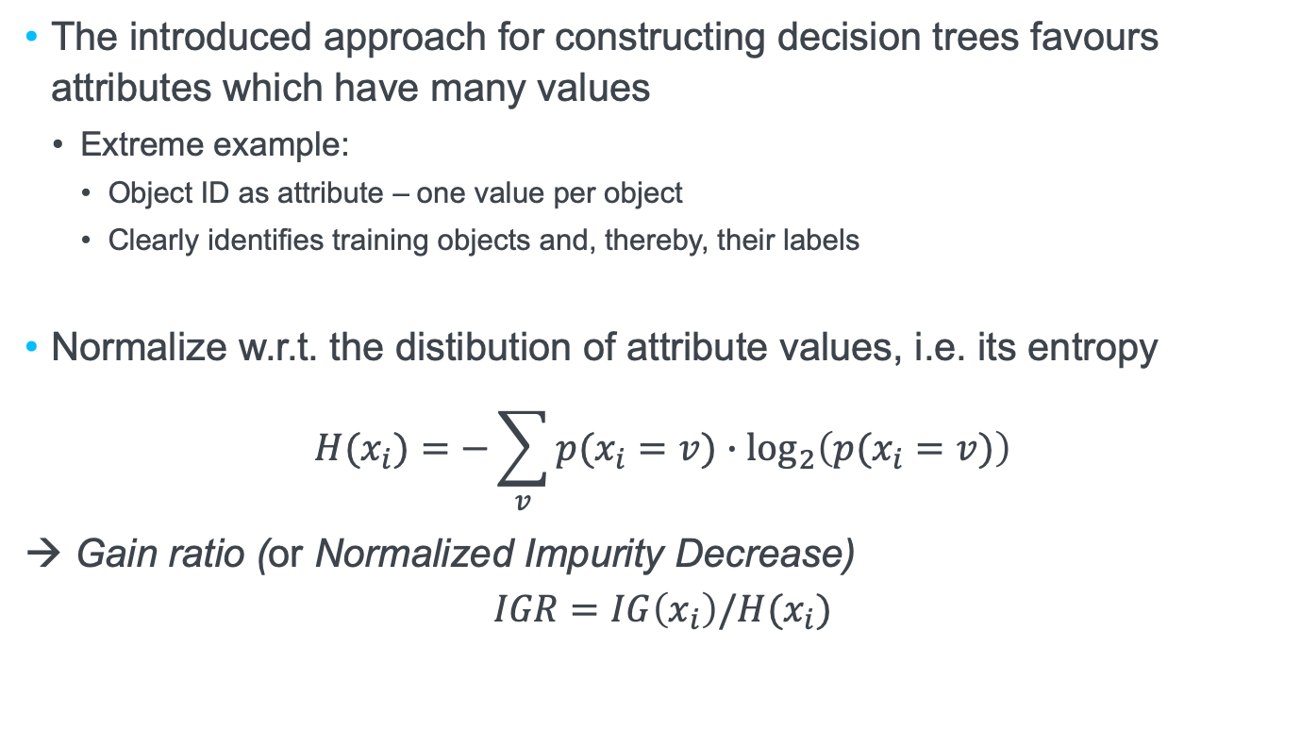
Attributes with many values
The introduced approach for constructing decision trees favours attributes which have many values
Extreme example:
Object ID as attribute – one value per object
Clearly identifies training objects and, thereby, their labels
Normalize w.r.t. the distibution of attribute values, i.e. its entropy
$$H(x_{i})=−\sum_{v}{p(x_{i}=v)∙{\text{log}}_{2}\left(p(x_{i}=v)\right)}$$
→ Gain ratio (or Normalized Impurity Decrease)
$$IGR=IG\left(x_{i}\right)/H(x_{i})$$
Use gain ratio instead of information gain for deciding on which attribute to use.

Slide 38
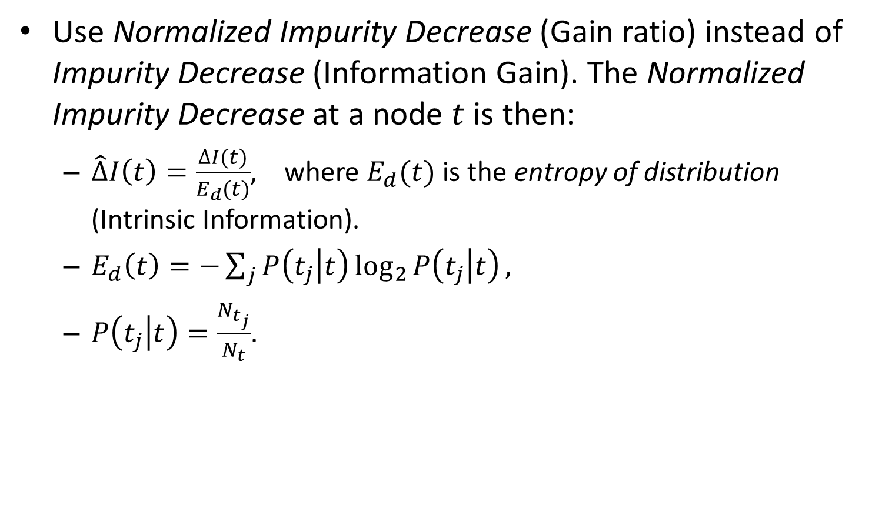
Normalized Impurity Decrease (alternative notation)
Use Normalized Impurity Decrease (Gain ratio) instead of Impurity Decrease (Information Gain). The Normalized Impurity Decrease at a node $t$ is then:
$\hat{∆}I\left(t\right)=\frac{∆I(t)}{E_{d}(t)}$, where $E_{d}(t)$ is the entropy of distribution (Intrinsic Information).
$E_{d}\left(t\right)=−\sum_{j}{P\left(t_{j} | t\right)\log_{2}{P\left(t_{j} | t\right)}},$
$P\left(t_{j} | t\right)=\frac{N_{t_{j}}}{N_{t}}$.

Slide 39
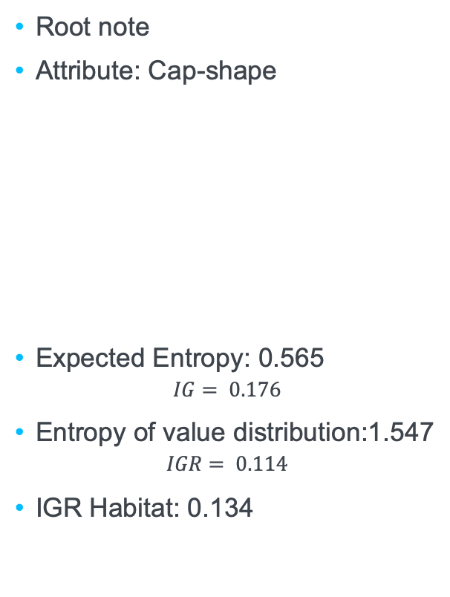
Example
Root note
Attribute: Cap-shape
Expected Entropy: 0.565
$$IG= 0.176$$
Entropy of value distribution:1.547
$$IGR= 0.114$$
IGR Habitat: 0.134
???
value | p | e | total | entropy
b | 0 | 29 | 29 | 0
f | 1 | 13 | 14 | 0.371
s | 0 | 3 | 3 | 0
x | 20 | 34 | 54 | 0.951

Slide 40
Example
Attribute: Gill-size
Entropy of value distribution:0.943
IGR gill-size: 0.412
value | p | e | total | entropy
b | 0 | 64 | 64 | 0
n | 21 | 15 | 36 | 1
???
b
n
???
???
p:0
e:64
p:21
e:15

Slide 41
Example
Attribute: Gill-size
Entropy of value distribution:0.943
IGR gill-size: 0.412
Next node ...
value | p | e | total | entropy
b | 0 | 64 | 64 | 0
n | 21 | 15 | 36 | 1
???
b
n
edible
???
p:21
e:15

Slide 42
Overfitting
Algorithm for decision tree induction is optimizing the training error
Adding more nodes to the tree will reduce the training error
Model becomes more complex!
Risk of overfitting
Wanted: idea of the error rate on new data
Generalization error
Training error is not a good estimator for the generalization error

Slide 43
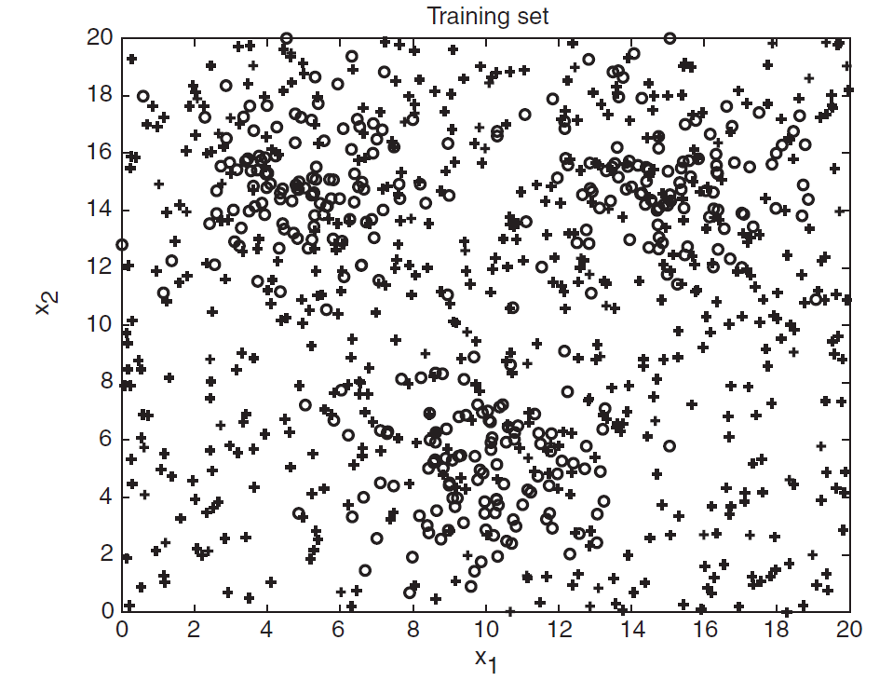
Overfitting
1200 o 1800 +

Slide 44
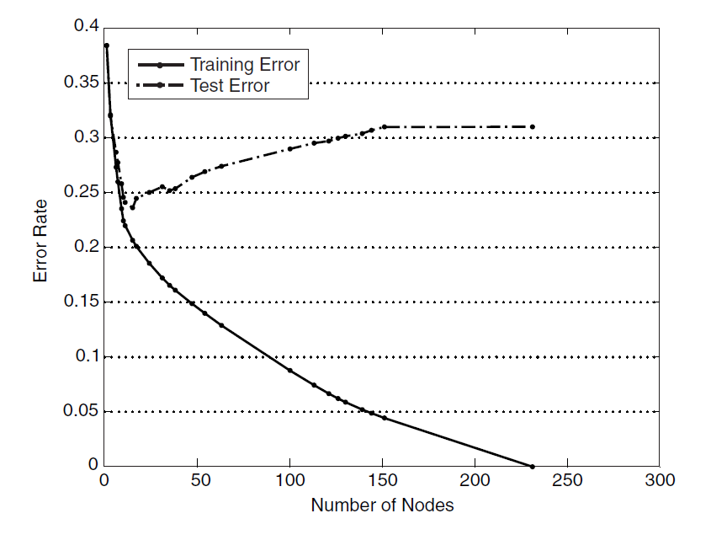
Overfitting
Data split: 30% training, 70% evaluation

Slide 45
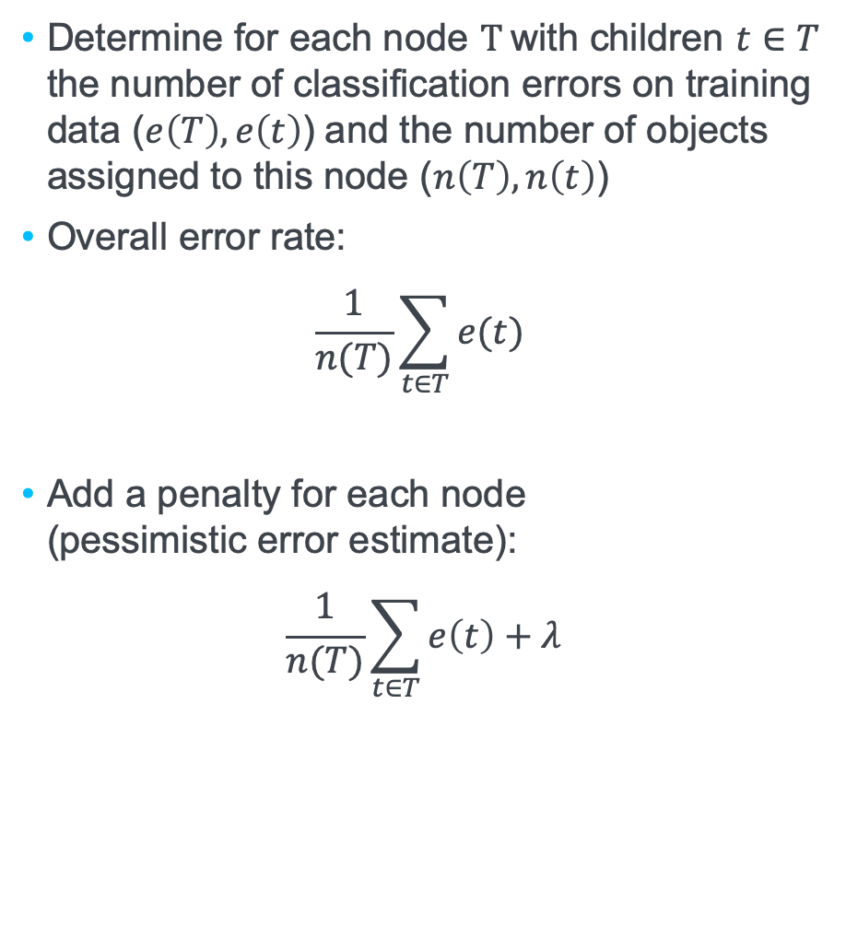


Estimating the Generalization Error
Determine for each node $T$with children $t∈T$ the number of classification errors on training data ($e\left(T\right),e\left(t\right)$) and the number of objects assigned to this node ($n\left(T\right),n\left(t\right)$)
Overall error rate:
$$\frac{1}{n(T)}\sum_{t∈T}^{ }{e(t) }$$
Add a penalty for each node (pessimistic error estimate):
$$\frac{1}{n(T)}\sum_{t∈T}^{ }{e\left(t\right)+λ}$$
Example: 0.167
$$x_{i}$$
blue
orange
orange
o: 1
b: 6
o: 4
b: 2
o: 5
b: 0
Example ($λ$=0.5): 0.25
Regularization
Notes:
3 of 18 = 1/6

Slide 46
Tree Pruning
During construction
Extend stop criterion:
Require minimum information gain
Require mimimum number of instances to be covered by a node
Post processing
Remove leaf nodes
Optimize other criteria (e.g. estimates for the generalization error)
Prune excessively deep sub-trees
Selection
Construct different trees (e.g chosing second best attributes, using subsets of training data)
Select best and smallest tree

Slide 47
Attribute Splitting

Slide 48
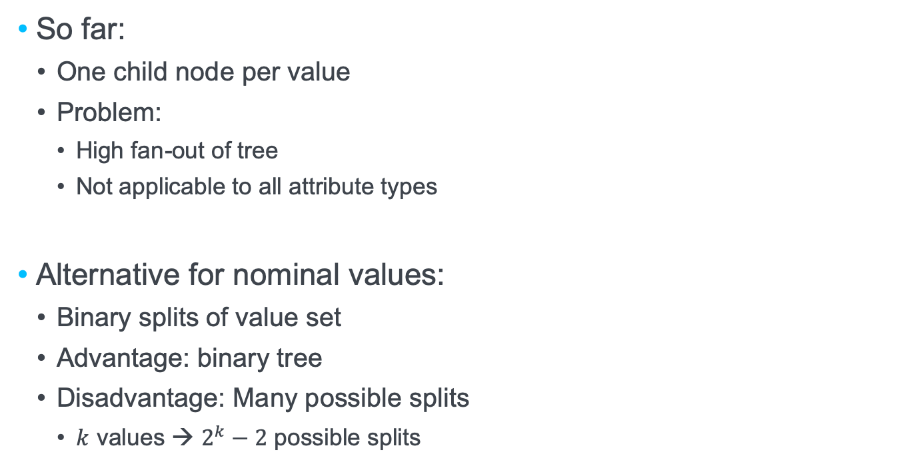
Attribute Splitting
So far:
One child node per value
Problem:
High fan-out of tree
Not applicable to all attribute types
Alternative for nominal values:
Binary splits of value set
Advantage: binary tree
Disadvantage: Many possible splits
$k$ values → $2^{k}−2$ possible splits

Slide 49
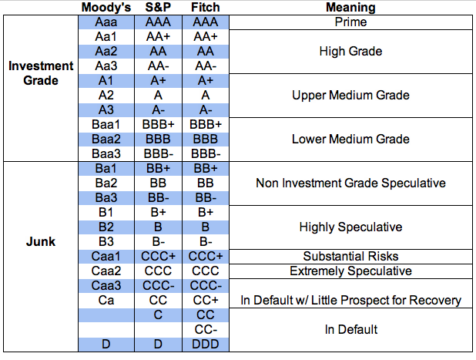
Ordinal values
We can use the order of values to create „meaningful“ splits
Example:
Ratings of shares
Generate splits, such that neighbour categories are merged

Slide 50
Dealing with numerical data
Attributes with numerical data (e.g. height and diameter of a mushroom)
Sort observed values
Use inbetween values for the split
Using the middle between two observed values, provides better separation boundaries
Alternative: Binning – turns numerical data into ordinal data
7
12
20
21
23
25
28
30
9.5
16
20.5
22
24
26.5
29

Slide 51
Equi-width vs. Equi-depth Bins
Fixed width for the bins
Fixed number of elements per bin (a.k.a. frequency binning)

Slide 52
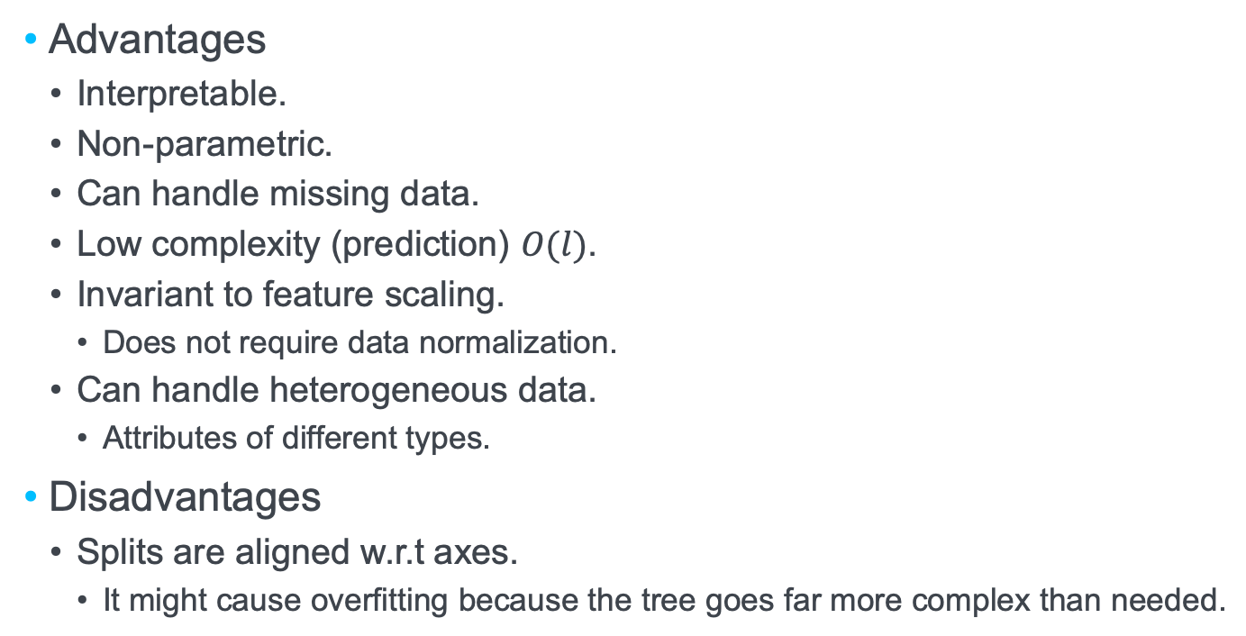
Pros and Cons of Decision Trees
Advantages
Interpretable.
Non-parametric.
Can handle missing data.
Low complexity (prediction) $O(l)$.
Invariant to feature scaling.
Does not require data normalization.
Can handle heterogeneous data.
Attributes of different types.
Disadvantages
Splits are aligned w.r.t axes.
It might cause overfitting because the tree goes far more complex than needed.

Slide 53
?
?
Question:
3 Binning
?
?
?
?

Slide 54
Question: Exponential distribution
The exponential distribution for parameter $λ>0$ is given by the probability density function: $pdf\left(x\right)=λe^{−λx}$
One of its uses is the modeling of breakdown of equipment.
The probability that some equipment breaks down until time t may be modelled by F(t).
Assume you want to have two equal sized bins, where do you set the split?
Solution: The median of the exponential function is, where $F\left(t\right)=0.5$
$$\int_{0}^{t}{λe^{−λx}dx=0.5}$$
$$⟺ −e^{−λx}{\left.​\right|}_{0}^{t}=0.5$$
$$⟺−e^{−λt}+1=0.5$$
$$⟺e^{−λt}=0.5$$
$$⟺−λt=−ln{2}$$
$$⟺t=\frac{\ln{2}}{λ}$$

Slide 55
Question: Exponential distribution
The exponential distribution for parameter $λ>0$ is given by the probability density function: $pdf\left(x\right)=λe^{−λx}$
One of its uses is the modeling of breakdown of equipment.
The probability that some equipment breaks down until time t may be modelled by F(t).
Assume you want to have two equal sized bins, where do you set the split?
Solution: The mean time between failures is the expected value of the cumulative distribution function
$$E\left[t\right]=\int_{0}^{∞}{x∙λe^{−λx}dx=\frac{1}{λ}}$$
Hint: $\int{f^{′}g=fg−\int{fg′}}$, set $g=x, f^{′}=e^{−λx}$ (see e.g. https://www.integralrechner.de/)
Be careful: this is th previously given, but wrong solution.
The mean shows what time I should expect in average, not how many incidences occur in which time interval

Slide 56
References
Manning, C. D., Raghavan, P., & Schütze, H. (2008). Introduction to information retrieval. Cambridge: Cambridge University Press.
Pang-Ning, T., Steinbach, M., & Kumar, V. (2006). Introduction to data mining. Addison Wesley.
Witten, I. H., Frank, E., & Hall, M. A. (2011). Data Mining: Practical Machine Learning Tools and Techniques: Practical Machine Learning Tools and Techniques. Elsevier.

Slide 57

IPVS
Steffen Staab
Steffen.staab@ipvs.uni-stuttgart.de
To be defined
ipvs.uni-stuttgart.de/departments/ac/
Analytic Computing, IPVS
Universitätsstraße 32, 50569 Stuttgart

