Slide 1
Scaling Up Bioimaging with Microfluidic Chips Workshop
Report of advances
November 2025
Josefina Reyes A

Slide 2
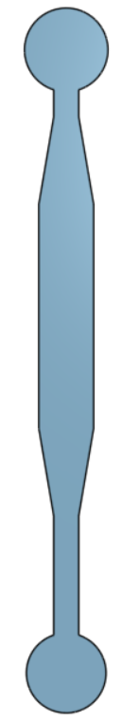
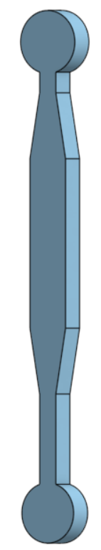
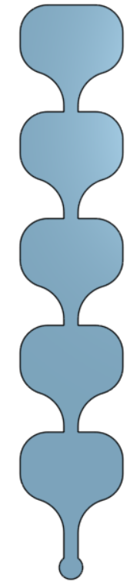
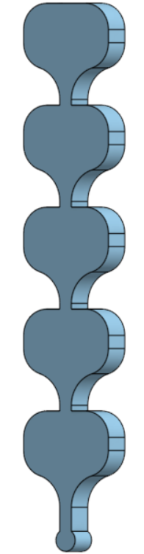
Visualization chambers
Measures
Inlet
Inlet
~1000 µm
~570 µm
These chips are from a pre-existing mold in the lab.
They are prepared with a 10:1 PDMS (SYLGARD 184 Silicone Elastomer) mix ratio, cured at 80°C for 80 minutes, punched with a 1.5 mm biopsy punch, and bonded to a glass slide using a Plasma Cleaner.
~180 µm
~85 µm
~ 3 cm
~ 3 cm
These chips work to visualize small objects (cells, droplets, among others).
Also, they can be adapted for other uses by changing the number of punches
~4300 µm
~4700 µm
Outlet
Outlet
Victor Teixeira Noronha (Flow Interface)
Pablo Lobos-Ruiz (Flow interface)
Lorenzo Tell (Cells & Tissues)
Paula Céspedes (Cells & Tissues)
Will receive both

Slide 3
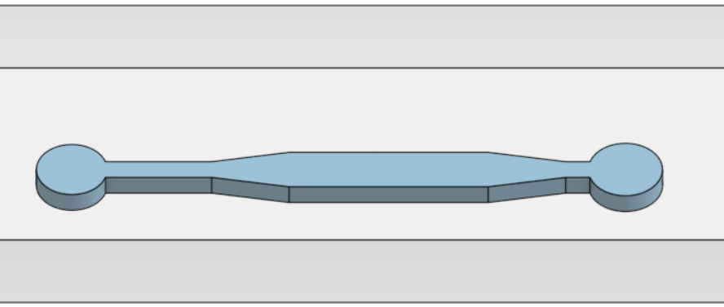
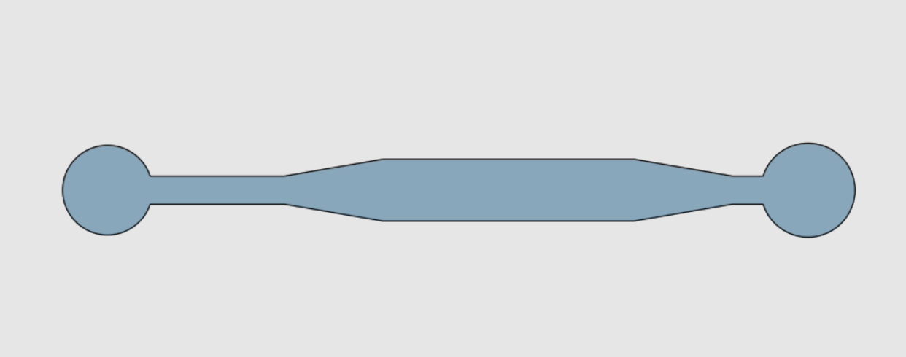
Design A: The punch for the root has an angle close to 45°, and can be filled with a pipette tip (p200) for the plant root culture
Plant-in-Agarose filled 200ul tip
Inlet
(culture medium)
Outlet
Ramiro Rodriguez (Flow Interface)
Will receive it
Inlet
Design B: The orange temporary inlet and outlets (later to be blocked with a pin or glue) are to fill in the matrix, lyophilize the whole chip to make it porous, and then use the chip with cell and reagent flow between the blue connections.
Inlet
(oil for perfusion)
Inlet
(oil for perfusion)
Juan Carlos Forero (Cells & Tissues)
Will receive it
Outlet

Slide 4
Design C: These punches may serve as a simple gradient channel, allowing for the mixing of two or three (when not using A for cells) solutions. The generated concentrations can be adjusted with the flow, and recovered in the outlet
Inlet B
Outlet
(mixed)
Inlet A
Inlet C
Cristopher Villablanca (Cells & Tissues)
Will receive it
Design D: These punches may be used to generate a thin matrix of a hydrogel of interest, adjusting the thickness by controlling the flow of the oil phase. Posteriorly, the oil can be removed and replaced with culture medium with cells, which will attach to the matrix for culture
Inlet
(oil for perfusion)
Outlet
(oil for perfusion)
Inlet
(Hydrogel)
Outlet
(Hydrogel)
Inlet
(oil for perfusion)
Outlet
(oil for perfusion)
Glauben Landskron (Cells & Tissues)
Will receive it

Slide 5
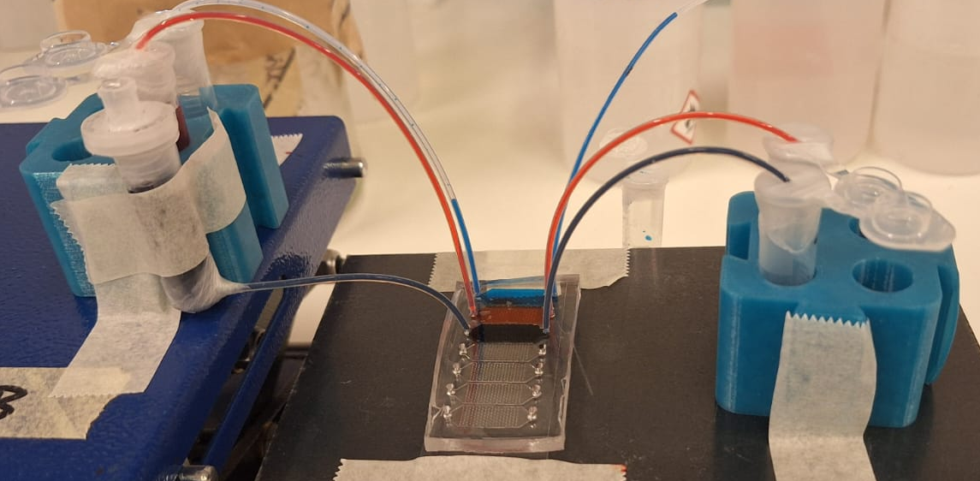
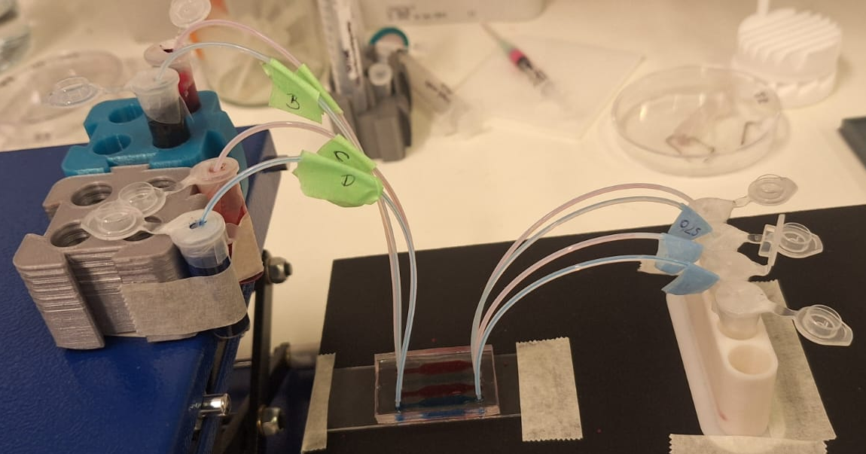
Flow control - without a pump
This setup could enable the culture of cells inside the chips for extended periods of time, without the need for a syringe pump.
However, it has been challenging to maintain a steady and consistent flow over time.
For these, we have tested different variables:
Height
Inside diameter of tubing (0.25, 0.7, and 1 mm)
Tubing (inside diameter) | Slower flows reached
1 mm | ~ 6 ml/h
0.7 mm | ~ 1 ml/h
0.25 mm | ~ 0.4 ml/h
I’m still testing different parameters, because some conditions allow a slow flow, but it’s not constant, and it stops when the inlet and outlet have the same volume

Slide 6
Suggested materials
Tubing, PTFE, 1/16” x 0.25 or 0.7 mm
1 ml syringes
21G needle (for 0.7 mm tubing) or 27G needle (for 0.25 mm tubing)
Scotch
0.2 µm filter
Tweezers
Eppendorf tubes
Parafilm
Additional recommendations:
Fill all the tubing before connecting it to the chip, to avoid adding air to it. Bubbles interfere with the correct flow
  You can do it with the syringe and the needle
  The size of the recommended needles is related to the inside diameter of the tubing
  Use the tweezers to fit the needle in the tubing
You can make a hole in the tap of the Eppendorf tube or use parafilm to attach the tube, with the aim of avoiding movements and ambient contaminations
Initially, we will provide some of these materials for you to test if you don’t have them – please complete our table to know what we need to send.

