Slide 1
Course: Programming with C#
Session: .NET Framework

Slide 2
Objective
By the end of this session, you will be able to understand:
Introducing .NET Framework
Components of .NET Framework
Program execution in .NET
Getting started with Visual Studio 2012
C# Program structure
Use the operators
Use conditional constructs
Use looping constructs
Methods in C#
Notes:
Instructor Notes:
By the end of this course, participants should be able to:
<Obj1>
<Obj 2>

Slide 3
What is a Framework?
A framework is a software infrastructure.
A framework is a software infrastructure in which a software that provides generic functionality can be selectively changed by adding user-written code to it, hence providing application-specific software.
Framework is used to develop or run or debug the application.
Once a framework is installed in the machine, we can continue the application development instead of developing it from the scratch.

Slide 4
Introducing the .NET Framework
.NET Framework, introduced by Microsoft, aims at integrating various programming languages and services.
.NET Framework is designed to make significant improvements in code reuse, code specialization, resource management, multi language development, security, deployment, and administration.
.NET Framework consists of all the technologies that help in creating and running robust, scalable, and distributed applications.

Slide 5
Introducing the .NET Framework
The .NET suite consists of:
.NET Products
.NET Services
.NET Framework
Let us understand each component of the .NET suite in detail.

Slide 6
Introducing the .NET Framework
.NET Products:
.NET products aim at allowing developers to create applications, which are capable of interacting seamlessly with each other.
All .NET products use extensible Markup Language (XML) for describing and exchanging data between applications.
An example of a .NET product is Visual Studio .NET.

Slide 7
Introducing the .NET Framework
.NET Services:
.NET helps you to create software as Web services. A Web Service is an application or business logic that is accessible through standard Internet protocols such as Hypertext Transfer Protocol (HTTP) and Simple Object Access Protocol (SOAP). You can identify the service by a Uniform Resource Locator (URL).
Microsoft has come up with its own set of Web services, known as My Services.
This service allows users to access data by linking calendars, phonebooks, address books, and personal references to the passport authentication service.

Slide 8
Introducing the .NET Framework
The .NET Framework:
It is the foundation for designing, developing, and deploying applications.
It is the core of the .NET infrastructure because it exists as a layer between the .NET applications and the underlying operating system.
Let us understand the .NET Framework in detail.
Notes:
Student already have learnt about type 2 SCDs in Module I. Therefore, you can start this topic by asking the following questions to students:
What are type 2 SCDs?
Given an example to explain type 2 SCDs.
This will recapitulate what they have learnt about type 2 SCD in Module 1.
Now explain the strategy to update the data into these dimension tables with help the example given in SG.
After explaining the examples, you can ask students to think of an example of a type 2 SCD and then tell the strategy to update the data into this dimension table.

Slide 9

.NET Features
Multiple Language Support
Language interoperability
Powerful framework
1000s of libraries
Intelligent Application Software Visual Studio

Slide 10
Components of the .NET Framework
The various components of the .NET Framework are:
Deployment framework (Built in visual studio)
Common Language Runtime
The .NET Framework Class Library
User and Program Interfaces
Development Framework (additional component)
Common Language Runtime
The .NET Framework Class Library

Slide 11
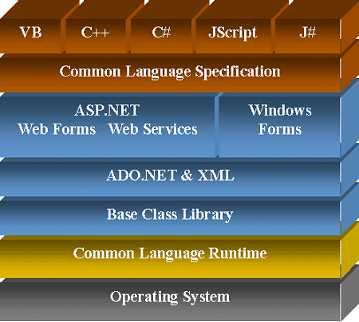
Components of the .NET Framework
The following figure displays the various components of the .NET Framework.

Slide 12
Components of the .NET Framework
Common Language Runtime (CLR):
CLR is the RunTime where all programs in .NET are executed. (like JVM is RunTime in Java).
CLR provides services such as code compilation, memory allocation, and garbage collection.
CLR allows the execution of code across different platforms by translating code into Intermediate Language (IL).

Slide 13
Components of the .NET Framework
IL is a low level language that the CLR understands.
IL is converted into machine language during execution by the JIT compiler. During JIT compilation, code is also checked for type safety.
Type safety ensures that objects are always accessed in a compatible way.

Slide 14
Components of the .NET Framework
CLR consists of a set of common rules followed by all the languages of the .NET Framework. This set of rules is known as Common Language Specification (CLS).
CLS enables an object or application to interact with the objects or applications of other languages.
The classes that follow the rules specified by CLS are termed as CLS-compliant classes. The classes defined in the .NET Framework class library are CLS-compliant.

Slide 15
Components of the .NET Framework
One of the specifications defined in CLS is CTS, which provides a type system that is common across all languages. CTS define how data types are declared, used, and managed in the code at run time.
While executing the program, CLR:
Identifies the process of compilation
Identifies the process of code execution

Slide 16
Components of the .NET Framework
The .NET Framework Class Library:
The .NET Framework class library works with any .NET language, such as VB.NET, VC++ .NET, and VC#.
The .NET Framework class library provides classes that can be used in the code to accomplish a range of common programming tasks, such as string management, data collection, database connectivity, and file access.
The .NET Framework class library comprises of:
Namespaces
Assemblies

Slide 17
Components of the .NET Framework
User and Program Interfaces:
At the presentation layer, .NET provides four types of user interfaces:
Windows Forms
Web Forms
Console Applications
Mobile Emulators
.NET provides a program interface, Web Services, to communicate with remote components.

Slide 18
Components of the .NET Framework
Advantages of the .NET Framework:
Consistent programming model
Multi-platform applications
Multi-language integration
Automatic resource management
Ease of deployment

Slide 19
Using Visual Studio .NET IDE
The Visual Studio .NET IDE provides you with a common interface for developing various kinds of projects for the .NET Framework.
The IDE also provides you with a centralized location for designing the user interface for an application, writing code, and compiling and debugging the application.

Slide 20
Creating Projects and Solutions
In Visual Studio .NET, an application can be made up of one or more items, such as files and folders.
To organize these items efficiently, Visual Studio .NET has provided two types of containers:
Project: It typically contains items that make up the application. These items are interrelated.
Project file extension is .csproj / .vbproj
Solution: It usually acts as a container for one or more projects.
Solution file extension in .sln

Slide 21
Creating Projects and Solutions
The following figure shows a solution with multiple projects.
Solution
Project 1
Items
Project 1
Project 2
Project 2
Items
Miscellaneous Files

Slide 22
Creating Projects and Solutions
To create a console application in Visual Studio, you need to create a project. To create a project, you need to perform the following steps
Select File→New→Project. The New Project dialog box will be displayed.
2. Select Start → All Programs → Microsoft Visual Studio 2010 → Microsoft Visual Studio 2010. The Start Page - Microsoft Visual Studio window will be displayed.
3. In the New Project dialog box, select Visual C# from the Project Types pane and Console Application from the Templates pane.

Slide 23
Creating Projects and Solutions
4. Specify the name of the application in the Name text box.
5. Specify the location where the new project is to be created in the Location combo box. You can use the Browse button to browse to the folder in which the new project is to be created.
6. Click the OK button.

Slide 24
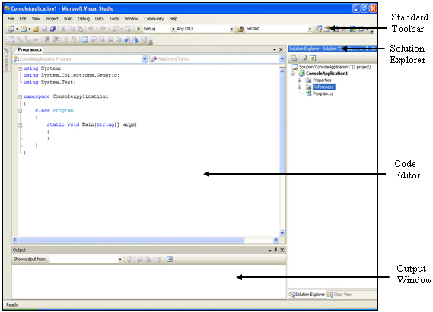
Creating Projects and Solutions
User Interface Elements of Visual Studio .NET IDE:
When you work with a console application project in Visual Studio .NET, you can use the following main elements in Visual Studio .NET IDE.

Slide 25
Creating Projects and Solutions
Standard Toolbar:
The Standard toolbar is located below the menu bar. It provides shortcuts for menu commands.

Slide 26
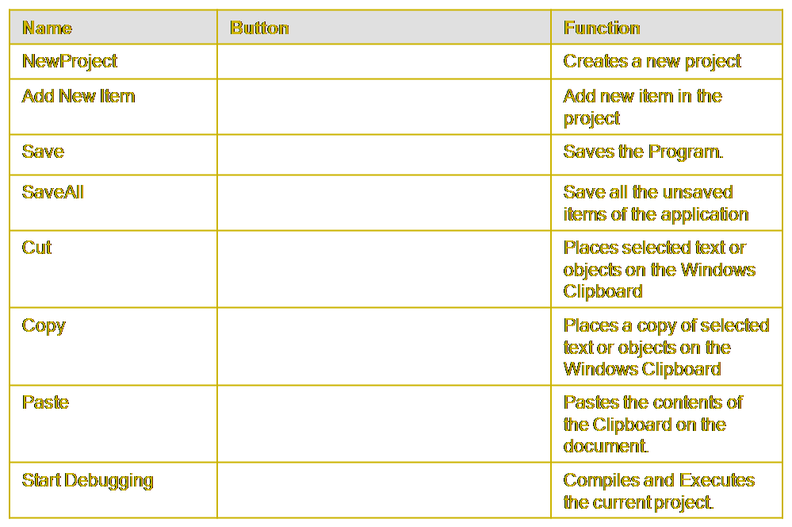
Creating Projects and Solutions

Slide 27
Creating Projects and Solutions
The Start Page:
When you start Visual Studio .NET, it displays the Start Page- Microsoft Visual Studio.
The Start Page is the default home page for the browser provided within the Visual Studio .NET IDE.
This tab displays some of the recent projects and the last date of their modification. You can open any one of these projects.

Slide 28
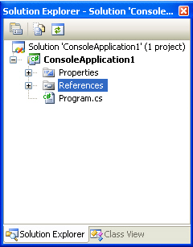
Creating Projects and Solutions
The Solution Explorer Window:
The Solution Explorer window lists the solution name, the project name, and all the classes that are used in the project.

Slide 29
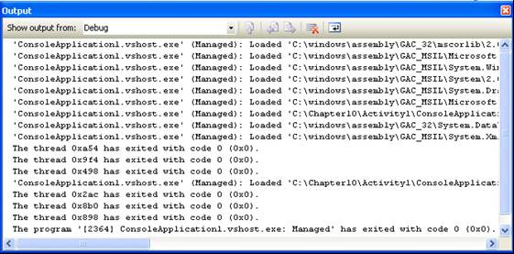
Creating Projects and Solutions
The Output Window:
The Output window displays messages for the status of various features provided in the Visual Studio .NET IDE.

Slide 30
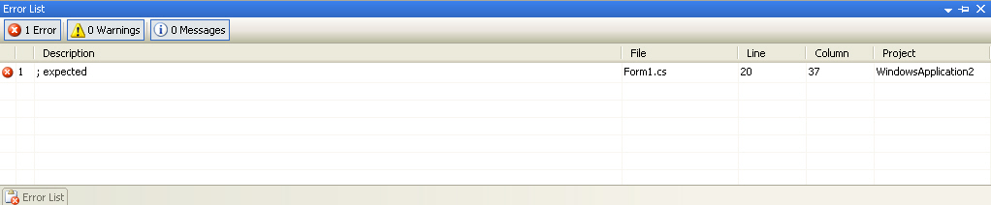
Creating Projects and Solutions
The Error List Window:
The Error List window displays a list of errors along with the source (the file and the line number) of the error. It helps you identify and locate problems that are detected automatically as you edit or compile code.

Slide 31
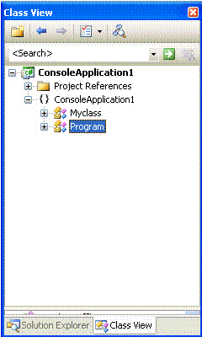
Creating Projects and Solutions
The Class View Window:
The Class View window displays the classes, methods, and properties associated with a particular file. They are displayed in a hierarchical tree-view depicting the containership of these items.

Slide 32
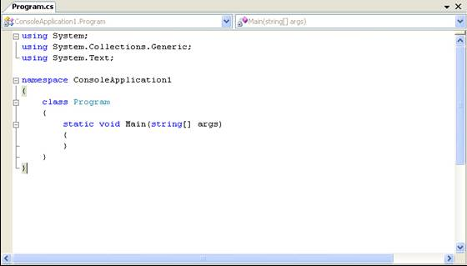
Creating Projects and Solutions
The Code Editor:
The code editor allows you to enter and edit code. You may use this editor to add code for your class.

Slide 33
Compiling and Executing Project
To compile and execute the application, you need to perform the following steps:
1. Select Build→Build Solution or press F6 to compile the application.
2. Select Debug→Start Debugging or press F5 to execute the application.

Slide 34
Debugging Application
To compile and execute the application, you need to perform the following steps:
1. Select Build→Build Solution or press F6 to compile the application.
2. Select Debug→Start Debugging or press F5 to execute the application.

Slide 35
What is C#?
C# is a Object oriented programming language from Microsoft.
C# is pronounced as C-Sharp.
It is a used develops application programs.
It is a PURE OOPS language (fully secured).
C#.NET is a language, which targets to .NET technology.
It is available in Visual Studio.
Csc is the compiler for C#.
The compiled C# program generated .exe or .dll.

Slide 36
C# Syntax
C# follows C and C++ syntax.
C# is Case Sensitive.
Every Statement must terminate using semicolon (;).
Execution starts using Main() method
It is a high level language, used to develop application programs.
C# Compiler: csc is a compiler, it converts C# code to IL Code(.NET under stable code).

Slide 37
Using Operators
Applications use operators to process the data entered by a user.
Operators in C# can be classified as follows:
Arithmetic operators
Arithmetic Assignment operators
Unary operators
Comparison operators
Logical operators

Slide 38
Arithmetic Operators
Arithmetic operators are the symbols that are used to perform arithmetic operations on variables.
The following table describes the commonly used arithmetic operators.
Operator | Description | Example
+ | Used to add two numbers | X=Y+Z; If Y is equal to 20 and Z is equal to 2, X will have the value 22.
- | Used to subtract two numbers | X=Y-Z; If Y is equal to 20 and Z is equal to 2, X will have the value 18.
* | Used to multiply two numbers | X=Y*Z; If Y is equal to 20 and Z is equal to 2, X will have the value 40.
/ | Used to divide one number by another | X=Y/Z; If Y is equal to 21 and Z is equal to 2, X will have the value 10. But, if Y is equal to 21.0 and Z is equal to 2, X will have the value 10.5.
% | Used to divide two numbers and return the remainder | X=Y%Z; If Y is equal to 21 and Z is equal to 2, X will contain the value 1.

Slide 39
Arithmetic Assignment Operators
Arithmetic operators are the symbols that are used to perform arithmetic operations on variables.
The following table describes the commonly used arithmetic operators.
Operator | Usage | Description
= | X = 5; | Stores the value 5 in the variable X.
+= | X+=Y; | Same as: X = X + Y;
-= | X-=Y; | Same as: X = X - Y;
*= | X*=Y; | Same as: X = X * Y;
/= | X/=Y; | Same as: X = X / Y;
%= | X%=Y; | Same as: X = X % Y;

Slide 40
Unary Operators
Unary operators are used to increment or decrement the value of an operand by 1.
The following table explains the usage of the increment and decrement operators.
Operator | Usage | Description | Example
++ | ++Operand; (Preincrement operator) Or, Operand++; (Postincrement operator) | Used to increment the value of an operand by 1 | Y = ++X; If the initial value of X is 5, after the execution of the preceding statement, values of both X and Y will be 6. Y = X++; If the initial value of X is 5, after the execution of the preceding statement, value of X will be 6 and the value of Y will be 5.
-- | --Operand; (Predecrement operator) Or, Operand--; (Postdecrement) | Used to decrement the value of an operand by 1 | Y = --X; If the initial value of X is 5, after the execution of the preceding statement, values of X and Y will be 4. Y = X--; If the initial value of X is 5, after the execution of the preceding statement, value of X will be 4 and the value of Y will be 5.

Slide 41
Comparison(or)Relational Operators
These operators are used to compare two values and perform an action on the basis of the result of that comparison.
The following table explains the usage of commonly used comparison operators.
Operator | Usage | Description | Example (In the following examples, the value of X is assumed to be 20 and the value of Y is assumed to be 25)
< | expression1 < expression2 | Used to check whether expression1 is less than expression2 | bool Result; Result = X < Y; Result will have the value true.
> | expression1 > expression2 | Used to check whether expression1 is greater than expression2 | bool Result; Result = X > Y; Result will have the value false.
<= | expression1 <= expression2 | Used to check whether expression1 is less than or equal to expression2 | bool Result; Result = X <= Y; Result will have the value true.
>= | expression1 >= expression2 | Used to check whether expression1 is greater than or equal to expression2 | bool Result; Result = X >= Y; Result will have the value false.

Slide 42
Comparison Operators
Operator | Usage | Description | Example (In the following examples, the value of X is assumed to be 20 and the value of Y is assumed to be 25)
== | expression1 == expression2 | Used to check whether expression1 is equal to expression2 | bool Result; Result = X == Y; Result will have the value false.
!= | expression1 != expression2 | Used to check whether expression1 is not equal to expression2 | bool Result; Result = X != Y; Result will have the value true.

Slide 43
Logical Operators
Logical operators are used to evaluate expressions and return a Boolean value.
The following table explains the usage of logical operators.
Operator | Usage | Description | Example
&& | expression1 && expression2 | Returns true if both expression1 and expression2 are true. | bool Result; string str1, str2; str1 = “Korea”; str2 = “France”; Result= ((str1==“Korea”) && (str2==“France”)) Console.WriteLine (Result .ToString()); The message displays True because str1 has the value “Korea” and str2 has the value “France”.
! | ! expression | Returns true if the expression is false. | bool Result int x; x = 20; Result=(!( x == 10)) Console.WriteLine(Result.ToString()); The message displays True because the expression used returns true.

Slide 44
Logical Operators
Operator | Usage | Description | Example
|| | expression1 || expression2 | Returns true if either expression1 or expression2 or both of them are true. | bool Result string str1, str2; str1 = “Korea”; str2 = “England”; Result= ((str1==“Korea”) || (str2== “France”)) Console.WriteLine (Result .ToString()); The message displays True if either str1 has the value “Korea” or str2 has the value “France”.
^ | expression1 ^ expression2 | Returns true if either expression1 or expression2 is true. It returns false if both expression1 and expression2 are true or if both expression1 and expression2 are false. | bool Result; string str1, str2; str1 = “Korea”; str2= “France”; Result = (str1== “Korea”) ^ (str2== “France”); Console.WriteLine (Result .ToString()); The message False is displayed because both the expressions are true.

Slide 45
Keywords to write C# program
Keywords | Functionality
using | This keyword is used import a library in current program Ex: using System; using System.Data;
namespace | This keyword is used to group the classes (this is optional) Note: By default a namespace will be created with the name given for the project When the project is create, a namespace gets added automatically with project name.
Class | This keyword is used to create a class (A class is a user defined data type) Note: a program can have any number of classes. There should be one class with name Program and it should contain Main() method
Main | This is the startup of .net program Note: Main is case sensitive
static | Used to invoke method without creating object. Note: C# Main method should be prefixed with static
void | This keyword is used to specify data type nothing in the return type

Slide 46
Using Conditional Constructs
Conditional constructs allow the selective execution of statements, depending on the value of expression associated with them.
The comparison operators are required for evaluating the conditions.
The various conditional constructs are:
The if…else construct
The switch…case construct

Slide 47
The if…else Construct
The if…else conditional construct is followed by a logical expression where data is compared and a decision is made on the basis of the result of the comparison.
The following is the syntax of the if…else construct:
if (expression)
{
statements;
}
else
{
statements;
}

Slide 48
The if…else Construct
The if…else constructs can be nested inside each other.
When if…else construct is nested together, the construct is known as cascading if…else constructs.

Slide 49
The switch…case Construct
The switch…case construct is used when there are multiple values for a variable.
The following is the syntax of the switch…case construct:
switch (VariableName)
{
case ConstantExpression_1:
statements;
break;
case ConstantExpression_2:
statements;
break;

Slide 50
The switch…case Construct
…
case ConstantExpression_n:
statements;
break;
default:
statements;
break;
}

Slide 51
Demo: Calculator Using Conditional Constructs Conditional Constructs
Problem Statement:
Write a program that emulates a calculator. The calculator should be able to perform the following mathematical operations:
Addition
Subtraction
Multiplication
Division

Slide 52
Using Loop Constructs
Loop are iteration control structures are used to execute one or more lines of code repetitively.
The following loop constructs are supported by C#:
The while loop
The do…while loop
The for loop
For each loop used in collections

Slide 53
The while Loop
The while loop construct is used to execute a block of statements for a number of times.
While loop is an example of infinite loop.
The following is the syntax of the while loop construct:
while (expression)
{
statements;
}
Note
Loop initialization and update are optional in while loop.

Slide 54
do…while Loop
It is an infinite loop.
The do…while loop construct is not similar to the while loop construct.
Even the condition failed, the do..while loop will execute once.
do..while is an exit control loop.
The following is the syntax of the do…while loop construct:
do
{
statements;
}while(expression);

Slide 55
do…while Loop
The following figure shows the difference between the do…while and while loop construct.
do while
Execute body of Loop
Evaluate
Condition
False
True
Evaluate
Condition
False
Execute body of Loop
True

Slide 56
The for Loop
The for loop structure is used to execute a block of statements for a specific number of times.
For loop is finite loop.
For loop is an entry control loop.
The following is the syntax of the for loop construct:
for (initialization; termination; update stmt)
{
statements;
}

Slide 57
The for Loop
The following figure shows the sequence of execution of a complete for loop construct.
Initialization
Evaluate
Condition
False
Exit the for Loop
Body of the for Loop
Increment/ Decrement
Notes:
Student already have learnt about SCDs in Module I. Therefore, you can start this topic by asking the following questions to students:
What are type 1 SCDs?
Given an example to explain type 1 SCDs.
This will recapitulate what they have learnt about type 1 SCD in Module 1.
Now explain the strategy to load the data into these dimension tables with help of the given diagram. Relate this diagram to the example given in SG.

Slide 58
Loops Syntax and Examples
 | while loop Syntax | while loop example to display 1 to 10 numbers
 | while ( expression ) { Statements; } | int i=1; while ( i<=10 ) { Console.WriteLine(i); i++; }
 | do while loop Syntax | do while loop example to display 1 to 10 numbers
 | do { Statements; } while ( expression ); | int i=1; do { Console.WriteLine(i); i++; } while ( i<=10 );

Slide 59
Loops Syntax and Examples
 | for loop syntax | for loop example
 | for ( initiazation ; expression ; updation) { Statements; } | for (int i = 1 ; i <=10; i++) { Console.WriteLine(i); }

Slide 60
Difference between while and do..while
 | Difference between while and do while | do while loop execute once even the condition failed.
 | Display 11 to 10 using while loop | Display 1 to 10 using do while loop
 | int i = 11; while ( i<=10) { Console.WriteLine(i); i++; } | int i=11; do { Console.WriteLine(i); i++; } while ( i<=10 );

Slide 61
Demo: Fibonacci Series Using Loop Constructs
Write a program that generates the Fibonacci series up to 200.
using System;
class Program
{
static void Main(string[] args)
{
Console.Write("Enter an integer : ");
int n = Convert.ToInt32(Console.ReadLine());
int fact = 1;
for (int i = n ; i>=1; i--)
{
fact*=i;
}
Console.WriteLine("Factorial of {0} is{1}",n,fact);
Console.ReadKey();
}
}

Slide 62
The break and continue Statements
The break statement is used to exit from the loop and prevents the execution of the remaining loop.
The continue statement is used to skip all the subsequent instructions and take the control back to the loop.

Slide 63
Using Methods
A method is a set of one or more program statements, which can be executed by referring to the method name.
To use methods, you need to:
Define methods
Call methods

Slide 64
Defining Methods
Defining a method means declaring the elements of its structure.
Consider the syntax of defining a method:
<Access specifier> <Return Type> <Method Name>(Parameter List)
{
Method Body
}

Slide 65
Defining Methods
The elements of the method declaration include the method name, the parameters list, the return type, and the method body.
The following are the elements of a method:
Access specifier
Return type
Method name
Parameter list
Method body
Let us understand each of the element of the method declaration.

Slide 66
Defining Methods
Defining a method means declaring the elements of its structure.
This determines the extent to which a variable or method
can be accessed from another class.
Consider the syntax of defining a method:
<Access specifier> <Return Type> <Method Name>(Parameter List)
{
Method Body
}

Slide 67
Defining Methods
Defining a method means declaring the elements of its structure.
A method can return a value of any type. If the method is not returning any value, use void as the return type.
Consider the syntax of defining a method:
<Access specifier> <Return Type> <Method Name>(Parameter List)
{
Method Body
}

Slide 68
Defining Methods
Defining a method means declaring the elements of its structure.
This is a unique identifier and is
case-sensitive. The method name cannot be the same as the variable name or any other non-method item declared in the class.
Consider the syntax of defining a method:
<Access specifier> <Return Type> <Method Name>(Parameter List)
{
Method Body
}

Slide 69
Defining Methods
Defining a method means declaring the elements of its structure.
This is used to pass and receive the data from a method. It is enclosed between parentheses. The parentheses are included even if there are no parameters.
Consider the syntax of defining a method:
<Access specifier> <Return Type> <Method Name>(Parameter List)
{
Method Body
}

Slide 70
Defining Methods
Defining a method means declaring the elements of its structure.
This contains the set of instructions needed to complete
the required activity.
Consider the syntax of defining a method:
<Access specifier> <Return Type> <Method Name>(Parameter List)
{
Method Body
}

Slide 71
C# Method Parameters
C# method can have four different kind of parameters
Default value type
Ref
Out
params

Slide 72
Calling Methods
After defining the method, you can execute it by calling it.
You can call a method by using the name of the method.
The method name is followed by parentheses even if the method call has no parameters, as shown in the following example:
MethodName();

Slide 73
Calling Methods
The method parameters are by default value type:
Following method example used to return sum of two numbers given in the parameter
using System;
class Program
{
public static int Addition(int a, int b)
{
return (a + b);
}
static void Main(string[] args)
{
int result = Addition(5, 6);
Console.WriteLine("Result is : "+result);
Console.ReadKey();
}
}

Slide 74
Static Method
Static methods are method, can be invoked without creating objects
using System;
class Program
{
public static void Display()
{
Console.WriteLine("From Display");
}
static void Main(string[] args)
{
Display();
Console.ReadKey();
}
}

Slide 75
Static Methods in other classes
Static methods in other classes can be invoked with class name
using System;
class MyClass
{
public static void MyMethod()
{
Console.WriteLine("From Method");
}
}
class Program
{
static void Main(string[] args)
{
MyClass.MyMethod();
Console.ReadKey();
}
}

Slide 76
Method with ref parameter
Ref parameter is used to send a reference of a variable to the function parameters
Using ref, the value can be modified in the definition
using System;
class Program
{
public static void Swap(int a,int b)
{
int temp=a;
a=b;
b=temp;
}

Slide 77
Method with ref parameter
public static void Main()
{
int a = 5, b = 6;
Console.WriteLine("Values before swap: a={0}, b={1}",a,b);
Swap(a, b);
Console.WriteLine("Values after swap: a={0}, b={1}", a, b);
Console.ReadKey();
}
}

Slide 78
Method out parameter
Out parameters are used to initialize values in the method definition:
using System;
class Program
{
public static void Initialize(out int a,out int b)
{
a = 1;
b = 1;
}
public static void Main()
{
int a , b ;
Initialize(out a, out b);
Console.WriteLine("Values after swap: a={0},b={1}", a, b);
Console.ReadKey();
}
}

Slide 79
Method Out Parameter: Example-2
Out parameter using int.TryParse method
using System;
class Program
{
static void Main(string[] args)
{
string s = "1a0";
int n;
bool status = int.TryParse(s, out n);
if( status)
Console.WriteLine("n = {0}",n);
else
Console.WriteLine("Failed to parse");
Console.ReadKey();
}
}

Slide 80
Using Methods with Parameters
Output: The output parameters are used to pass the value out of the method. The following example shows the parameters passed by reference:
void CalculateSum(ref int num1,ref int num2, out int result){
result=num1+num2;
}
void Accept(){
int val1=10;
int val2=2;
int recieveVal;
CalculateSum( ref val1,ref val2,outrecieveVal);
}

Slide 81
Using Methods with Parameters
Reference: The parameters passed by reference does not creates a separate copy of the variable in the memory. A reference parameter stores the memory address of the data member passed. The following example shows the parameters passed by reference:
void CalculateSum( ref int num1,ref int num2){
//… }
void Accept()
{
int val1=10;
int val2=2;
CalculateSum( ref val1,ref val2);
}

Slide 82
Summary
In this session, you learned that:
The .NET Framework is made up of many components, such as Common Language Specification (CLS), Common language Runtime (CLR), and Just-In-Time (JIT) compiler.
CLS is a set of rules that are followed by all the languages of the .NET Framework.
When a program is compiled using Visual Studio .NET the compiler translates the code into the Intermediate Language (IL) instead of machine language.

Slide 83
Summary
The Just-In-Time (JIT) compiler is used to translate code from IL into machine language.
The Common Language Runtime (CLR) is the environment where all .NET applications are executed.
The Visual Studio .NET Integrated Development Environment (IDE) provides you with a common interface for developing various kinds of applications for the .NET Framework.
Visual Studio .NET provides two types of containers, projects and solutions to organize the constituents of an application.

Slide 84
Summary
Abstraction is the process of reducing information content in order to retain only the relevant information for a particular purpose.
Encapsulation is the process of hiding all the details of an object that do not contribute to its essential characteristics.
An access specifier is used to determine whether any other class or function can access the member variables and functions of a particular class.
The public access specifier allows a class to expose its member variables and member functions to other functions and objects.

Slide 85
Summary
The private access specifier allows a class to hide its member variables and member functions from other class functions and objects.
The protected access specifier allows a class to hide its member variables and member functions from other class objects and functions, just like the private access specifier while implementing inheritance.
A method is a set of one or more program statements that can be executed by referring to the method name.
Defining a method means declaring the elements of its structure.

Slide 86
Summary
The access modifiers that can be used with methods are public, protected, internal, protected internal, and private.
Parameters allow information to be passed into and out of a method. When you define a method, you can include a list of parameters in parentheses.
Parameters can be passed by using any one of the following parameters types:
Value
Reference
Output

Slide 87
Summary
Pass by value is the default mechanism for passing parameters in C#.
A reference parameter is a reference to a memory location of a data member.
Output parameters are like reference parameters, except that they transfer data out of the method rather than into it.
The return statement is used to return the control to the caller.

Slide 88
Summary
Operators are used to compute and compare values and test multiple conditions.
You use arithmetic operators to perform arithmetic operations on variables like addition, subtraction, multiplication, and division.
You can use arithmetic assignment operators to perform arithmetic operations and assign the result to a variable.
The unary operators, such as the increment and decrement operators, operate on one operand.

Slide 89
Summary
Comparison operators are used to compare two values and perform an action on the basis of the result of the comparison.
Logical operators are used to evaluate expressions and return a Boolean value.
Conditional constructs are used to allow the selective execution of statements. The conditional constructs in C# are:
if…else
switch…case

Slide 90
Summary
Looping constructs are used when you want a section of a program to be repeated a certain number of times. C# offers the following looping constructs:
while
do…while
for
The break and continue statements are used to control the program flow within a loop.

