Slide 1
Course: Developing Web Application using ADO.NET and ASP.NET
Session: Entity Frame Work

Slide 2
Objective
By the end of this session, you will be able to understand:
Difference between Linq to SQL and Entity Frame work
Notes:
2

Slide 3
LINQ to SQL allows you to query and modify SQL Server database by using LINQ syntax. Entity framework is a great ORM shipped by Microsoft which allow you to query and modify RDBMS like SQL Server, Oracle, DB2 and MySQL etc. by using LINQ syntax. Today, EF is widely used by each and every .NET application to query to database. The difference between LINQ to SQL and EF is given below.

Slide 4
LINQ to SQL | Entity Framework
It only works with SQL Server Database. MYSQL | It can work with various data Bases like Oracle, DB2,
It generates a .dbml to maintain the relation | It generates an .edmx files (.csdl, .msl and .ssdl)
It has not support for complex type. | It has Support for Complex Type.

Slide 5
The Microsoft ADO.NET Entity Framework is an Object/Relational Mapping (ORM) framework that enables developers to work with relational data as domain-specific objects, eliminating the need for most of the data access plumbing code that developers usually need to write. Using the Entity Framework, developers issue queries using LINQ, then retrieve and manipulate data as strongly typed objects. The Entity Framework's ORM implementation provides services like change tracking, identity resolution, lazy loading, and query translation so that developers can focus on their application-specific business logic rather than the data access fundamentals.

Slide 6
Entity framework is an Object/Relational Mapping (O/RM) framework. It is an enhancement to ADO.NET that gives developers an automated mechanism for accessing & storing the data in the database.
Entity framework is useful in three scenarios. First, in case of existing database or to design database first than other parts of the application. Second, focus on your domain classes and then create the database from your domain classes. Third, to design the database schema on the visual designer and then create the database and classes.

Slide 7
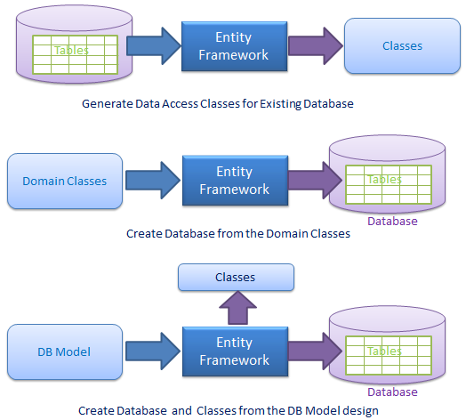

Slide 8
Entity Framework
Entity Framework (EF) is an object-relational mapper that enables .NET developers to work with relational data using domain-specific objects. It eliminates the need for most of the data-access code that developers usually need to write.

Slide 9
The ADO.NET Entity Framework enables developers to create data access applications by programming against a conceptual application model instead of programming directly against a relational storage schema. The goal is to decrease the amount of code and maintenance required for data-oriented applications.

Slide 10
Entity Framework applications provide the following
benefits:
Applications can work in terms of a more application-centric conceptual model, including types with inheritance, complex members, and relationships.
Applications are freed from hard-coded dependencies on a particular data engine or storage schema.
Mappings between the conceptual model and the storage-specific schema can change without changing the application code.
Developers can work with a consistent application object model that can be mapped to various storage schemas, possibly implemented in different database management systems.
Multiple conceptual models can be mapped to a single storage schema.
Language-integrated query (LINQ) support provides compile-time syntax validation for queries against a conceptual model.

Slide 11
.edmx Files
An .edmx file is an XML file that defines a model that can be used with Entity Framework. The model is made up of a conceptual model, a storage model and the mapping between these models. An .edmx file also contains information that is used by the EF Designer to render a model graphically.
The recommended practice for creating and editing an .edmx file is to use the EF Designer. There are also some scenarios in which you might have to edit an .edmx file manually.
By default, an .edmx file opens with the EF Designer. However, you can open an .edmx file with the XML Editor by following these steps:
Right-click the .edmx file in Solution Explorer and select Open With...
Select XML Editor and click OK.

Slide 12
.edmx File Contents
The following is a high-level breakdown of the contents of an .edmx file. For more details, see the .edmx schemas in your Visual Studio XML directory.
Note: The schema that is used depends on the version of Visual Studio that the model is created in.

Slide 13
Hierarchy of .config Files
The .NET Framework relies on .config files to define configuration options. The .config files are text-based XML files. Multiple .config files can, and typically do, exist on a single system.
System-wide configuration settings for the .NET Framework are defined in the Machine.config file. The Machine.config file is located in the %SystemRoot%\Microsoft.NET\Framework\%VersionNumber%\CONFIG\ folder.
The default settings that are contained in the Machine.config file can be modified to affect the behavior of .NET applications on the whole system.

Slide 14
Handling Errors
ASP.NET applications must be able to handle errors that occur during execution in a consistent manner. ASP.NET uses the common language runtime (CLR), which provides a way of notifying applications of errors in a uniform way. When an error occurs, an exception is thrown. An exception is any error, condition, or unexpected behavior that an application encounters.
In the .NET Framework, an exception is an object that inherits from the System.Exception class. An exception is thrown from an area of code where a problem has occurred. The exception is passed up the call stack to a place where the application provides code to handle the exception. If the application does not handle the exception, the browser is forced to display the error details.

