Slide 1
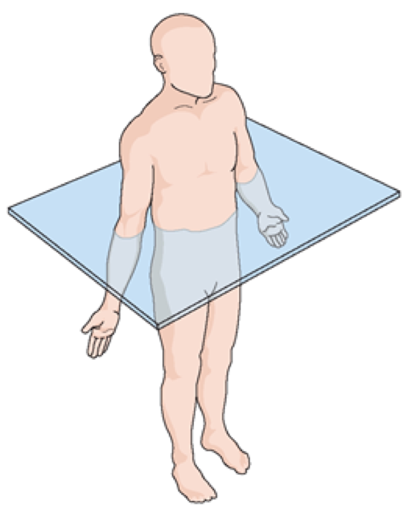
Transverse/Axial
Plane
x
y
0
0

Slide 2
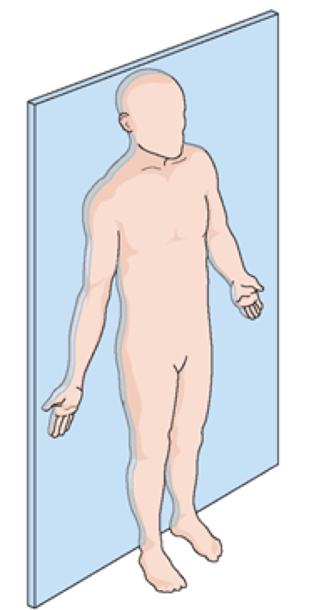
Coronal
Plane
z
x
0
0

Slide 3
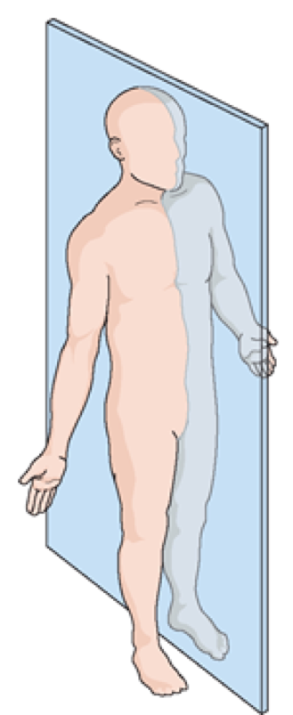
Sagittal
Plane
z
y
0
0

Slide 4
Coronal
Plane
Sagittal
Plane
Transverse/Axial
Plane
z
z
x
y
x
0
y
0
0
0
0
0

