Slide 1

LiteClaw
A Lightweight WhatsApp-Driven GenAI Agent Framework
Designing a Practical Everyday AI Assistant for Real-World Interaction via WhatsApp
ROSE5780 GenAI Technologies and RPA
1155245465 LI Jianxuan
1

Slide 2

Why Current AI Agents Do Not Fit Everyday Life
The Everyday Reality
Why Existing Agents Fall Short
Most assistant needs happen during micro-moments:
Commuting to work or school
Walking between classes
Waiting in a queue
Before sleep — quick ideas or reminders
In these moments, sending a message is more natural than opening a dashboard or terminal.
✖
Too heavy to understand or customize for personal use
✖
Too risky for everyday personal device interaction
✖
Too desktop-dependent for mobile micro-moments
✖
Too costly to become a daily habit
Can a sub-2,000-line framework deliver secure, WhatsApp-native AI assistance with free LLM support?
2

Slide 3

Market Gap: Powerful Frameworks vs. Everyday Usability
Framework | Code Volume | WhatsApp | Free LLM | Daily-Use Fit
OpenClaw | ~500K | No | No | Low
AutoGPT | ~80K | No | No | Low
LangChain | ~200K | Plugin | Partial | Medium
NanoClaw | ~3.9K | No | Yes | Medium
Commercial bots | N/A | Yes | No | Low
The Gap
No solution combines lightweight code, WhatsApp-native delivery, agent reasoning, local tools, and various LLM support.
Our Solution: LiteClaw
~1,800 lines of TypeScript
WhatsApp-native via Baileys
Single-decision (bounded & safe)
Your own LLM (Groq, Gemini)
4 micro-task tools + AuthZ wall
LiteClaw is designed as a lightweight, safe, WhatsApp-native personal AI assistant.
3

Slide 4

System Architecture: One Message, One Bounded Action
WhatsApp
Message
→
Agent
Core
→
AuthZ
Wall
→
Tool
(optional)
→
WhatsApp
Reply
Simple
Safe
Auditable
One decision per message
No multi-turn loops
Default-deny AuthZ
Local-only tools
Every action logged
Complete audit trail
Supporting: LLM Client (Groq/Gemini/Anthropic) | Memory Manager | Context Loader | Scheduler | Audit Log | ~20 files, ~1,800 LOC, 0 database
4

Slide 5
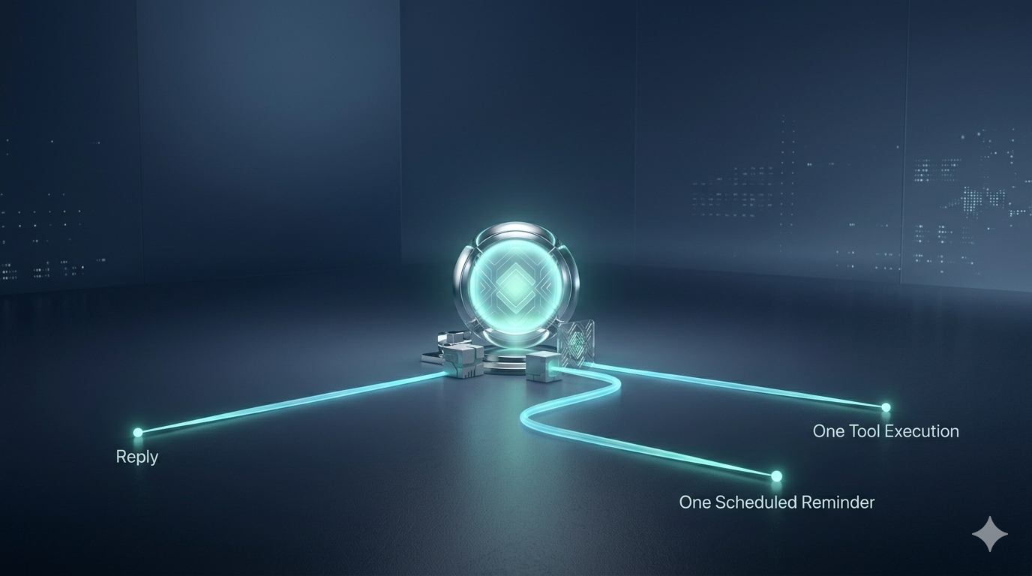
Method: Single-Decision Design for Trustworthy Daily Use
reply
tool_call
schedule
Direct text response
Execute one local tool
Create cron reminder
Why This Design Fits Daily Use
Predictable
Users know exactly what the system will do — one action per message, every time
Bounded Cost
No runaway tool chains — LLM usage proportional to messages sent
Auditable
Every decision logged — users can review what the assistant did
Safer than Loops
One-shot execution eliminates cascading failures from multi-turn hallucination
5

Slide 6

Method: Local Tools and Memory for Everyday Micro-Tasks
Design goal: Support frequent, low-friction, everyday micro-tasks — not unrestricted system access.
Todo
Memory System
Capture, list, complete tasks
Priorities + completion tracking
memory.md
Long-term facts with timestamps
conversations.md
Recent history, auto-trim at 40
Notes
Daily journaling (YYYY-MM-DD.md)
Timestamped entries + weekly summary
Time
Prompt Design
Current time + cron reminders
Delivered to WhatsApp on schedule
1. Agent identity + behavior 2. Three JSON response formats 3. {context} = memory + tools + tasks 4. "Output ONLY valid JSON"
File Ops
Read/write/append/list files
Path-restricted to data/ & notes/
6

Slide 7
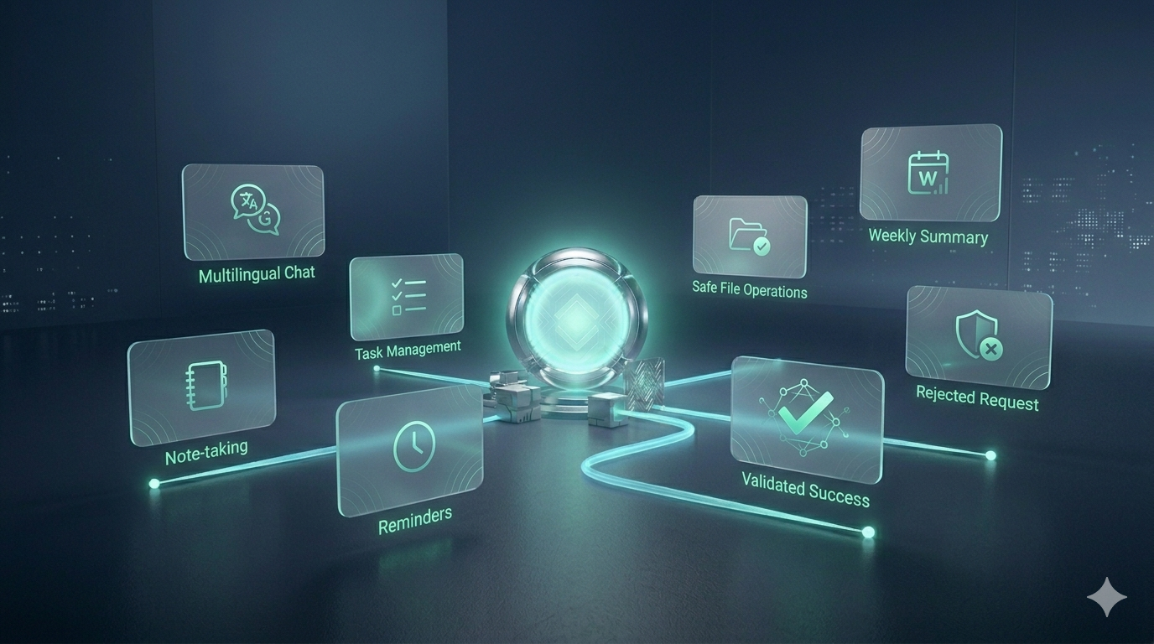
Results: What LiteClaw Can Do in Real Use
Tested end-to-end with Google Gemini 2.5 Flash (free tier)
✅ Natural language chat in English and Chinese
✅ Set reminders via natural language → cron
✅ Add/list/complete tasks via natural language
✅ Safe file read/write within sandbox
✅ Create daily notes with timestamped entries
✅ Auto-reject unauthorized tool requests
✅ Generate weekly journal summaries
All 7 scenarios passed. LiteClaw handles the kinds of tasks users actually perform in daily life.
7

Slide 8

Results: Why the System Is Technically Credible
Code Complexity
5-Layer Security
Framework | LOC | Reduction
OpenClaw | ~500,000 | Baseline
AutoGPT | ~80,000 | 84%
NanoClaw | ~3,900 | 99.2%
LiteClaw | ~1,800 | 99.6%
1
WhatsApp Allowlist
2
Single-Decision Bound
3
AuthZ Default-Deny
4
Path Sandbox
5
Audit Trail
Trust = Compact enough to read in one afternoon + Safe enough for personal device + Free enough for daily habit
8

Slide 9

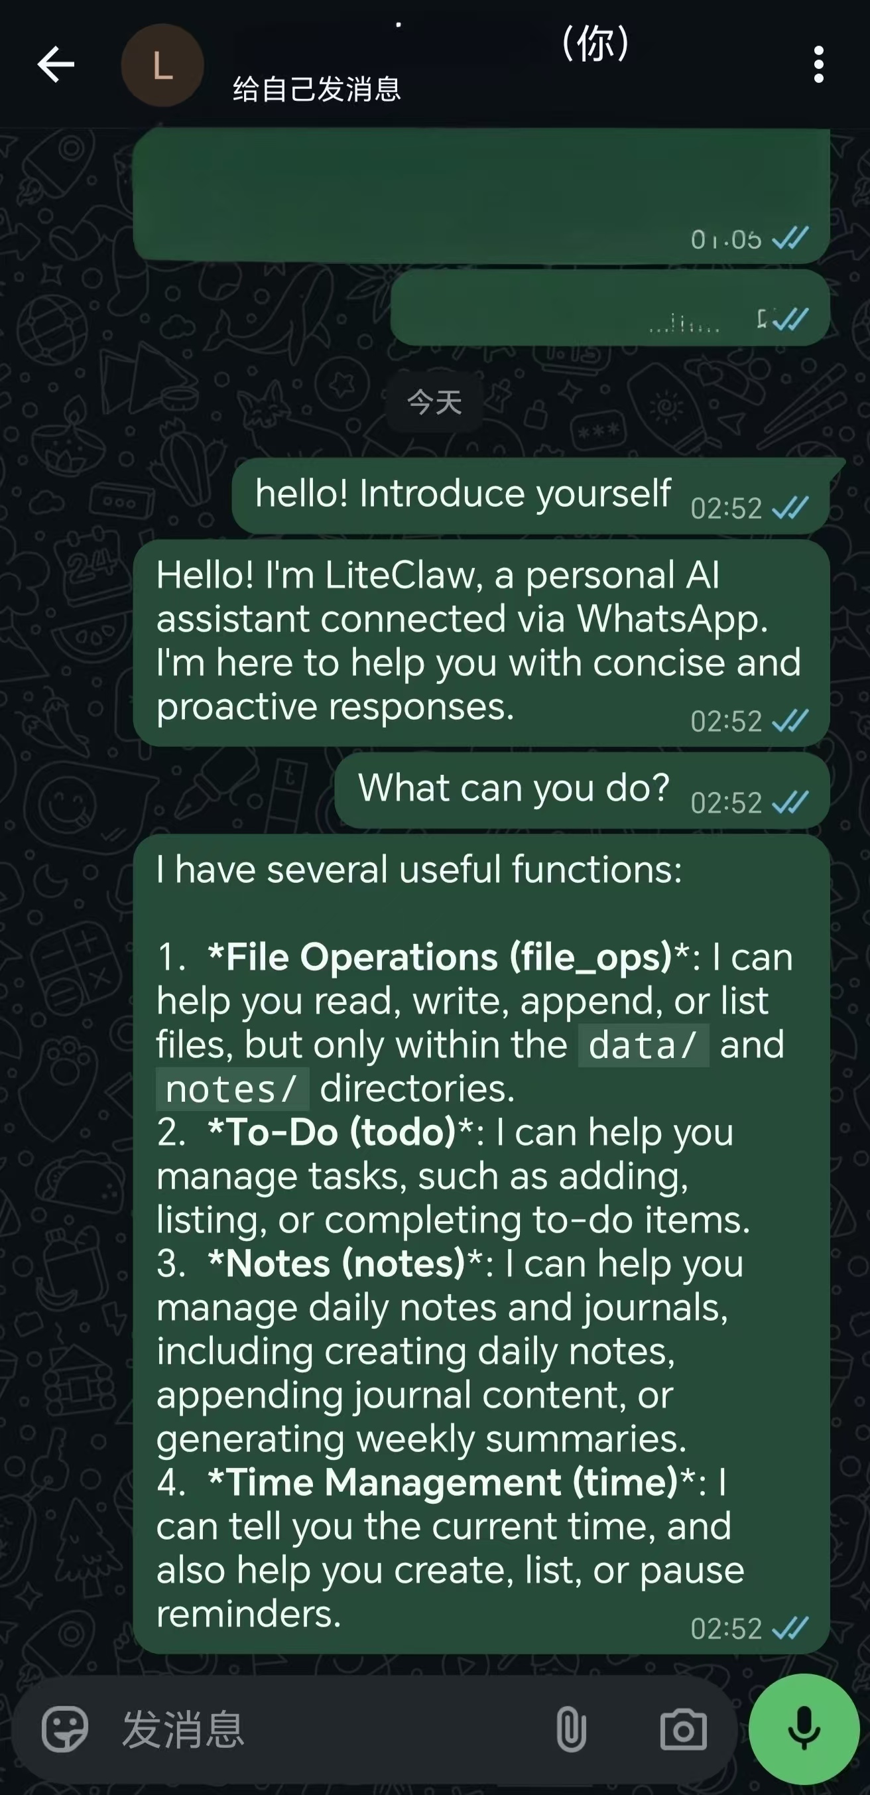
Demo: Natural WhatsApp Interaction in Daily Life
How users interact with LiteClaw:
“Remind me to submit the report tomorrow at 9am”
→ Creates cron reminder, delivered via WhatsApp
“Help me add a task: buy milk tonight”
→ Adds to todo list with medium priority
“Create a note for today: project idea about AI assistant”
→ Appends timestamped entry to daily journal
Setup: clone → npm install → .env (free Gemini key) → npm start → scan QR | GitHub: github.com/LIJianxuanLeo/liteclaw
The innovation is not just in the functions, but in how naturally they fit into an interface people already use every day.
9

Slide 10

Practicality Matters for Personal AI Agents
A personal AI assistant becomes more practical when it is lightweight, bounded and trustworthy, and reachable through everyday messaging.
What We Showed
Future Work
99.6% code reduction vs. OpenClaw
All 7 functional tests passed
5-layer security model validated
Free LLM + WhatsApp = daily habit
Multi-platform (Telegram, Signal)
Voice message transcription
RAG-based memory retrieval
Multi-user session isolation
github.com/LIJianxuanLeo/liteclaw
10

