Slide 1
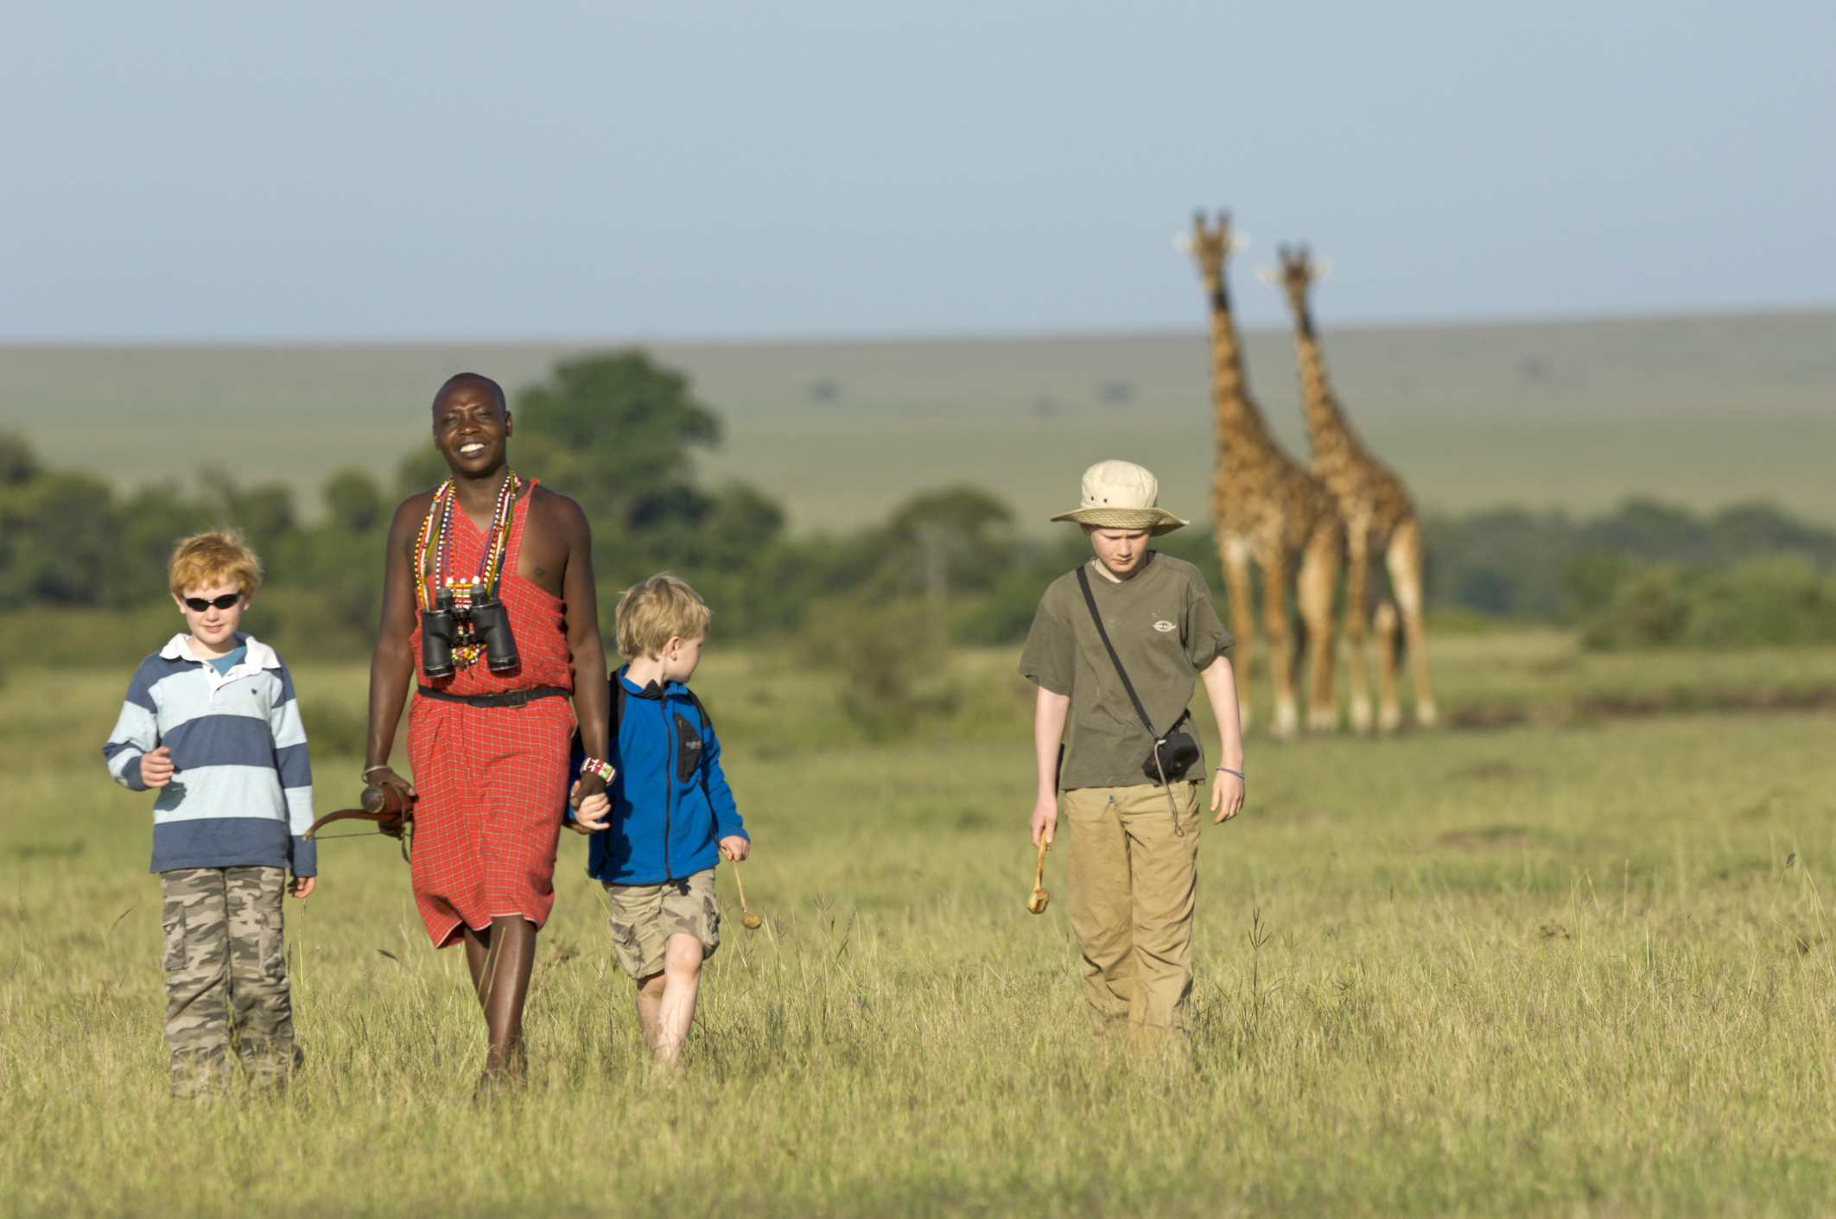
CAPSTONE PROJECT
Tanzania Tourism Prediction
LIKHITH GOWDA C
PGDA 28

Slide 2
TABLE OF CONTETNT
Problem statement
Objective
Methodology
About the dataset
Feature Description
Data Preparation
How helpful for business

Slide 3
PROBLEM STATEMENT
The Tanzanian tourism sector plays a significant role in the Tanzanian economy, contributing about 17% to the country’s GDP and 25% of all foreign exchange revenues.
The sector, which provides direct employment for more than 600,000 people and up to 2 million people indirectly, generated approximately $2.4 billion in 2018 according to government statistics.
As I started to find the data I came across this dataset through an competition hosted by Zindi website.
In this project I’m predicting how much money a tourist will spend when visiting Tanzania?

Slide 4
OBJECTIVE
The objective of this project is to develop a machine learning model to predict what a tourist will spend when visiting Tanzania. The model can be used by different tour operators and the Tanzania Tourism Board to automatically help tourists across the world estimate their expenditure before visiting Tanzania.

Slide 5
METHODOLOGY
The dataset was taken from an hackathon by Zindi.
Pre-process the dataset by removing any duplicates, missing values or inconsistent data.
Analyse the dataset and extract relevant features that are likely to impact Total cost.
Transform and scale the features appropriately, for example, by standardizing or normalizing
Choose a suitable Machine Learning Algorithms to train the model
Train the selected model using the prepared dataset
Use appropriate techniques to prevent overfitting, such as regularization.
Evaluate the performance of the trained model on the testing set
Use appropriate metrics such as R-squared, Adjusted R-squared. RMSE

Slide 6
ABOUT DATASET
The dataset describes 4809 rows of up-to-date information on tourist expenditure collected by the National Bureau of Statistics (NBS) in Tanzania. The dataset was collected to gain a better understanding of the status of the tourism sector and provide an instrument that will enable sector growth.
Your goal is to accurately predict tourist expenditure when visiting Tanzania.
The majority of the visitors under the age group of 25-44.

Slide 7
FEATURE DESCRIPTION
ID - Unique identifier for each tourist
Country - The country a tourist coming from
Age group - The age group of a tourist
Travel with - The relation of people a tourist travel with to Tanzania
Total female - Total number of females
Total male - Total number of males
Purpose - The purpose of visiting Tanzania
Main activity - The main activity of tourism in Tanzania
Infor source - The source of information about tourism in Tanzania
Tour arrangement - The arrangement of visiting Tanzania
Package transport int - If the tour package include international transportation service
Package accommodation - If the tour package include accommodation service

Slide 8
Package food - If the tour package include food service
Package transport tz - If the tour package include transport service within Tanzania
Package sightseeing - If the tour package include sightseeing service
Package guided tour - If the tour package include tour guide
Package insurance - If the tour package include insurance service
Night mainland - Number of nights a tourist spent in Tanzania mainland
Night Zanzibar - Number of nights a tourist spent in Zanzibar
Payment mode - The mode of payment for tourism service
First trip tz - If it was a first trip to Tanzania
Most impressing - what impressed a tourist in Tanzania
Total cost (TARGET VARIABLE) - The total tourist expenditure in TZS(currency)

Slide 9
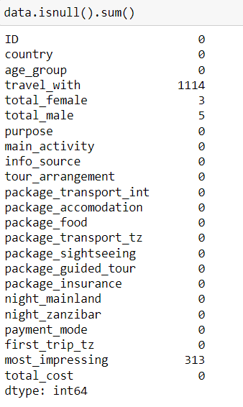
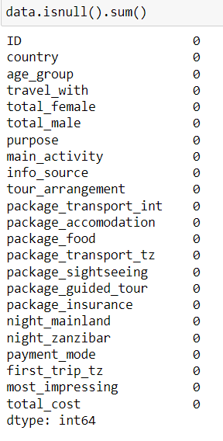
DATA PREPARATION
NULL VALUES
NULL VALUES HAS BEEN TREATED

Slide 10
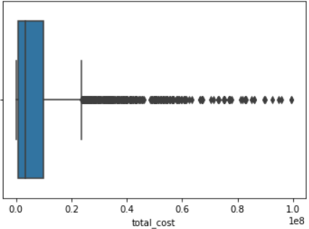
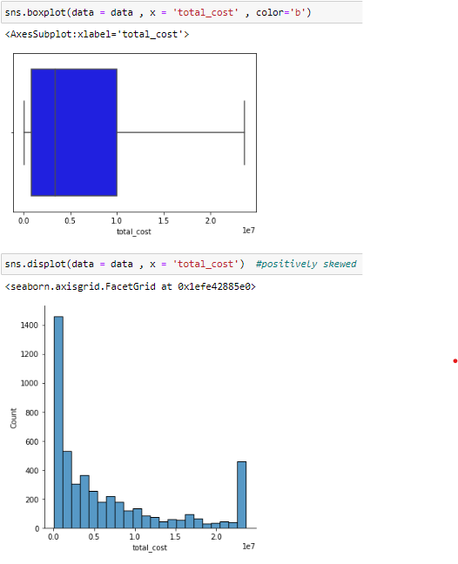
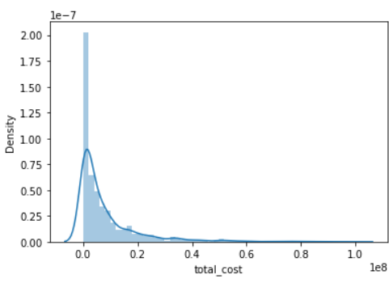
TARGET VARIABLE
OUTLIERS
OUTLIERS HAS BEEN HANDLED

Slide 11
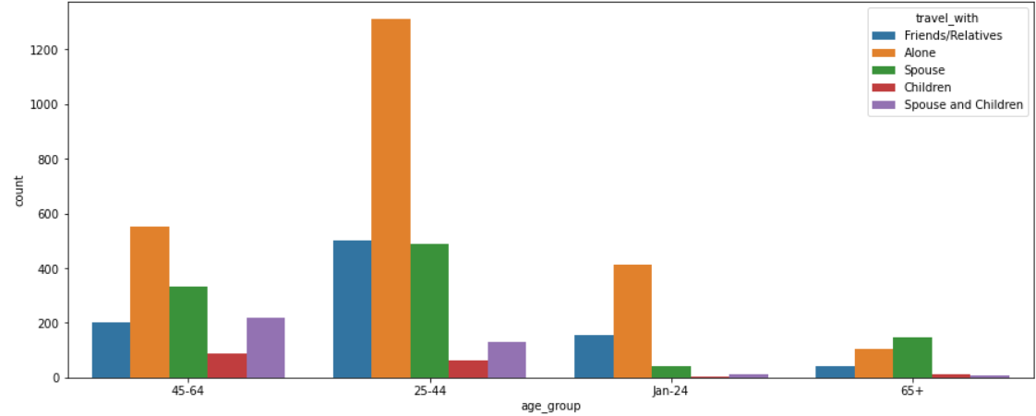
RELATIONSHIP OF AGE_GROUP WITH PURPOSE

Slide 12
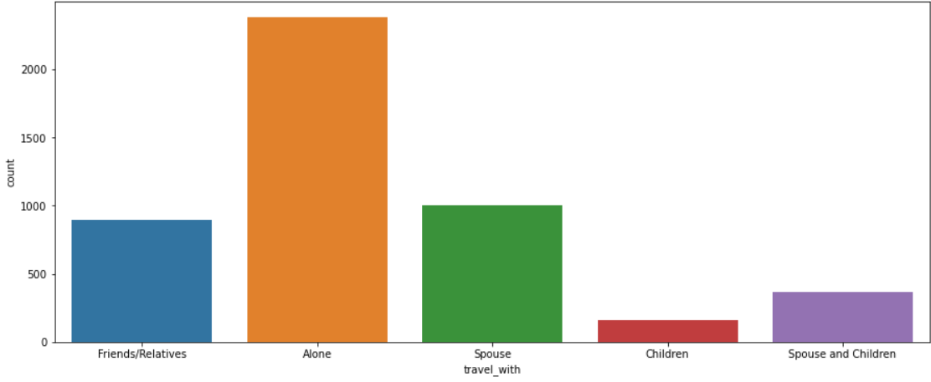
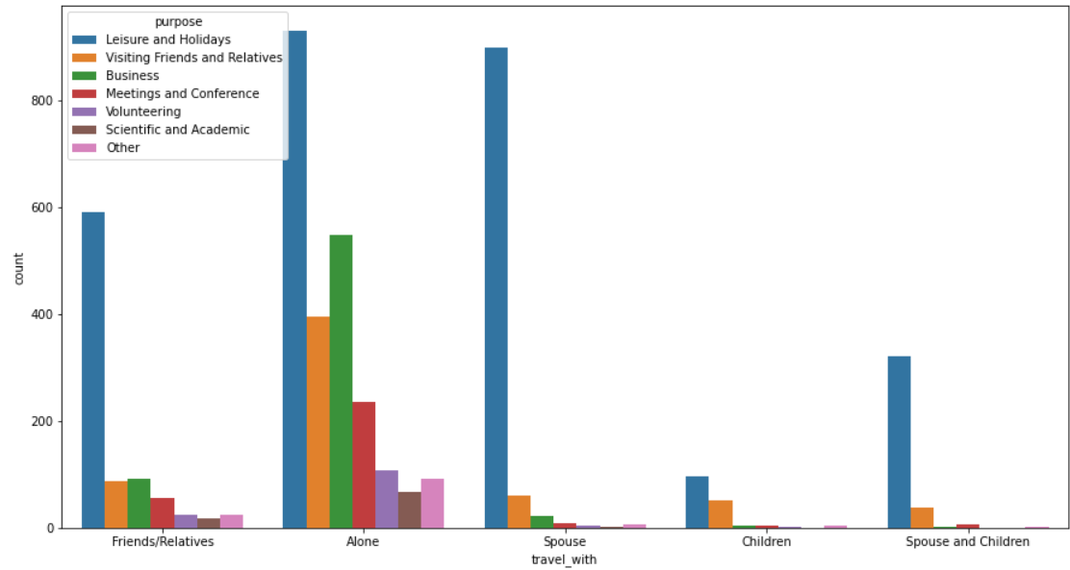
TRAVEL_WITH
RELATIONSHIP OF TRAVEL_WITH PURPOSE
MAIN PURPOSE OF ALL THE PEOPLE IS HOLIDAYS

Slide 13
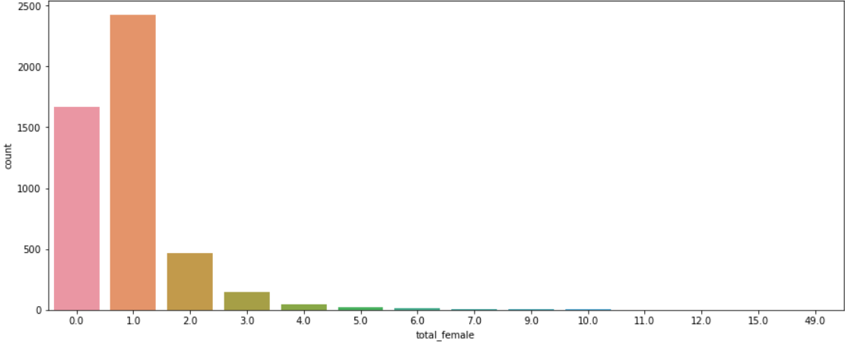
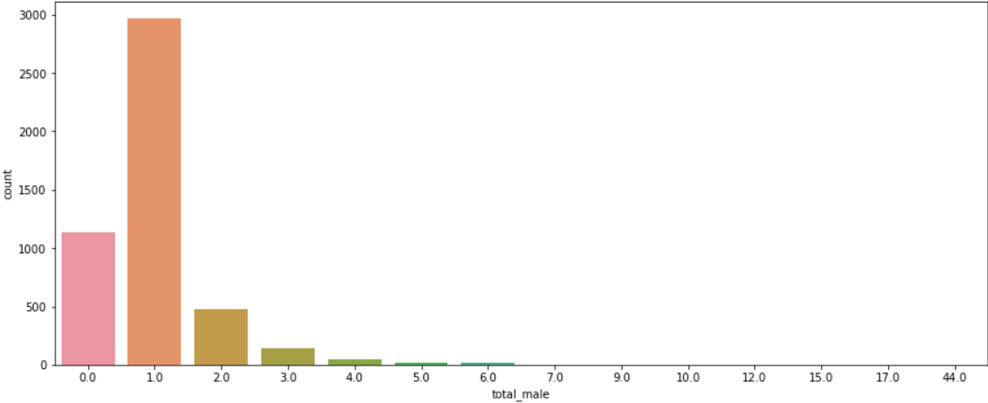
TOTAL_FEMALE
TOTAL_MALE
FROM BOTH THE PLOTS WE CAN SEE THAT INDIVIDUAL FEMALE AND MALE TRAVELLED RATIO IS HIGHER PEOPLE IN GROUP

Slide 14
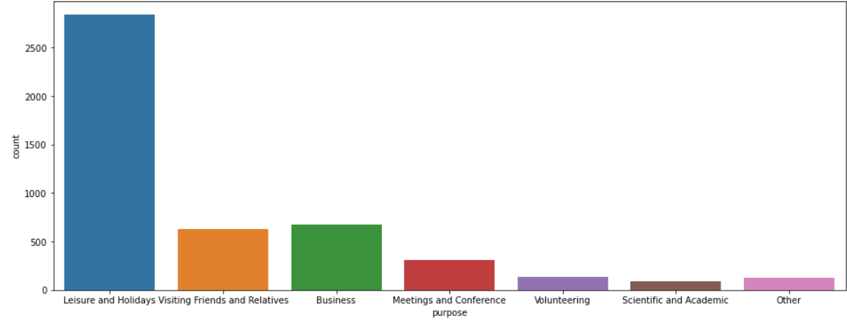
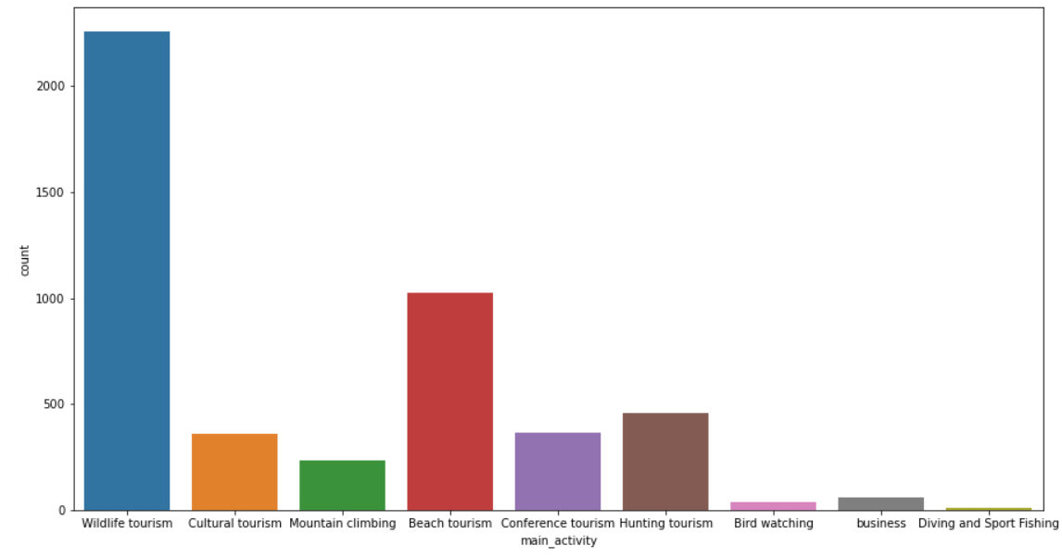
PURPOSE
MAIN ACTIVITY
LEISURE AND HOLIDAYS HAS MORE IMPACT AND TANZANIA COMPARED TO BUSINESS AND OTHER PURPOSE
WILDLIFE TOURISM HAS MAJOR IMPACT ON TANZANIA MOST PEOPLE VISIT BECAUSE OF WILDLIFE

Slide 15
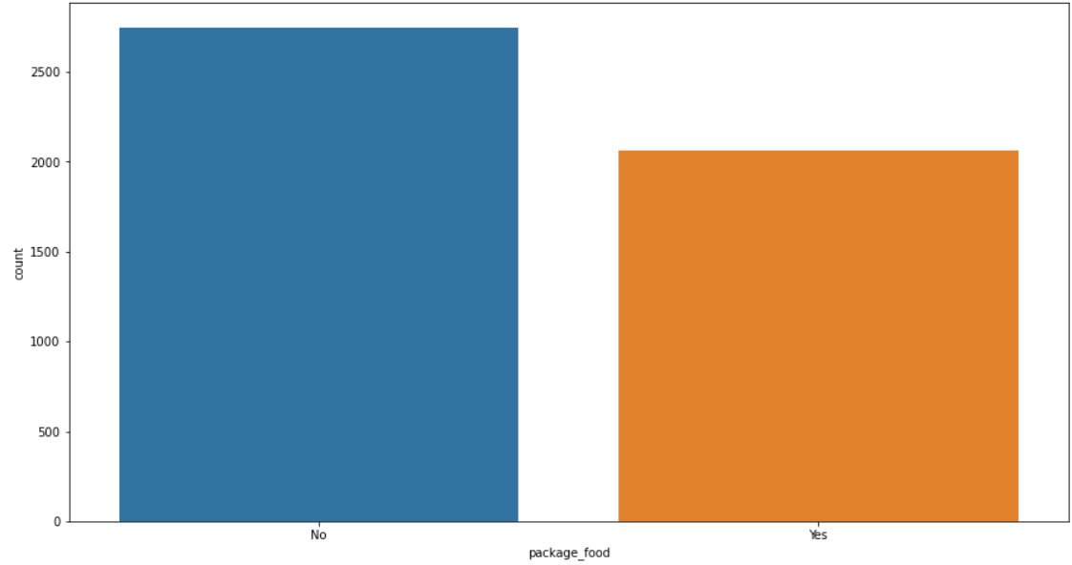
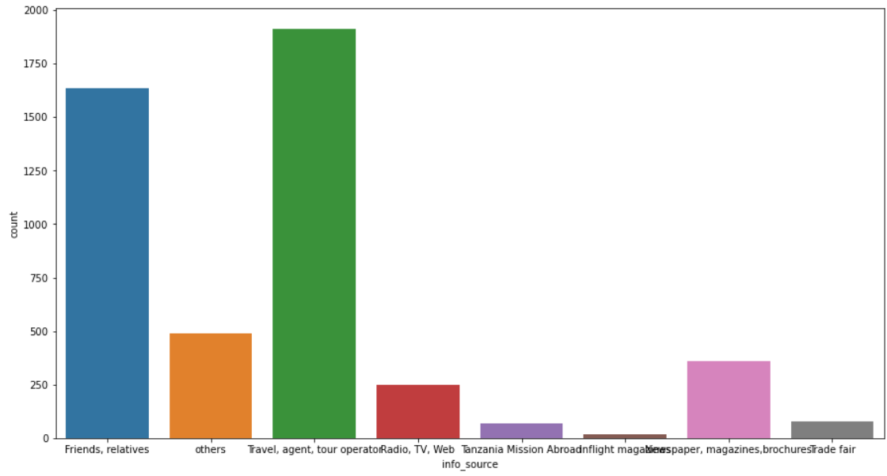
PACKAGE_FOOD
INFO_SOURCE
MAJORITY OF THE PEOPLE DIDN’T HAVE THE FOOD_PACKAGE

Slide 16
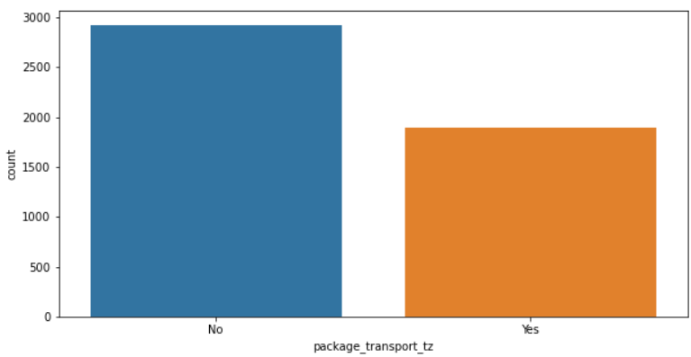
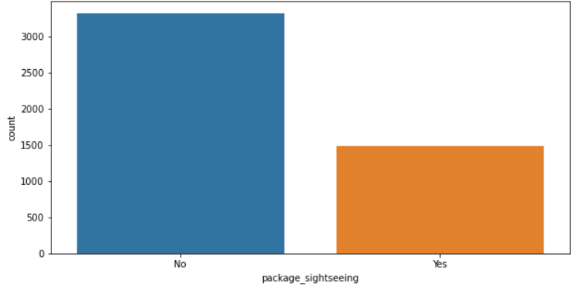
PACKAGE_TRANSPORT_TZ
PACKAGE_SIGHTSEEING

Slide 17
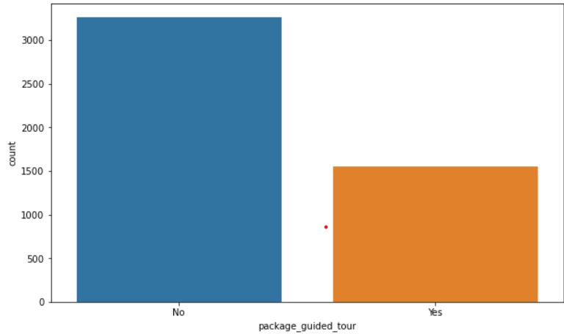
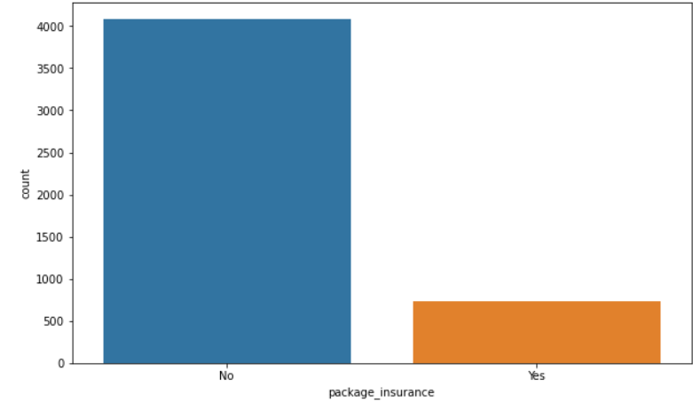
PACKAGE_GUIDED_TOUR
PACKAGE_INSURANCE

Slide 18
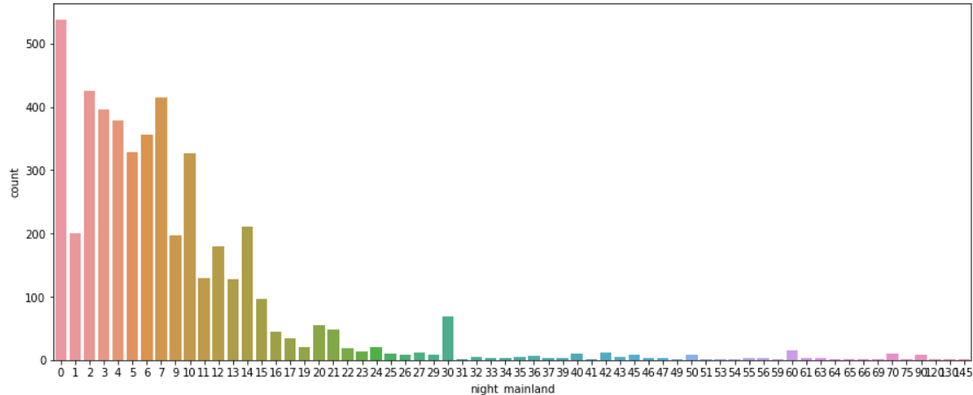
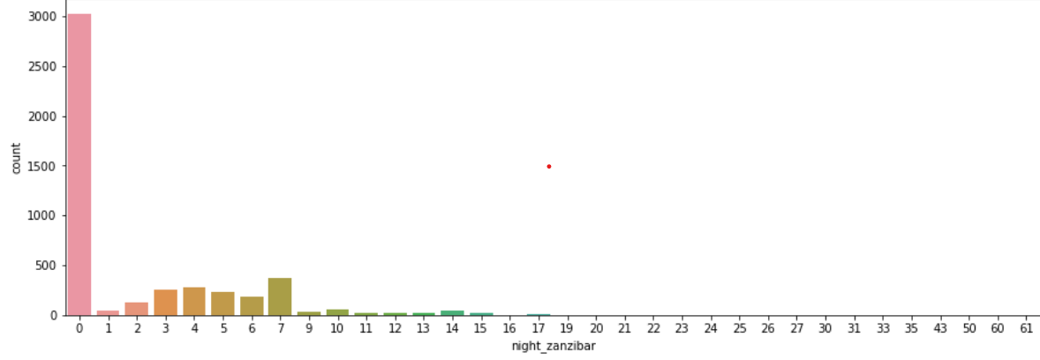
NIGHT_MAINLAND
NIGHT_ZANZIBAR

Slide 19
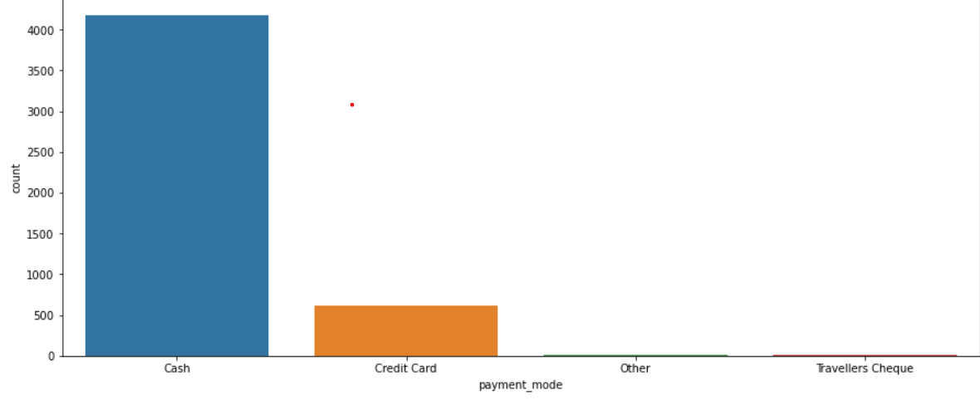
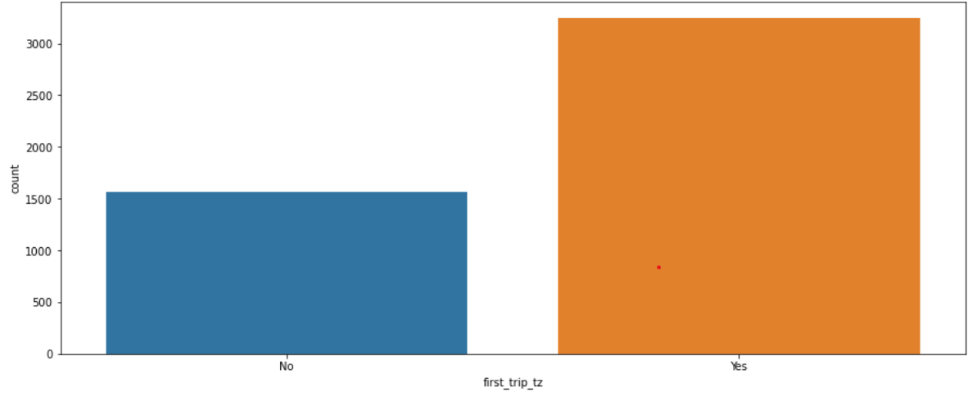
PAYMENT_MODE
FIRST_TRIP_TZ

Slide 20
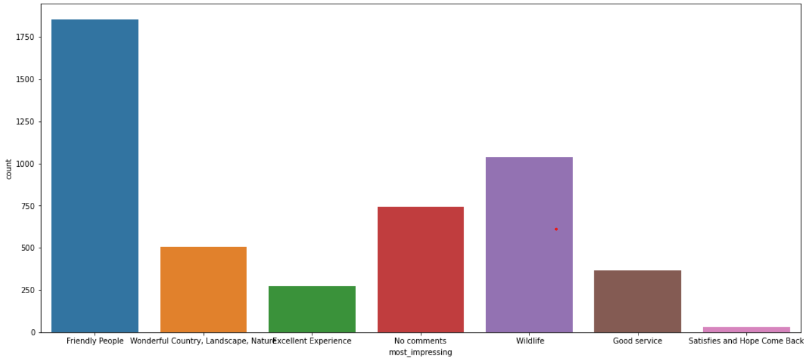
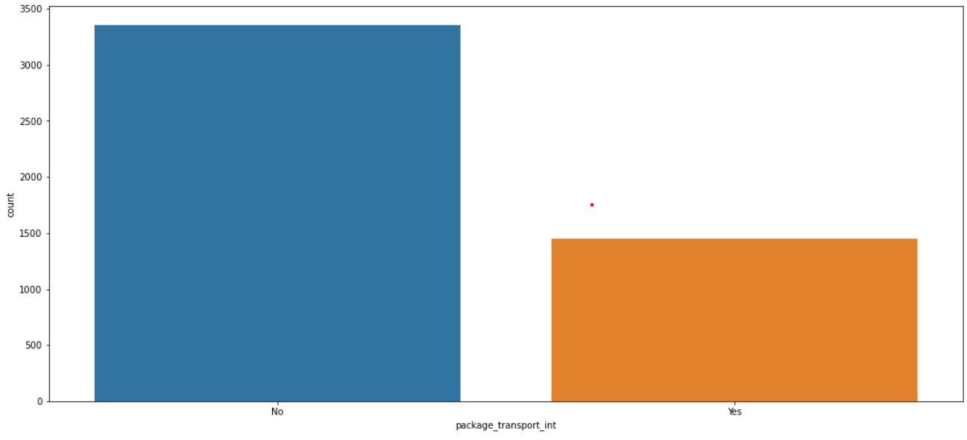
MOST_IMPRESSING
PACKAGE_TRANSPORT_INT

Slide 21
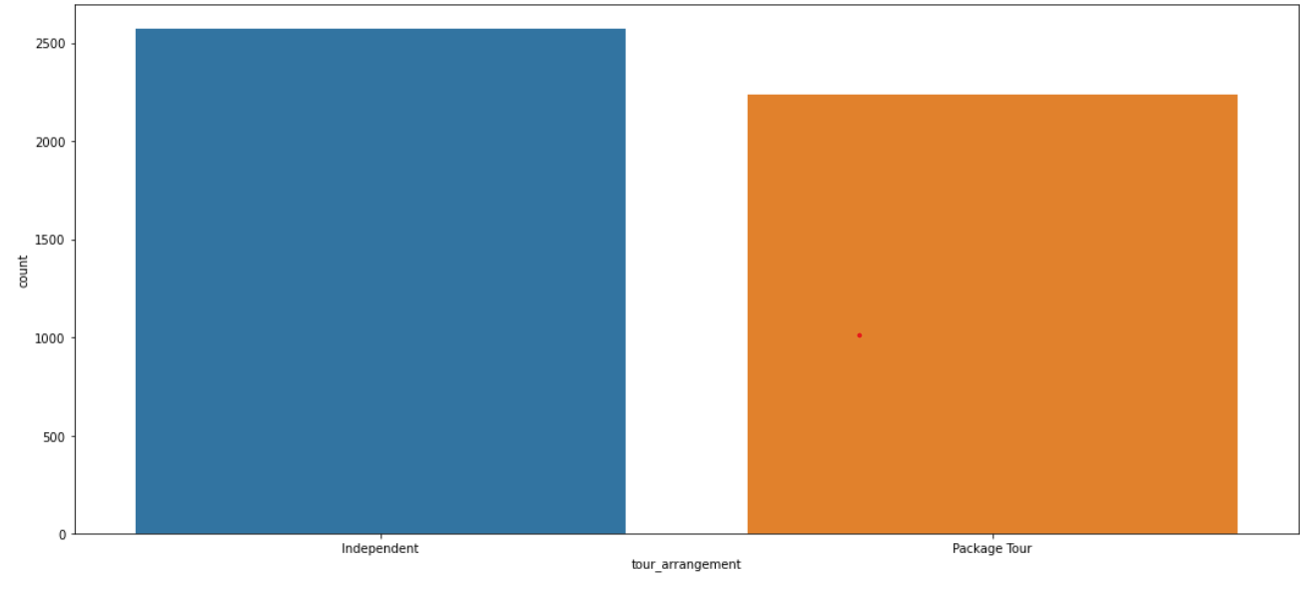
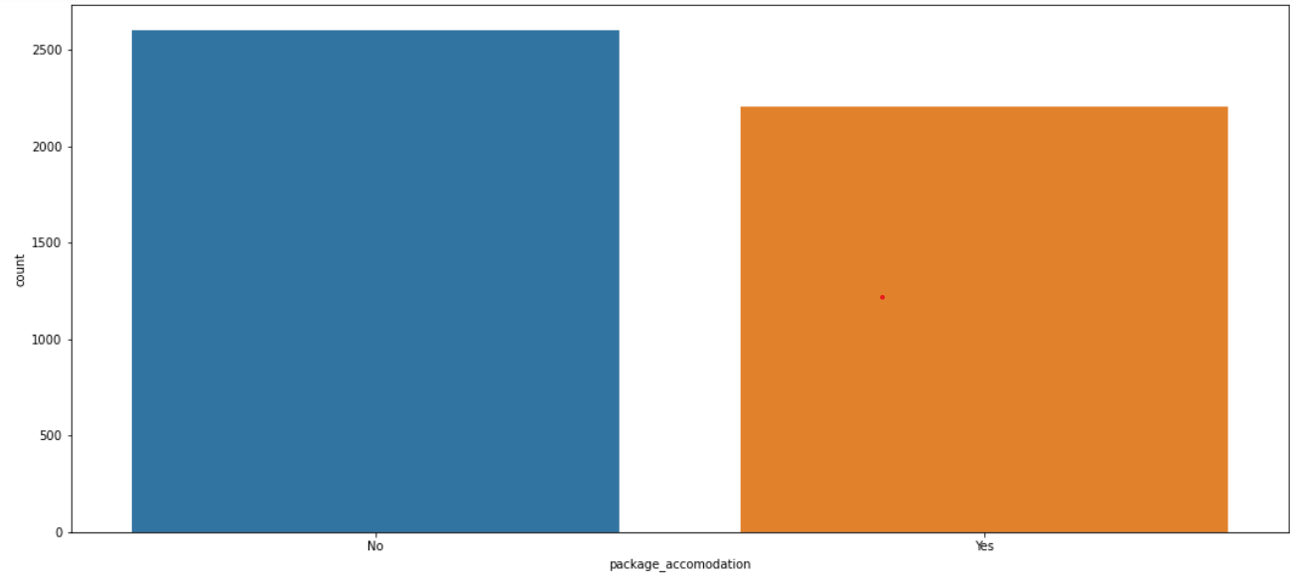
TOUR_ARRANGEMENT
PACKAGE_ACCOMODATION

Slide 22
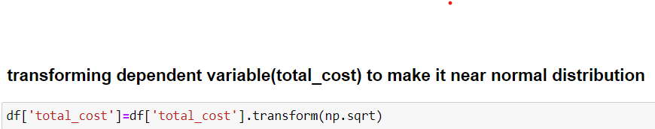
Before the model is fitted on the data necessary feature transformation was performed on the data which include the following;
Converting categorical columns into numerical using label encoding
Dropping features based on statistical tests like ANNOVA and TUKEY-HSD tests
Standardization and Normalization
Transforming data into a normal distribution using the square root function is a specific type of power transformation
Gradient boosting to improve performance of the model

Slide 23
Finally the data set was split into Train and Test data later the following models were used in the process :
Linear Regression (Using OLS)
Linear Regression (Using Sklearn Method)
Gradient Boosting

Slide 24
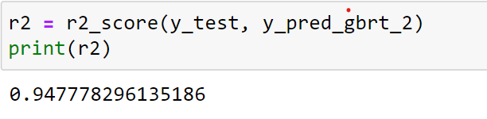
It is clear from the above that the Gradient Boosting Regressor gives the Best Accuracy
R- squared is the evaluation matrix for the model

Slide 25
How Helpful is it?
The Tanzanian tourism sector plays a significant role in the Tanzanian economy, contributing about 17% to the country’s GDP and 25% of all foreign exchange revenues. The sector, which provides direct employment for more than 600,000 people and up to 2 million people indirectly, generated approximately $2.4 billion in 2018 according to government statistics. Predicting the total cost of the tourism may indirectly impact the country’s GDP

