Slide 1
Minimal Implementation of pNFS like filesystem by
Ravikumar Manjunath
Sanjeev Bagewadi

Slide 2
Agenda
Problem Statement
Basic Design
File Layout
Command line info
Results
Conclusion

Slide 3
Problem Statement
The scalibility of a network filesystems is limited if we have single server.
One of the solutions is to increase the bandwidth by spreading the load across multiple servers.
And along with the above solution we should still have unified namespace.
The idea is to implement a pNFS like filesystem and achieve data striping.

Slide 4
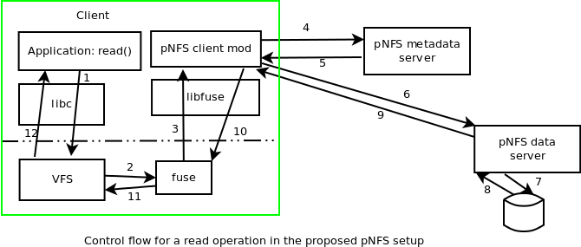
Basic Design

Slide 5
Main Components
FUSE Client on the client machines
  This is responsible for contacting the metadata and data servers for the filesystem operations
  The client machines would need fuse installed.
MetaData Server
  Manages the metadata of the FS
Data Server
  Responsible for reads/writes of the data extents

Slide 6
How is file metadata maintained ?
The metadata server maintains the directory structure and all the metadata for the files/directories
File Layouts - for each file it maintains the extent map in the file
<filesize>
<offset> <length> <dataserver-name> <extent-name>
<offset> <length> <dataserver-name> <extent-name>
# cat mds_share/file1
24144
0 16384 dshost1 file1.ext0
16384 16384 dshost2 file1.ext1

Slide 7
Steps of a read/write operation
The fuse kernel modules calls into pnfs_client
pnfs_client calls getlayout() to mds_server to fetch the layout for the given offset and length
getlayout() searches for the <off,len> in the layout file to find the matching extent
Returns the layout if found
In case of write if an extent is not found allocates one, updates size and returns the extent to pnfs_client
pnfs_client now contacts the ds_server for the actual read/write of the data.

Slide 8
Command Line Interface
How to start the metadata server ?
$ ./mds_server -d <share-dir> -f <dslist>
How to start dataservers ?
$ ./ds_server -S <mds-server-name> -d <share-dir>
-i fsid
  NOTE : Today we ignore the fsid. But, can be later used to identify the exact filesystem when multiple filesystems are shared.
How to mount on the client ?
$ ./pnfs_client -S <mds-server-name>
-f <fs-name-shared-by-mds-server>
<local-mnt-point>

Slide 9
Evaluation and Results

Slide 10
Future Work
Implement sharing of multiple filesystems
Dynamic addtion of data servers.
Page caching for better response times
Implementation of the missing filesystem operations

Slide 11
Conclusion
This is a basic pNFS like filesystem which stripes the data effectively
Demonstrates that the speed and capacity can be made scalable with this approach
Not all filesystem operations work. But it is easily possible to extend/implement them.

