Slide 1
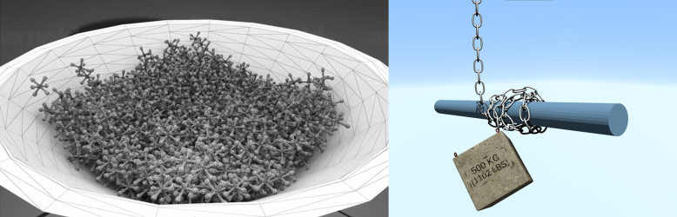
Collision Detection
Broad-Phase and Narrow-Phase

Slide 2

Outline Today
Collision Detection Pipeline
Spatial Hashing
Gilbert–Johnson–Keerthi (GJK)
Pair Condidates
Colliding Pairs
$${\{x,x}^{new}\}$$
or
or
Bounding Volume Hierarchy (BVH)
Separating Axis Theorem (SAT)
Broad-Phase Collision Culling
Narrow-Phase Collision Test

Slide 3
Hashing Table
Hash table is a data structure that implements an associative array or dictionary. It is an abstract data type that maps keys to values.
Key-Value Pairs
Hash Function
Data (Array)
{ }
Name:歪比歪比
TEL: 11122223333
00
11122223333
12313423452
33322221111
01
02
{ }
03
Name:歪比巴卜
TEL: 33322221111
·
·
·
32
{ }
33
Name:嗷嗷嗷
TEL: 12313423452
34

Slide 4

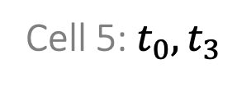
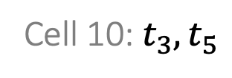



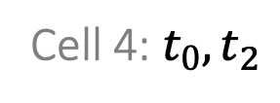
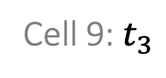
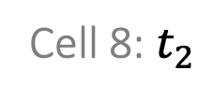
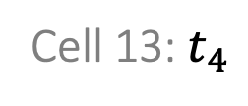

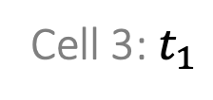

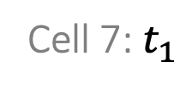

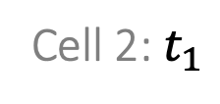
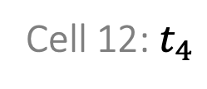

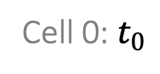
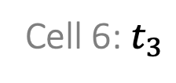

Spatial Hashing
In a spatial hash we are dealing with locations in space, and locality is very important, so our hash function will not change the distribution of the inputs. Spatial hashing divides the space by a grid and stores objects into grid cells.
12
13
14
15
$$t_{4}$$
Cell 12: $t_{4}$
Cell 13: $t_{4}$
Cell 14: $t_{5}$
Cell 15: $t_{5}$
$$t_{5}$$
8
9
10
11
Cell 8: $t_{2}$
Cell 9: $t_{3}$
Cell 10: $t_{3}, t_{5}$
Cell 11:
$$t_{2}$$
4
5
$$t_{3}$$
6
7
Cell 4: $t_{0},t_{2}$
Cell 5: $t_{0}, t_{3}$
Cell 6: $t_{3}$
Cell 7: $t_{1}$
$$t_{0}$$
0
1
2
3
$$t_{1}$$
Cell 0: $t_{0}$
Cell 1:
Cell 2: $t_{1}$
Cell 3: $t_{1}$
$$idx=4y+x$$

Slide 5
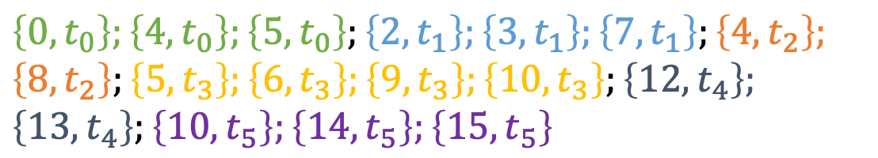
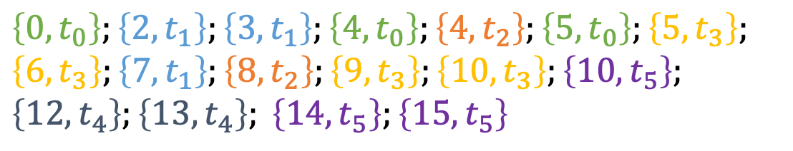
Spatial Hashing
Instead of allocating memories to cells, we can build an object-cell list and then sort them. This avoids memories wasted in empty cells.
12
13
14
15
$$\left\{0, t_{0}\right\};\left\{4, t_{0}\right\};\left\{5, t_{0}\right\};\left\{2, t_{1}\right\};\left\{3, t_{1}\right\};\left\{7, t_{1}\right\};\left\{4, t_{2}\right\};$$
$$\left\{8, t_{2}\right\};\left\{5, t_{3}\right\};\left\{6, t_{3}\right\};\left\{9, t_{3}\right\};\left\{10, t_{3}\right\};\left\{12, t_{4}\right\};$$
$$\left\{13, t_{4}\right\};\left\{10, t_{5}\right\};\left\{14, t_{5}\right\};\left\{15, t_{5}\right\}$$
$$t_{4}$$
$$t_{5}$$
8
9
10
11
Sort by cell ID
$$t_{2}$$
4
5
$$t_{3}$$
6
7
$$\left\{0, t_{0}\right\};\left\{2, t_{1}\right\};\left\{3, t_{1}\right\};\left\{4, t_{0}\right\};\left\{4, t_{2}\right\};\left\{5, t_{0}\right\};\left\{5, t_{3}\right\};$$
$$\left\{6, t_{3}\right\};\left\{7, t_{1}\right\};\left\{8, t_{2}\right\};\left\{9, t_{3}\right\};\left\{10, t_{3}\right\};\left\{10, t_{5}\right\};$$
$$\left\{12, t_{4}\right\};\left\{13, t_{4}\right\}; \left\{14, t_{5}\right\};\left\{15, t_{5}\right\}$$
$$t_{0}$$
0
1
2
3
$$t_{1}$$

Slide 6
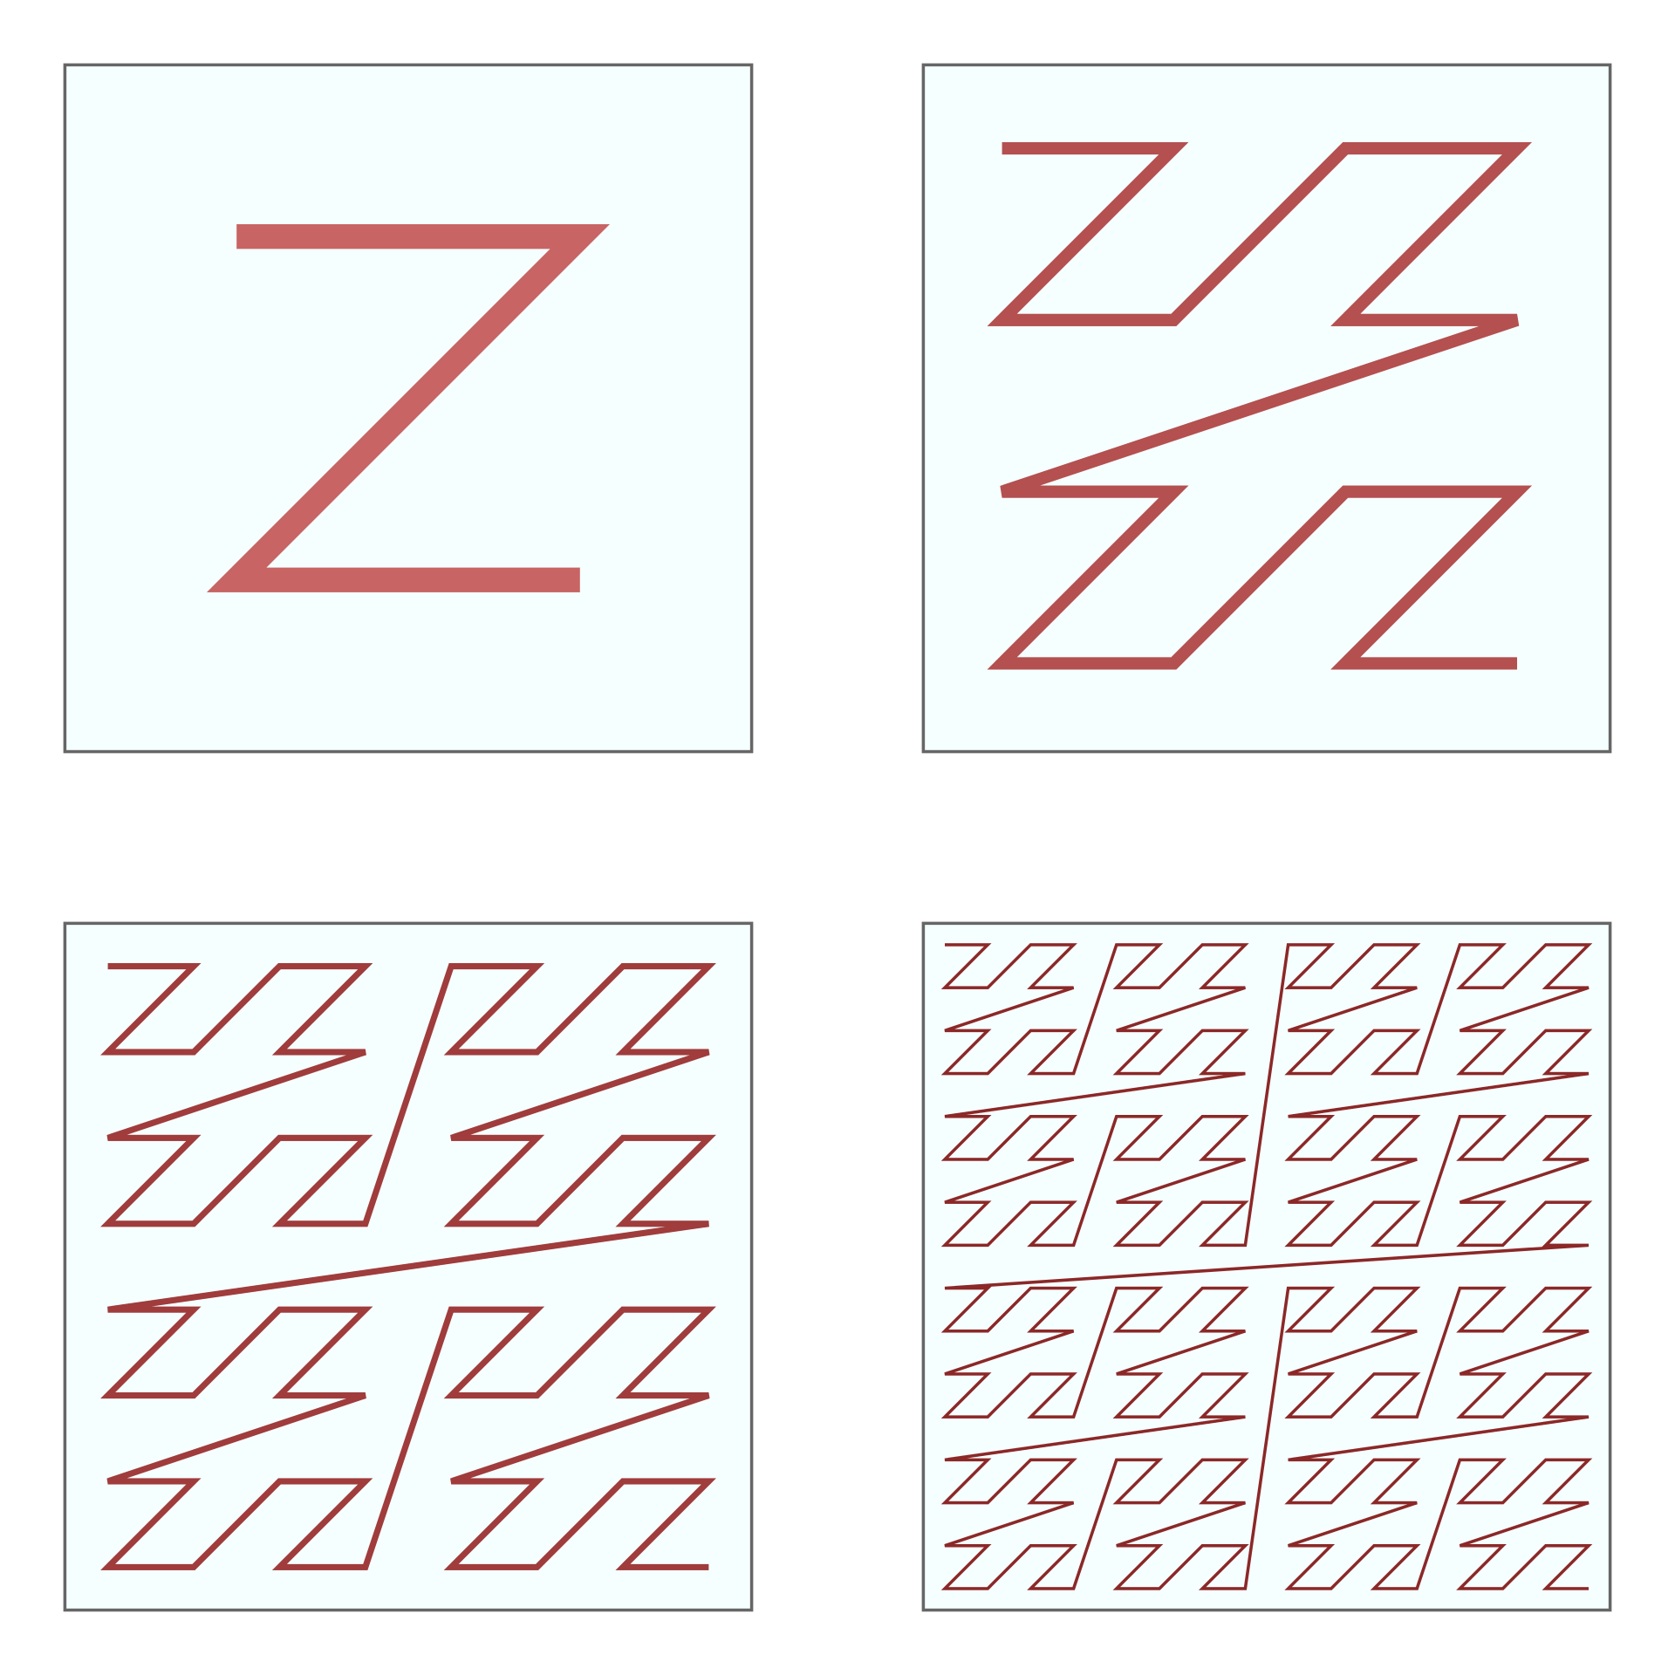
Morton Code
One question is how to define the cell ID. Using the grid order is not optimal, since it cannot be easily extended and it is lack of locality. Morton code uses a Z-pattern instead.
0
1
4
5
0
1
2
3
6
7
8
9
12
13
2
3
10
11
14
15
Grid order
Morton code order

Slide 7
Bounding Volume Hierarchy
Axis-aligned bounding box (AABB) is the most popular bounding volume. Besides that, there are also spheres and oriented bounding box (OBB).
Two AABBs intersect if and only if they intersect in every axis.

Slide 8
Bounding Volume Hierarchy
Bounding volume hierarchy is built on geometric/topological proximity of objects.
A
E
B
F
C
D
G
I
H
J
A
B
C
D
E
F
G
H
I
J

Slide 9
Bounding Volume Hierarchy
Bounding volume hierarchy is built on geometric/topological proximity of objects.
A
E
B
F
C
D
G
I
H
J

Slide 10
Bounding Volume Hierarchy
Bounding volume hierarchy is built on geometric/topological proximity of objects.
A
E
B
F
C
D
G
I
H
J

Slide 11
Bounding Volume Hierarchy
Bounding volume hierarchy is built on geometric/topological proximity of objects.
A
E
B
F
C
D
G
I
H
J

Slide 12
Bounding Volume Hierarchy
Bounding volume hierarchy is built on geometric/topological proximity of objects.
A
E
B
F
C
D
G
I
H
J
A
B
C
D
E
F
G
H
I
J

Slide 13
Bounding Volume Hierarchy
Bounding volume hierarchy is built on geometric/topological proximity of objects.
A
E
B
F
C
D
G
I
H
J
A
B
C
D
E
F
G
H
I
J

Slide 14
Comparison between SH and BVH
Spatial Hashing
Easy to implement
GPU friendly
Needs to recompute after updating objects
Bounding Volume Hierarchy
More involved
Not GPU friendly
To update BVH, just update bounding volumes

Slide 15
Outline Today
Collision Detection Pipeline
Spatial Hashing
Gilbert–Johnson–Keerthi (GJK)
Pair Condidates
Colliding Pairs
$${\{x,x}^{new}\}$$
or
or
Bounding Volume Hierarchy (BVH)
Separating Axis Theorem (SAT)
Broad-Phase Collision Culling
Narrow-Phase Collision Test

Slide 16
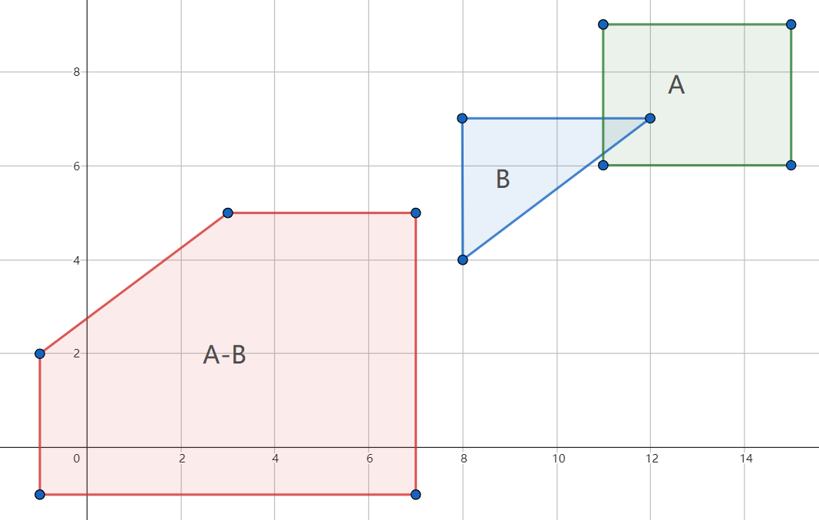

Gilbert–Johnson–Keerthi (GJK)
The Gilbert–Johnson–Keerthi distance algorithm is a method of determining the minimum distance between two convex sets.
When will the collision occur?
GJK: When they overlap .
Minkowski Difference:
$$A−B=\left\{a−b \right| a∈A, b∈B\}$$
There is overlap between two convex polygons if their Minkowski difference contains the origin (0, 0).

Slide 17
Gilbert–Johnson–Keerthi (GJK)
The Minkowski difference is quite expensive. So we look for a simplex closest to the origin in the Minkowski difference.
Simplex:
Specifically, a k-simplex is a k-dimensional polytope which is the convex hull of its k + 1 vertices.
k=0
k=1
k=2
k=3

Slide 18
Gilbert–Johnson–Keerthi (GJK)
First, we choose the direction, project the two convex sides, and find the points that form the simplex.

Slide 19

Gilbert–Johnson–Keerthi (GJK)
First, we choose the direction, project the two convex sides, and find the points that form the simplex.

Slide 20
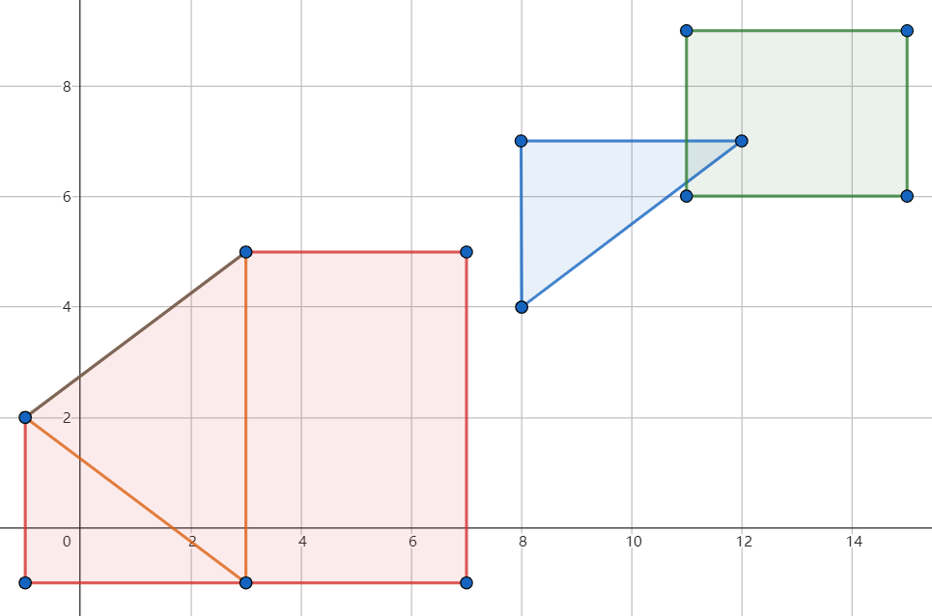
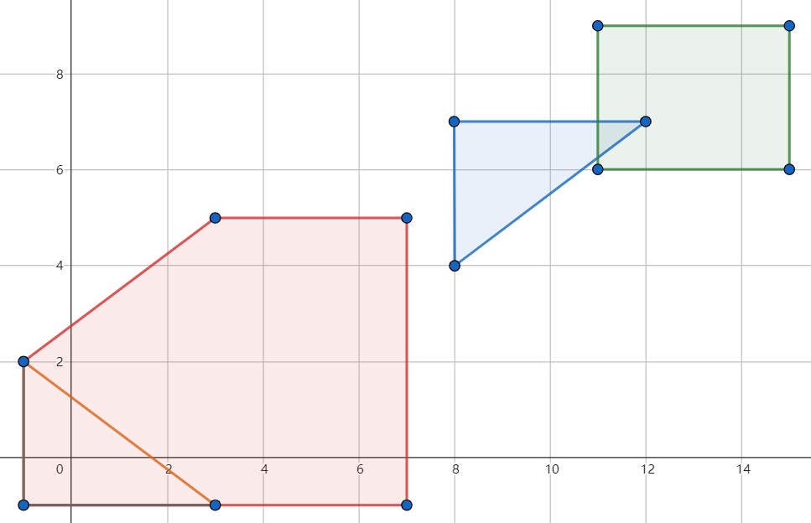
Gilbert–Johnson–Keerthi (GJK)
First, we choose the direction, project the two convex sides, and find the points that form the simplex.
Collision detected!

Slide 21
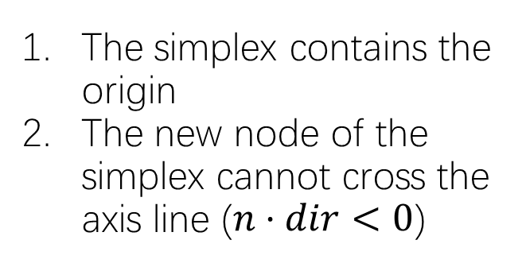
Gilbert–Johnson–Keerthi (GJK)
First, we choose the direction, project the two convex sides, and find the points that form the simplex.
termination condition
The simplex contains the origin
The new node of the simplex cannot cross the axis line ($n⋅dir<0$)

Slide 22
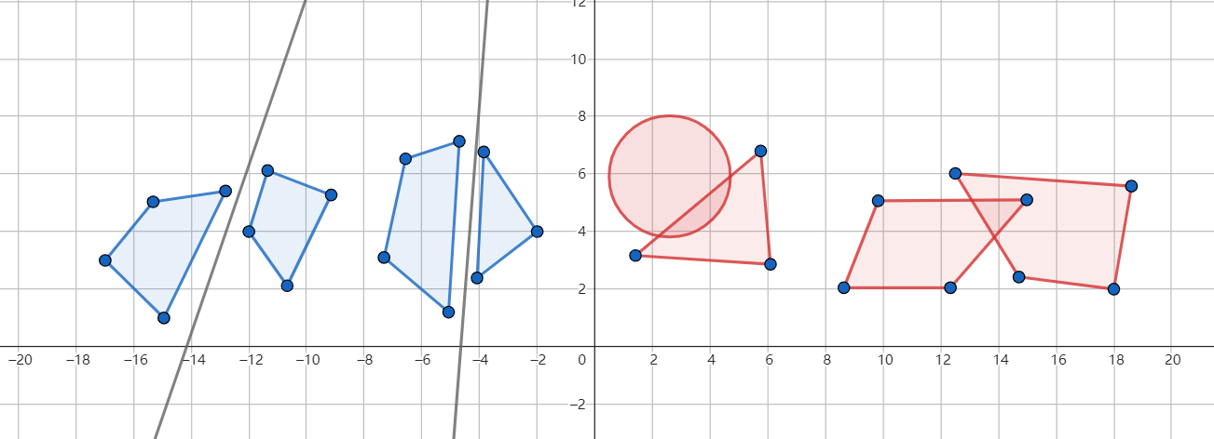
Separating Axis Theorem (SAT)
If two objects do not collide, there always exists a straight line (plane in 3D) that can separate the two objects.

Slide 23
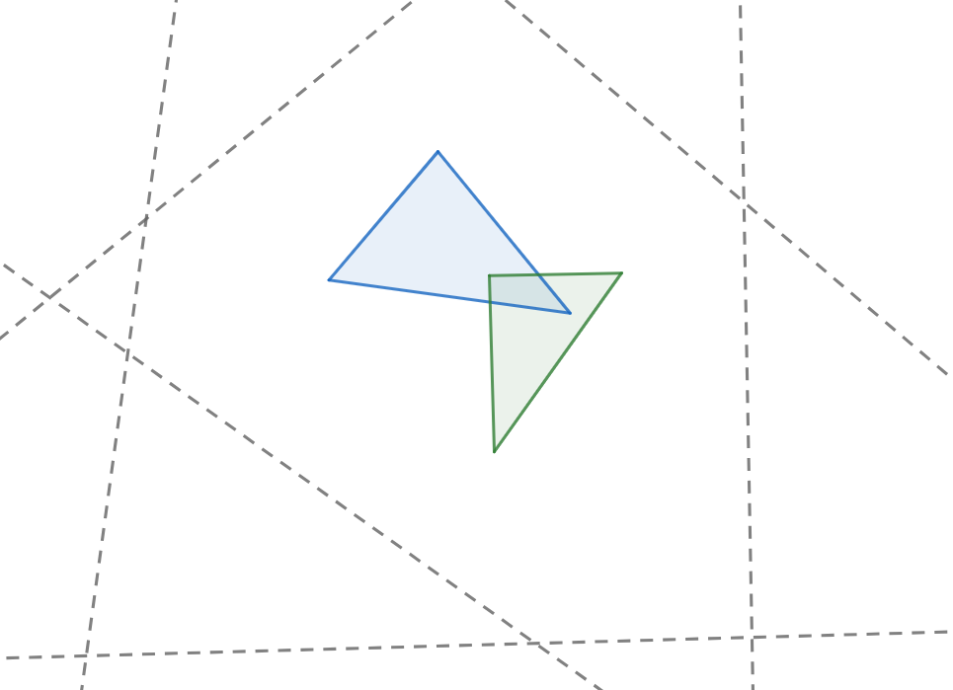
Separating Axis Theorem (SAT)
If two objects do not collide, there always exists a straight line (plane in 3D) that can separate the two objects.
3
6
Project the two convex polygons onto the perpendicular of each edge of the simplex.
If there exists a perpendicular line on which the projections of the two polygons do not overlap, then the two convex polygons do not collide; otherwise, they do collide.
1
2
5
6
3
2
4
5
1
4

Slide 24
Reference and Futher Readings
Finite Element Method, Part I [SIGGRAPH 2012 Course] [Link]
Dynamic Deformables: Implementation and Production Practicalities [SIGGRAH 2020 Course] [Link]
TaichiCourse 01: Lecture 08 [Link]
GAMES Course 103 – Lecture 7: Other Constrained Methods and Linear Finite Element Method I [Link]
All relevant files (ppt, pdf, image, code, video):
https://github.com/LILKOTYO/Lab-Presentation/tree/master/20220725_Spatial_and_Temporal_Discretization

