Slide 1
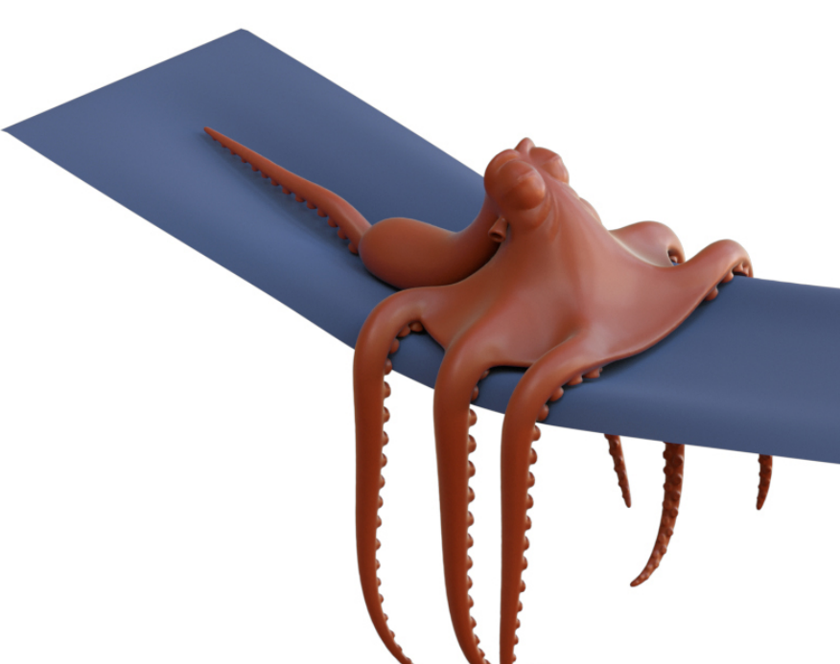
Deformable Simulation
Spatial and Temporal Discretization

Slide 2
Outline today
The temporal integration
Explicit
Implicit
Symplectic
The spatial integration
Mass-Spring system
The finite element method

Slide 3
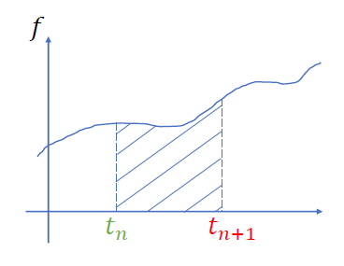



Equations of motion (general cases)
$$M\ddot{x}=f(x)$$
$$\dot{x}=v \dot{v}=a=M^{−1}f$$
$$x\left(t_{n}+h\right)=x\left(t_{n}\right)+\int_{0}^{h}{v\left(t_{n}+t\right)dt}$$
$$v\left(t_{n}+h\right)=v\left(t_{n}\right)+\int_{0}^{h}{M^{−1}f\left(t_{n}+t\right)dt}$$
$h=t_{n+1}−t_{n}$ is the time-step size
We don’t know how to integrate this quantity
We don’t know anything after $t_{n}$

Slide 4

Temporal integration (Explicit)
$$x_{n+1}=x\left(t_{n}\right)+\int_{0}^{h}{v\left(t_{n}+t\right)dt}≈x_{n}+hv_{n}$$
$$v_{n+1}=v\left(t_{n}\right)+\int_{0}^{h}{M^{−1}f\left(t_{n}+t\right)dt}=v_{n}+hM^{−1}f(x_{n})$$
Accuracy: 1st-order accurate
$$\int_{0}^{h}{v\left(t_{n}+t\right)dt}=hv\left(t_{n}+0\right)+\frac{h^{2}}{2}v^{′}\left(t_{n}+0\right)+…$$
$=hv_{n}+O(h^{2})$

Slide 5
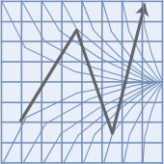
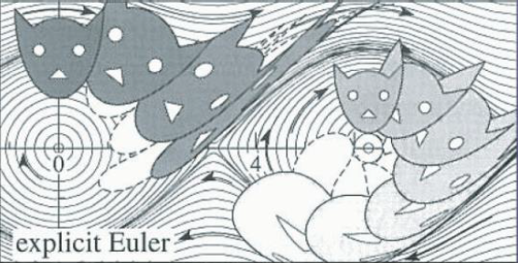

Temporal integration (Explicit)
Stability:
$\frac{d}{dt}x=λx$
$x_{n+1}=x_{n}+hλx_{n}$
$x_{n}={\left(1+hλ\right)}^{n}x_{0}$
Condition of stability:
$\left|1+hλ\right|≤1, h≤\frac{2}{\left|λ\right|}$
-2
0
Explicit Euler is extremely fast, but it will also increase the system energy gradually. Not recommended in almost all situations.

Slide 6
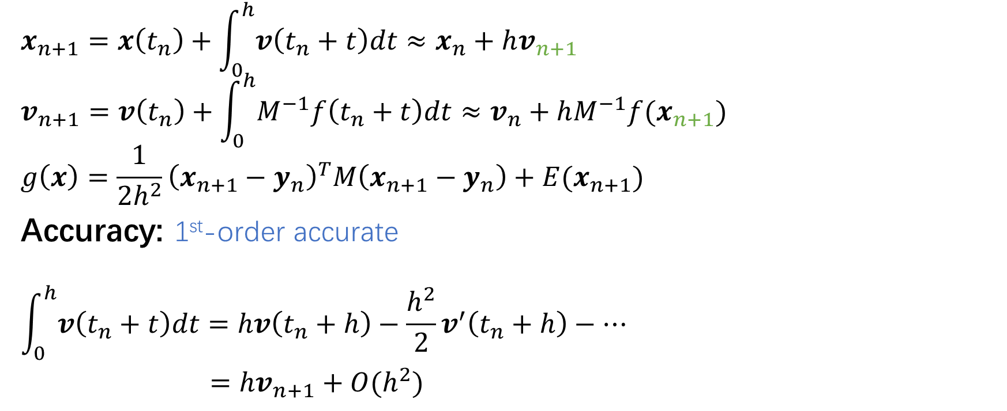

Temporal integration (Implicit)
$$x_{n+1}=x\left(t_{n}\right)+\int_{0}^{h}{v\left(t_{n}+t\right)dt}≈x_{n}+hv_{n+1}$$
$$v_{n+1}=v\left(t_{n}\right)+\int_{0}^{h}{M^{−1}f\left(t_{n}+t\right)dt}≈v_{n}+hM^{−1}f(x_{n+1})$$
$$g\left(x\right)=\frac{1}{2h^{2}}{\left(x_{n+1}−y_{n}\right)}^{T}M\left(x_{n+1}−y_{n}\right)+E(x_{n+1})$$
Accuracy: 1st-order accurate
$$\int_{0}^{h}{v\left(t_{n}+t\right)dt}=hv\left(t_{n}+h\right)−\frac{h^{2}}{2}v^{′}\left(t_{n}+h\right)−…$$
$=hv_{n+1}+O(h^{2})$
Expand where $Δt=h$

Slide 7
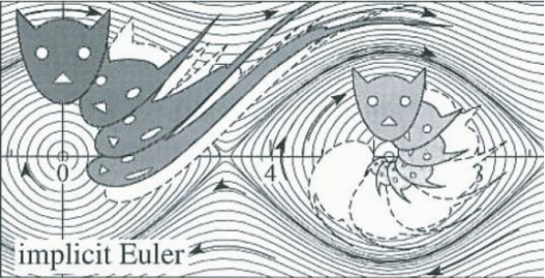

Temporal integration (Implicit)
Stability:
$\frac{d}{dt}x=λx$
$x_{n+1}=x_{n}+hλx_{n+1}$
$x_{n}={\left(1−hλ\right)}^{−n}x_{0}$
Condition of stability:
$\left|1−hλ\right|≥1$
Implicit Euler integrals are unconditionally stable!
Implicit Euler is often expensive due to the nonlinear optimization, it is often stable for large time steps and is widely used in performance centric applications. (game / design / animation)

Slide 8
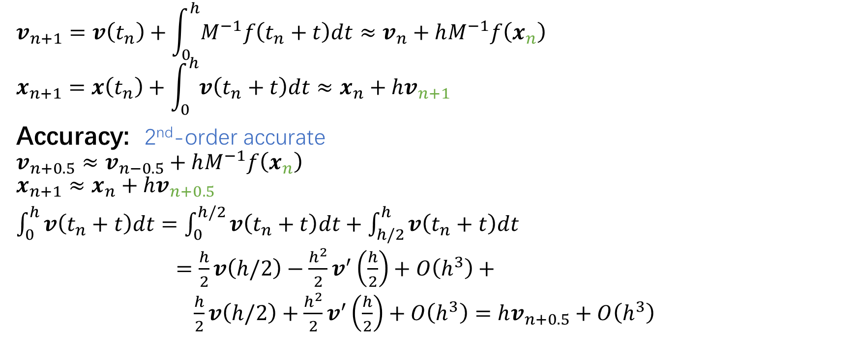
Temporal integration (Symplectic)
$$v_{n+1}=v\left(t_{n}\right)+\int_{0}^{h}{M^{−1}f\left(t_{n}+t\right)dt}≈v_{n}+hM^{−1}f\left(x_{n}\right)$$
$$x_{n+1}=x\left(t_{n}\right)+\int_{0}^{h}{v\left(t_{n}+t\right)dt}≈x_{n}+hv_{n+1}$$
Accuracy: 2nd-order accurate
$$v_{n+0.5}≈v_{n−0.5}+hM^{−1}f\left(x_{n}\right)$$
$$x_{n+1}≈x_{n}+hv_{n+0.5}$$
$\int_{0}^{h}{v\left(t_{n}+t\right)dt}=\int_{0}^{h/2}{v\left(t_{n}+t\right)dt}+\int_{h/2}^{h}{v\left(t_{n}+t\right)dt}$
$=\frac{h}{2}v\left(h/2\right)−\frac{h^{2}}{2}v^{′}\left(\frac{h}{2}\right)+O\left(h^{3}\right)+$
$\frac{h}{2}v\left(h/2\right)+\frac{h^{2}}{2}v^{′}\left(\frac{h}{2}\right)+O\left(h^{3}\right)=hv_{n+0.5}+O\left(h^{3}\right)$
Midpoint

Slide 9
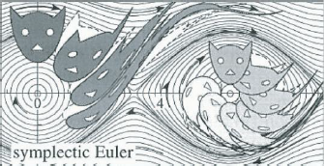
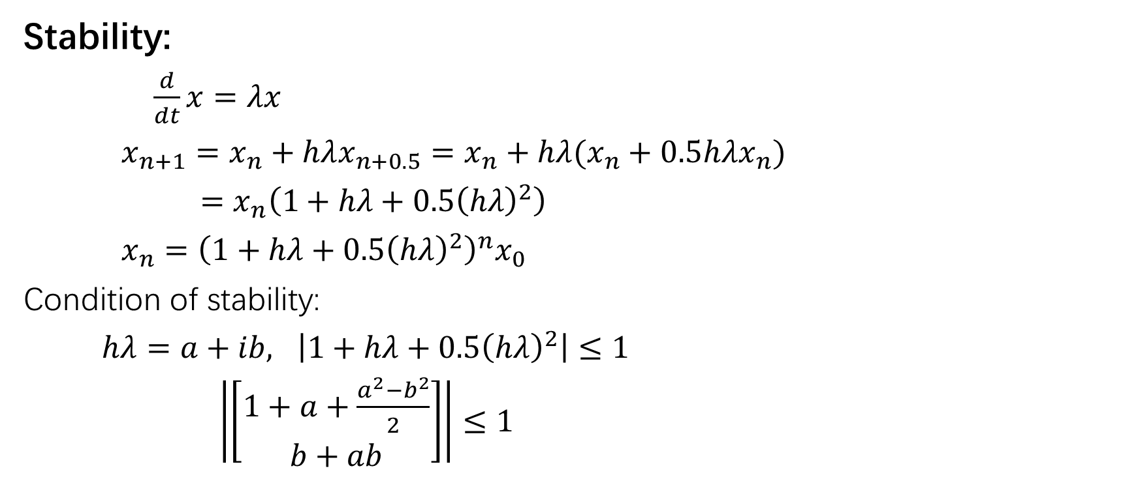
Temporal integration (Symplectic)
Stability:
$\frac{d}{dt}x=λx$
$x_{n+1}=x_{n}+hλx_{n+0.5}=x_{n}+hλ(x_{n}+0.5hλx_{n})$
$=x_{n}\left(1+hλ+0.5{\left(hλ\right)}^{2}\right)$
$x_{n}={\left(1+hλ+0.5{\left(hλ\right)}^{2}\right)}^{n}x_{0}$
Condition of stability:
$hλ=a+ib, \left|1+hλ+0.5{\left(hλ\right)}^{2}\right|≤1$
$\left|\left[\begin{matrix}1+a+\frac{a^{2}−b^{2}}{2} \\ b+ab\end{matrix}\right]\right|≤1$
-2
0
Symplectic Euler is as fast as forward Euler. It has been widely used in accuracy centric applications (astronomy simulation / molecular dynamics etc).

Slide 10

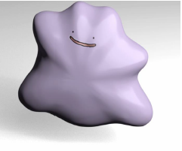

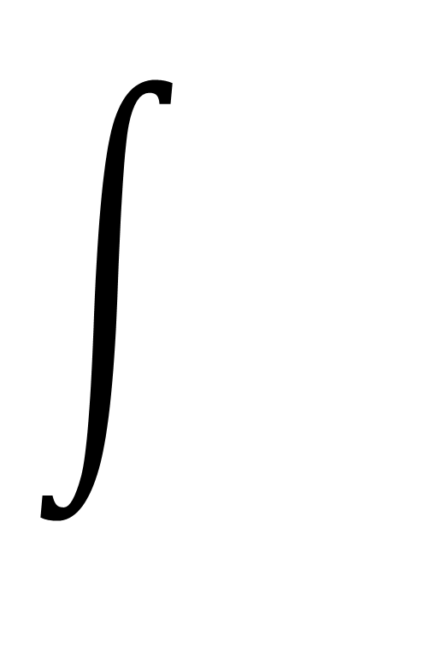
Spatial integration
For conservative forces (as most of the elastic forces are), the energy definition is all we need for their simulations.
A deformable object is a continuum body
?
$$E=$$
How to describe the deformation?
How to describe the elastic energy?

Slide 11
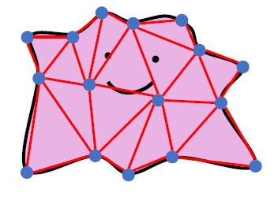
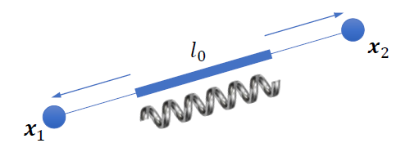


Mass-spring system
Aggregate the volume mass to the vertices
Link the mass vertices with springs
How to describe the deformation?
“Deformation” $=l−l_{0}$
How to describe the elastic energy?
Hooke’s Law: $E\left(x_{1},x_{2}\right)=\frac{1}{2}k{\left(l−l_{0}\right)}^{2}$
$$E=\int{} = \sum{}$$

Slide 12

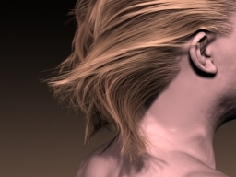
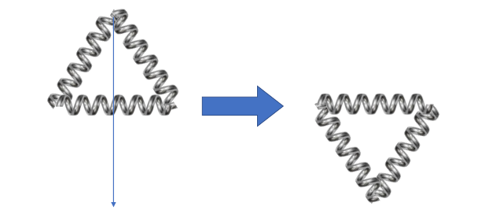
Mass-spring system
Mass-spring systems are particularly useful in:
Mass-spring systems are NOT the best choices when simulating continuum area/volume
Cloth Sim
Dinev et al. 2018
Hair Sim
Selle et al. 2018

Slide 13











Linear finite element method (FEM)
How to describe the deformation?
Translation: $φ\left(X\right)=X+t$ $F=\frac{∂φ}{∂X}=I$
Rotation: $φ\left(X\right)=RX$ $F=\frac{∂φ}{∂X}=R$
Scaling: $φ\left(X\right)=SX$ $F=\frac{∂φ}{∂X}=S$
$$X$$
$$x$$
$$φ\left(X\right)≈\frac{∂φ}{∂X}X+(φ\left(X^{∗}\right)−\frac{∂φ}{∂X}X^{∗})$$
$$x=φ(X)$$
$$t$$
$$F$$
$$x≈FX+t$$
$$R=\left[\begin{matrix}cos⁡(θ) & −sin⁡(θ) \\ sin⁡(θ) & cos⁡(θ)\end{matrix}\right], S=\left[\begin{matrix}2 & 0 \\ 0 & 1\end{matrix}\right]$$
Notes:
在一个小的邻域内，可以把x=FX+t视作成立

Slide 14
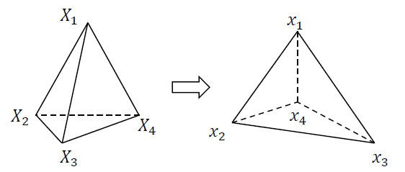




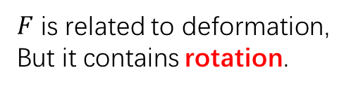

Linear finite element method (FEM)
How to describe the elastic energy?
Define: $Ψ\left(x\right)=Ψ(F)$ is an energy density function at $x=φ(X)$, so $E=∑w_{e}Ψ(F_{e})$
Is it appropriate to do so?
$$x_{1}=FX_{1}+t$$
$$x_{2}=FX_{2}+t$$
$$x_{3}=FX_{3}+t$$
$$x_{4}=FX_{4}+t$$
$$F=D_{s}D_{m}^{−1}$$
$$\left[\begin{matrix}x_{1}−x_{4} & x_{2}−x_{4} & x_{3}−x_{4}\end{matrix}\right]=F\left[\begin{matrix}X_{1}−X_{4} & X_{2}−X_{4} & X_{3}−X_{4}\end{matrix}\right]$$
$F$ is related to deformation,
But it contains rotation.
$$D_{s}$$
$$D_{m}$$
Notes:
F能够描述四面体的各顶点相对位置的关系，也就是说他其中不包含平移相关的量

Slide 15
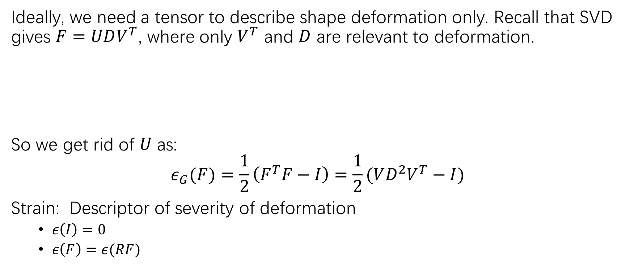


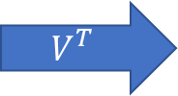
Linear finite element method (FEM)
Ideally, we need a tensor to describe shape deformation only. Recall that SVD gives $F=UDV^{T}$, where only $V^{T}$ and $D$ are relevant to deformation.
So we get rid of $U$ as:
$$ε_{G}(F)=\frac{1}{2}\left(F^{T}F−I\right)=\frac{1}{2}(VD^{2}V^{T}−I)$$
Strain: Descriptor of severity of deformation
$ε\left(I\right)=0$
$ε\left(F\right)=ε(RF)$
$$V^{T}$$
$$D$$
$$U$$
Green strain
Notes:
怎么把U丢掉呢？用svd嘛，不太好，这并不优雅

Slide 16

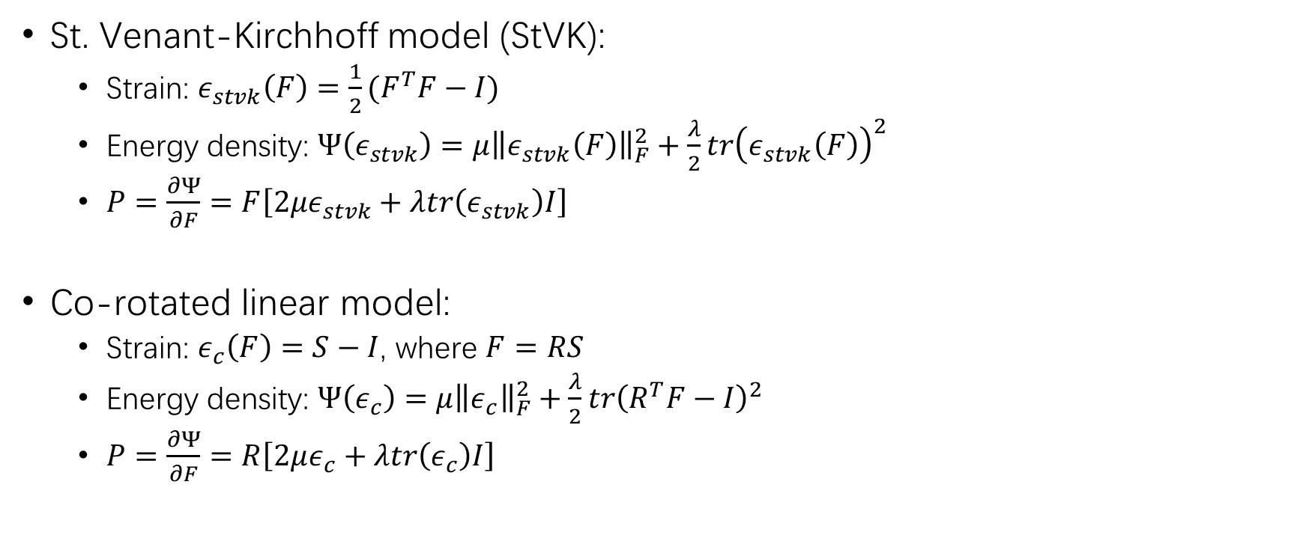



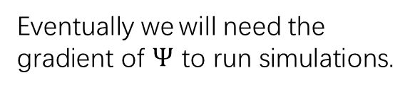
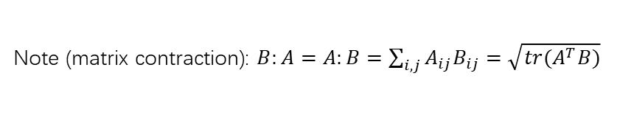
Linear finite element method (FEM)
St. Venant-Kirchhoff model (StVK):
Strain: $ε_{stvk}\left(F\right)=\frac{1}{2}(F^{T}F−I)$
Energy density: $Ψ\left(ε_{stvk}\right)=μ{\left\|ε_{stvk}\left(F\right)\right\|}_{F}^{2}+\frac{λ}{2}tr{\left(ε_{stvk}\left(F\right)\right)}^{2}$
$P=\frac{∂Ψ}{∂F}=F\left[2με_{stvk}+λtr\left(ε_{stvk}\right)I\right]$
Co-rotated linear model:
Strain: $ε_{c}\left(F\right)=S−I$, where $F=RS$
Energy density: $Ψ\left(ε_{c}\right)=μ{\left\|ε_{c}\right\|}_{F}^{2}+\frac{λ}{2}tr{\left(R^{T}F−I\right)}^{2}$
$P=\frac{∂Ψ}{∂F}=R\left[2με_{c}+λtr\left(ε_{c}\right)I\right]$
1st-Piola-Kirchhoff stress tensor
Eventually we will need the gradient of $Ψ$ to run simulations.
$$\frac{∂Ψ}{∂x}=\frac{∂F}{∂x}:\frac{∂Ψ}{∂F}$$
A $\left(12×1\right)×\left(3×3\right)$ tensor
A $\left(3×3\right)$ tensor (matrix)
Note (matrix contraction): $B:A=A:B=\sum_{i,j}{A_{ij}B_{ij}}=\sqrt{tr(A^{T}B)}$
A $\left(12×1\right)$ tensor (vector)
Notes:
“StVK是一种会翻转的模型，所以当体积丢失到一定程度的时候确实会翻掉的” “如果你仔细研究StVK的能量，会发现当F=0的时候也是它的一个（非最小）极值点。当然当F=-F的时候因为strain不变，所以还会存在一个额外的最小极值点。”
应力张量

Slide 17
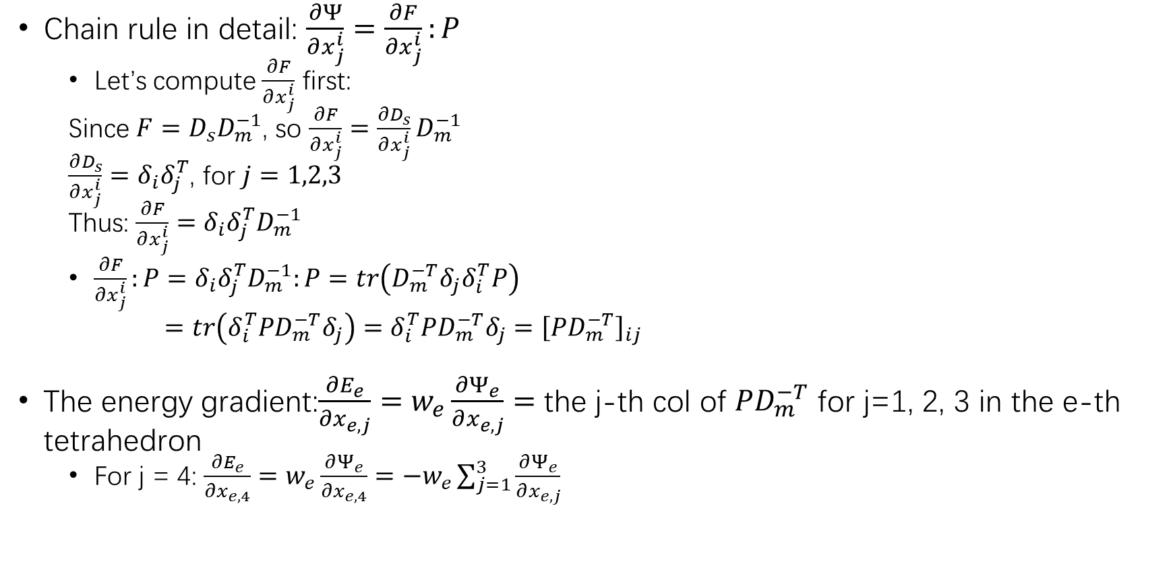
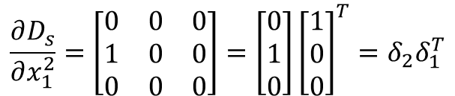
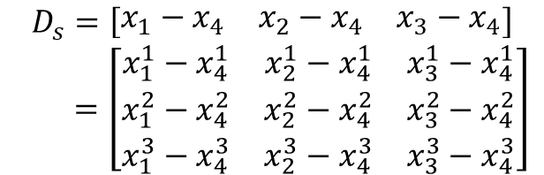
Linear finite element method (FEM)
Chain rule in detail: $\frac{∂Ψ}{∂x_{j}^{i}}=\frac{∂F}{∂x_{j}^{i}}:P$
Let’s compute $\frac{∂F}{∂x_{j}^{i}}$ first:
Since $F=D_{s}D_{m}^{−1}$, so $\frac{∂F}{∂x_{j}^{i}}=\frac{∂D_{s}}{∂x_{j}^{i}}D_{m}^{−1}$
$\frac{∂D_{s}}{∂x_{j}^{i}}=δ_{i}δ_{j}^{T}$, for $j=1,2,3$
Thus: $\frac{∂F}{∂x_{j}^{i}}=δ_{i}δ_{j}^{T}D_{m}^{−1}$
$\frac{∂F}{∂x_{j}^{i}}:P=δ_{i}δ_{j}^{T}D_{m}^{−1}:P=tr\left(D_{m}^{−T}δ_{j}δ_{i}^{T}P\right)$
$=tr\left(δ_{i}^{T}PD_{m}^{−T}δ_{j}\right)=δ_{i}^{T}PD_{m}^{−T}δ_{j}={\left[PD_{m}^{−T}\right]}_{ij}$
The energy gradient:$\frac{∂E_{e}}{∂x_{e,j}}=w_{e}\frac{∂Ψ_{e}}{∂x_{e,j}}=$ the j-th col of $PD_{m}^{−T}$ for j=1, 2, 3 in the e-th tetrahedron
For j = 4: $\frac{∂E_{e}}{∂x_{e,4}}=w_{e}\frac{∂Ψ_{e}}{∂x_{e,4}}=−w_{e}\sum_{j=1}^{3}{\frac{∂Ψ_{e}}{∂x_{e,j}}}$
$$D_{s}=\left[\begin{matrix}x_{1}−x_{4} & x_{2}−x_{4} & x_{3}−x_{4}\end{matrix}\right]$$
$$=\left[\begin{matrix}x_{1}^{1}−x_{4}^{1} & x_{2}^{1}−x_{4}^{1} & x_{3}^{1}−x_{4}^{1} \\ x_{1}^{2}−x_{4}^{2} & x_{2}^{2}−x_{4}^{2} & x_{3}^{2}−x_{4}^{2} \\ x_{1}^{3}−x_{4}^{3} & x_{2}^{3}−x_{4}^{3} & x_{3}^{3}−x_{4}^{3}\end{matrix}\right]$$
$$\frac{∂D_{s}}{∂x_{1}^{2}}=\left[\begin{matrix}0 & 0 & 0 \\ 1 & 0 & 0 \\ 0 & 0 & 0\end{matrix}\right]=\left[\begin{matrix}0 \\ 1 \\ 0\end{matrix}\right]{\left[\begin{matrix}1 \\ 0 \\ 0\end{matrix}\right]}^{T}=δ_{2}δ_{1}^{T}$$
The sum of all internal forces in a tetrahedron
should be zero
Note (matrix contraction): $B:A=A:B=\sum_{i,j}{A_{ij}B_{ij}}=\sqrt{tr(A^{T}B)}$
Notes:
首先是看一个四面体的情况
然后把视角放到全局，一个百变怪，或者说一个软体物体，由很多很多个四面体构成，那么对第e个四面体来说，有：

Slide 18
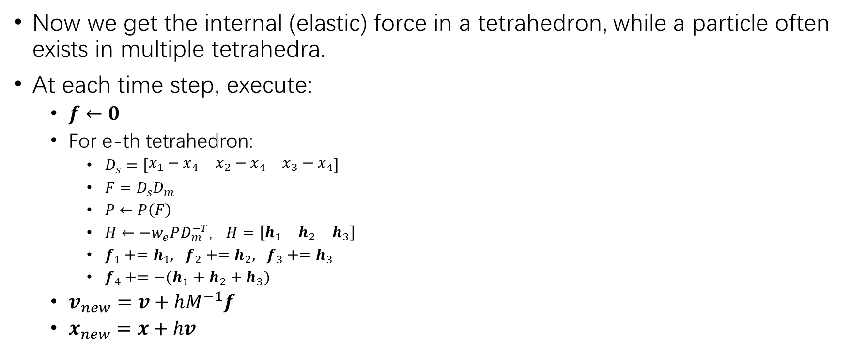
Linear finite element method (FEM)
Now we get the internal (elastic) force in a tetrahedron, while a particle often exists in multiple tetrahedra.
At each time step, execute:
$f←0$
For e-th tetrahedron:
$D_{s}=\left[\begin{matrix}x_{1}−x_{4} & x_{2}−x_{4} & x_{3}−x_{4}\end{matrix}\right]$
$F=D_{s}D_{m}$
$P←P\left(F\right)$
$H←−w_{e}PD_{m}^{−T}$, $H=\left[\begin{matrix}h_{1} & h_{2} & h_{3}\end{matrix}\right]$
$f_{1}+=h_{1}, f_{2}+=h_{2}, f_{3}+=h_{3}$
$f_{4}+=−(h_{1}+h_{2}+h_{3})$
$v_{new}=v+hM^{−1}f$
$x_{new}=x+hv$

Slide 19
Reference and Futher Readings
Finite Element Method, Part I [SIGGRAPH 2012 Course] [Link]
Dynamic Deformables: Implementation and Production Practicalities [SIGGRAH 2020 Course] [Link]
TaichiCourse 01: Lecture 08 [Link]
GAMES Course 103 – Lecture 7: Other Constrained Methods and Linear Finite Element Method I [Link]
All relevant files (ppt, pdf, image, code, video):
https://github.com/LILKOTYO/Lab-Presentation/tree/master/20220725_Spatial_and_Temporal_Discretization

