Slide 1
LInear Modelling of EEG data
Multiple Comparison Correction
Cyril R. Pernet, University of Edinburgh
Guillaume, A. Rousselet, University of Glasgow

Slide 2
What is the problem?
When we do a statistical test, we set alpha, the probability to reject H0 (under H0) – this is also known as type I error rate
The famillywise error rate has to do with the number of tests performed, and assuming tests are independents from each other, the FWER = 1 - (1 - alpha)^n
eg. so for alpha =5/100, if we do 2 tests we should get about 1-(1-5/100)^2 ~ 9% false positives, if we do 126 electrodes * 150 time frames tests, we should get about 1-(1-5/100)^18900 ~ 100% false positives! i.e. you can’t be certain of any of the statistical results you observe

Slide 3
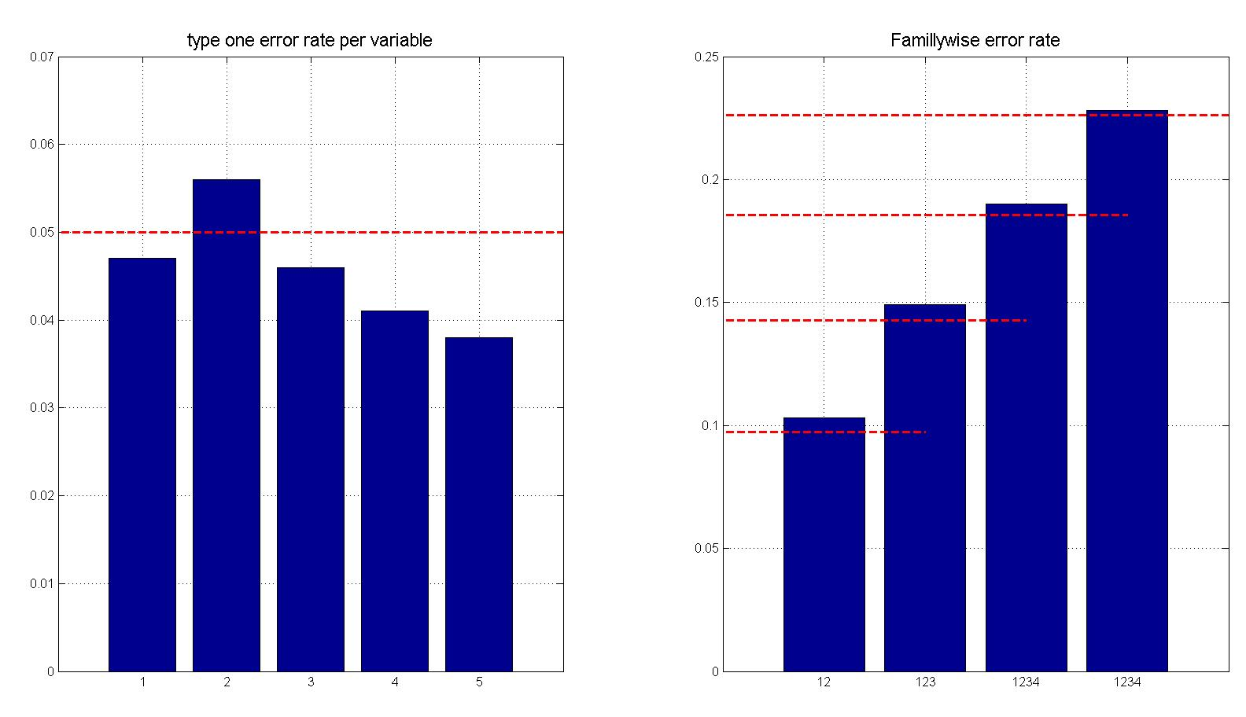
What is the problem?
Illustration with 5 independent variables from N(0,1)
Repeat 1000 times and measures type 1 error rate
22%
18%
14%
9%
5%
Notes:
Left plot: type 1 error rate measured on each variable ~= 0.05
Right plot: family wise error rate considering 2, 3, 4 or 5 variables together

Slide 4
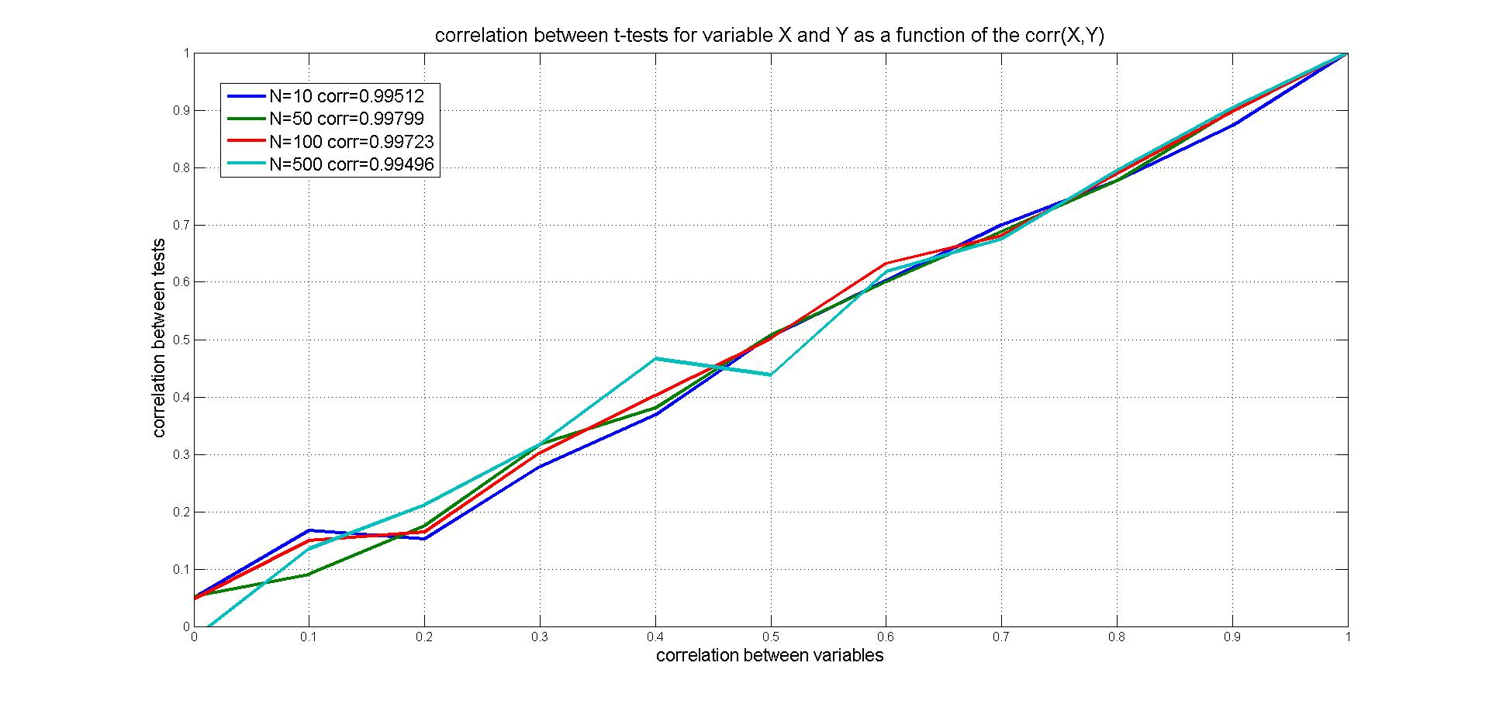
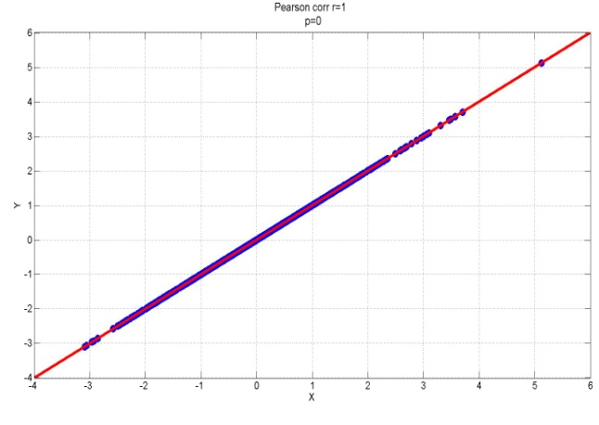
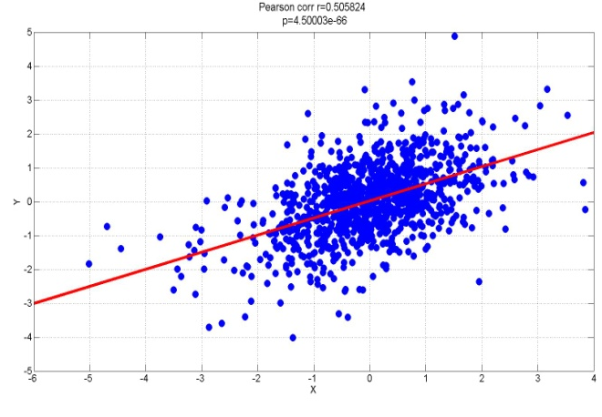
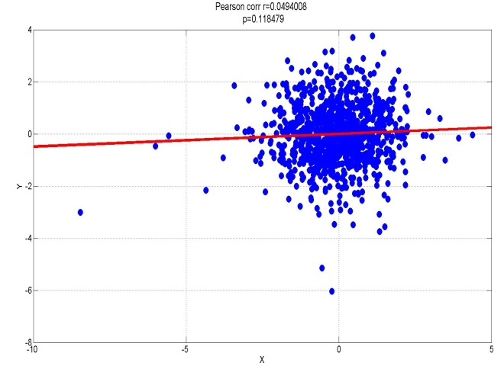
What is the problem?
Illustration with 2 variables with Pearson‘s r=0:1
As we observed one test, we know something about the outcome of the other test when variables are corr.
Notes:
For 2 variables X and Y do ttest(X) and ttest(Y); repeat 1000 times and plot(corr(X,Y),corr(ttest(X),ttest(Y))
Subplots show for N=10 and corr(X,Y)=0, 0.5 and 1 the correlations between ttest(X) and ttest(Y)

Slide 5
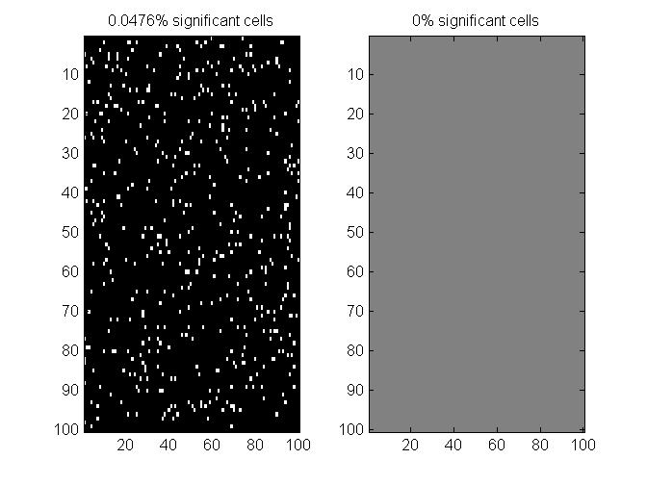
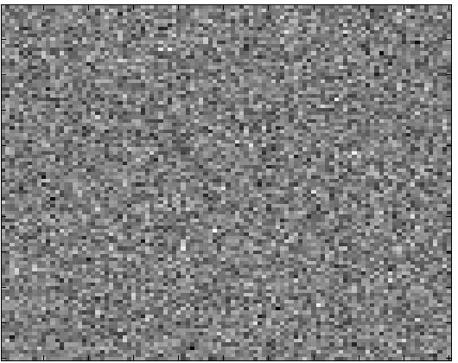
What is the solution?
Bonferroni correction allows to keep the FWER at 5% by simply dividing alpha by the number of tests
trials
electrodes
time
One sample t test > 0 ?
Notes:
Fake data of dimension 100 * 100 * 10 trials from N~(0,1) → we obtain 5% false positives for the whole space 10000*5/100

Slide 6
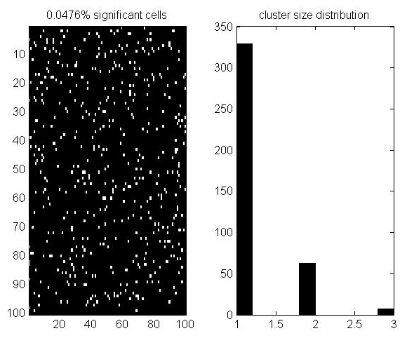
What is the solution?
Wait, it is well known that Bonferroni is too conservative, i.e. the FWER < alpha. In EEG we instead consider cluster because it is much less likely that statistics are significant in groups
trials
electrodes
time
One sample t test > 0 ?
Notes:
With completely independent data we have ~50 clusters of 2 and 2 cluster of 3

Slide 7
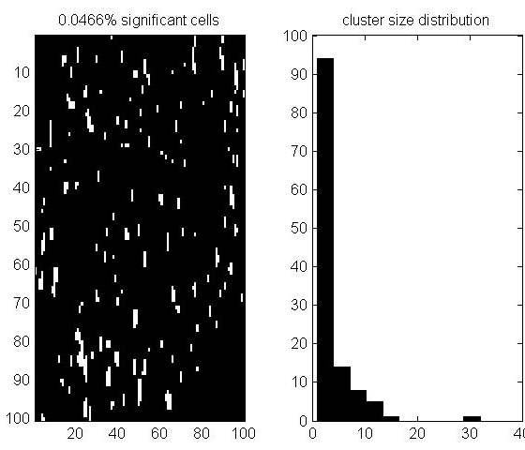
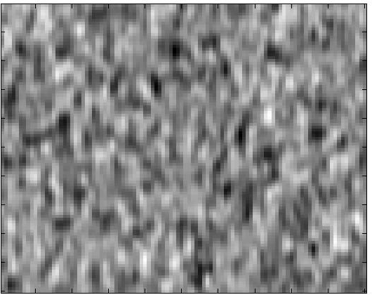
What is the solution?
Wait, it is well known that Bonferroni is too conservative, i.e. the FWER < alpha. In EEG we instead consider cluster because is much less likely that statistics are significant in groups – but data are smooth in space and time!
trials
electrodes
time
One sample t test > 0 ?
Notes:
Smoothing with a Gaussian kernel (5,10) we know have many clusters > 10 even up to 30 !

Slide 8
What is the solution?
Clustering is a good option because it accounts for topological features in the data. Techniques like Bonferroni, FDR, max(stats) control the FWER but independently of the correlation between tests.
To use clustering we need to consider cluster statistics rather than individual statistics
Cluster statistics depend on (i) the cluster size, which depends on the data at hand (how correlated data are in space in time), and (ii) the strength of the signal (how strong are the t, F values in a cluster) or (iii) a combination of both.

Slide 9
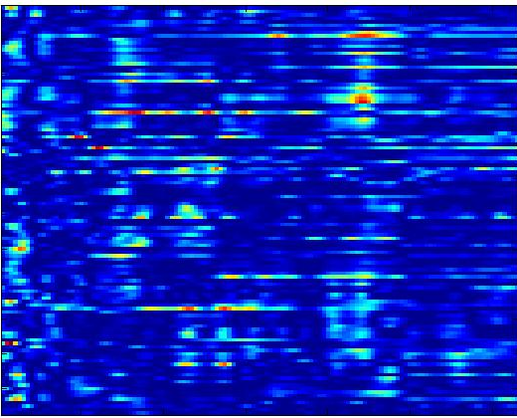
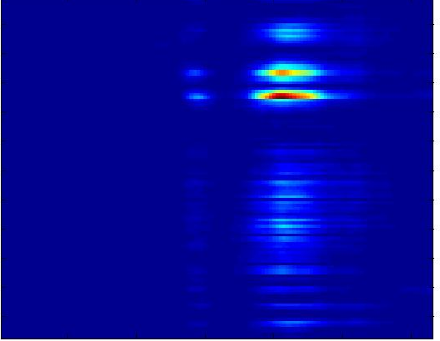
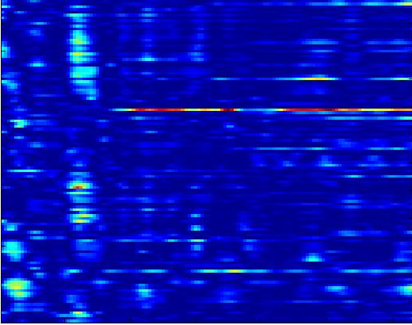
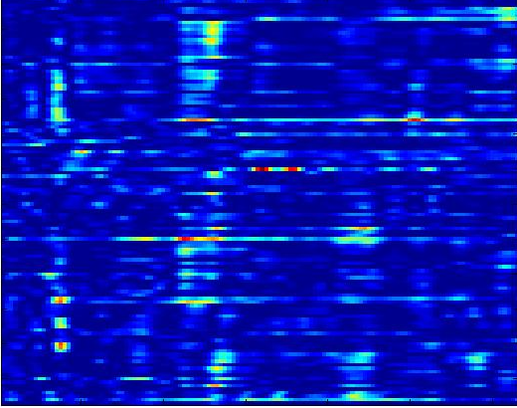
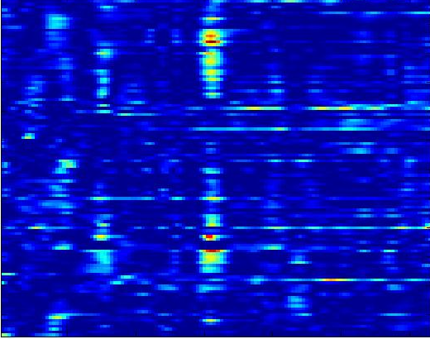
What is the solution?
In LIMO EEG, we bootstrap the data under H0: center the data or break the link between the design matrix and the data and then resample and test – by chance some significant results are obtained.
Observed F values
F values under H0

Slide 10
Bootstrap: central idea
“The bootstrap is a computer-based method for assigning measures of accuracy to statistical estimates.” Efron & Tibshirani, 1993
“The central idea is that it may sometimes be better to draw conclusions about the characteristics of a population strictly from the sample at hand, rather than by making perhaps unrealistic assumptions about the population.” Mooney & Duval, 1993

Slide 11
Bootstrap philosophy
DATA
BRAIN
n samples
WITH replacement
*
BOOTSTRAP
SAMPLES
DATA
DATA
ANALYSES
Distributions & CI

Slide 12
Percentile bootstrap: general recipe
original data
1
2
3
4
5
6
7
8
1
2
2
2
3
4
5
6
7
8
8
(1) sample WITH replacement n observations (under H1 for CI of an estimate, under H0 for the null distribution)
bootstrapped data
(2) compute estimate
e.g. sum, trimmed mean
∑
(3) repeat (1) & (2) b times
(4) sort the b estimates*
(5) get 1-alpha confidence interval
∑1 ∑2 ∑3 ∑4 ∑5 ∑6 ... ∑b

Slide 13
Percentile bootstrap estimate of mean
% self-awarness data, Wilcox, 2005, p58
Bootstrapped estimates
Sample with replacement b times
data
compute estimate
Distribution of bootstrapped
estimates of the mean
get PDF
Sort & get CI

Slide 14
Distributions can take any shape
Non signif. value
Signif. value
2.5%
97.5%
2.5%
97.5%
2.5%
97.5%
The percentile bootstrap method allows the bootstrap estimate of the sampling distribution to conform to any shape the data suggest, taking into account the variance and the skewness of the sample. This can be the distribution of T/F values, the distribution of cluster size, height or mass or the distribution of TFCE scores.

Slide 15
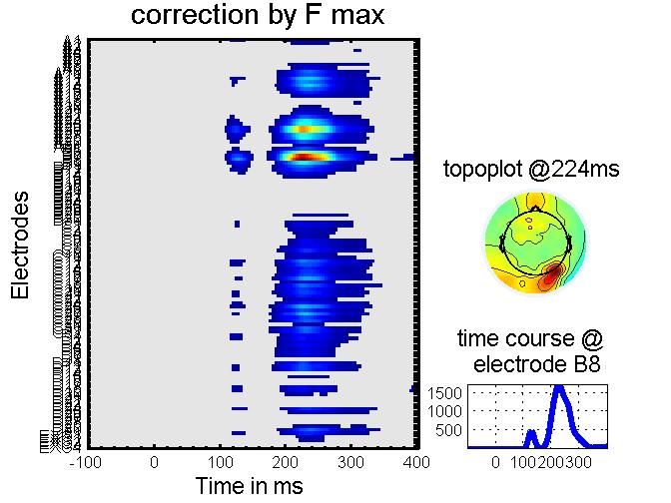
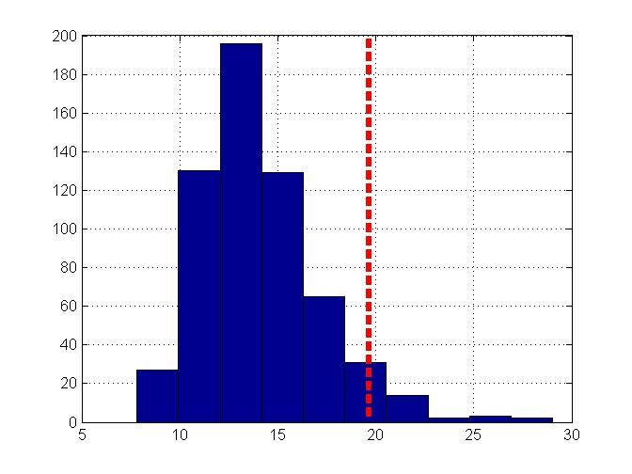
MCC using max across the whole space
Max(stat): for each bootstrap record the max(t) or max(F) to build the distribution of max under H0. Then threshold the observed results using this distribution. Because the max value is obtained across all electrodes and time frames, it corrects to thresholding data through this whole space. Max(stat) doesn’t account for clusters.
Max F values
Under H0

Slide 16
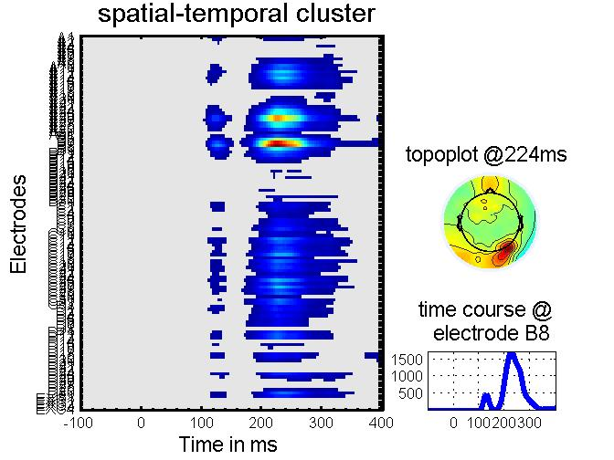
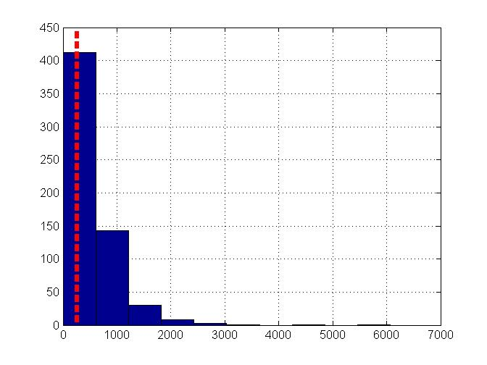
MCC using (max of) clusters
Spatial-Temporal clustering: for each bootstrap, threshold at alpha and record the max(cluster mass), i.e. sum of F values within a cluster. Then threshold the observed clusters based on there mass using this distribution → accounts for correlations in space and time.
Max cluster mass
Under H0
Loss of resolution: inference is about the cluster, not max in time or specific electrode !

Slide 17
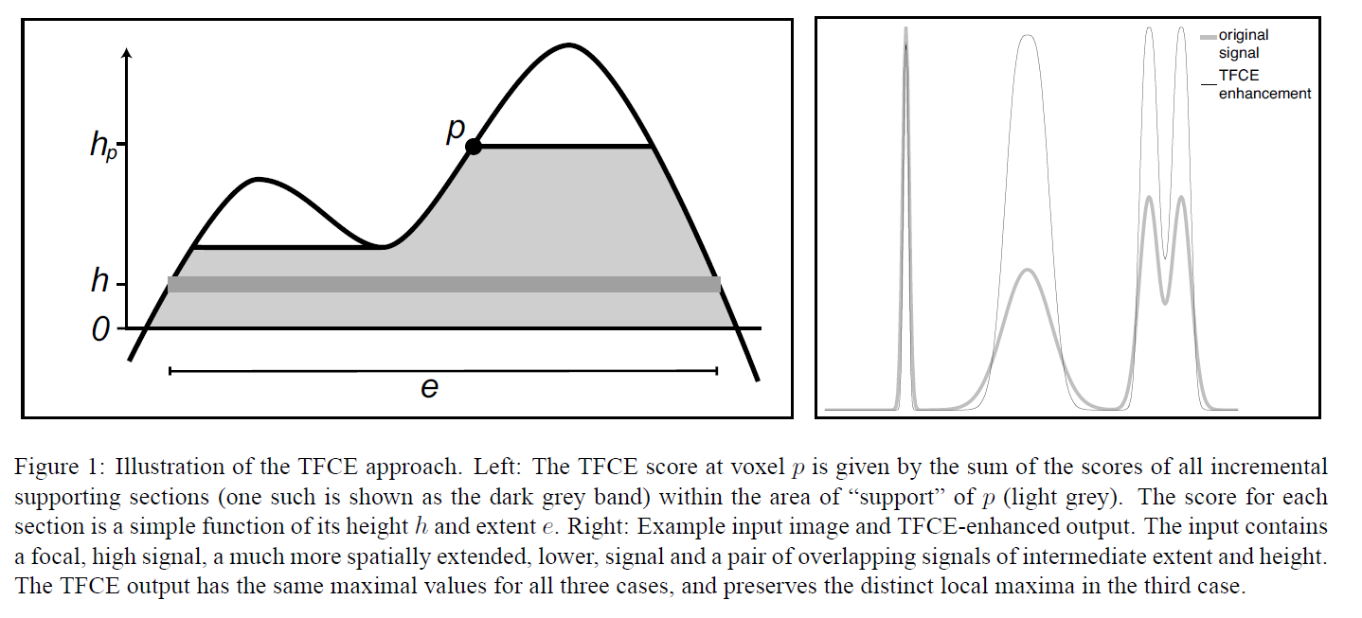
Threshold Free Cluster Enhancement
Threshold Free Cluster Enhancement (TFCE): Integrate the cluster mass at multiple thresholds. A TFCE score is thus obtain per cell but the value is a weighted function of the statistics by it’s belonging to a cluster.
Smith & Nichols 2009 NeuroImage 44

Slide 18
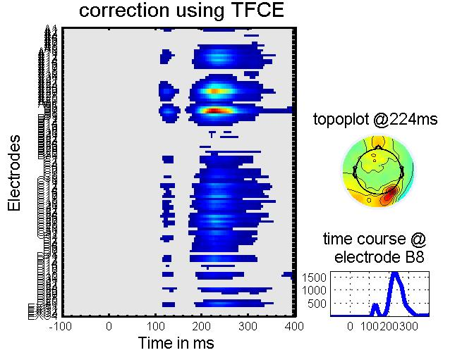
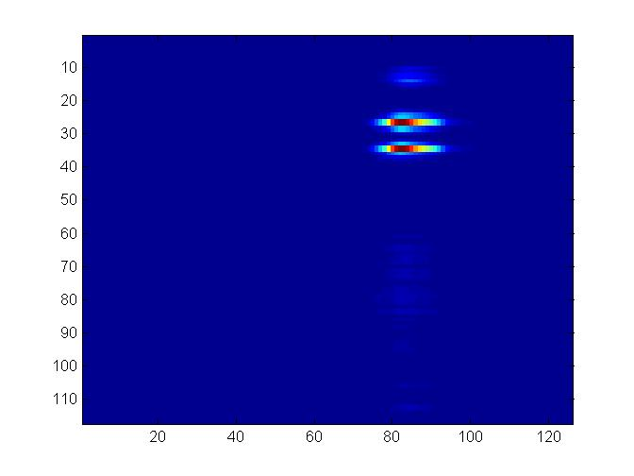
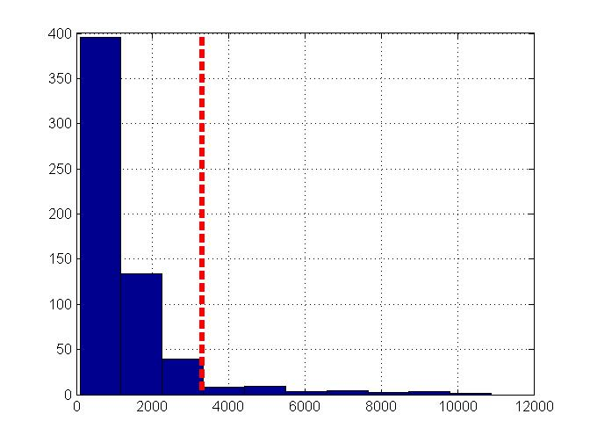
Threshold Free Cluster Enhancement
Threshold Free Cluster Enhancement (TFCE): Integrate the cluster mass at multiple thresholds. A TFCE score is thus obtain per cell but the value is a weighted function of the statistics by it’s belonging to a cluster. As before, bootstrap under H0 and get max(tfce).
Max tfce values
Under H0
Observed F values
TFCE scores
Excellent resolution: inference is about cells, but we accounted for space/time dependence

Slide 19
Conclusions
When performing multiple tests, statistical correction MUST be applied.
All techniques provide a FWER at the specified level but not all techniques have the same power.
Spatial-temporal clustering and TFCE seem to provide good estimates, with TFCE giving higher spatio-temporal inference resolution, but at the cost of long computing time.

