Slide 1
物聯網實務 HW13
電機碩一 11278008 林佳慧
日期:2023/12/13

Slide 2
Homework 13-1
Deploy your code to firebase hosting

Slide 3
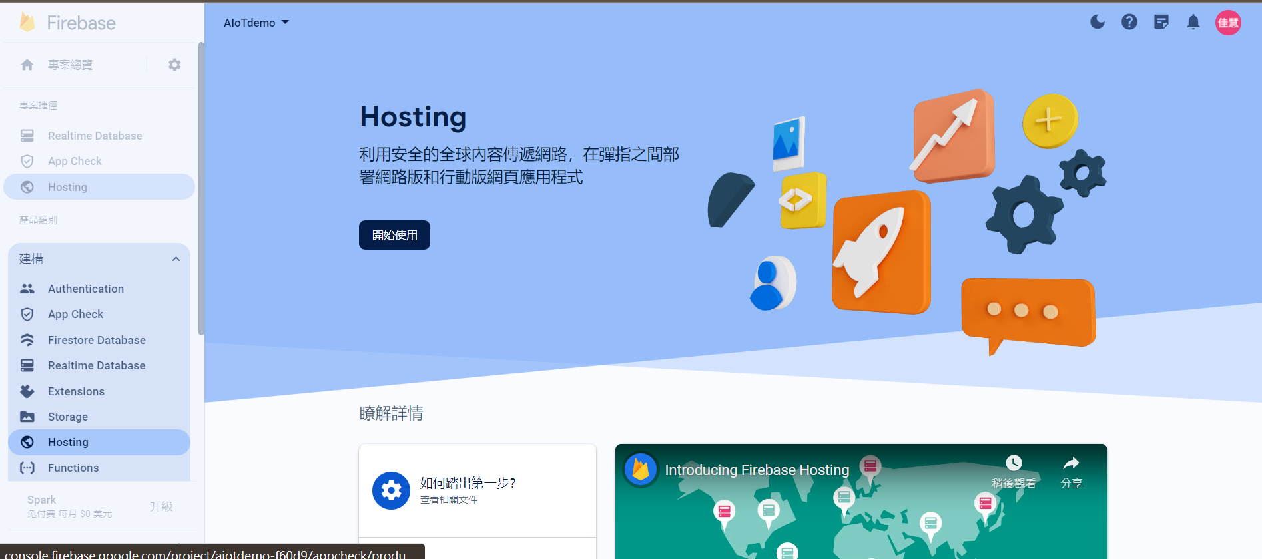
Choose AIoTdemo Project
1. Choose AIoTdemo
3. Get started
2. Hosting

Slide 4
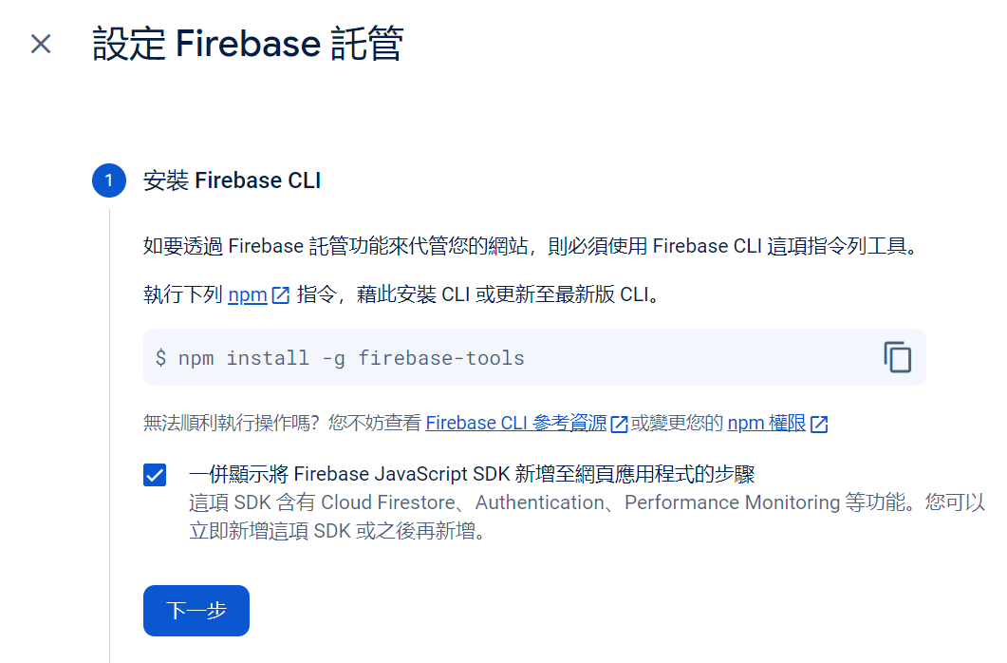

Set up Firebase Hosting
1. Copy
2. Paste
3
4

Slide 5
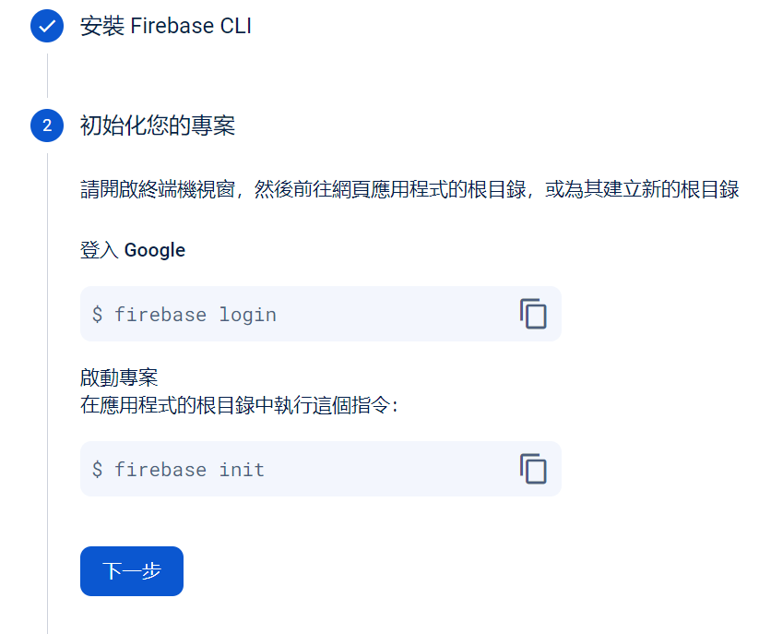

Set up Firebase Hosting
1. Copy
2. Paste
4. Paste
3. Copy
5

Slide 6
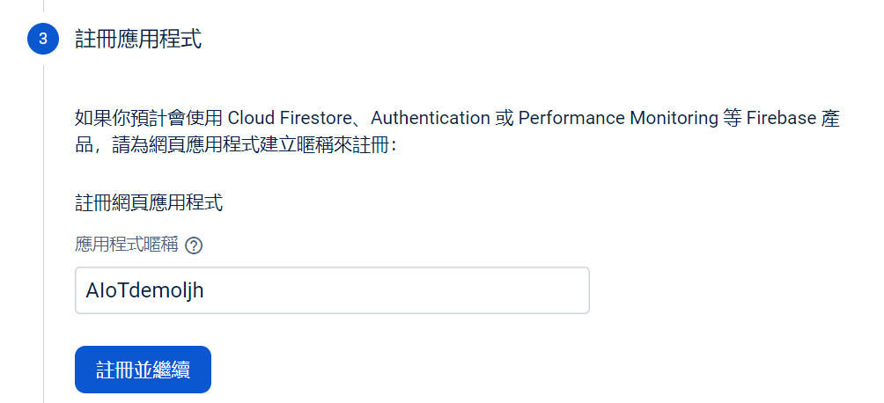
Set up Firebase Hosting
Web App

Slide 7
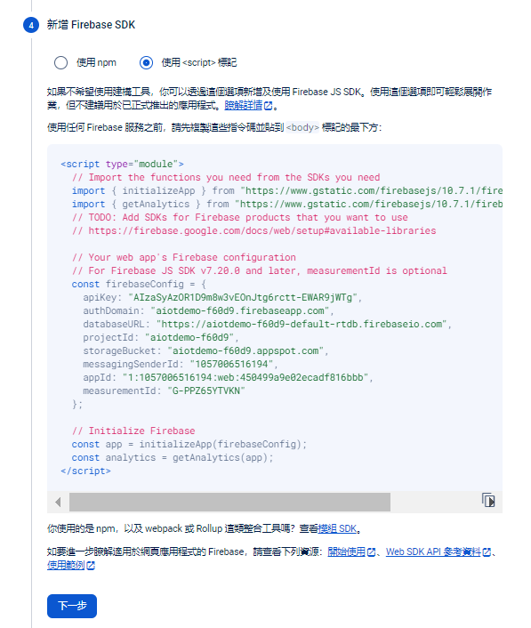
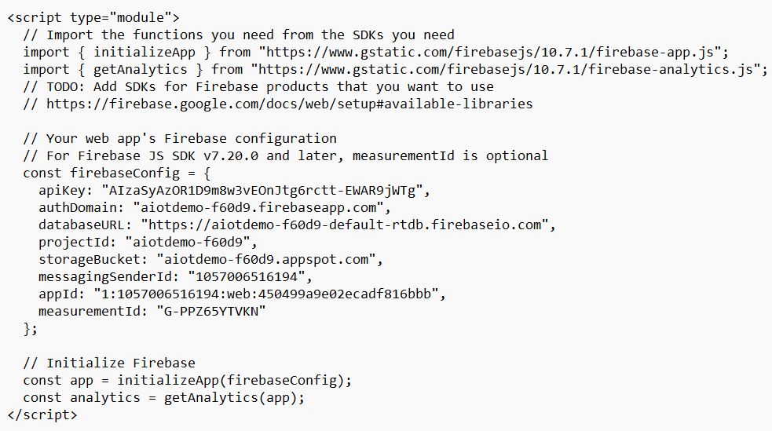
2. Paste
1. Copy
3

Slide 8

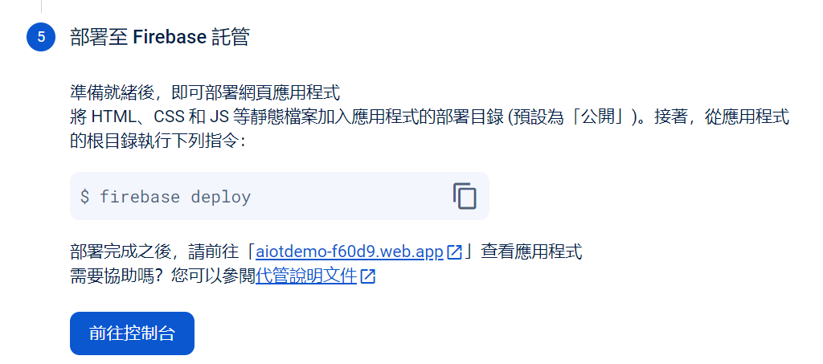
2. Paste
1. Copy
3

Slide 9
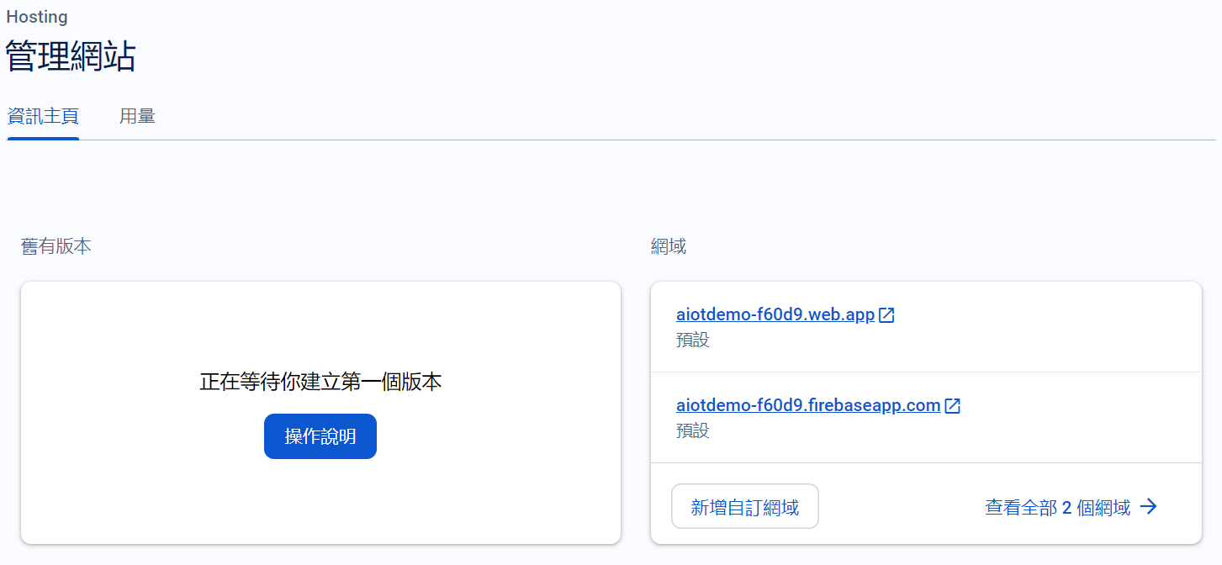
Open the Web App

Slide 10
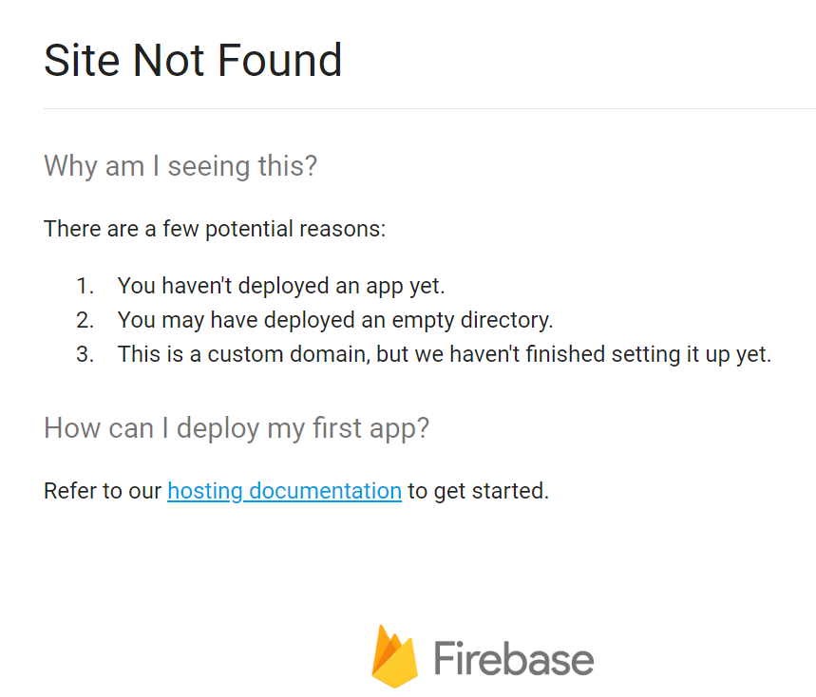
Web App

Slide 11
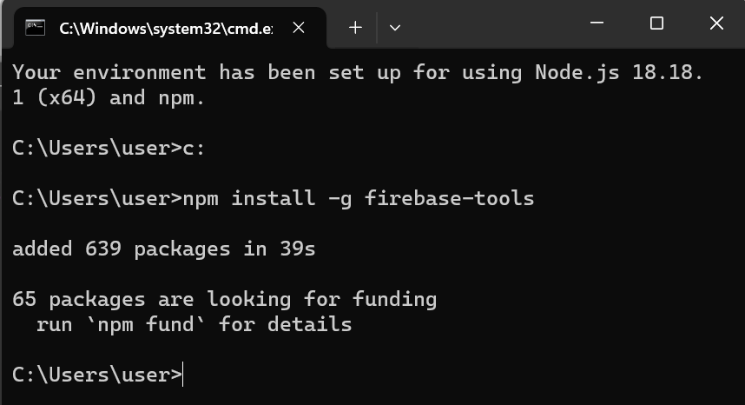
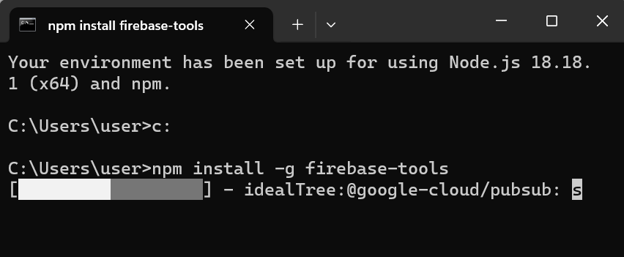
Node.js command
2. Install finished
1. npm install -g firebase-tools

Slide 12
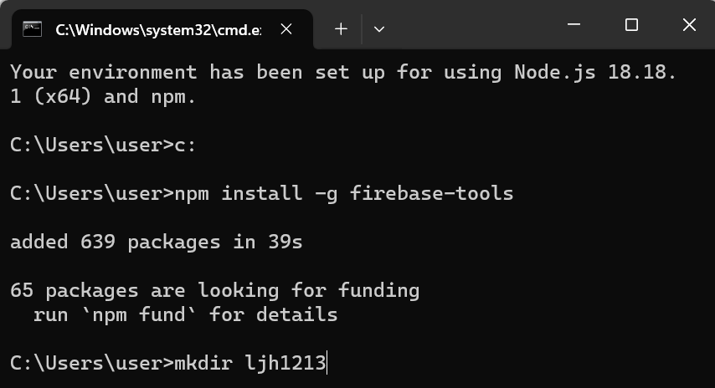
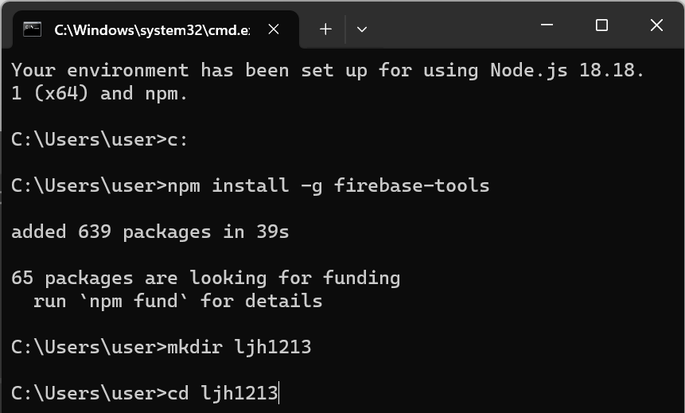
Node.js command
3. Use “mkdir” to new a folder
4. Use “cd” to go to the folder

Slide 13
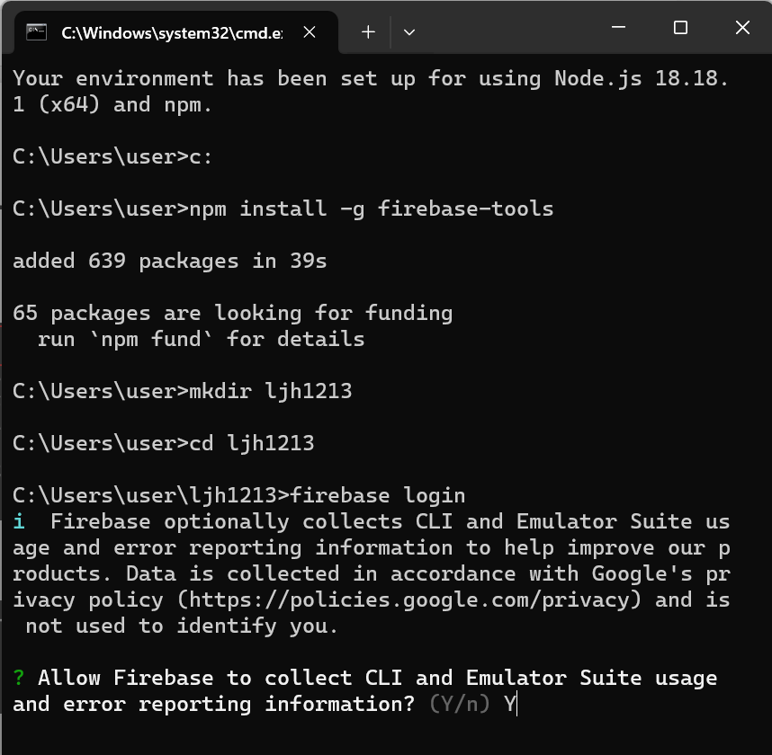
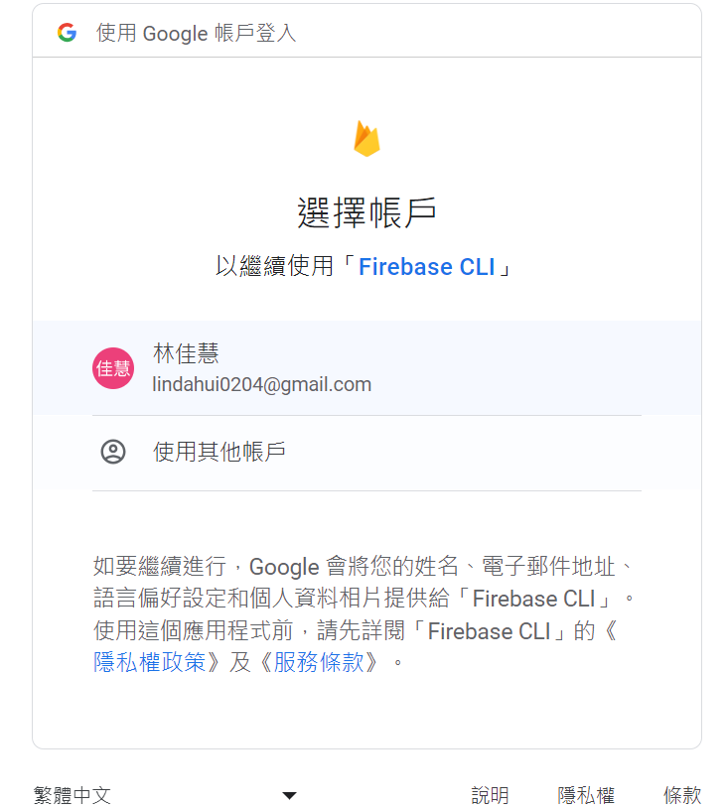
Node.js command
5. Firebase login

Slide 14
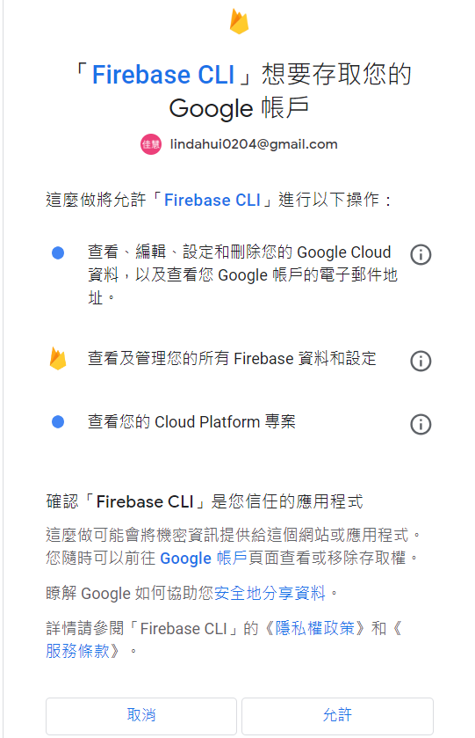
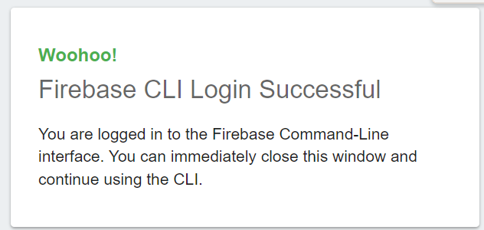

Slide 15
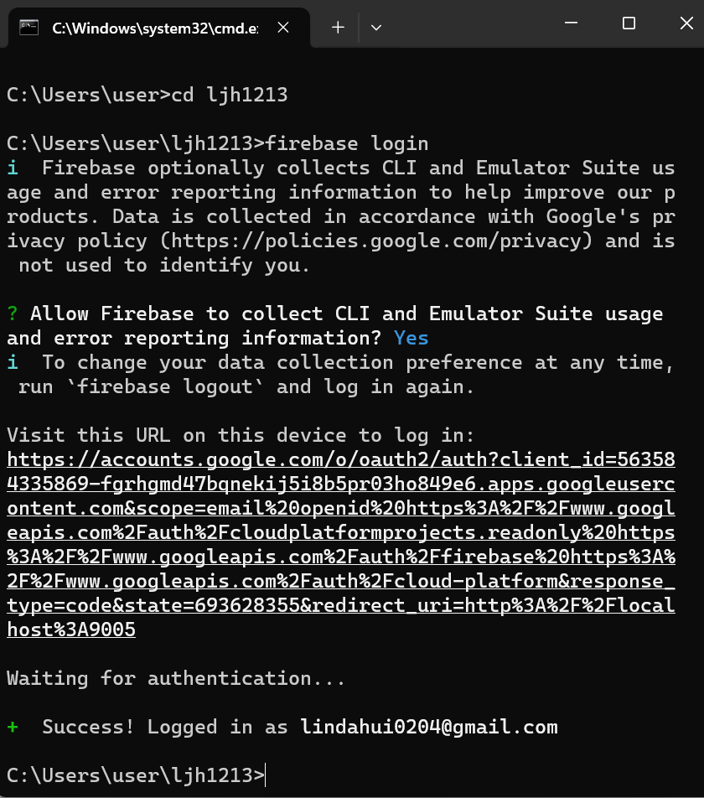
Success log in

Slide 16
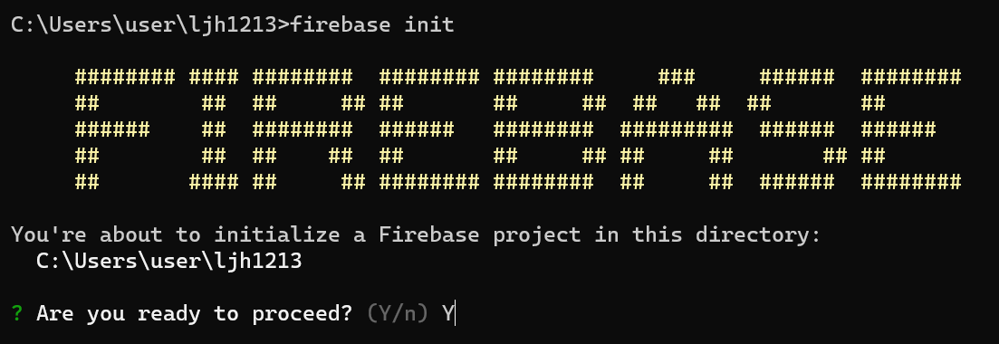
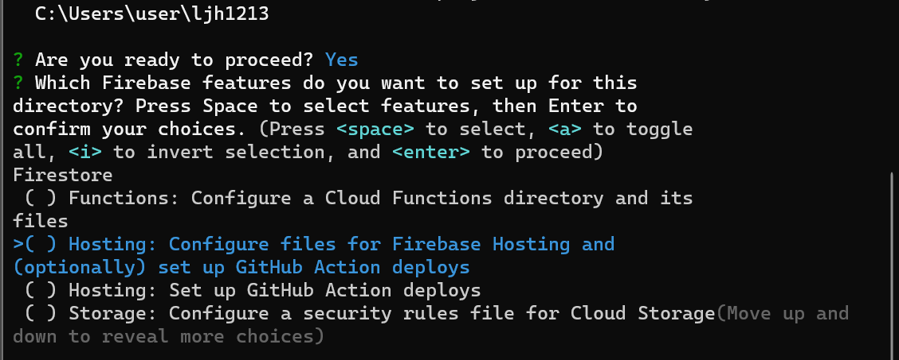
Firebase init
enter
Up and down keyboads

Slide 17
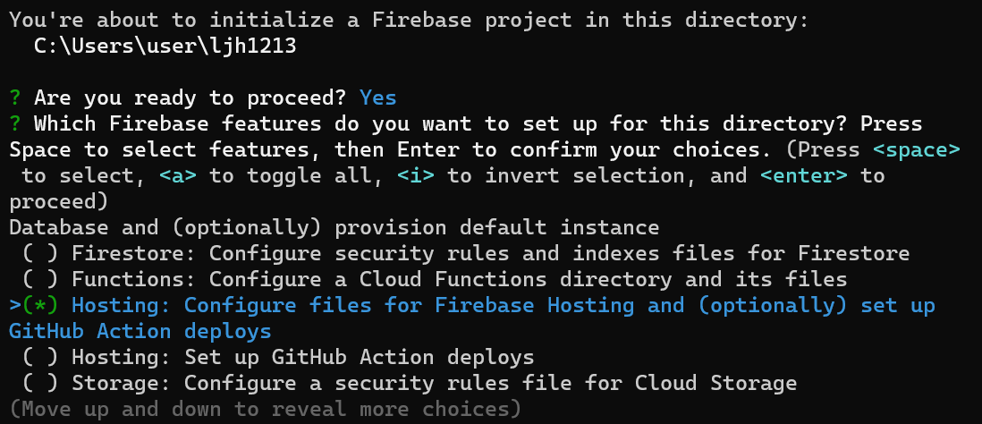
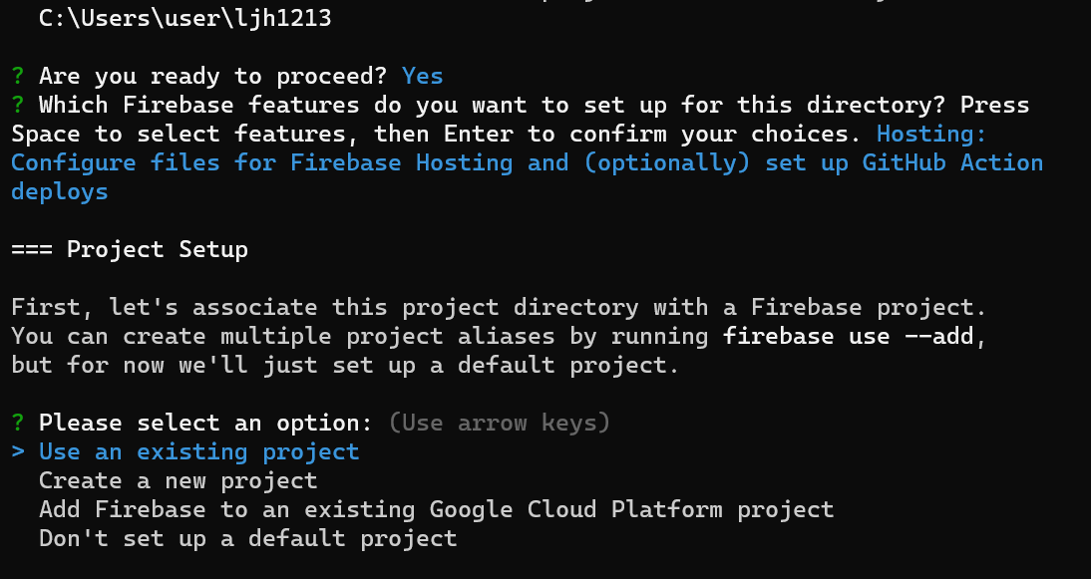
1. “space” keyboard
2. “enter” keyboard
enter

Slide 18
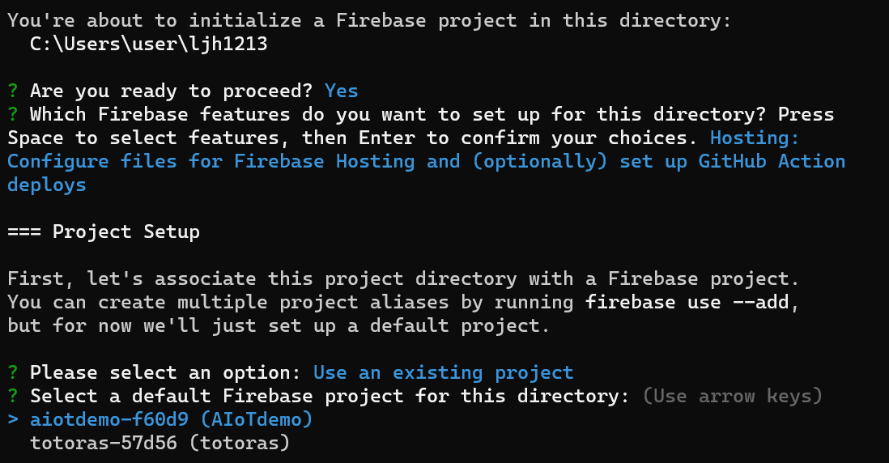
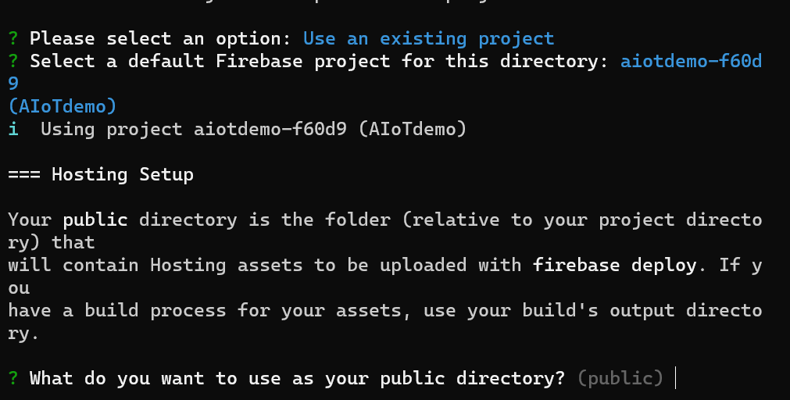
enter
enter

Slide 19
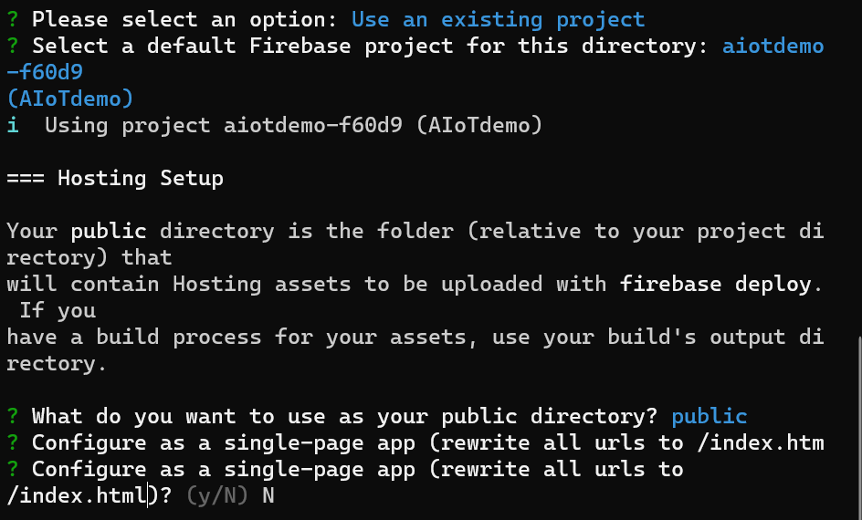
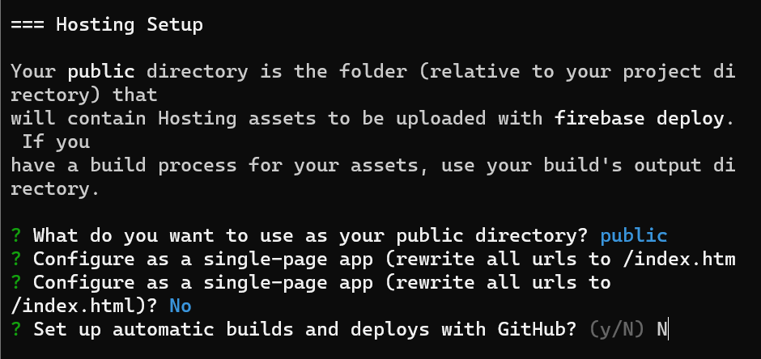
enter
enter

Slide 20
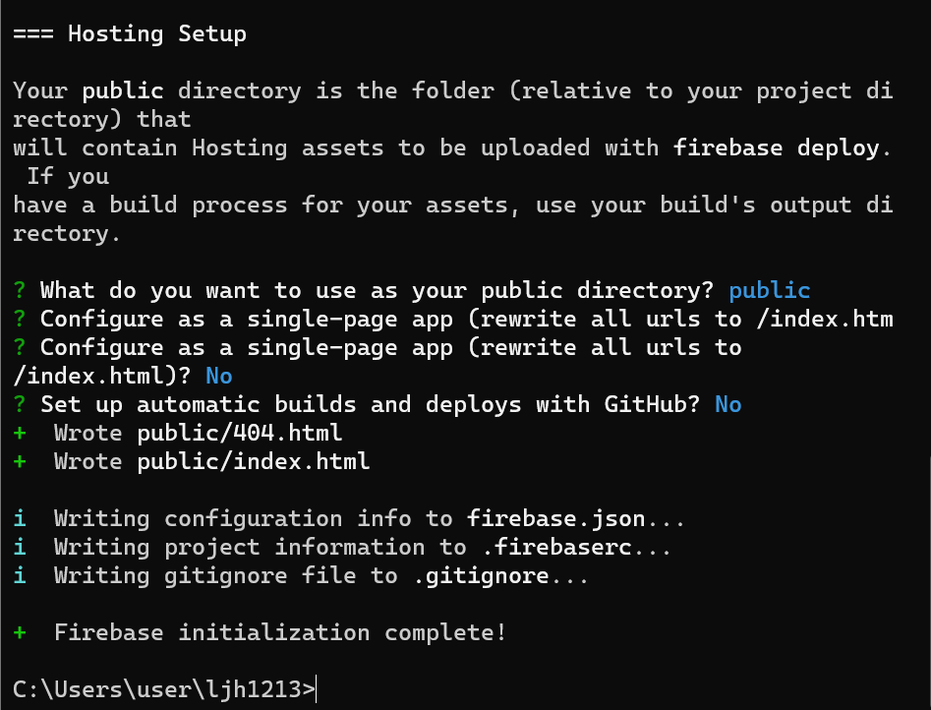

Slide 21
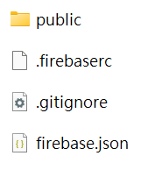

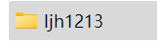
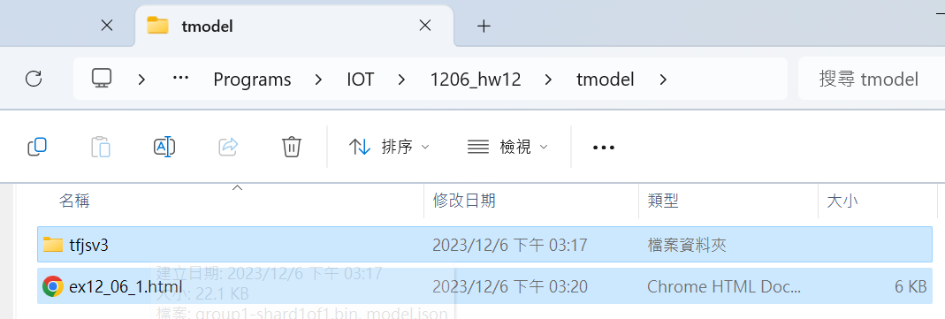
1. C:\Users\user\ljh1213
2. C:\Programs\IOT\1206_hw12\tmodel
1. Copy

Slide 22
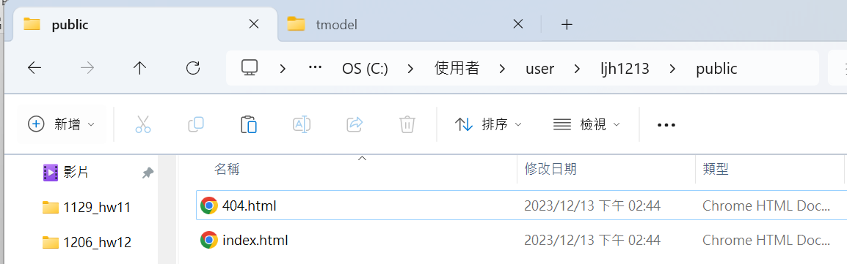
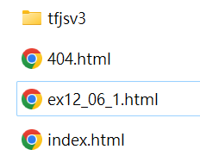
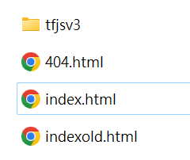
3. Paste to the C:\Users\user\ljh1213\public
Paste
4. Rename files

Slide 23
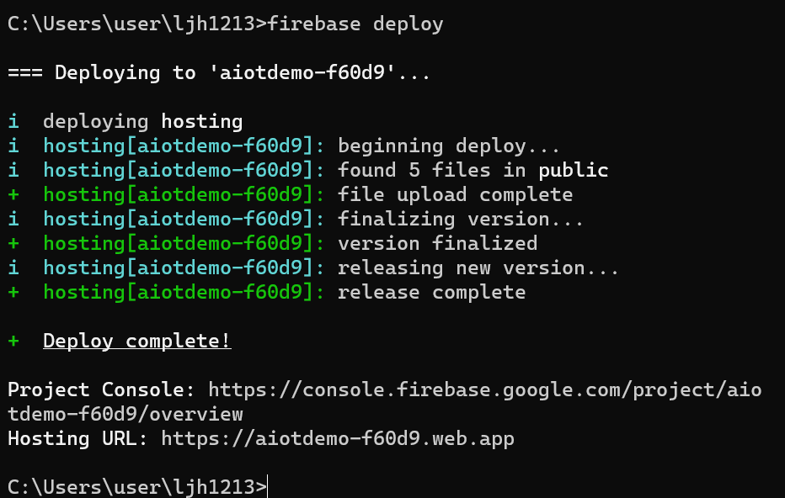
Firebase deploy
Deploy complete

Slide 24
Open Web App

Slide 25
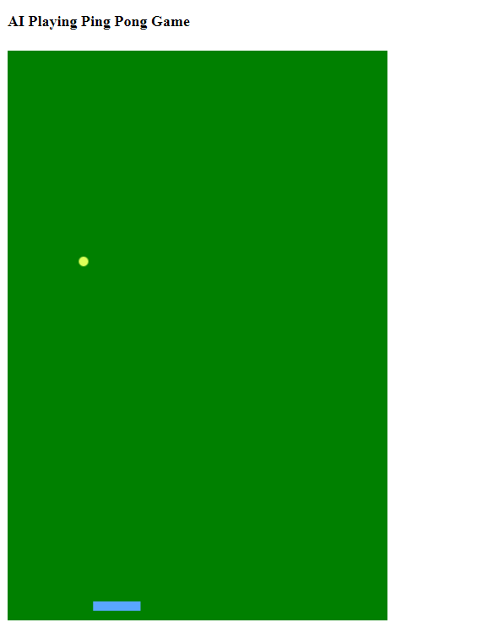
Result
https://aiotdemo-f60d9.web.app/

