Slide 1
物聯網實務 HW14
電機碩一 11278008 林佳慧
日期:2023/12/20

Slide 2
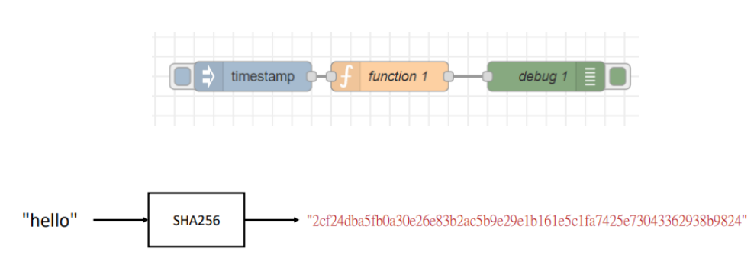
Exercise 14-1

Slide 3
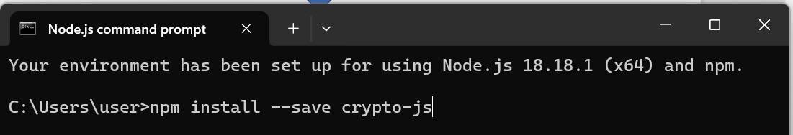
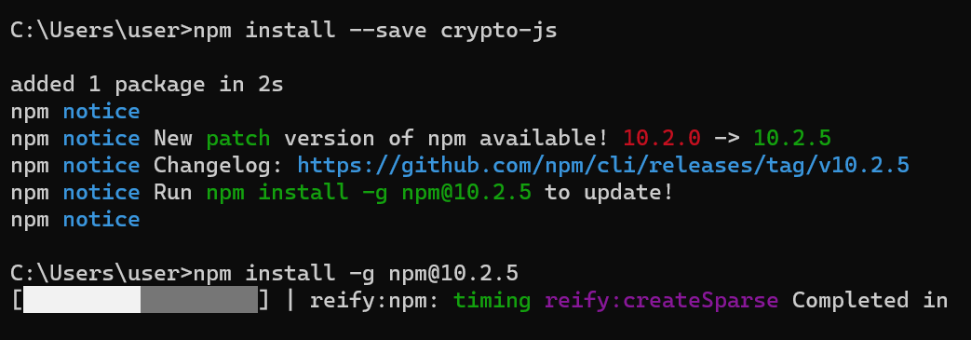
Install crypto-js
npm install –save crypto-js
Use “npm install –g npm@10.2.5 “ to update

Slide 4
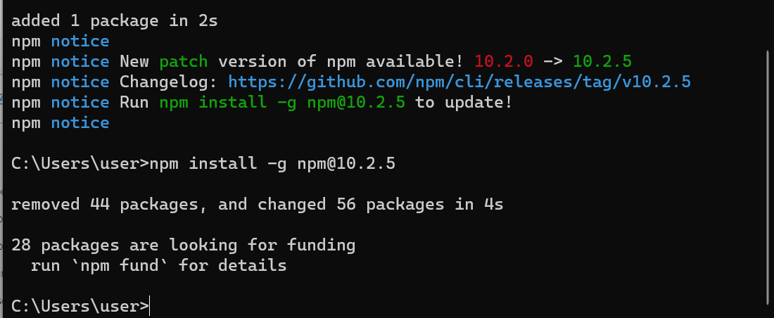
Done

Slide 5
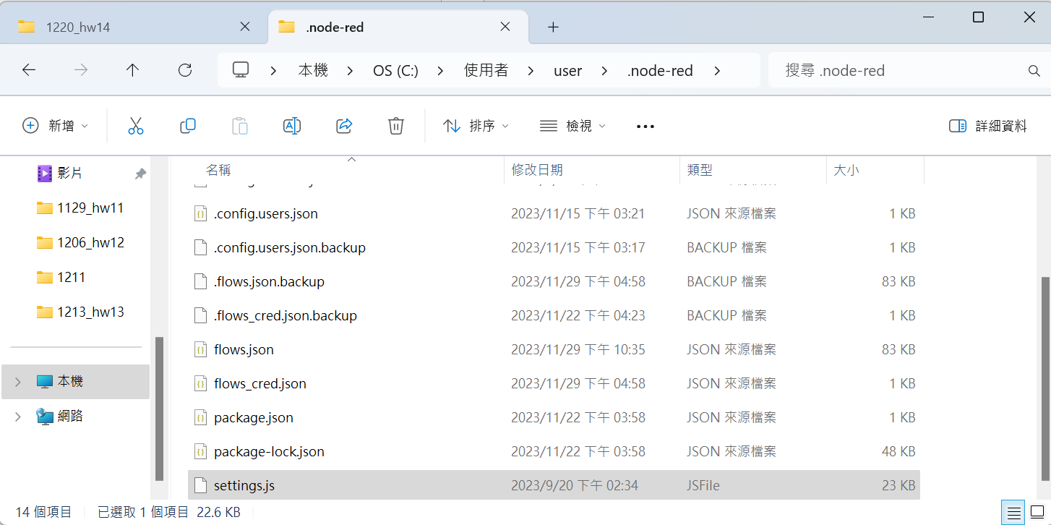
Edit settings.js

Slide 6
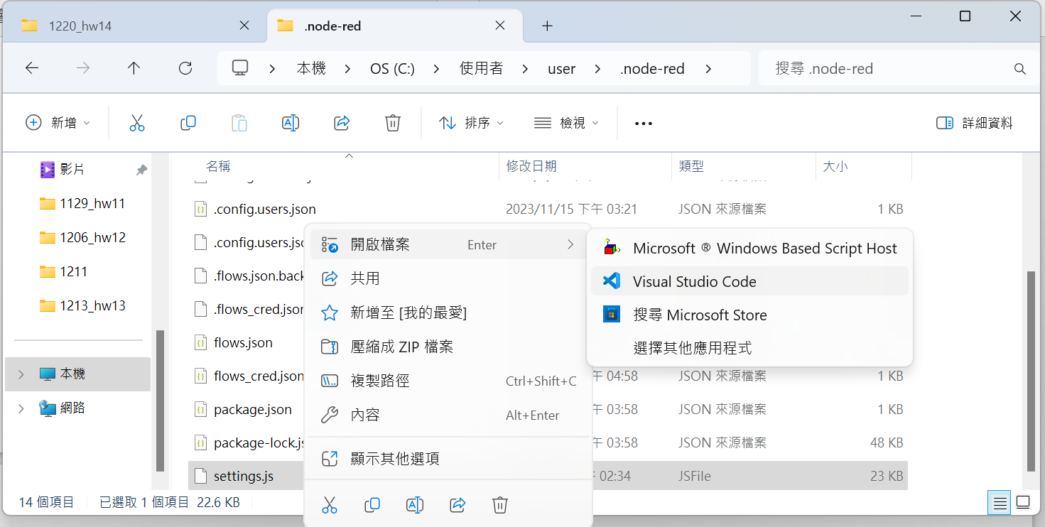
Edit settings.js
C:\Users\user\.node-red

Slide 7
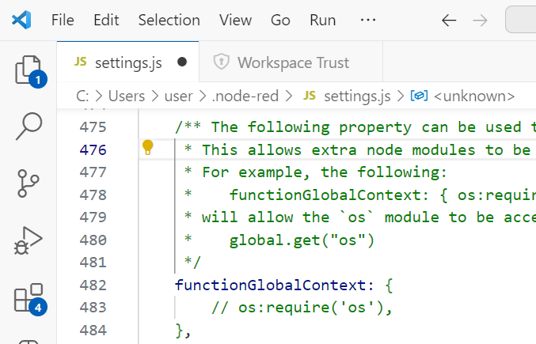
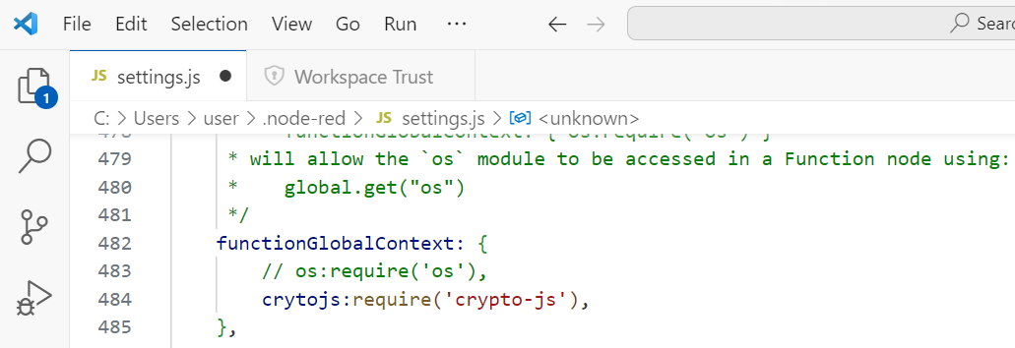
Edit settings.js
add
Save

Slide 8
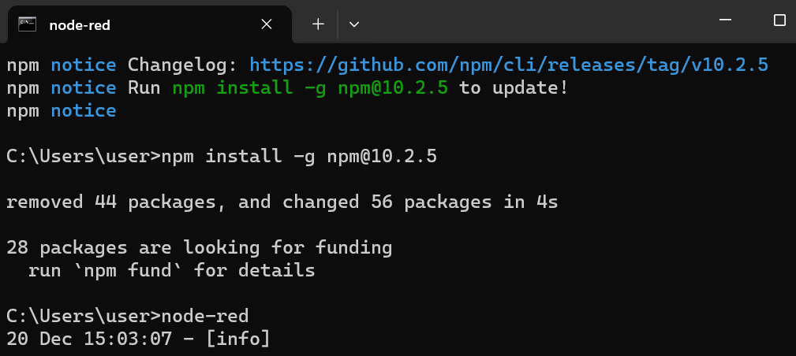
Run node-red

Slide 9
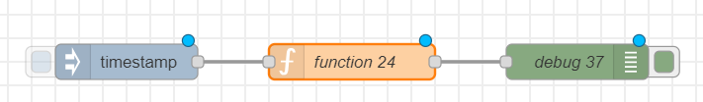
Build a Flow
var cryptojs = context.global.cryptojs;
var Hash = cryptojs.SHA256("hello");
msg.payload=Hash;
return msg;

Slide 10
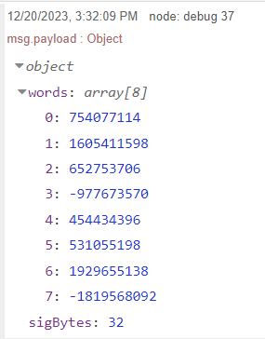
Trigger
click

Slide 11
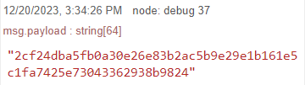
JavaScript Object toString()
click
var cryptojs = context.global.cryptojs;
var Hash = cryptojs.SHA256("hello");
msg.payload=Hash.toString();
return msg;

Slide 12
JavaScript Object toString()
Hash
Hash.toString();

Slide 13
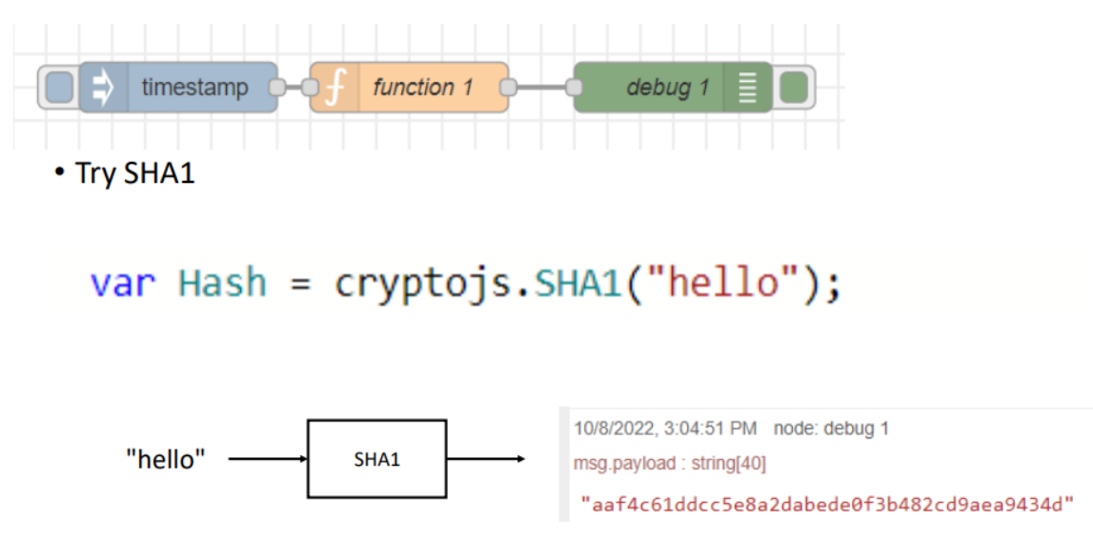
Homework 14-1

Slide 14
var Hash = cryptojs.SHA1("hello");
var cryptojs = context.global.cryptojs;
var Hash = cryptojs.SHA1("hello");
msg.payload=Hash.toString();
return msg;

Slide 15
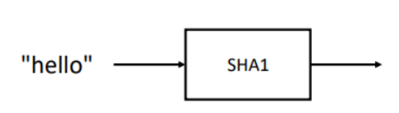


Slide 16
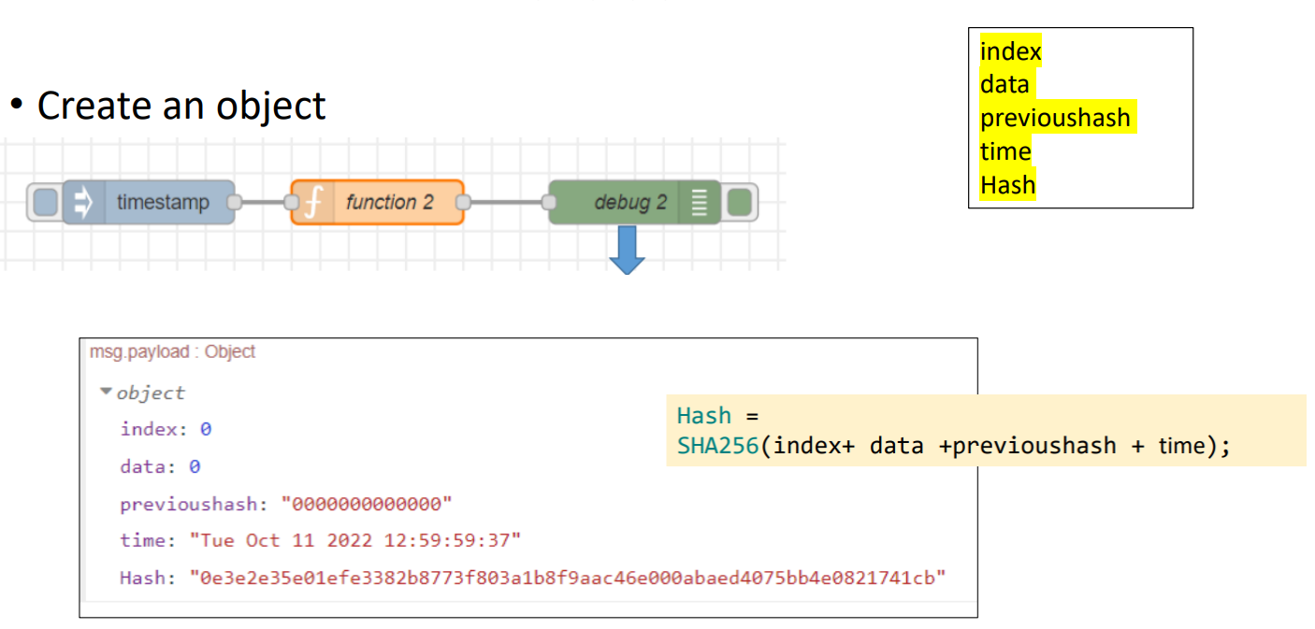
Exercise 14-2

Slide 17
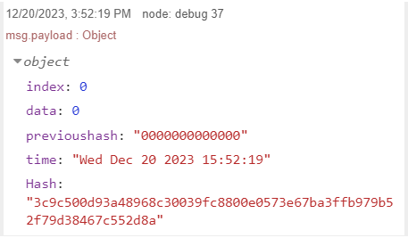
click
var cryptojs = context.global.cryptojs;
let data =0;
let previoushash="0000000000000";
const d = new Date();
var timestamp = d.getTime();
var time = d.toDateString()+" " + d.getHours()+":" + d.getMinutes()+":" + d.getSeconds();
var index = 0;
msg.url="";
var Hash = cryptojs.SHA256(previoushash + index + data + time);
msg.payload= {"index":index, "data":data, "previoushash":previoushash,"time":time, "Hash": Hash.toString()};
return msg;

Slide 18
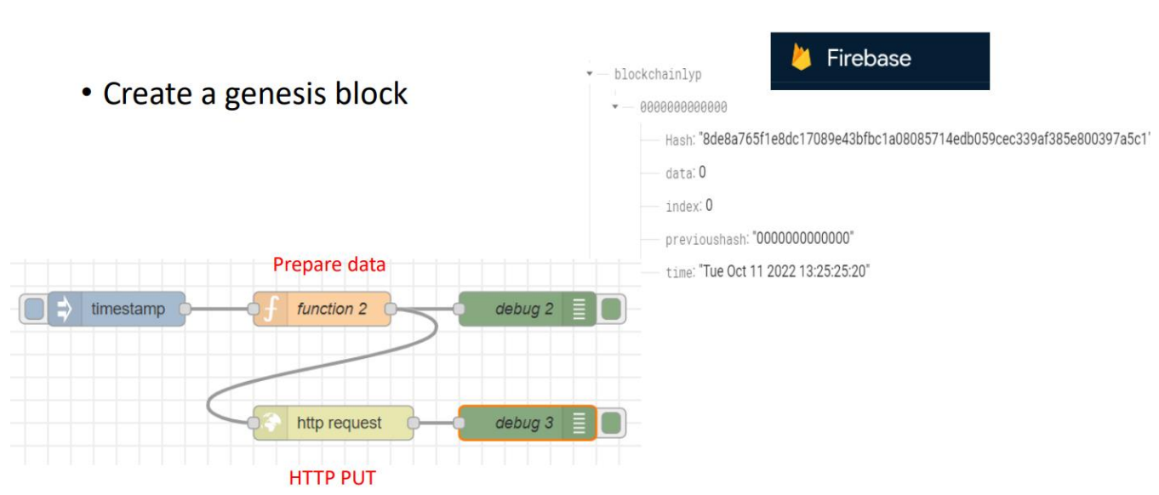
Exercise 14-3

Slide 19
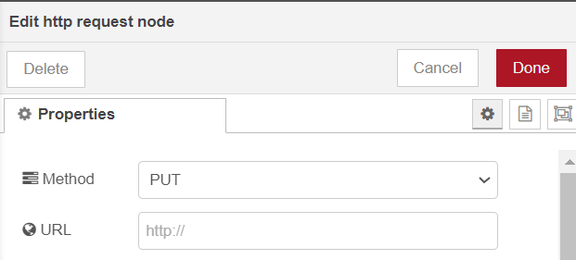
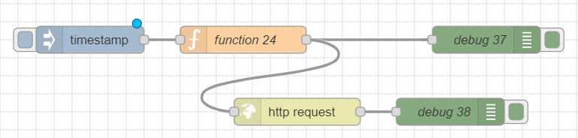
var cryptojs = context.global.cryptojs;
let data =0;
let previoushash="0000000000000";
const d = new Date();
var timestamp = d.getTime();
var time = d.toDateString()+" " + d.getHours()+":" + d.getMinutes()+":" + d.getSeconds();
var index = 0;
msg.url="https://xxxxxx-default-rtdb.firebaseio.com/" + "blockchainljh/" + "0000000000000" + ".json";
var Hash = cryptojs.SHA256(previoushash + index + data + time);
msg.payload= {"index":index, "data":data, "previoushash":previoushash,"time":time, "Hash": Hash.toString()};
return msg;

Slide 20
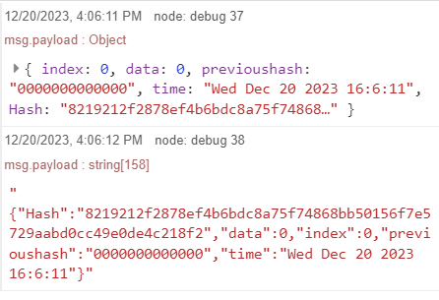

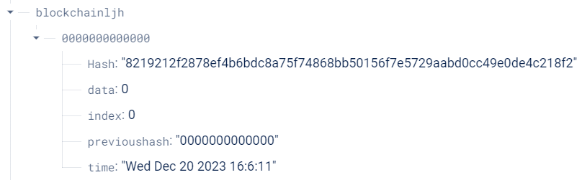
Check new data

Slide 21
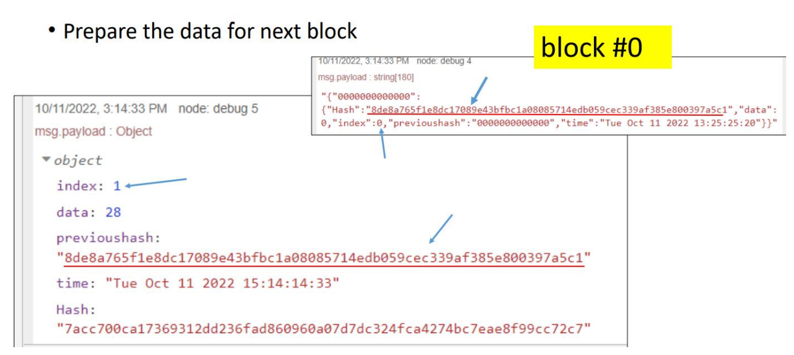
Exercise 14-4

Slide 22
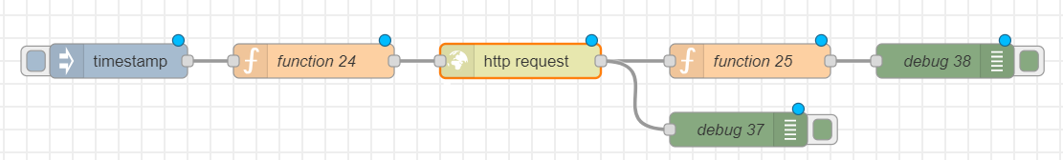
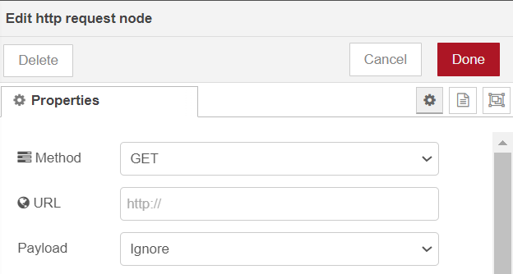
Set URL
HTTP GET
msg.url="https://aiotdemo-f60d9-default-rtdb.firebaseio.com/" + "blockchainljh.json";
return msg;

Slide 23
var revstr=msg.payload;
var obj=JSON.parse(revstr);
var revvalues=Object.values(obj);
var len = revvalues.length;
var lastvalue = revvalues[len - 1];
var previoushash = lastvalue.Hash;
var cryptojs = context.global.cryptojs;
let data = Math.round((Math.random()*100));
const d = new Date();
var timestamp = d.getTime();
var time = d.toDateString()+" " + d.getHours()+":" + d.getMinutes()+":" + d.getSeconds();
var index = len;
msg.url="https://xxxxxxx-default-rtdb.firebaseio.com/" + "blockchainljh/" + timestamp + ".json";
var Hash = cryptojs.SHA256(previoushash + index + data + time);
msg.payload= {"index":index, "data":data, "previoushash":previoushash,"time":time, "Hash": Hash.toString()};
return msg;

Slide 24
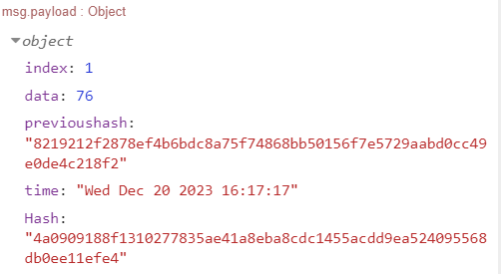
click

Slide 25
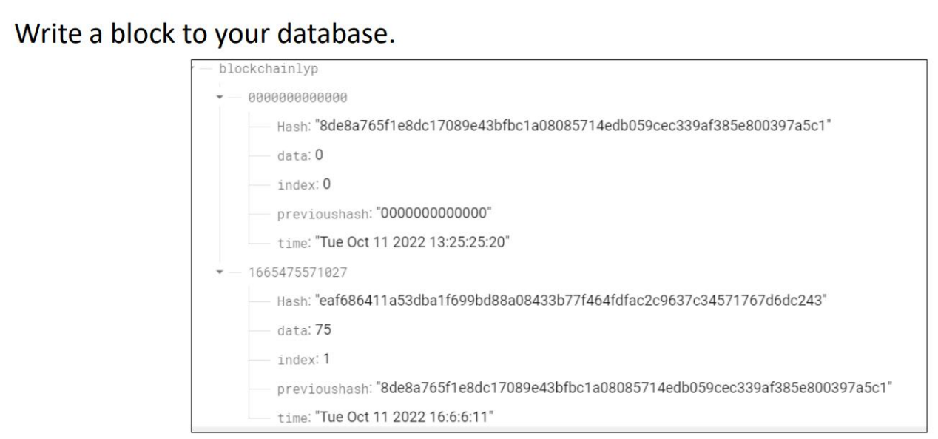
Exercise 14-5

Slide 26

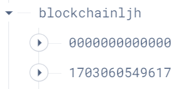
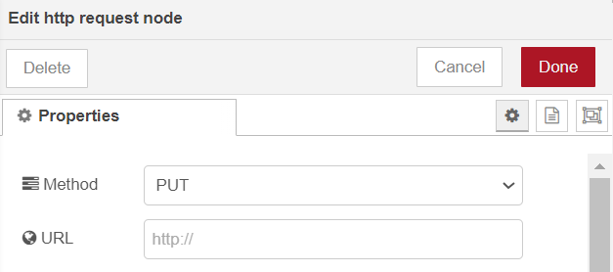
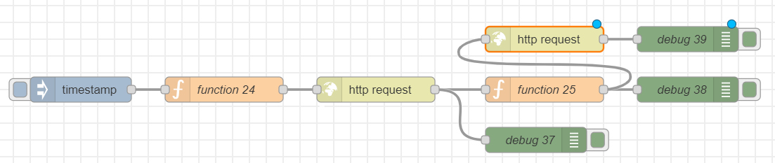
HTTP PUT
Set URL
HTTP GET

Slide 27
click

Slide 28
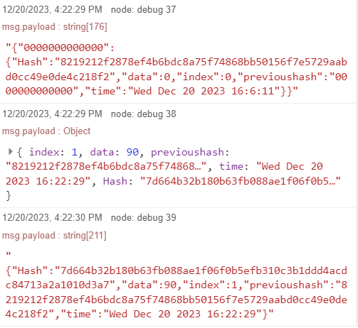
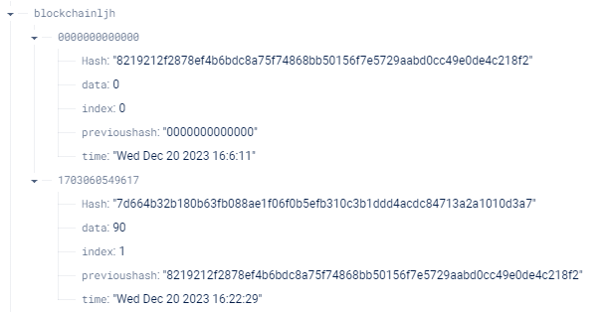
New data

Slide 29
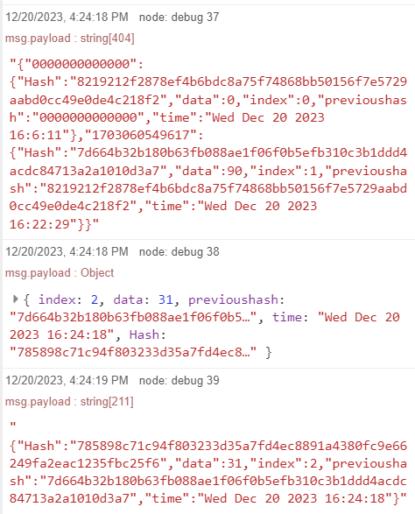
click

Slide 30
