Slide 1
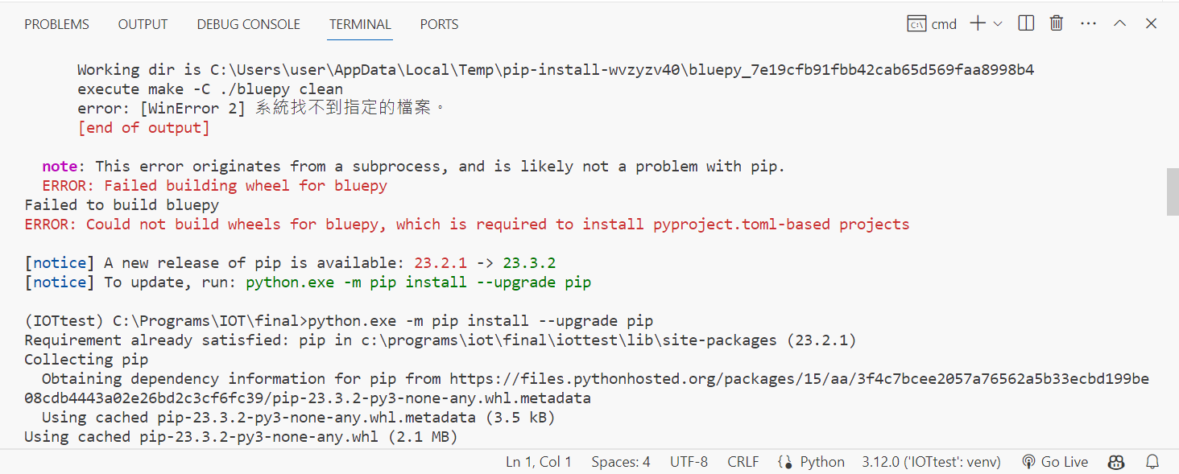

Slide 2
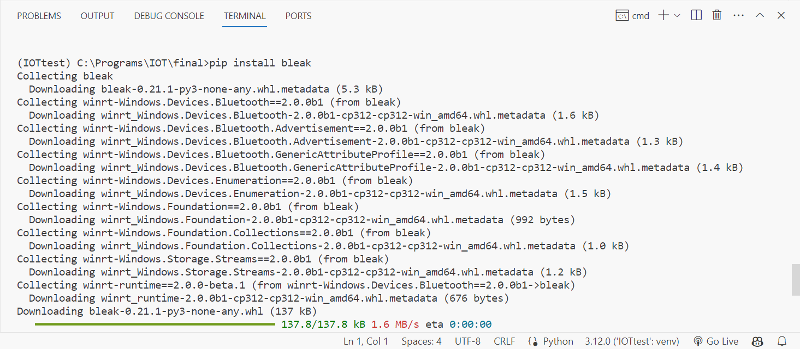
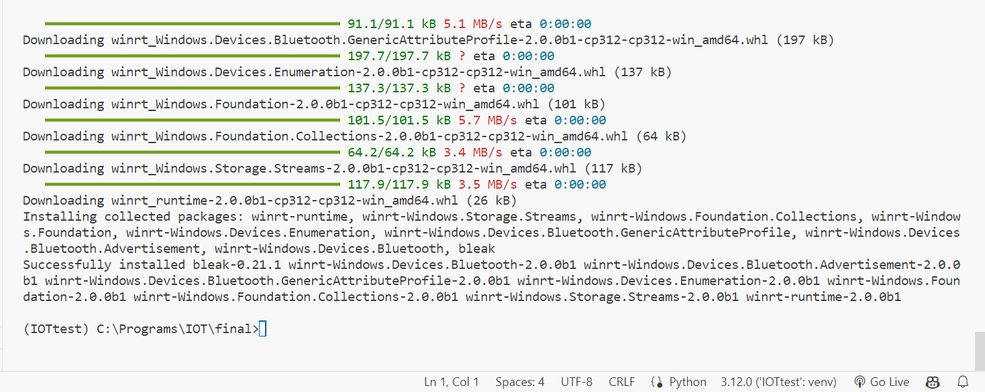

Slide 3
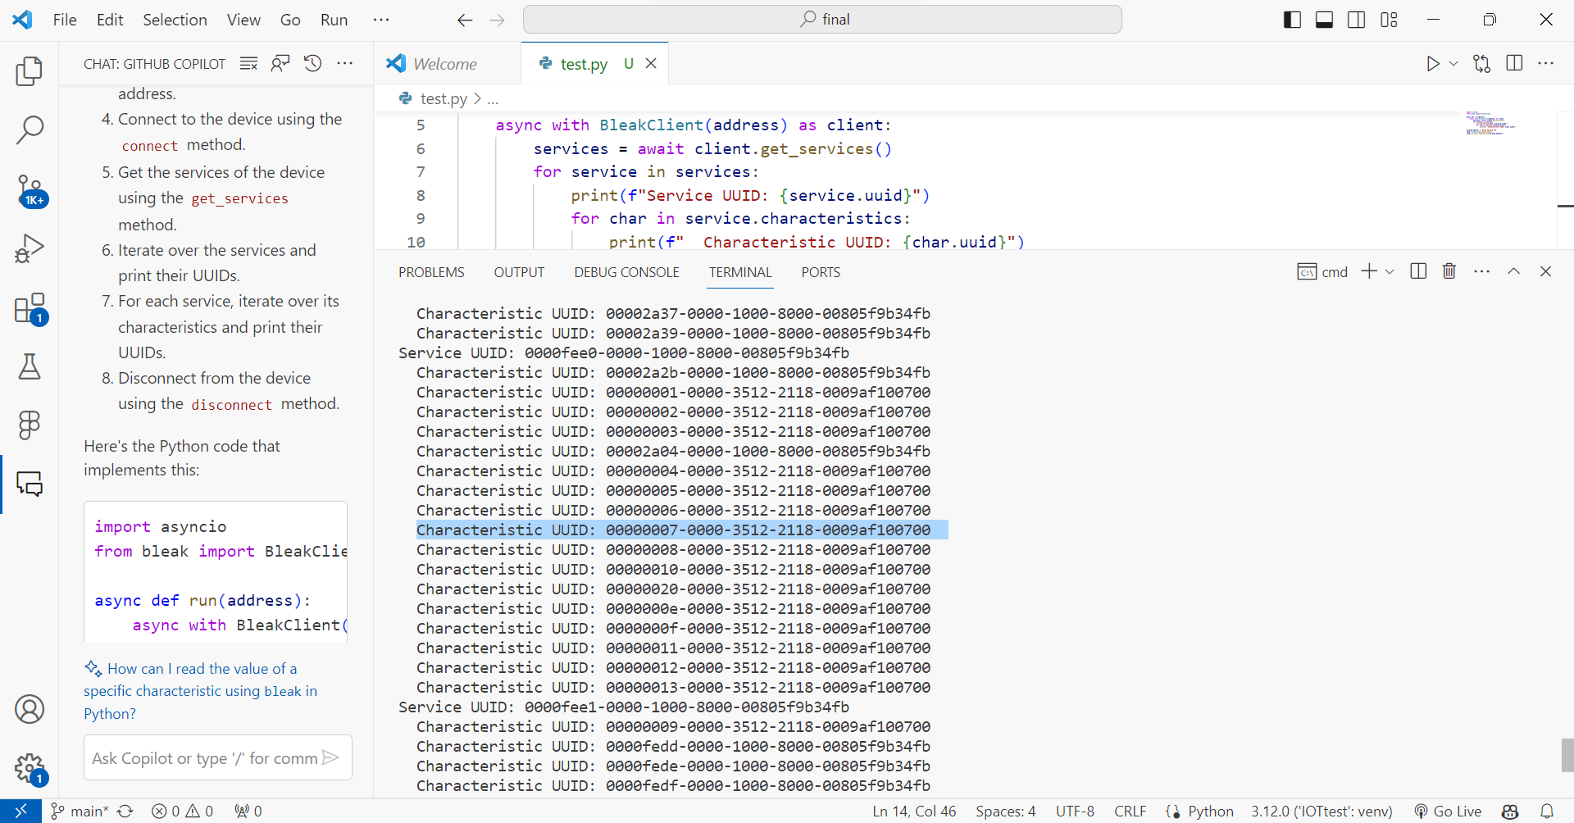
import asyncio
from bleak import BleakClient
async def run(address):
async with BleakClient(address) as client:
services = await client.get_services()
for service in services:
print(f"Service UUID: {service.uuid}")
for char in service.characteristics:
print(f" Characteristic UUID: {char.uuid}")
mi_band_address = 'D0:4E:AD:C0:AF:7D'
loop = asyncio.get_event_loop()
loop.run_until_complete(run(mi_band_address))

Slide 4
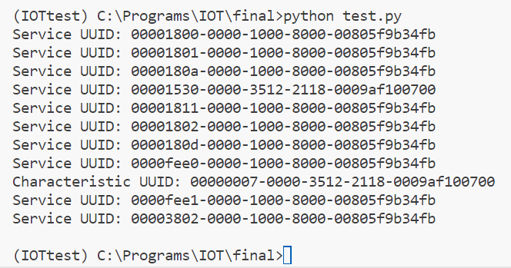
import asyncio
from bleak import BleakClient
async def run(address):
async with BleakClient(address) as client:
services = client.services
for service in services:
print(f"Service UUID: {service.uuid}")
for char in service.characteristics:
if str(char.uuid) == "00000007-0000-3512-2118-0009af100700":
print(f"Characteristic UUID: {char.uuid}")
mi_band_address = 'D0:4E:AD:C0:AF:7D'
asyncio.run(run(mi_band_address))

Slide 5
import asyncio
from bleak import BleakClient
async def run(address):
async with BleakClient(address) as client:
services = client.services
for service in services:
for char in service.characteristics:
if str(char.uuid) == "00000007-0000-3512-2118-0009af100700":
print(f"Attributes of characteristic {char.uuid}:")
descriptors = char.descriptors
for descriptor in descriptors:
print(descriptor)
# attributes = vars(char)
# for name, value in attributes.items():
# print(f" {name}: {value}")
# data = await client.read_gatt_char(char)
# print(f" Data: {data}")
mi_band_address = 'D0:4E:AD:C0:AF:7D'
asyncio.run(run(mi_band_address))

Slide 6
use python's bleak to crab uuid and characteristic
I just care about "Characteristic UUID: 00000007-0000-3512-2118-0009af100700" this UUID, Can I just print the information for this?

Slide 7
