Slide 1
物聯網實務 HW9
電機碩一 11278008 林佳慧
日期:2023/11/15

Slide 2
Exercise 9-1
Get the weather information form weather API and show them on the debug window in Node-RED

Slide 3
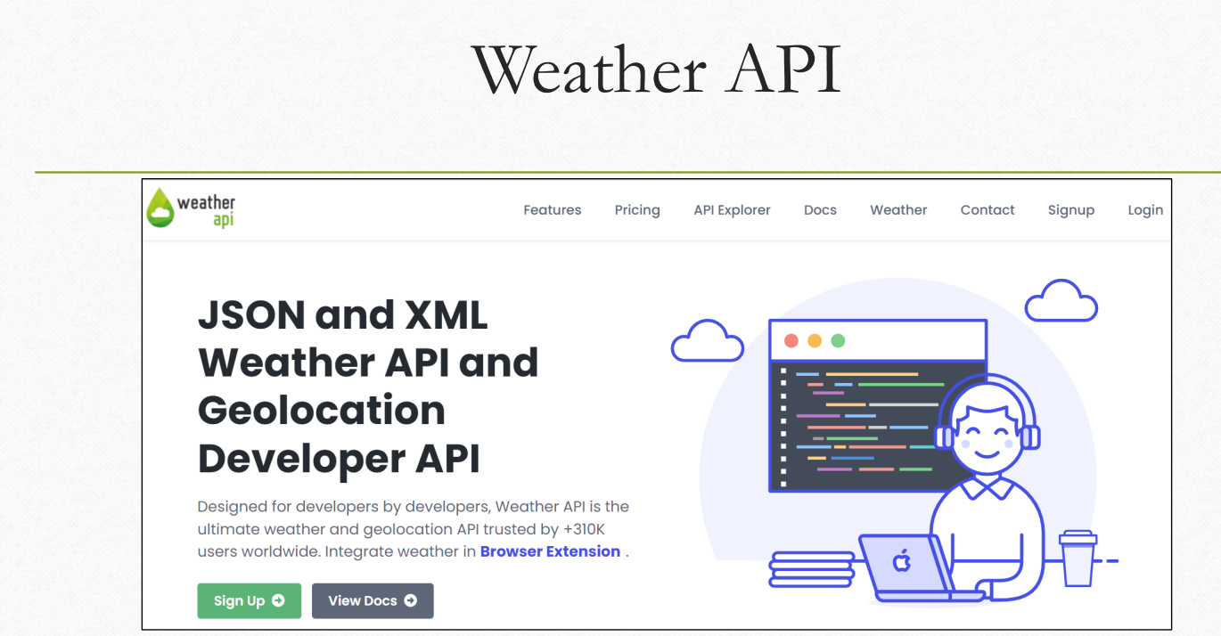
https://www.weatherapi.com/

Slide 4
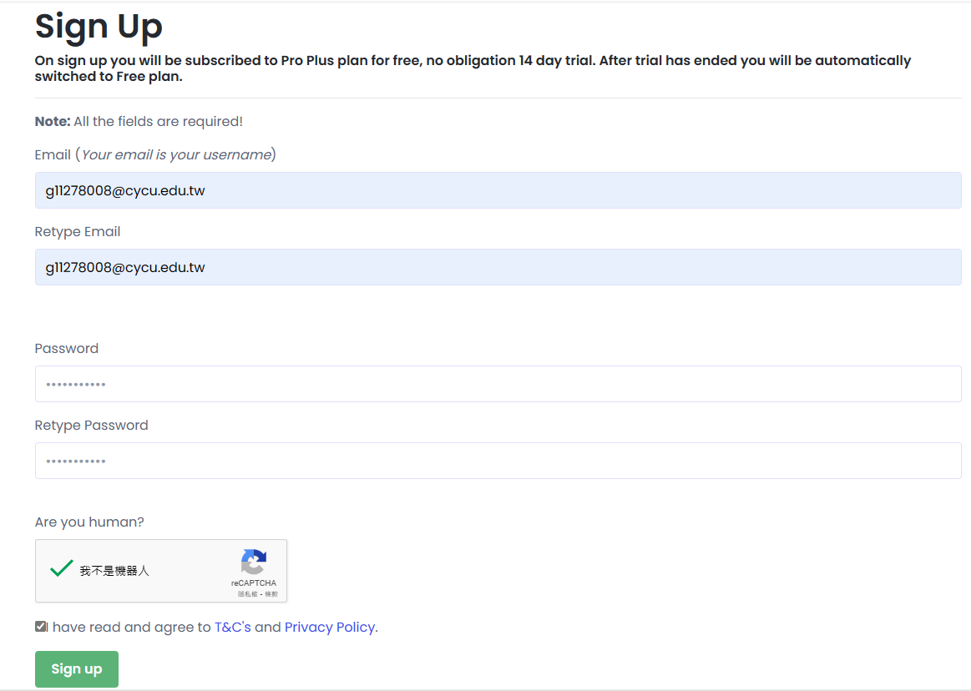
Sign Up

Slide 5
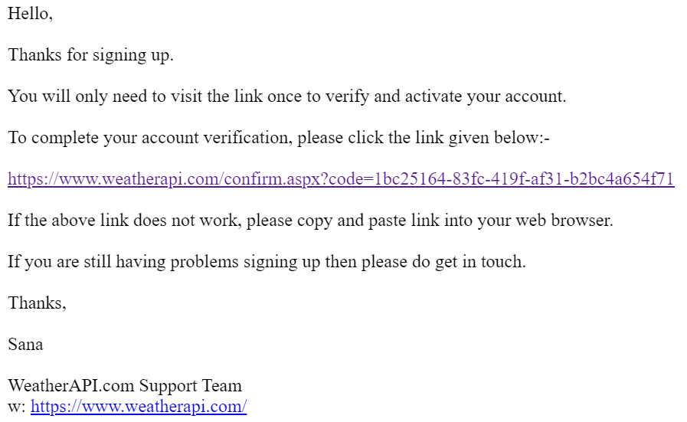
Account verification

Slide 6
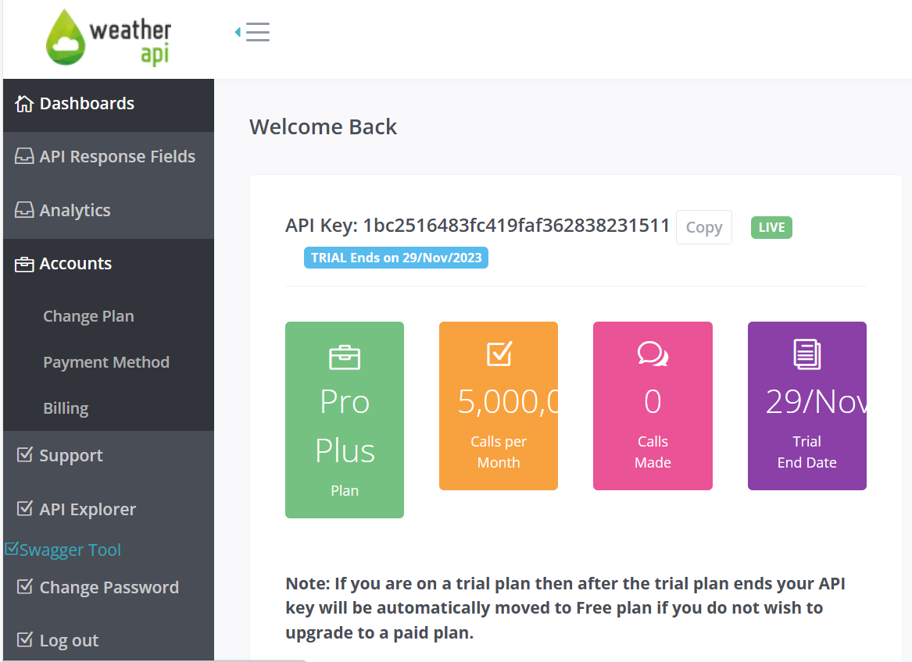

Slide 7
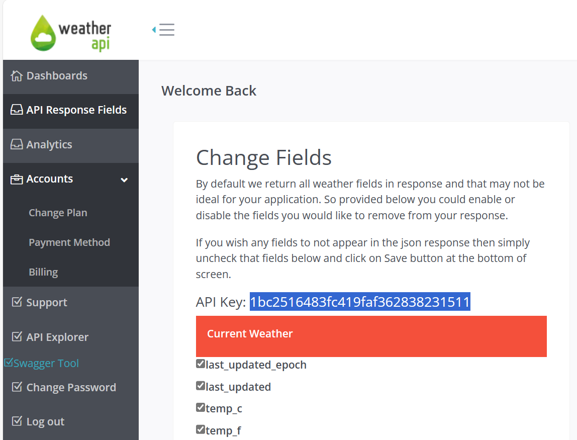
1
2. Copy
3

Slide 8
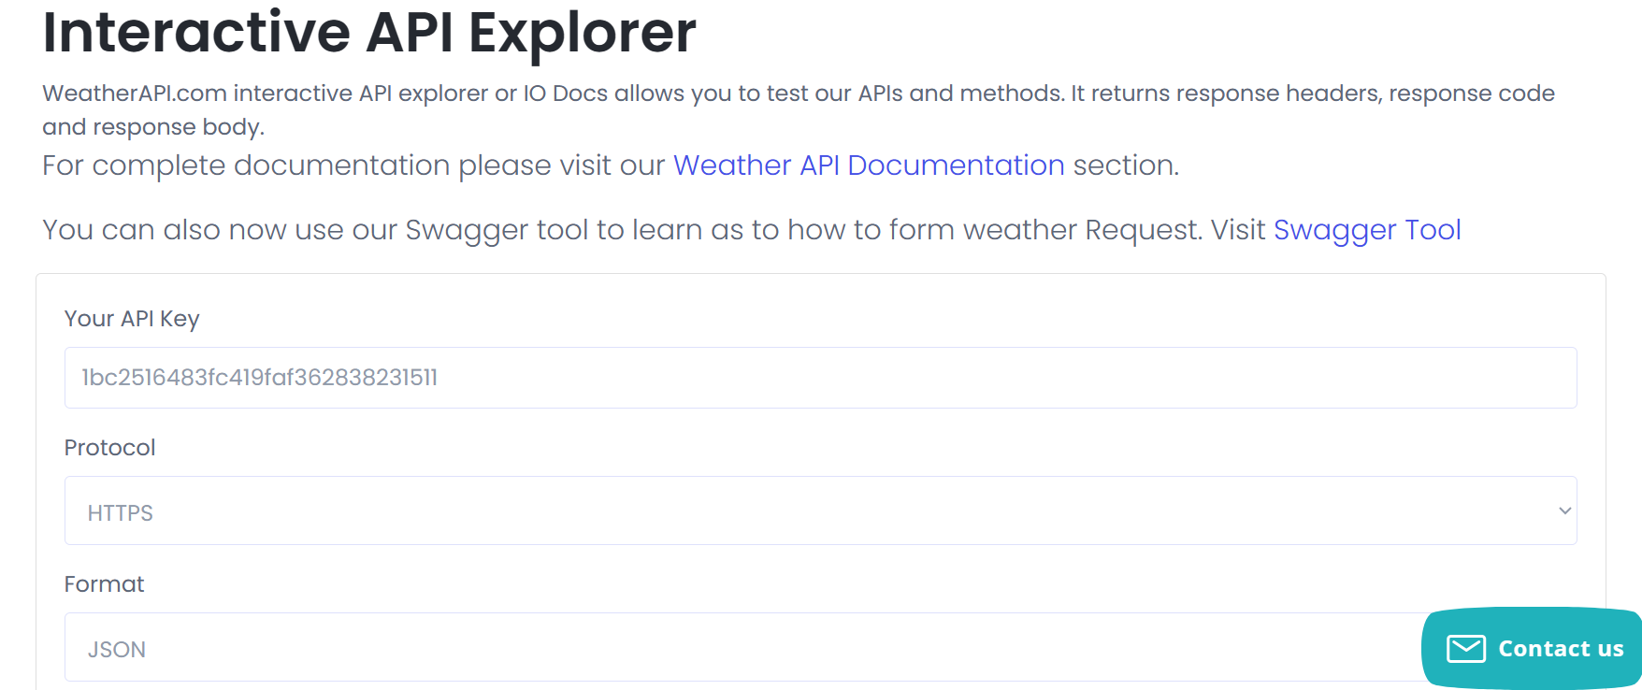
1. Paste
2. HTTPS
3. JSON

Slide 9
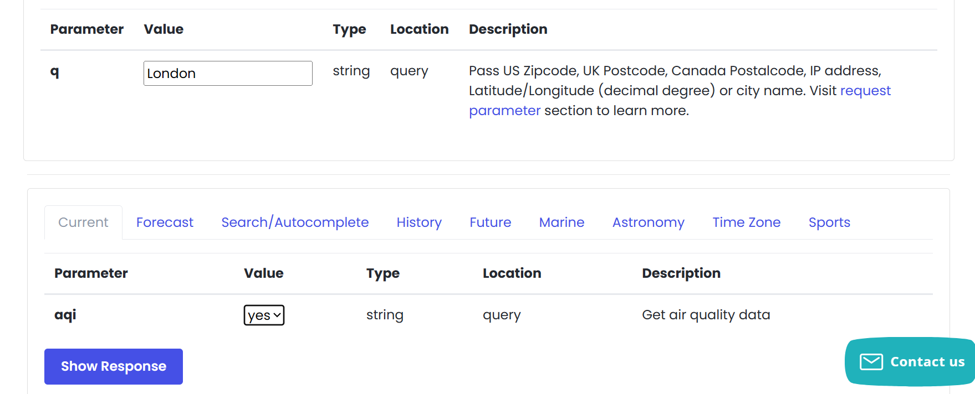
4. London
5. yes
6

Slide 10
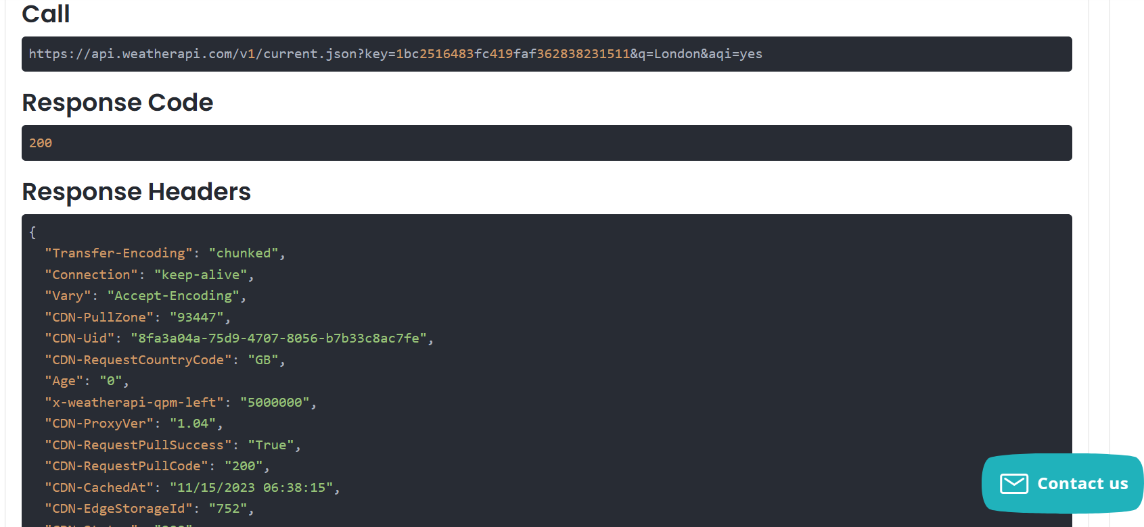
Copy

Slide 11
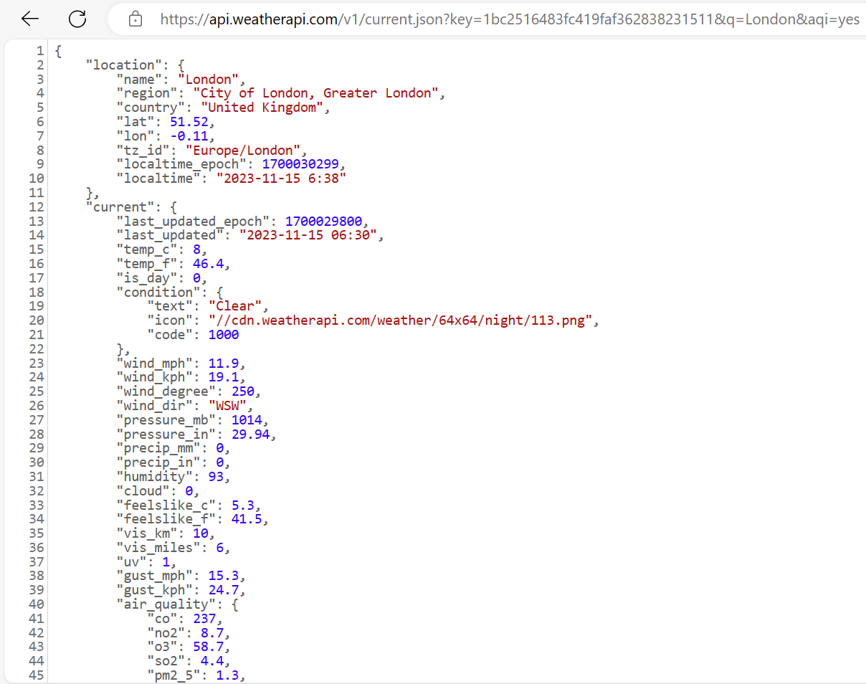
1. Paste
2. Select All & Copy

Slide 12
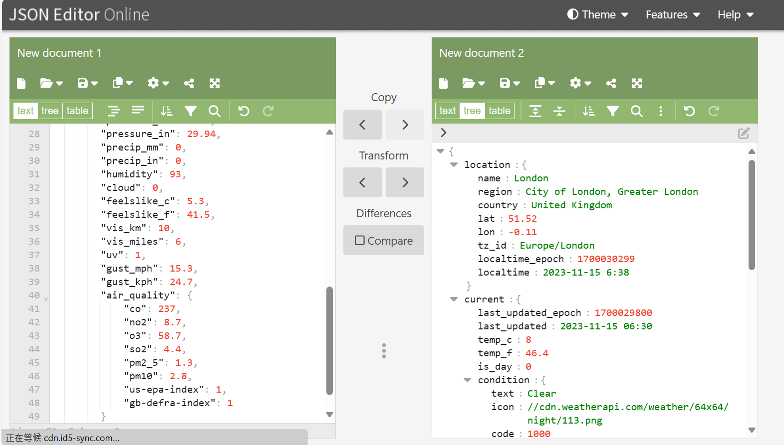
2
1. Paste

Slide 13
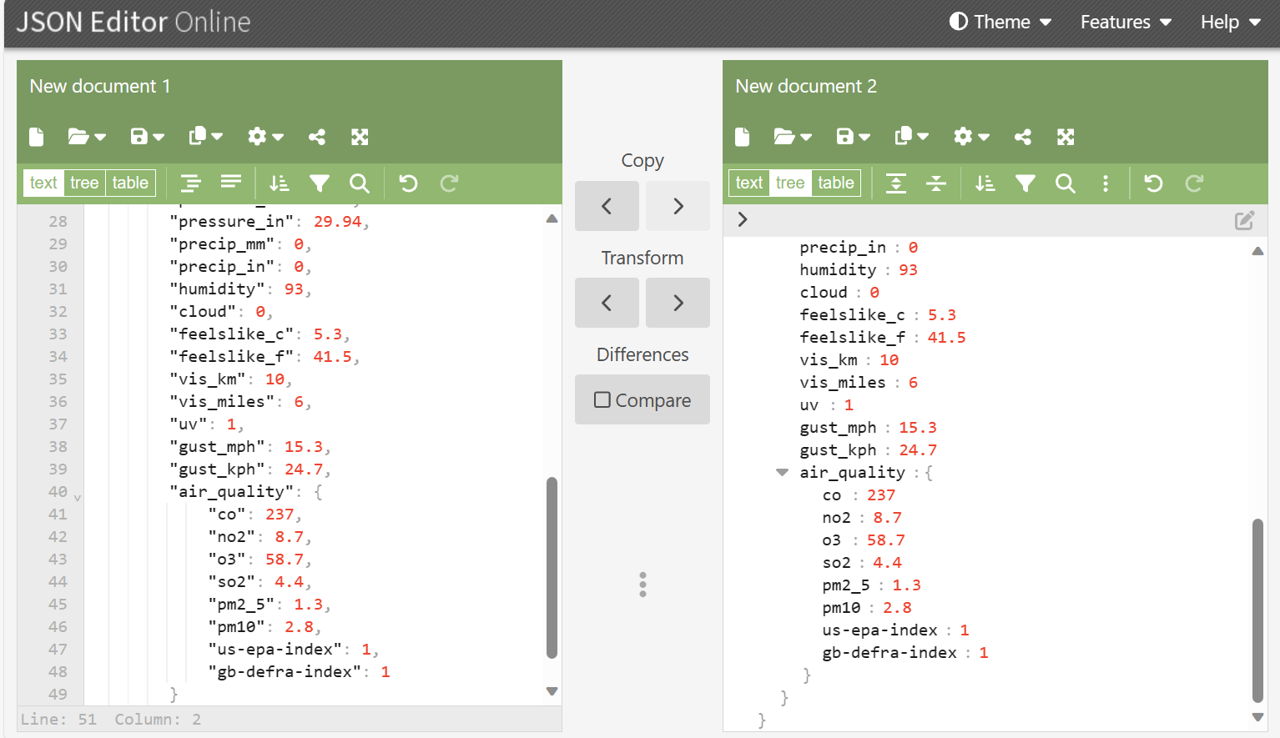

Slide 14
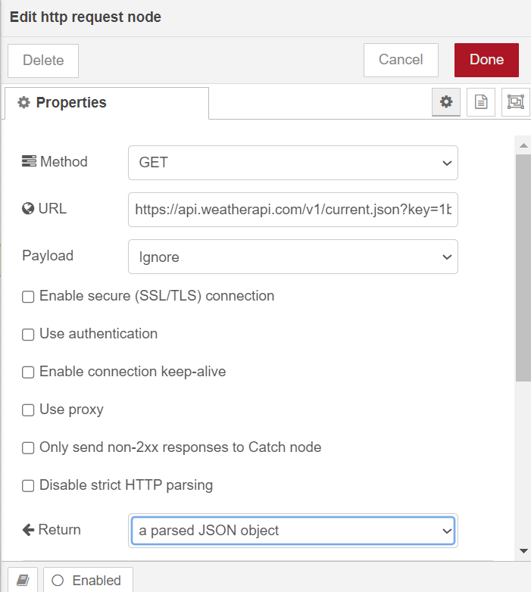
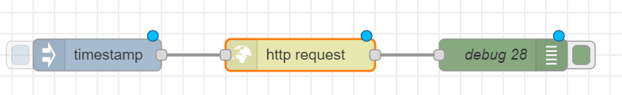
http request
My weather API
A parsed JSON object

Slide 15
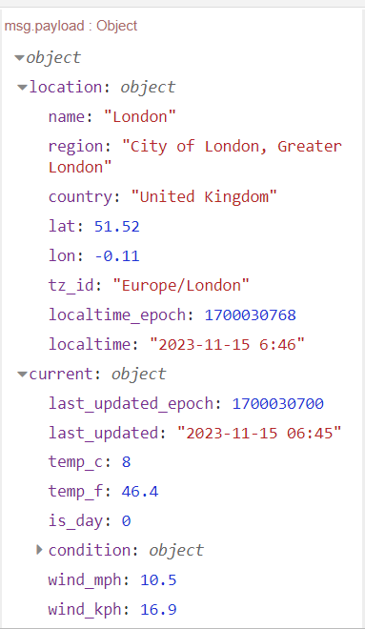

Click
Triger
Expand

Slide 16
Exercise 9-2
Build a weather station

Slide 17
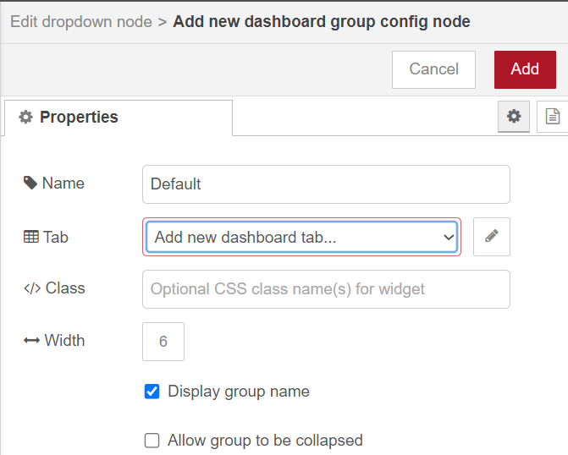
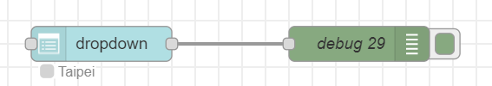
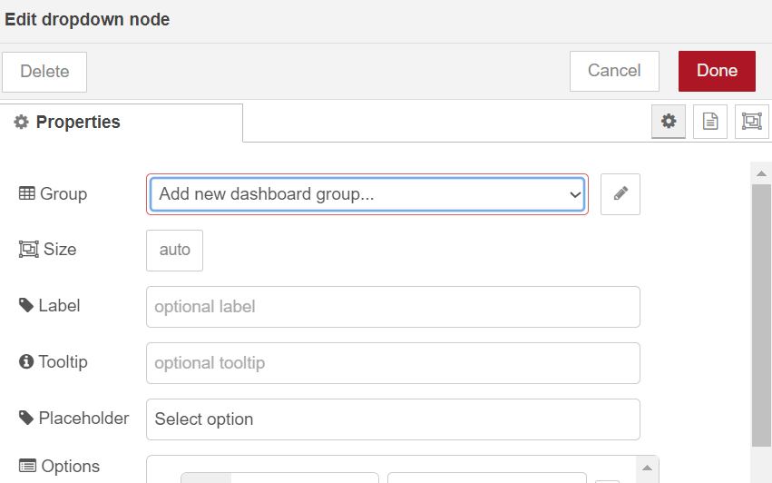
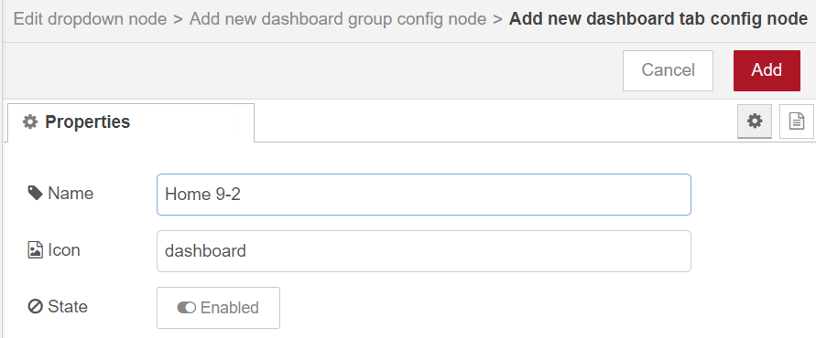
1. Double Click
4
5
2
3
6
7

Slide 18
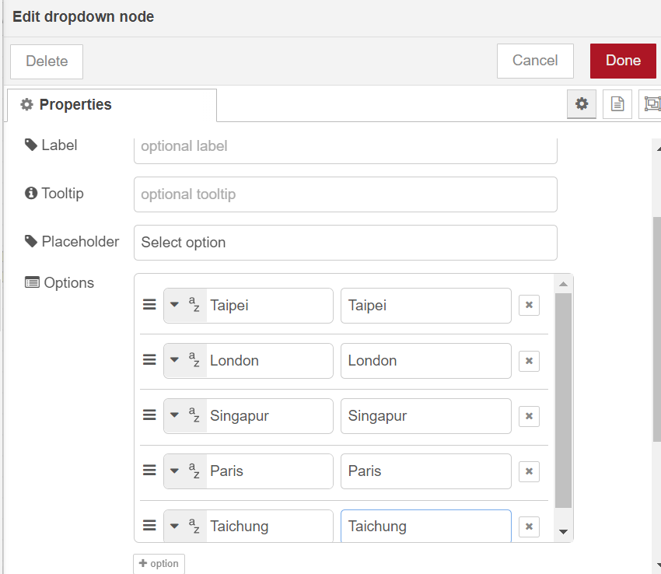
10
1
3
5
7
9
2,4,6,8

Slide 19
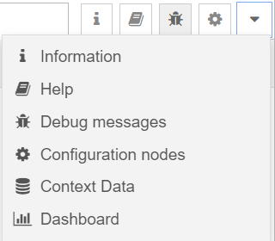
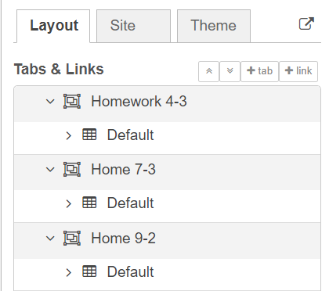
Go to Dashboard
1
3
2

Slide 20
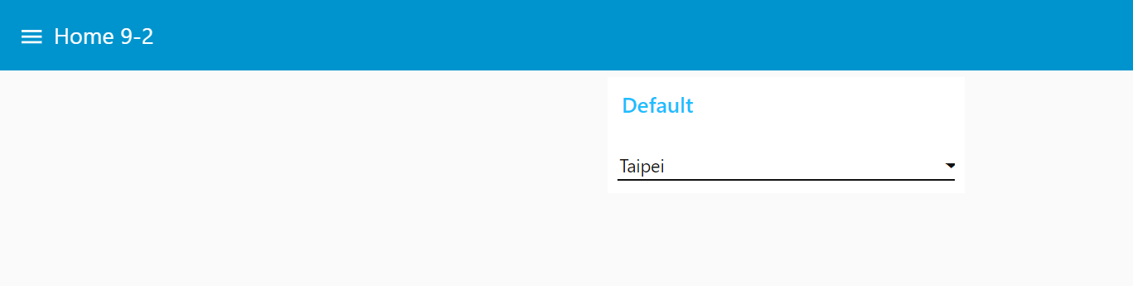
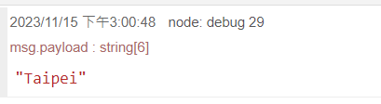
Choose Taipei

Slide 21
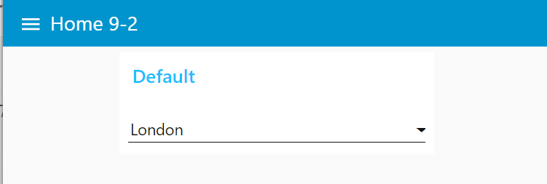
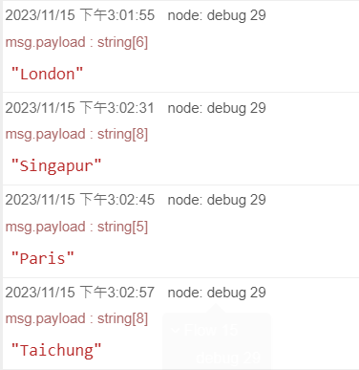
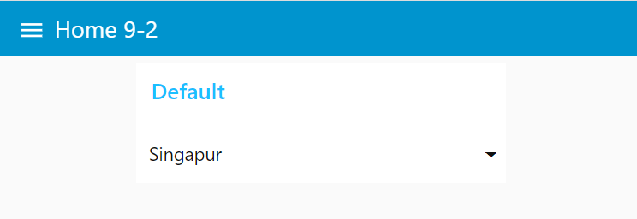
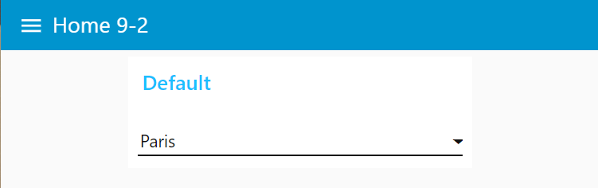
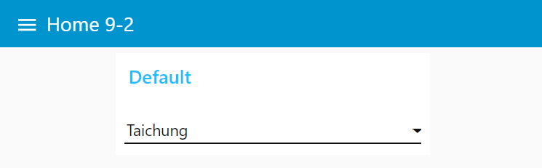
Choose London
Choose Singapur
Choose Paris
Choose Taichung

Slide 22

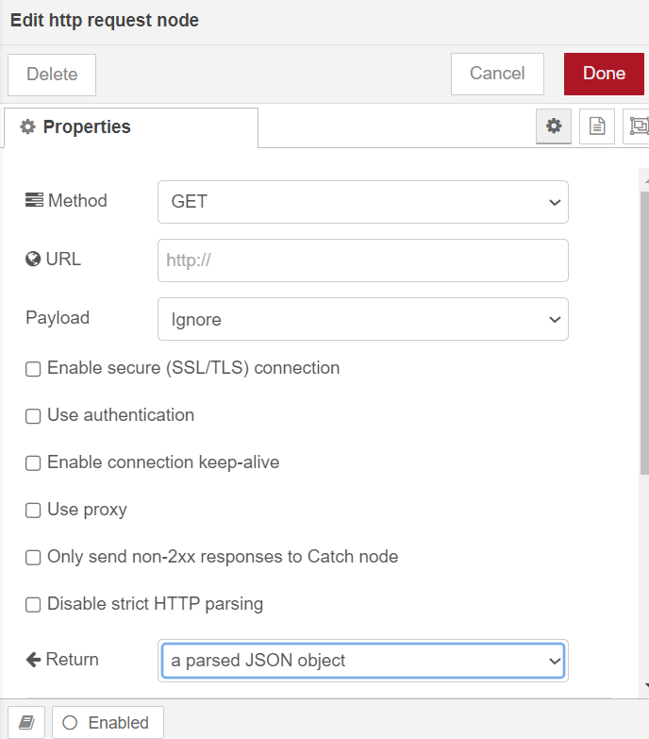
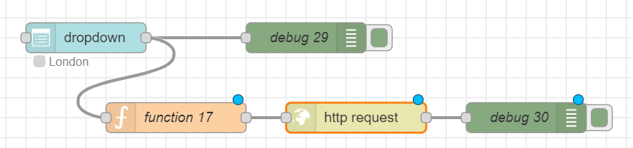
Add nodes
blank
A parsed JSON object
var city=msg.payload;
msg.url="https://api.weatherapi.com/v1/current.json?key=3xxx11&q="+city+"&aqi=yes";
return msg;

Slide 23
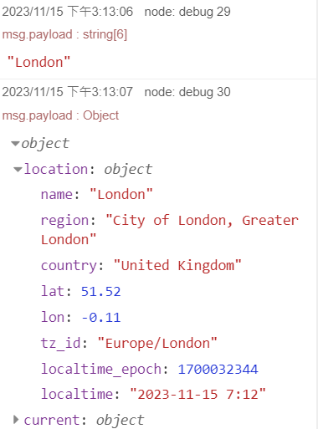
Test with choosing London
Choose London

Slide 24
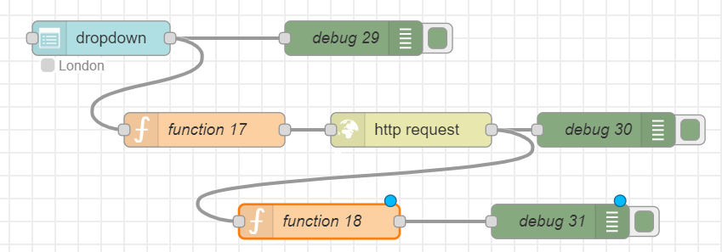
Add a function node and a debug node
var obj = msg.payload;
var current = obj.current;
msg.payload = current;
return msg;

Slide 25
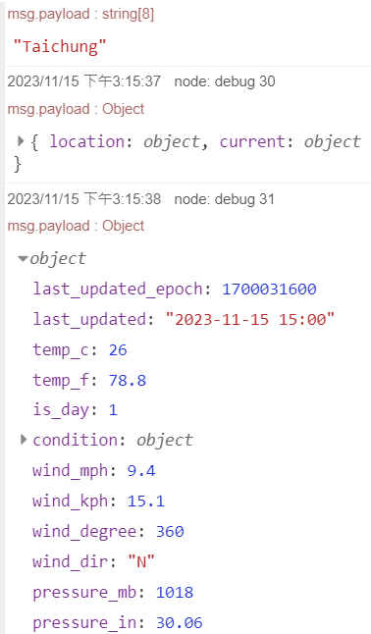
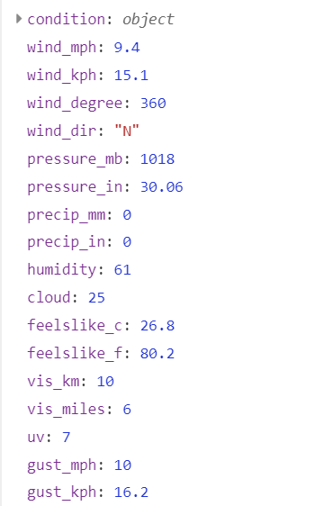
Choose Taipei
Choose Taichung
Expand

Slide 26
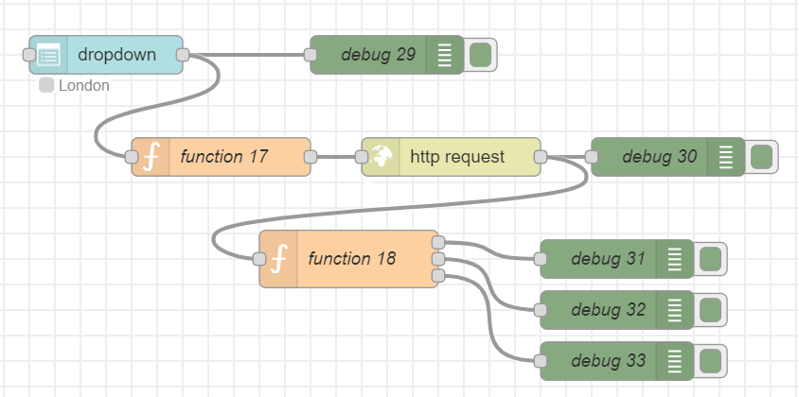
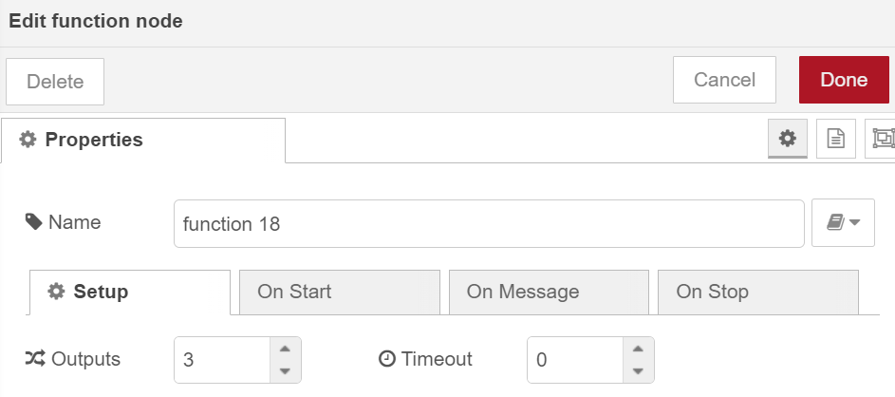
Add
var obj = msg.payload;
var current = obj.current;
var temp_c = current.temp_c;
var humidity = current.humidity;
var uv = current.uv;
msg={};
let msg1={};
let msg2={};
msg.topic = "temperature";
msg.payload = temp_c;
msg1.topic = "humidity";
msg1.payload = humidity;
msg2.topic = "uv";
msg2.payload = uv;
return [msg,msg1,msg2];
Add

Slide 27
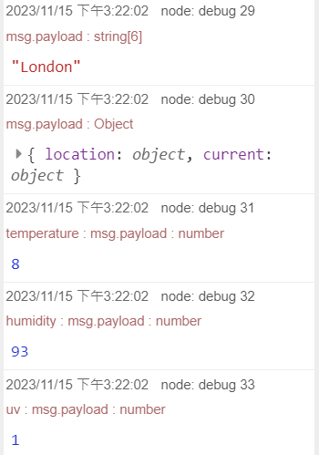
Choose London

Slide 28
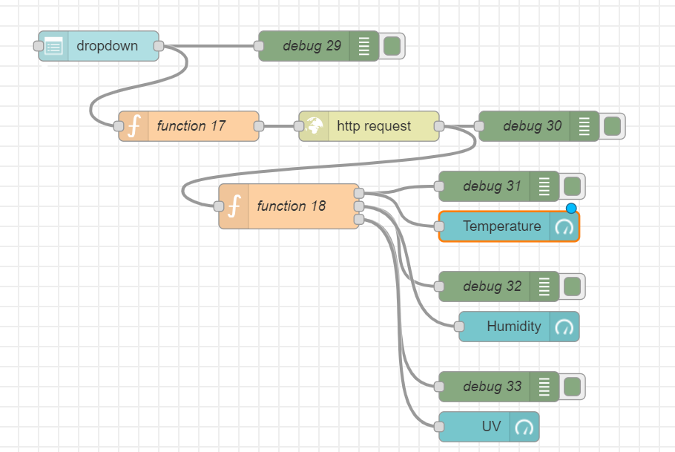
Add gauge

Slide 29
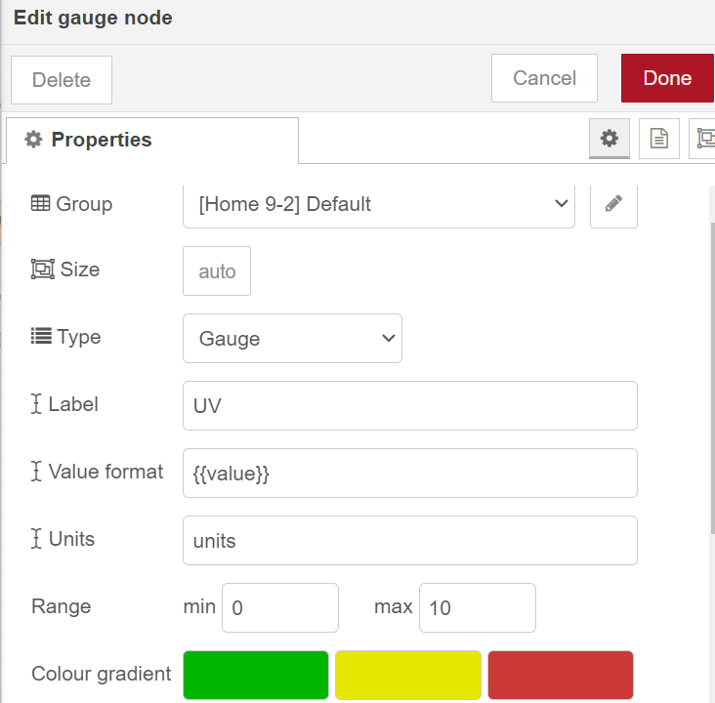
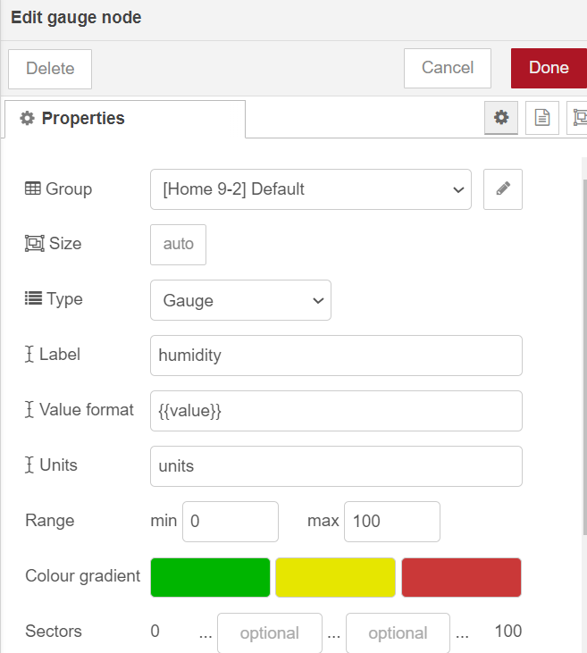
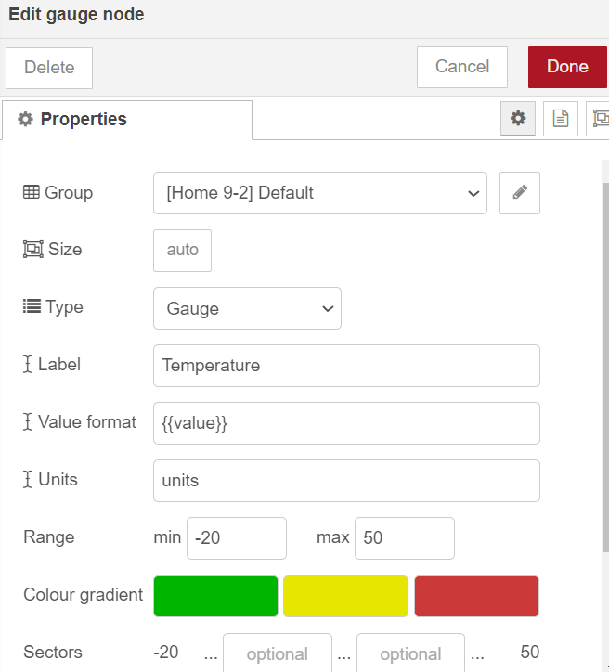
Home 9-2
Home 9-2
Home 9-2
UV
Humidity
Temperature
0
-20
50
100

Slide 30
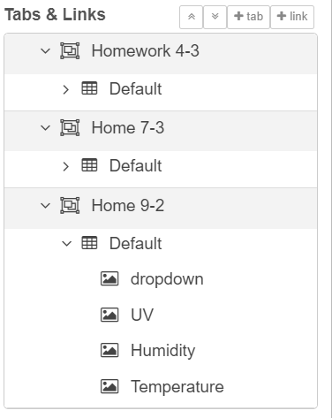

Move to the top

Slide 31
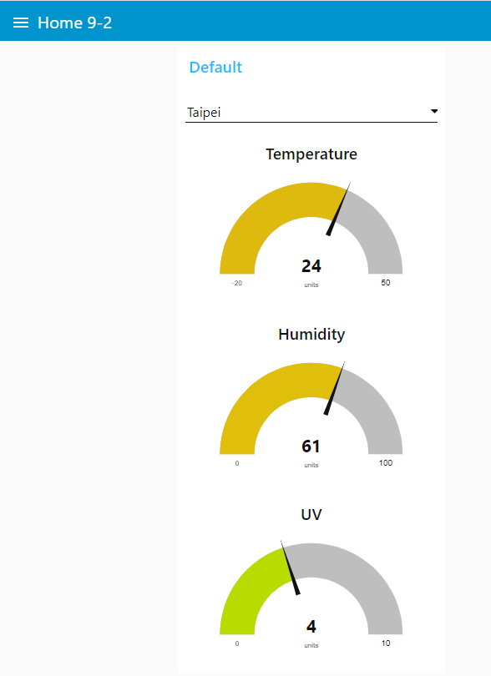
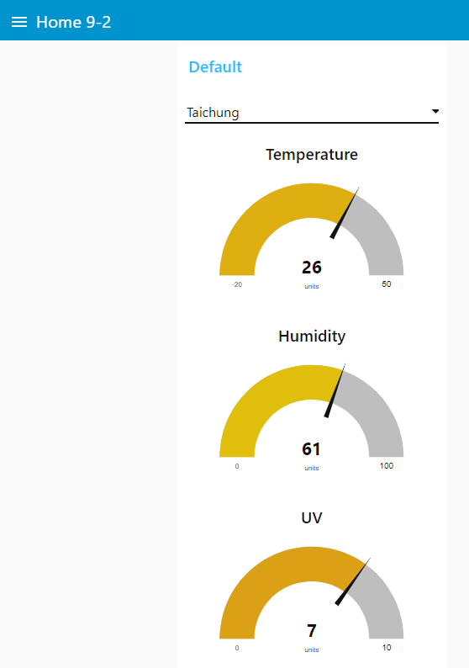
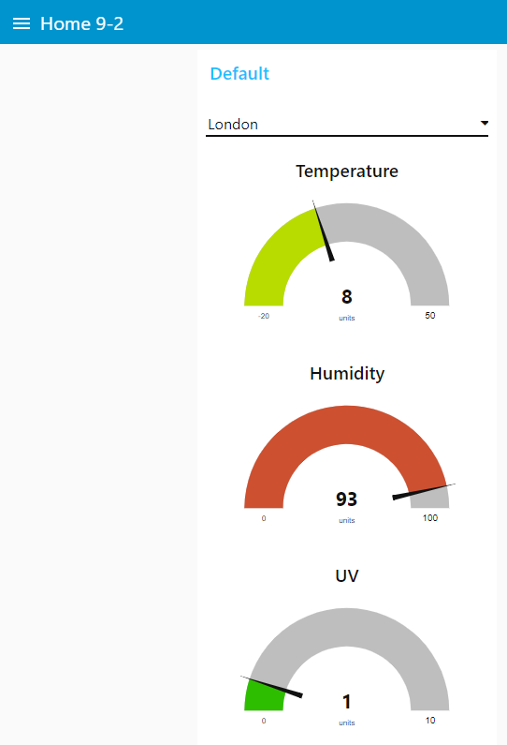
Result

Slide 32
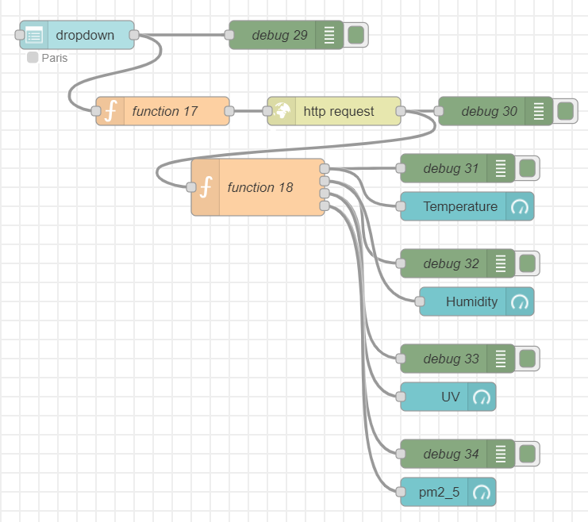
Add a pm2_5 gauge
var obj = msg.payload;
var current = obj.current;
var temp_c = current.temp_c;
var humidity = current.humidity;
var uv = current.uv;
var pm2_5 = current.air_quality.pm2_5;
msg={};
let msg1={};
let msg2={};
let msg3={};
msg.topic = "temperature";
msg.payload = temp_c;
msg1.topic = "humidity";
msg1.payload = humidity;
msg2.topic = "uv";
msg2.payload = uv;
msg3.topic = "pm2_5";
msg3.payload = pm2_5;
return [msg,msg1,msg2,msg3];

Slide 33
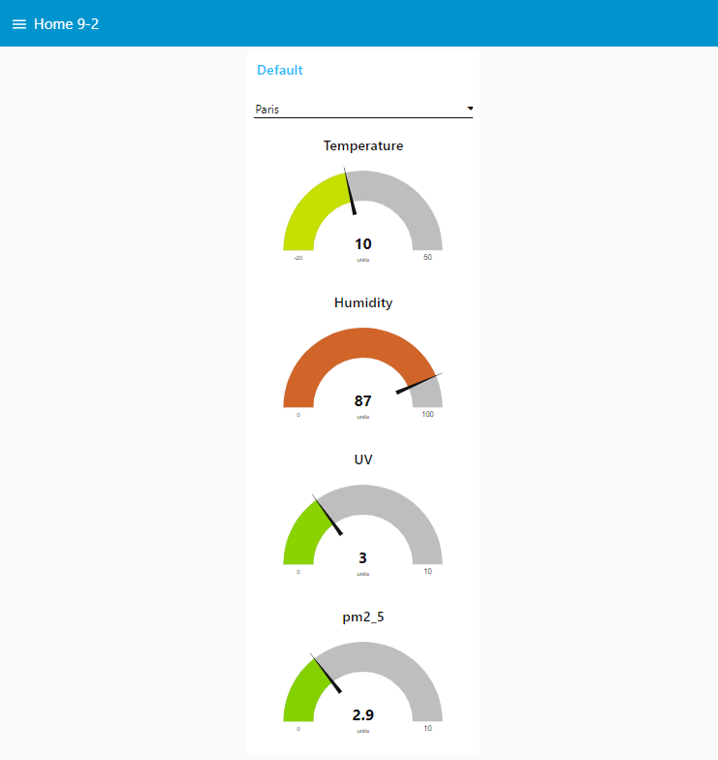
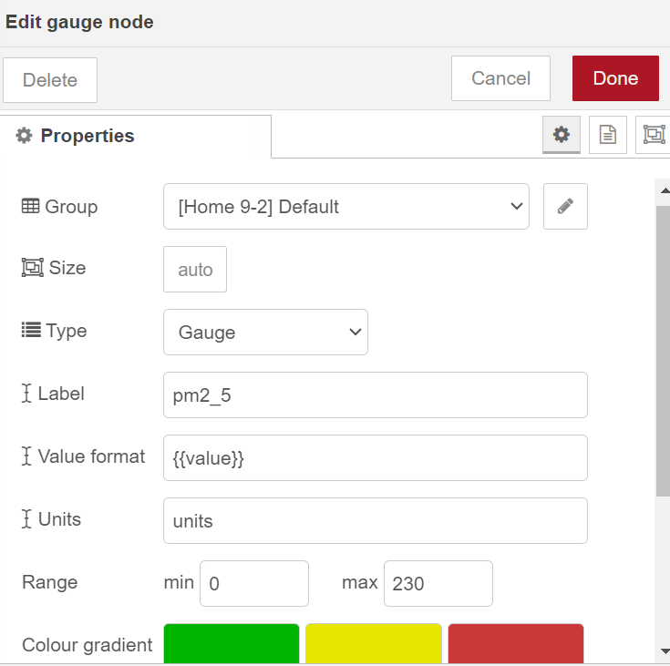
Home 9-2
Pm2_5
0
230

Slide 34
Homework 9-1
• Test the weather API for seven different cities.
• Taipei
• London
• Singapur
• Paris
• Taichung
• Taoyuan
• New Yor

Slide 35
city weather API
A parsed JSON object

Slide 36
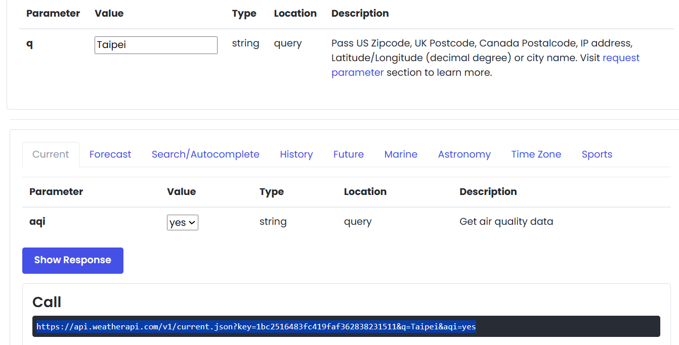
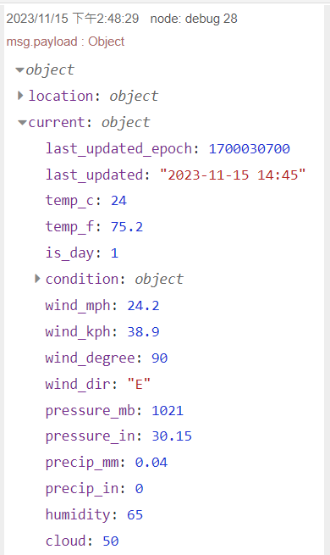
1. Taipei
3
2. Yes
4. Copy
5. Paste

Slide 37

1. London
3
2. Yes
4. Copy
5. Paste

Slide 38


1. Singapur
3
2. Yes
4. Copy
5. Paste

Slide 39


1. Paris
3
2. Yes
4. Copy
5. Paste

Slide 40


1. Taichung
3
2. Yes
4. Copy
5. Paste

Slide 41


1. Taoyuan
3
2. Yes
4. Copy
5. Paste

Slide 42


1. New York
3
2. Yes
4. Copy
5. Paste

Slide 43
Homework 9-2
Design ten cities weather station
London • Singapur • Shanghai • Taipei • Taichung • Taoyuan • New York • ?? • ?? • ?

Slide 44


Verify cities Weather Information
Chunghua
Kunshan

Slide 45


Add Option
10
1
3
5
Add Shanghai, Taoyuan, New York, Chunghua, Kunshan weather information
7
9
2,4,6,8

Slide 46

ten cities weather station

Slide 47





